Slide 1
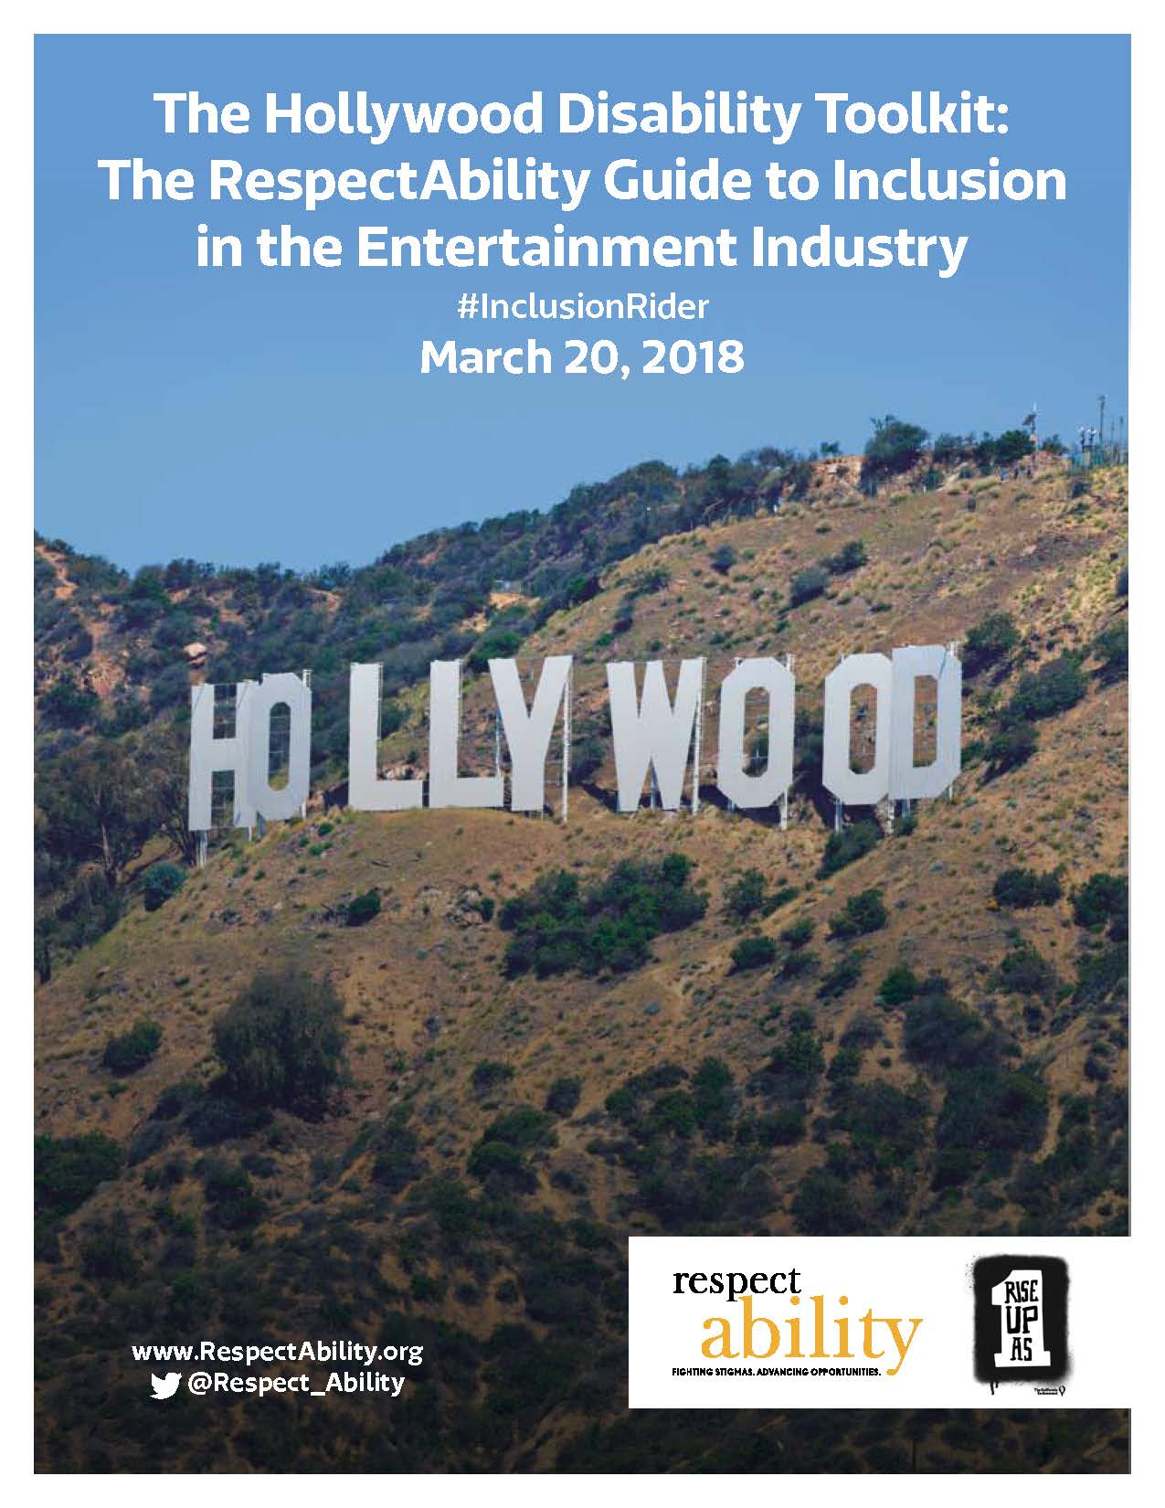
Hollywood Disability Toolkit: The RespectAbility Guide to Inclusion in the Entertainment Industry
Lauren Appelbaum
Communications Director, RespectAbility
Author, Hollywood Disability Inclusion Toolkit
Contact: LaurenA@RespectAbility.org
(202) 591-0703

Slide 2
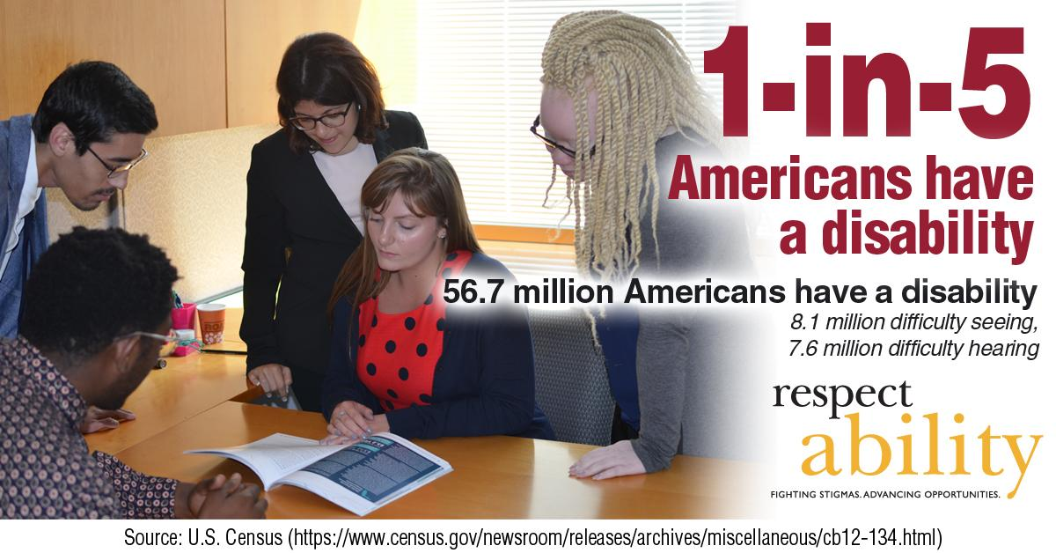
Who Has a Disability?
Notes:
"1 in 5 Americans have a disability. 56.7 Americans have a disability, 8.1 million difficulty seeing, 7.6 million difficulty hearing."
Source: U.S. Census

Slide 3
Forget 6 Degrees
8
Notes:
"51 percent of Americans report having a family member or close friend with a disability. 52 percent of Democrats report that they or a loved one have a disability. 44 percent of Republicans have a disability or a loved one with a disability. Independents have the largest number of voters who say they have a disability or a loved one with a disability: 58 percent."
Source: Laszlo Strategies September 2012 poll

Slide 4
Inclusion, Equity, Equality & Disability
Looking through the lens of disability

Slide 5
Intersectionality, Education and Disability Stats
Six million students with diagnosed disabilities are enrolled in America’s public schools.
There are 1,107,606 African American/black students with disabilities enrolled in America’s public schools.
There are 1,531,699 Latino students with disabilities in our schools today.
Children with disabilities and students of color are disproportionately suspended and expelled, which can be a contributing factor to the school-to-prison pipeline. Many student of color and/or ESL learners do not get a needed disability diagnosis or get the wrong one.
Only 57 percent of black students with disabilities graduate high school compared to 76 percent of black students without disabilities.
Only 59 percent of Latino students with disabilities graduate high school, compared to 79 percent of Latino students without a disability.

Slide 6
LGBTQ Individuals with Disabilities
Between 3 and 5 million Americans with disabilities identify as LGBTQ:
Lesbian, gay and bisexual adults have a higher prevalence of disability than their heterosexual counterparts.
36 percent of lesbians and 36 percent of bisexual women self-identify as people with disabilities.
26 percent of gay men and 40 percent of bisexual men are people with disabilities.
Estimated size of LGBTQ population within the disability community:
953,000 bisexual women have disabilities
490,000 lesbian/gay women have disabilities
615,000 bisexual men have disabilities.
647,000 gay men have disabilities.
Source: NIH-Disability Among Lesbian, Gay, and Bisexual Adults: Disparities in Prevalence and Risk.

Slide 7
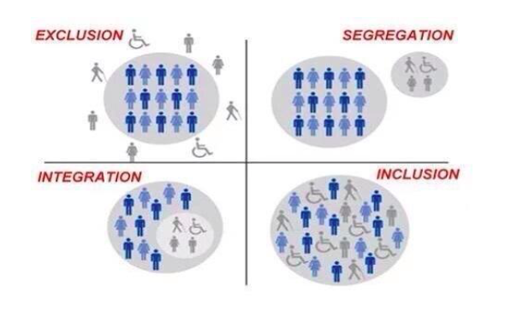
What Does Inclusion Look Like?
How to Raise Money for Great Causes!

Slide 8
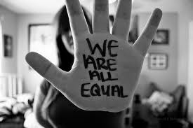
Leadership at the Top Needs To Share Vision of Inclusion
The message that all people are of equal value and must be respected and heard fairly, must be communicated from top down.
Pictured: Words “We are all equal” handwritten on palm of hand

Slide 9
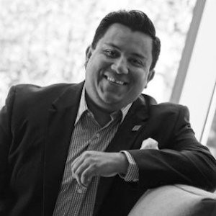
Jose Plaza, The California Endowment
“There is a difference within philanthropies in terms of their mission. Some are focused on education, some are focused on labor, some are focused on racial disparity. DISABILITY IS ALWAYS LEFT OUT. DISABILITY NEEDS TO BE FRONT AND CENTER.”
Jose Plaza is currently an Account Manager at the California Endowment. Plaza has previously worked for Hillary Clinton’s presidential campaign in 2016 as their Latino Vote Director in Florida, and for Enroll America as their National Director of Latino Engagement. Plaza earned a Ed. D in Higher Education from the University of South California in 2009.

Slide 10
Opportunity for the Entertainment Industry
Entertainment professionals across all platforms are working to become more inclusive of minorities. This is our opportunity to ensure inclusion and equality for all people – including America’s largest minority – the one-in-five Americans with a disability.
Opening the inclusion umbrella is the right thing to do as well as economically smart given that the disability market is valued at more than $1 trillion.
According to Nielsen Research, consumers with disabilities represent a $1 billion market segment. When you include their families, friends and associates, that total expands to more than $1 trillion. Americans with disabilities represent the third largest market behind Baby Boomers and the mature market.

Slide 11
Opportunity for the Industry
People with disabilities and their loved ones are your audience. There are 56 million Americans and 1.2 billion people around the world living with a disability, and the majority of people has a loved one with a disability.
When it comes to storytellers in film and television, there often are glaring errors when covering the disability community – errors that are easy to avoid.
RespectAbility is here to support your success. This comprehensive guide for disability inclusion is for entertainment professionals who wish to ensure they are as inclusive of people with disabilities as possible. This is a living document that will be updated constantly.

Slide 12
Opportunity for Inclusion
For generations, television and movies have represented people with disabilities as objects of pity. From the Jerry Lewis telethons to stories covering school teams as heroes for allowing one child with a disability to play on the court or field for a few minutes, society’s screens have propelled stigmas undermining people who have disabilities.
What we see and hear impacts our thoughts and feelings, which can have life and death consequences.
An increase in positive, diverse and accurate portrayals of people with disabilities in television and film would significantly help to end stigmas.

Slide 13
Portrayals of Disability in Film and TV
While people with disabilities are the largest minority in America (roughly 20 percent of the population), the disability community often is forgotten in conversations about inclusion and diversity.
While one in five people have a disability, according to GLAAD, fewer than two percent of scripted television characters (16 people) have disabilities in 2017-2018 season.
Only 2.7 percent of all speaking or named characters in film were show to have a disability in 2016 (up from 2.4 percent in 2015). None of the leading characters were from an underrepresented racial/ethnic group or the LGBTQ community.
Actors without disabilities play more than 95 percent of all characters with disabilities on television. Many characters are shown in a negative and inaccurate light.

Slide 14
Tools in the Guide
How RespectAbility Can Help in Your Work
Examples of Best Practices: Driving Inclusion Through Compelling Storytelling
Terminology Tips: Using the Appropriate Lexicon
Common Acronyms
Etiquette: Interacting with People with Disabilities
Disability FAQ
Learn More About Specific Disabilities
Resources
Related News Articles

Slide 15
Partnering with the Entertainment Industry
Identify the diverse talent needed to reflect the fact that 56 million people in the U.S. and more than one-billion people with disabilities worldwide.
Create both entertaining content for and with people with disabilities and benefit the bottom line by tapping into this trillion-dollar market.
Access raw, real, compelling, diverse and inclusive stories that will make TV and film more relevant.
Set the bar higher in the creation of welcoming entertainment that powerfully resonates with audiences.
Become the go-to creative and marketing ally that can help established voices and a new generation of artists and filmmakers reach new heights.
Acquire facts, resources and contacts needed to tell authentic disability stories in a way that will win audiences and advance dignity for all.
Understand disability etiquette and ensure disability is not viewed through the “pity lens.”
Update lexicons to ensure that scripts are culturally sensitive to the one-in-five people with disabilities and the people who love them.
Deliver free and impactful assistance to support the making and marketing of diverse films and TV shows that advance the inclusion and opportunities for people with disabilities.

Slide 16
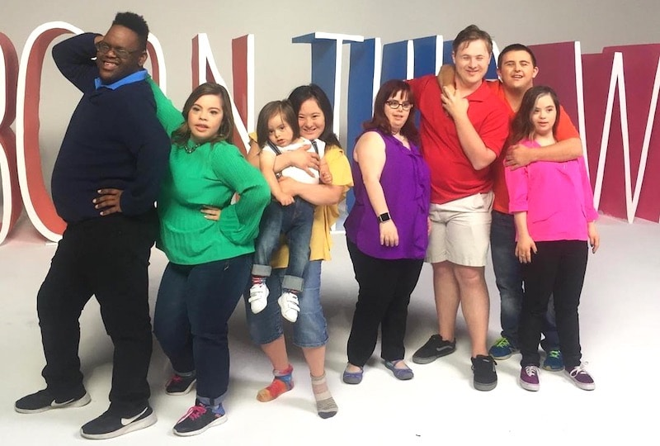
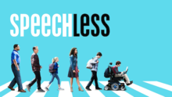
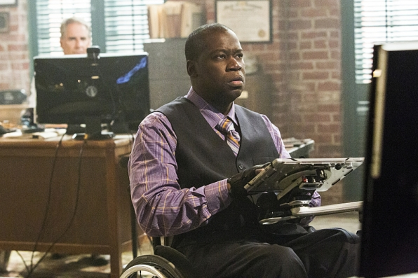
Examples of Best Practices: TV
Not an ordinary reality show, Born This Way stars seven diverse young adults with Down syndrome as they move toward full independence and deal with issues around employment, independent living, education and romance. Born This Way has won 3 Emmy awards, including for being the best-unstructured reality show.
In scripted television, Speechless is a sitcom centered on a family that happens to include a son with cerebral palsy, J.J. The fact that J.J. is played by Micah Fowler, an actor with cerebral palsy, is important. Actors without disabilities play more than 95 percent of characters with disabilities on television.
Also in scripted television, NCIS: New Orleans features a character in a wheelchair, Patton Plame. Daryl “Chill” Mitchell, an African American actor who uses a wheelchair, plays Plame.

Slide 17
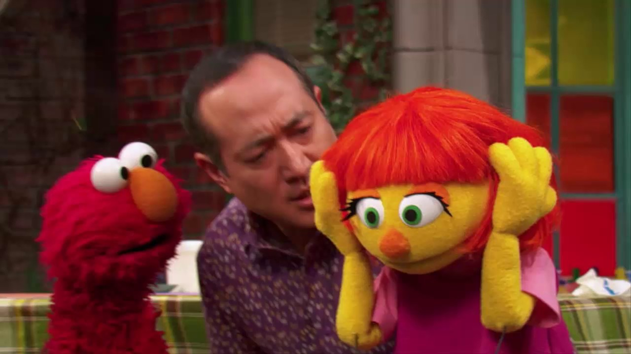
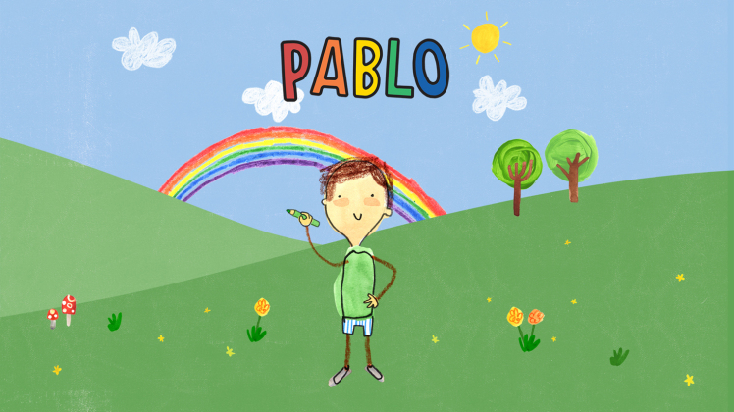
Examples of Best Practices: Children’s Television
In children’s television, Sesame Street has been educating children since the early 1960s. The show recently introduced Julia, a puppet character who has autism. Sesame Workshop’s goal was simple – to create a better understanding of autism in children.
Also in children’s television, Pablo aims to educate society about autism spectrum disorder. Produced by Paper Owl Productions, Pablo voiced by a boy with autism but also many of the creators involved behind-the-scenes also have autism.

Slide 18
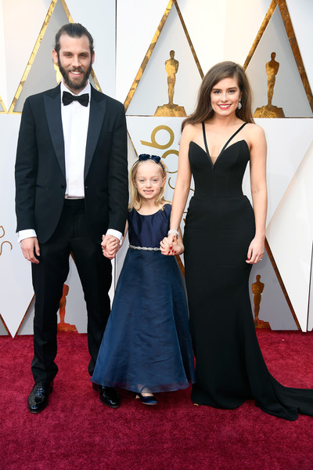
Examples of Best Practices: Film
In film, Oscar-winner The Silent Child features Maisie Sly, a young girl who is deaf. She plays Libby, a four-year-old girl who lives in a world of silence until she learns how to communicate using sign language – thanks to a caring social worker. It is important to note that Sly, the actress, is deaf in real life, as the majority of films winning for portrayal of disability often feature actors without the disability. This short story, inspired by real events, shows how deaf children can learn to communicate and relays the importance of educating children who are deaf.

Slide 19
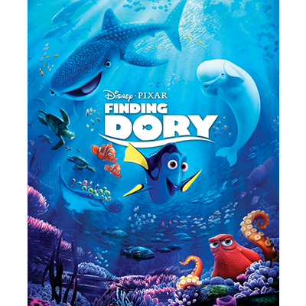
Examples of Best Practices: Animation
In children’s film, Finding Dory – a Pixar box office success – stars many characters with disabilities. Dory, the titular character, has short-term memory loss. Nemo has physical disabilities with his little fin and Hank is an octopus that is missing a tentacle. Destiny is visually impaired by her myopia, and Bailey has difficulty with echolocation. Disability is not something Dory needs to overcome, but something she needs to learn to live with, work with and accept to accomplish things “in her own Dory way.” In addition to putting a positive spin on Dory’s journey, Finding Dory highlights the importance of community for people with disabilities. Throughout the film, Dory is helped by Hank, Destiny, Bailey and, of course, Nemo and his father Marlin, many of whom have disabilities themselves.

Slide 20
Terminology Tips: Using the Appropriate Lexicon
Disability language style guide: The National Center on Disability and Journalism (NCDJ) provides the industry’s only disability language style guide.
http://ncdj.org/style-guide/
Use person-first language to keep the person first, not his or her disability. Language shapes perceptions, so a small word choice can make a big difference in communicating attitudes. Person-first language puts the person first instead of his or her disability. http://rtcil.org/products/media/guidelines#Person-First
If you are working with individuals with disabilities, ask them their preference. Some individuals with disabilities prefer identity-first (disabled person). Just as you may ask people for their gender pronoun preferences, you should ask people with disabilities you work with how they choose to be identified.
Think about other language that you use. What is considered acceptable language regarding disabilities has changed over time. Standards are changing as understanding evolves. Other terms are outdated medical or colloquial terms. Avoid terms like “wheelchair-bound” and “suffers from.” People with disabilities are not “victims.”
http://ncdj.org/2015/09/terms-to-avoid-when-writing-about-disability/
People with disabilities should not be described as “inspirational” or “courageous” just because they have a disability.

Slide 21
Etiquette - Interacting With People With Disabilities
People with disabilities are human. Acknowledge their differences as you would acknowledge anyone else’s uniqueness and treat them “as normal.”
Speak directly to a person with a disability, not to their companion or ASL interpreter.
Adults with disabilities are adults and deserve to be treated and spoken to as adults. Provide them with every option you provide those without disabilities.
If you are unsure of how you should interact with a person with a disability, just ask him or her. Just because someone has a disability, do not assume they need help.
A person’s mobility equipment, such as a wheelchair, scooter or cane, is part of his or her personal space. Do not touch or move it without permission, even if someone puts it down or chooses to leave it somewhere.
Listen attentively when you are talking with a person who has difficulty speaking. Be patient and wait for the person to finish, rather than correcting or speaking for the person.
People who have psychiatric disabilities may have varying personalities and different ways of coping with their disability. Treat each person as an individual.
There are visible disabilities as well as invisible disabilities, meaning not all disabilities are apparent.
Please note it is considered offensive to pretend to have a disability, and disability simulation experiences should be done for design/navigational purposes only.

Slide 22
Key Terms: Disability
Disability can be physical (i.e. vision, hearing, mobility), cognitive, intellectual, mental, sensory, developmental, or some combination of these that substantially limits one or more major life activity.
The Americans with Disabilities Act of 1990 (ADA) prohibits discrimination and ensures equal opportunity for persons with disabilities in employment, State and local government services, public accommodations, commercial facilities, and transportation.
Accommodation is any change in the work environment or in the way things are done that enables an individual with a disability to enjoy equal access and treatment.
Ableism is discrimination in favor of able-bodied people; the belief that people who have disabilities are somehow less human, less valuable, and less capable than others.

Slide 23
Sampling of Topics Covered in the Disability FAQ
What is considered a disability?
What is the Americans with Disabilities Act (ADA)?
What is an inclusion rider? How can they help people with disabilities in Hollywood?
What is person-first language? Does everyone use it?
How does intersectionality play into all of this?
What are some concrete steps to ensure we are inclusive?
How can I communicate that I am welcoming of people with disabilities?
What is some sample inclusion language to use for accommodations?
How do I ensure my website is fully accessible?
How can I tell if an animal is really a service animal and not just a pet?
What do I need to know regarding hiring employees with disabilities?
What tax and other incentives do employers have to hire people with disabilities?
Learn More About Specific Disabilities – including language to use and resources for accommodations

Slide 24
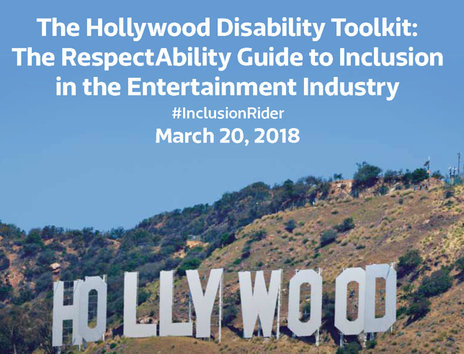
Sampling of Resources Included in Toolkit
Audio Description Services
Closed Captioning Services
Sign Language Interpreters
Disability Advocacy Resources
Hiring Performers with Disabilities
Hiring People with Disabilities Behind the Scenes
Disability Media Sources
Training Programs for Minorities
Employment Resources

Slide 25
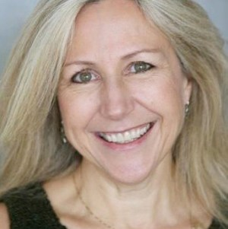
Kate Folb, Hollywood, Health and Society
Kate Folb came to Hollywood, Health & Society after working for more than 20 years in the entertainment education field. After an early career in television and music production/management, Folb joined the Scott Newman Center as director of special projects. There, she worked with top TV shows and films on issues of alcohol and other substance abuse. Later, she spent nearly 10 years as director of the Media Project, a partnership of Advocates for Youth and the Kaiser Family Foundation, which addressed portrayals of adolescent reproductive health in the media. In 2001 she led Nightingale Entertainment, an independent consulting firm working with foundations and national nonprofits including the Robert Wood Johnson Foundation and Planned Parenthood Federation of America on entertainment education and celebrity involvement in national media campaigns. Folb speaks fluent Spanish, holds a bachelor’s degree in Spanish from the University of Denver, and a master’s degree in education from UCLA.

Slide 26
USC Annenberg Lear Center Hollywood, Health & Society
Kate Langrall Folb | Program Director
Hollywood, Health & Society

Slide 27
What Do We Do?
We Study and Shape the Impact of Entertainment and Media on Society

Slide 28
Some of Our Partners Include:
WOMEN IN FILM
FOUNDATION

Slide 29
How Do We What We Do?
HH&S provides entertainment content creators with
information and access to experts on a wide range of topics:
from health and medicine to safety and security—and more.

Slide 30
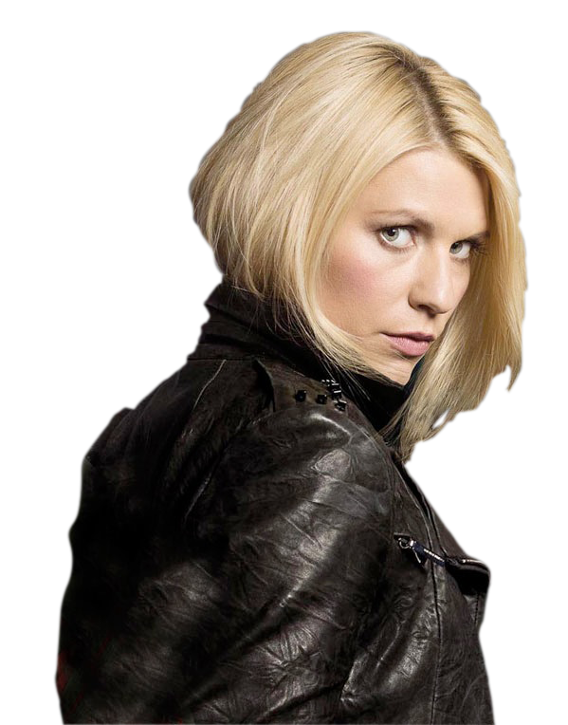
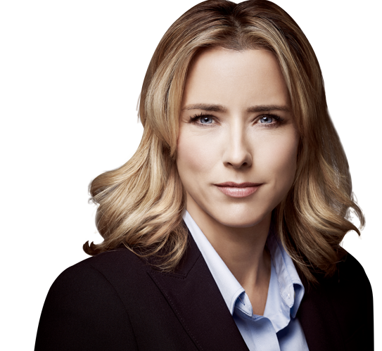
From 2012-2017 HH&S consulted on more than 1,105 aired storylines
Notes:
335 aired storylines from Oct. 2011 to Oct. 2013. Among the shows were Hostages (CBS), NCIS (CBS), Doc McStuffins (Disney Junior) and Homeland (Showtime).

Slide 31
Those aired storylines span hundreds of shows, seen on dozens of networks, cable and streaming channels
TELEMUNDO

Slide 32
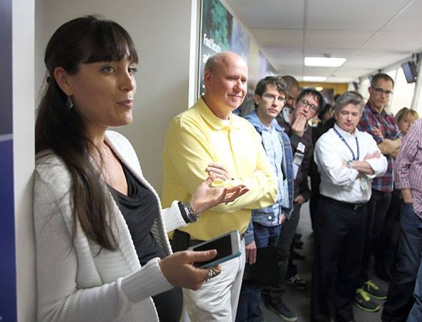
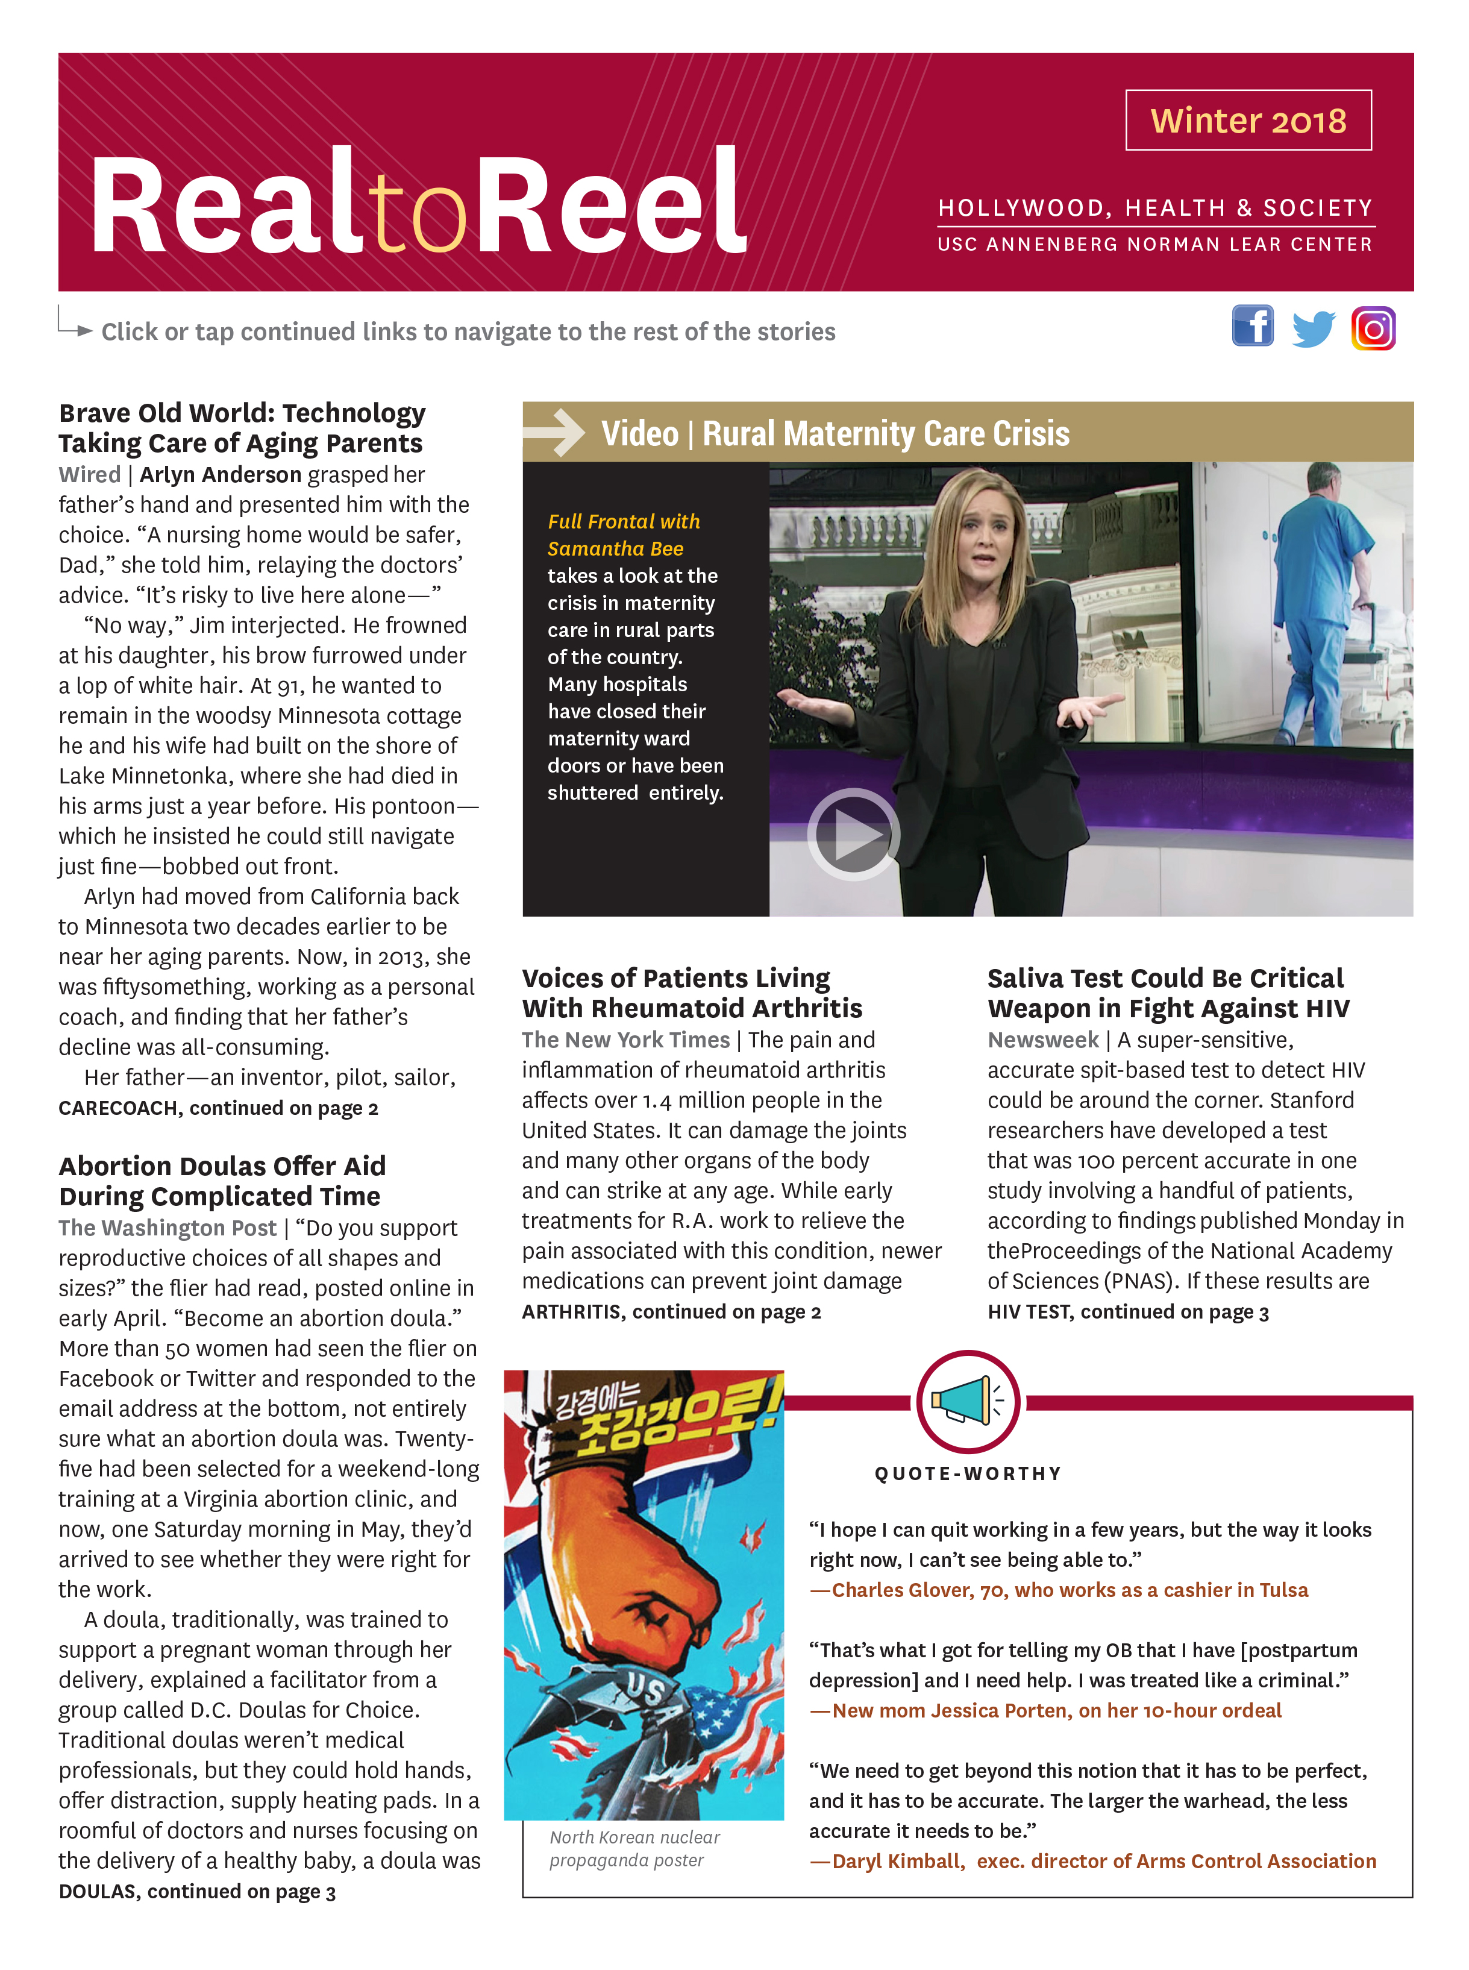
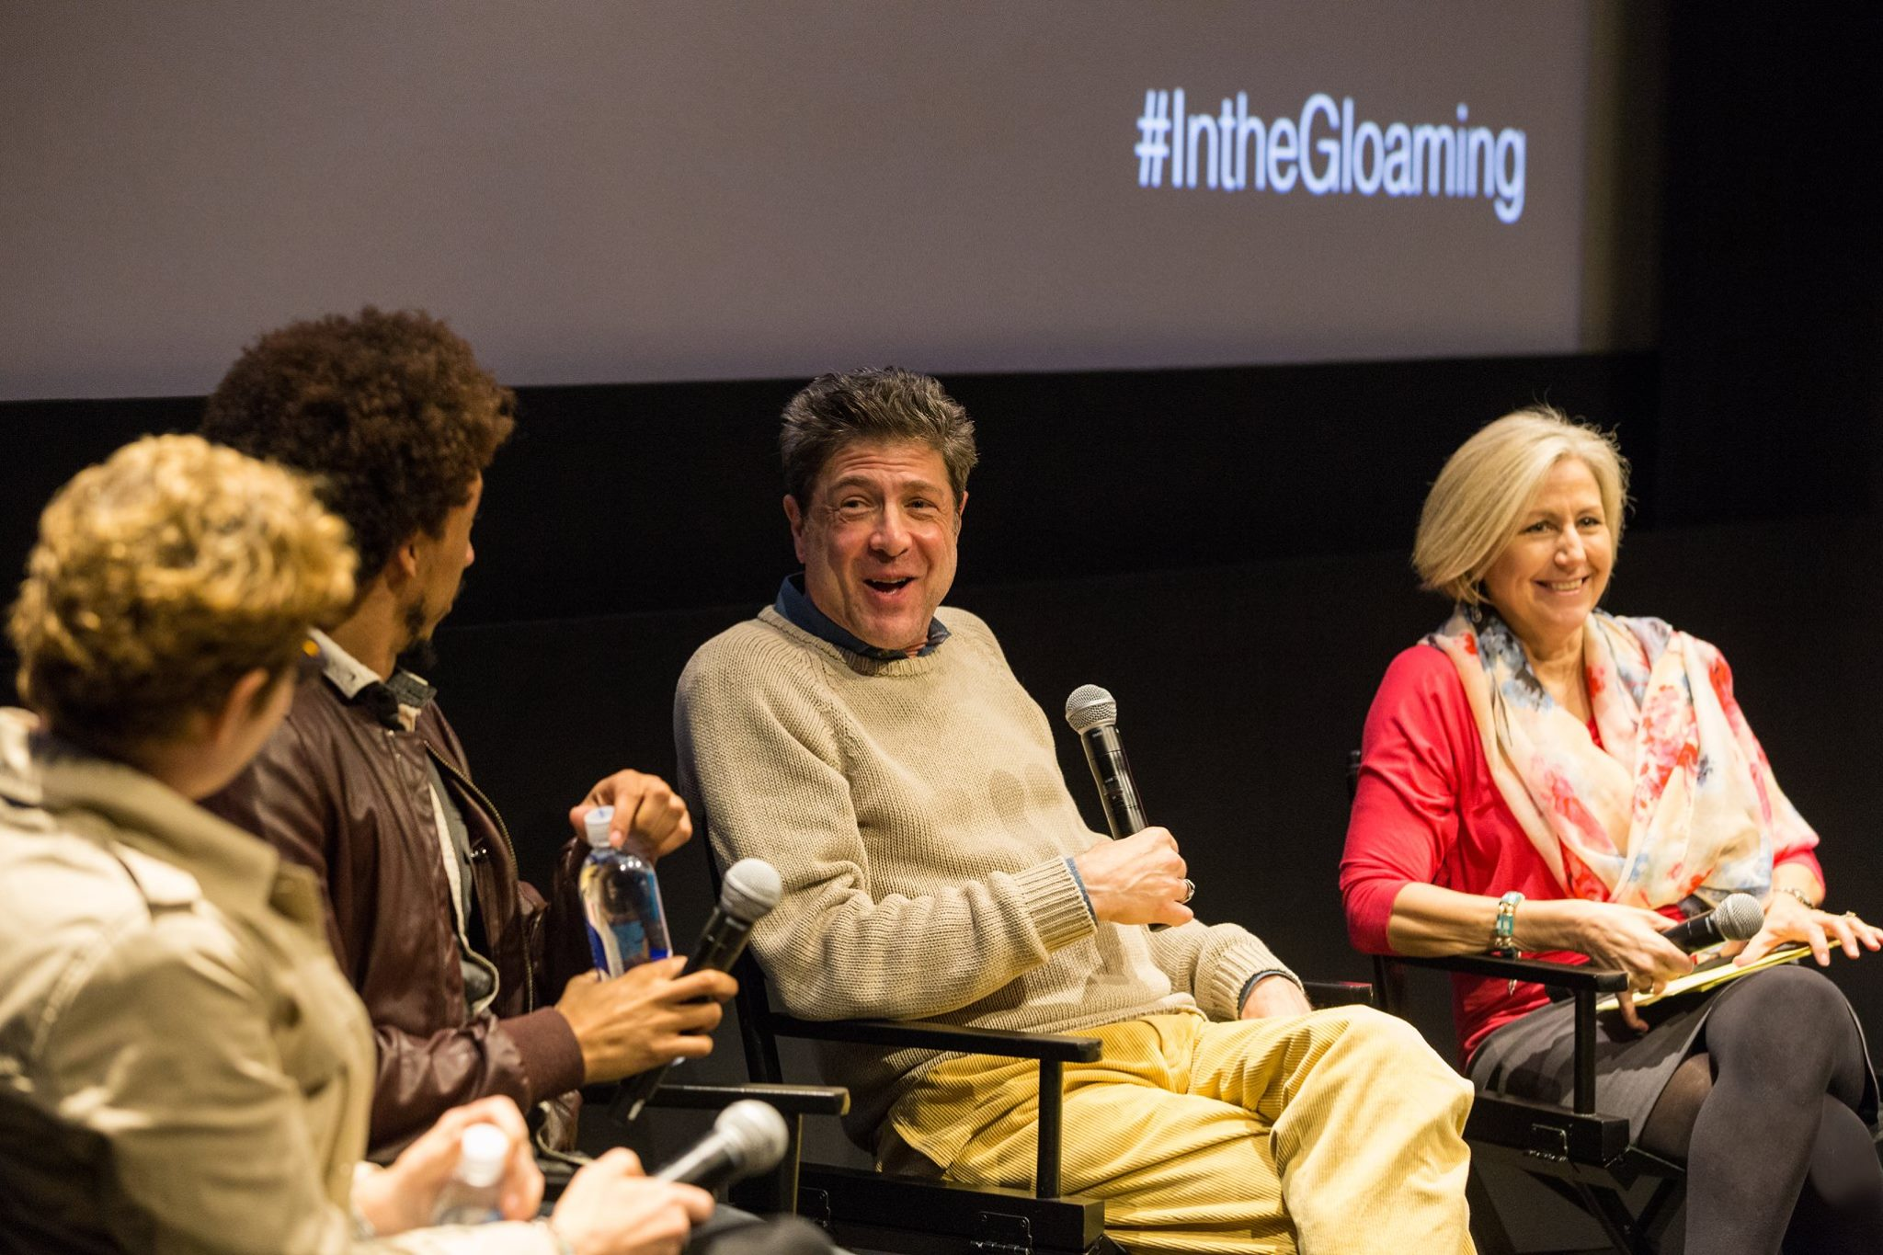
HH&S Services
Briefings / Consultations
Panel Discussions
On Location trips
HH&S Website
Tip Sheets
Real to Reel Newsletter
Sentinel Awards
PSA’s
Transmedia
Research & Evaluation
TV Monitoring
Content Analysis, Audience Demographics
Audience Impact
Notes:
So how do we work?
We hold briefings and consultations with the shows to walk them through the health and medical information in their stories. We connect them to top experts in the field that have specialty areas in the sometimes complex and bizarre cases they are working on. And we take those experts inside the writers room of the shows so they can have longer conversations and brainstorm new ideas.
We have tip sheets on our website that are basically fact sheets about different topics, and we send a quarterly Real to Reel newsletter to our network to keep them informed about the latest and greatest headlines, new research in the field, and case studies of people that they can learn from. I’ll talk a little about the Sentinel Awards, PSAs and transmedia as we go along.
We also conduct Research and Evaluation on our storylines to gage the impact that they have on the public, which Erica will tell you about a little later.

Slide 33
Impact

Slide 34
Royal Pains
“The Prince of Nucleotides” Episode: Transgender Storyline
Notes:
HH&S Consulted on this storyline. Storyline focused on a transgender teen girl, Anna, who is experiencing some health complications associated with her transition. The episode aired in June 2015, in the midst of several other transgender storylines in entertainment media, as well as Caitlyn Jenner’s transition story.
WATCH CLIP
In the end, the doctor, Hank, reverses course after weighing the risks of treatment vs. the mental health risks associated with stopping Anna’s transition. Ultimately he says she can continue with the hormonal treatment at a reduced dose but needs to be monitored closely.
This research was led by Annenberg doctoral student Traci Gillig. Just a note that the study was cross-sectional, so we cannot draw any causal conclusions.
Building upon Slater, Rouner & Long’s 2006 research on narratives addressing gay marriage and the death penalty, we set out to study the role of political ideology in relation to the polarized topic of transgender rights. Also incorporates theories of:
Narrative influence: Identification, transportation, emotional response
Cultivation theory: cumulative effects of exposure to multiple storylines
There is extensive research indicating that people interpret information in a manner consistent with their pre-existing ideological perspectives/worldview. As a result, messages that are contradictory to one's ideological perspective can be interpreted through this lens and lead to even greater polarization. We set out to examine whether entertainment narratives addressing transgender issues are able to overcome these ideological biases, and what factors make this more or less likely.

Slide 35
Royal Pains (USA Network)
Royal Pains (USA Network)
Transgender Storyline
Viewing Royal Pains transgender storyline
More positive attitudes toward transgender people
More support for trans-friendly policies
Cumulative effect – more shows with transgender characters
More positive attitudes toward transgender people
More support for trans-friendly policies
Seeing two or more transgender shows
Reduced link between political ideology and attitudes toward trans people by half
Source: Gillig, Rosenthal, Murphy, & Folb, 2017
Notes:
We consulted on a Royal Pains storyline focused on transgender teen girl, Anna, experiencing transition-related health complications
Aired in June 2015 amidst several other transgender entertainment narratives and the Caitlyn Jenner transition
We measured exposure to both Royal Pains storyline and several other transgender entertainment narratives:
Royal Pains viewers who saw the transgender storyline had more supportive attitudes toward transgender people and related policy issues than those who did not.
The more shows with transgender characters viewers saw, the more supportive their attitudes toward transgender people and policies
Exposure to transgender stories in the news, including the Caitlyn Jenner transition, did NOT influence attitudes
Exposure to two or more transgender storylines reduced the influence of political ideology on attitudes toward transgender people by half
Political ideology influenced responses to the Royal Pains storyline, such as identification with the transgender character and feelings of hope and disgust.

Slide 36
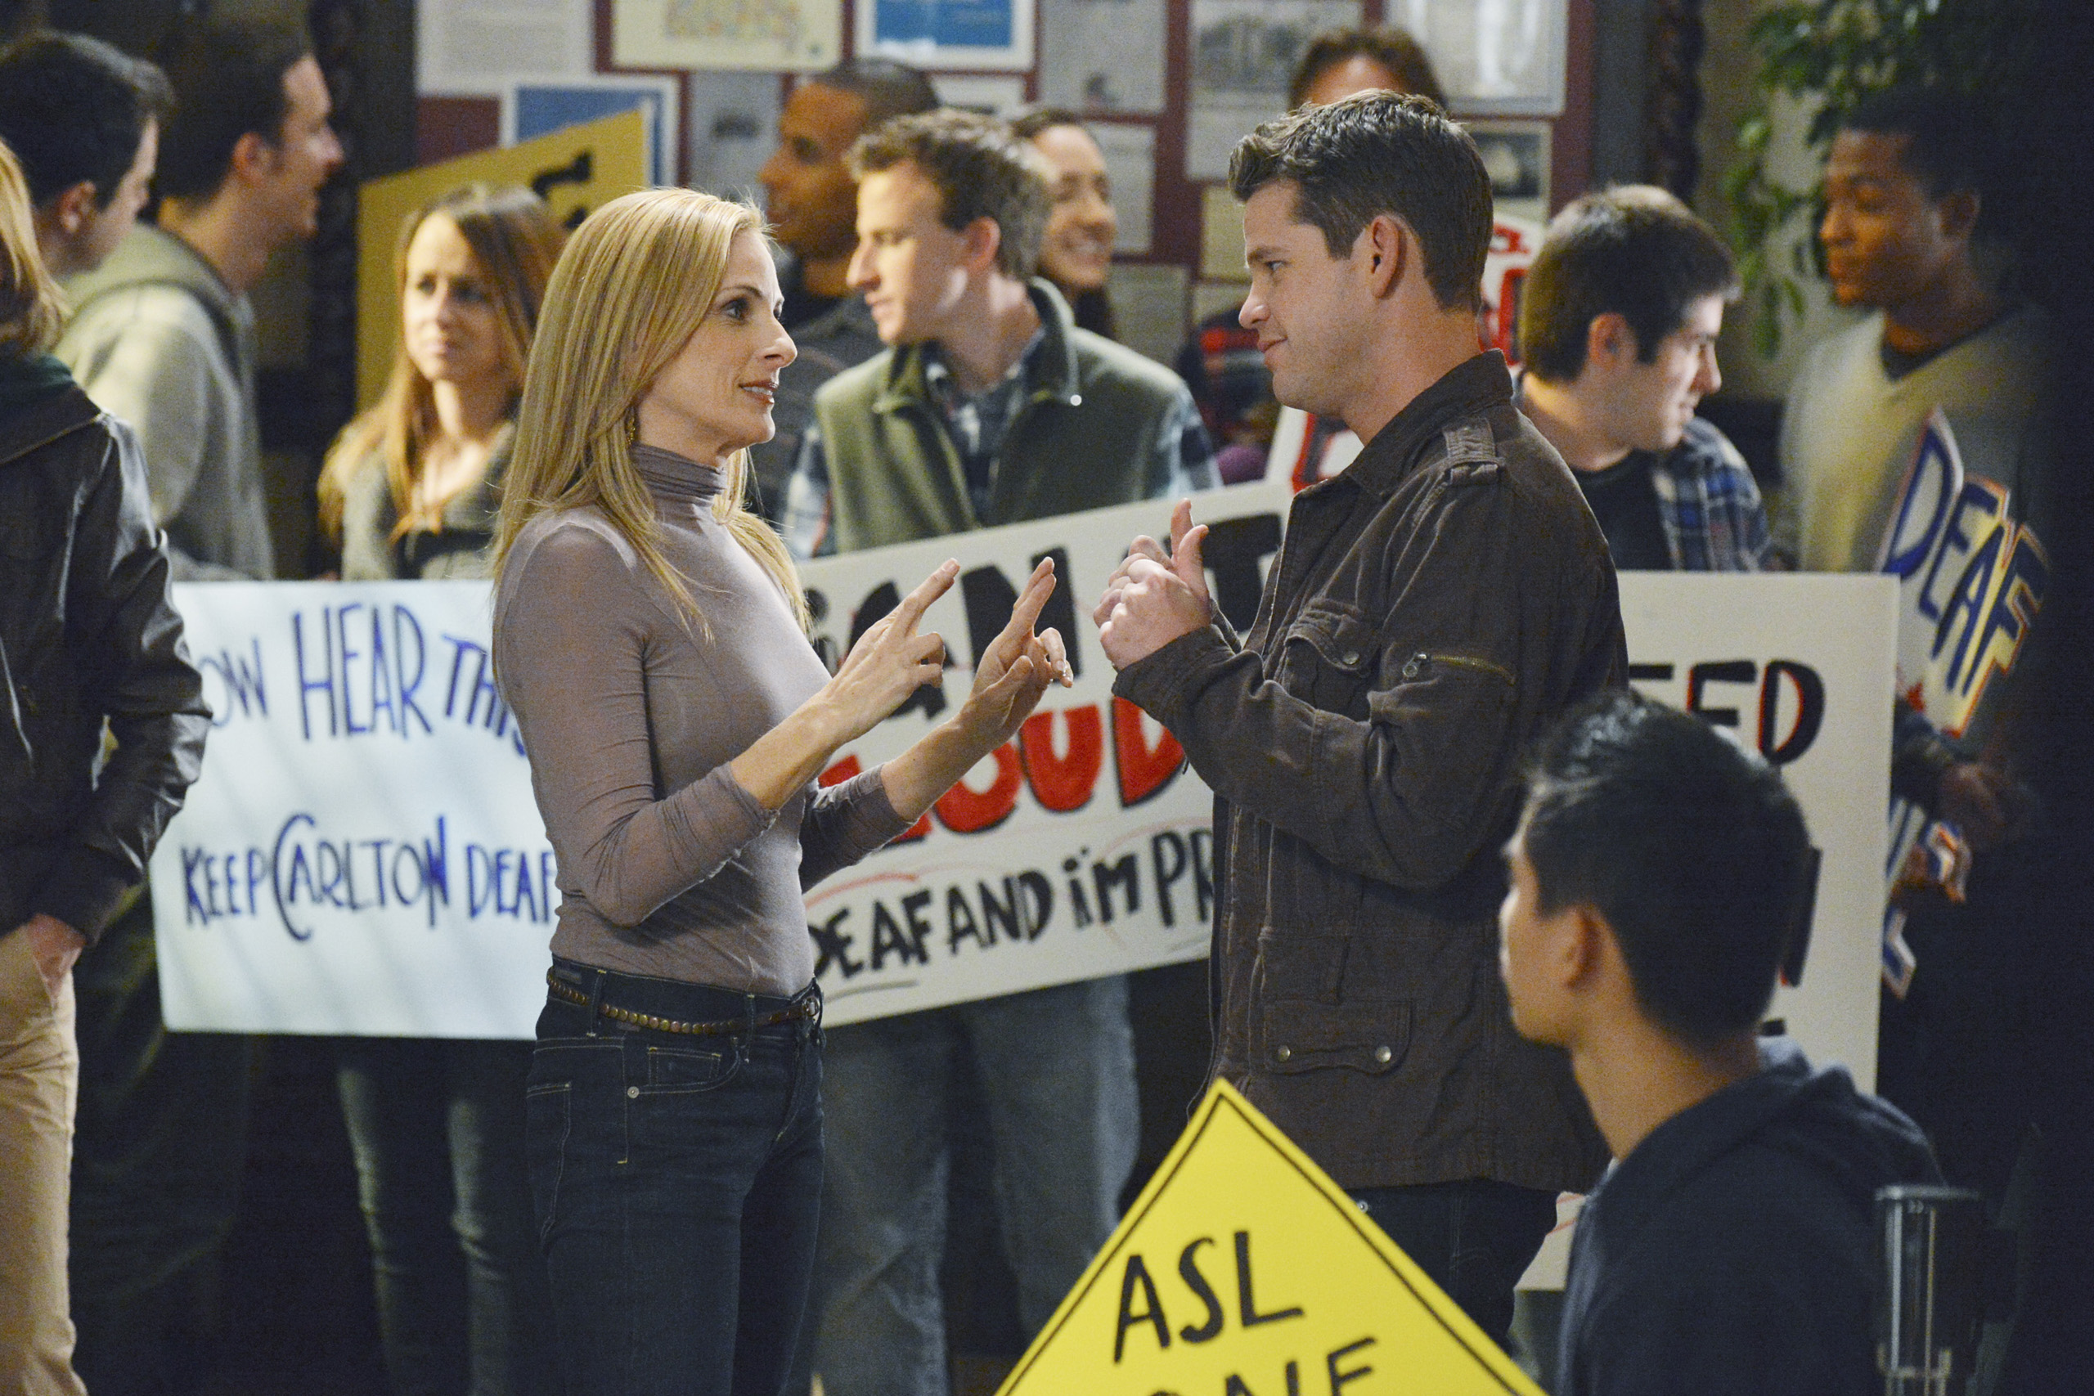
Breaking New Ground on TV
Breaking New Ground on TV: ‘Switched at Birth,’ ‘Speechless’ Cover Issues Facing Disability Community

Slide 37
Kate Folb
Kate Langrall Folb, Director
kate.folb@usc.edu / (323) 782-3315
www.usc.edu/hhs

Slide 38
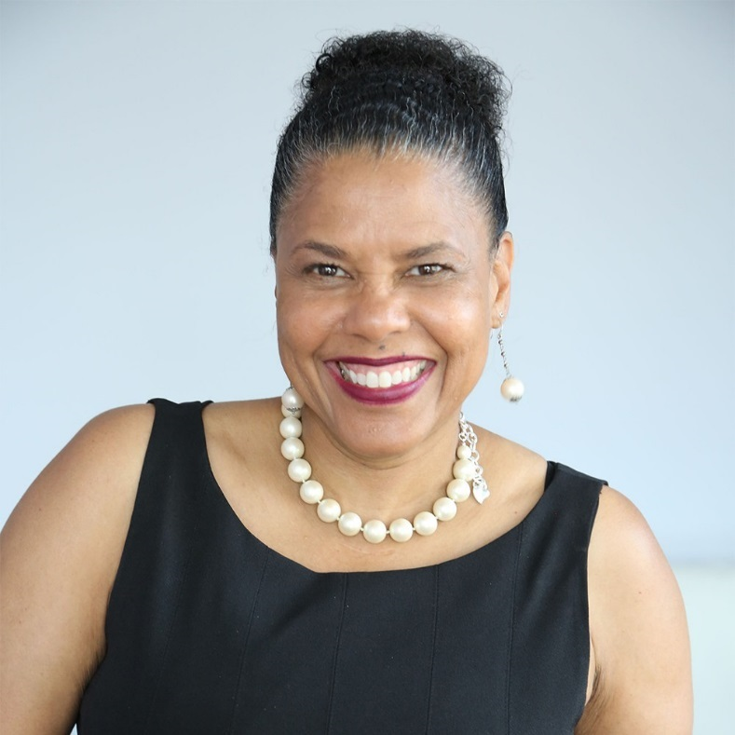
Dr. Donna Walton
Dr. Donna R. Walton grew up dreaming of becoming a great performer. Facing crowds fed her soul, but fate had other plans. Losing her leg in 1976 to osteogenic sarcoma, a potentially fatal form of bone cancer, Walton became motivated to fight for the respect and dignity she believes all people deserve, especially African American women with disabilities. In 2012, she founded the Divas With Disabilities Project, a digital campaign aimed to support women of color with disabilities. The bulk of Walton’s work highlights diversity and disability awareness. Walton is perhaps best known for her facilitation of Empowerment Salons for young girls and women of color. Drawing from her background in counseling and education, she conducts Empowerment Salons and workshops to teach women how to embrace their inner strength, to gain self-confidence and self-control over life’s challenges. Walton is also a member of RespectAbility’s Board of Advisors.

Slide 39
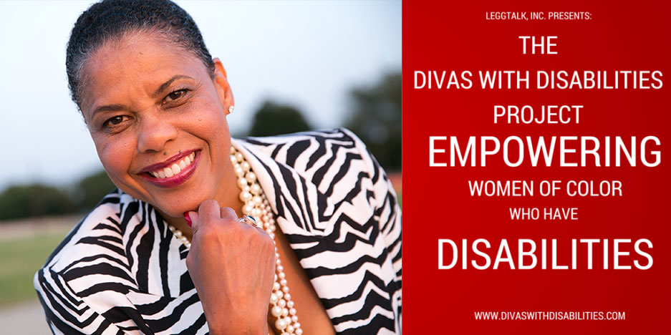
The Divas With Disabilities Project
The Divas with Disabilities Project: A creative extension of LEGGTalk, Inc. which transforms Lessons of Empowerment into Achieving Goals and Greatness.
Vision: To see more women of color with disabilities reflected in mass media.
Mission: To help shape the perception of what “disability” looks like by promoting women of color through various media platforms.
This campaign, started by Dr. Donna R. Walton, Founder & CEO of LEGGTalk, Inc., is bringing together women of color with disabilities throughout the world to reject and discredit stereotyped imagery historically portrayed by mass media.
Core Values
Diversity and Inclusion
Empowerment
Image Transformation
Integrity
Perseverance
Social Justice
Unity
Global Perspective

Slide 40
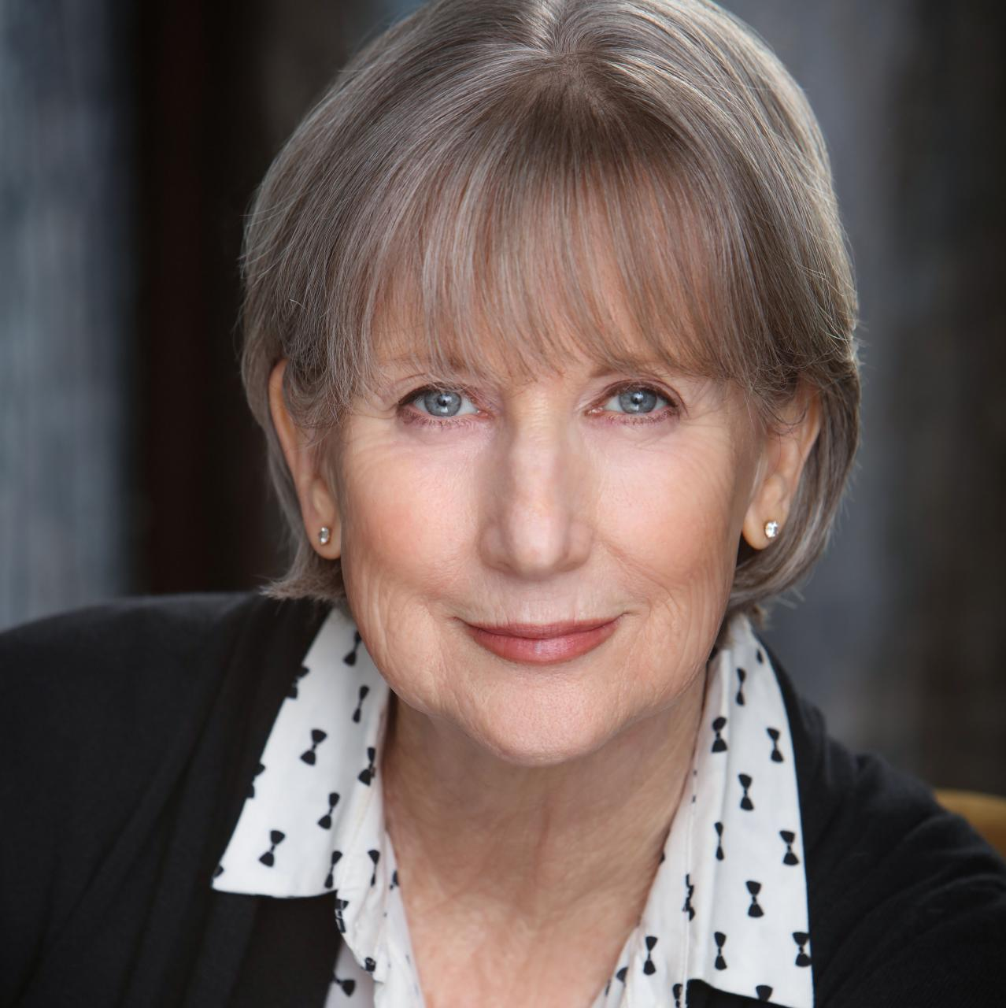
Gail Williamson, KMR Talent
Gail Williamson is a talent agent and head of the Diversity Department at Kazarian/Measures/Ruskin & Associates. The department focuses on representing clients with diverse disabilities. Williamson began her career as an advocate for talent with disabilities with the California Governor’s Committee for Employment of People with Disabilities working in their Media Access Office in Los Angeles in the early 90’s. To date, Williamson has represented talent with disabilities on Broadway, as network series regulars, as recurring characters and more. She is happy to ask “Why couldn’t the attorney use a wheelchair?” or “Couldn’t that mom be deaf?” or “Why can’t grocery bagger have Down syndrome?” Williamson’s own son Blair, who was born with Down syndrome, is an accomplished actor. His work was the beginning of her media training and eye opening experience on how media images can change public opinion.

Slide 41
Kazarian/Measures/Ruskin & Associations (KMR)
Ability Magazine interview: The way top actors get jobs is through an agent. The way top actors with disabilities get jobs is through dedicated folks like Gail Williamson and Mark Measures of Kazarian/Measures/Ruskin & Associates (KMR).

Slide 42
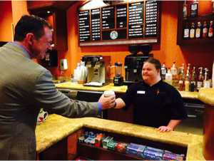
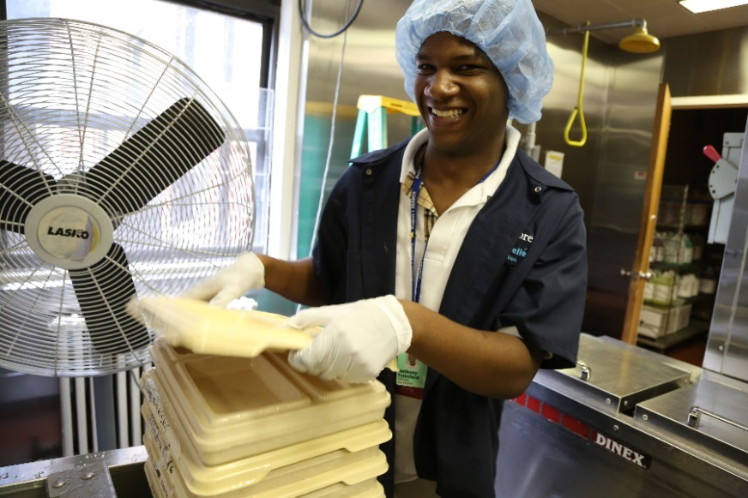
Changing the Perception of Disability
Including people with visible disabilities in all crowd scenes
Having leading characters with a disability, but not be the focus
Why can’t a judge just happen be a wheelchair user?
Why can’t a surgeon just happen to have a prosthetic leg?
Why can’t a student just happen to be Deaf?
Why can’t a barista just happen to have Down syndrome?

Slide 43
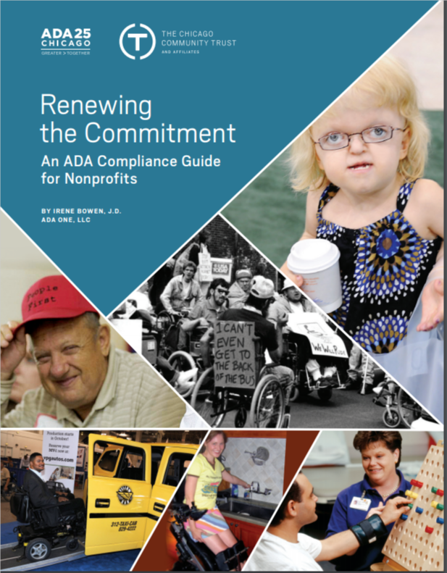
ADA Accessible Resource Guide
The Chicago Community Trust
http://www.cct.org/wp-content/uploads/2015/08/2015ADAComplianceGuide.pdf

Slide 44
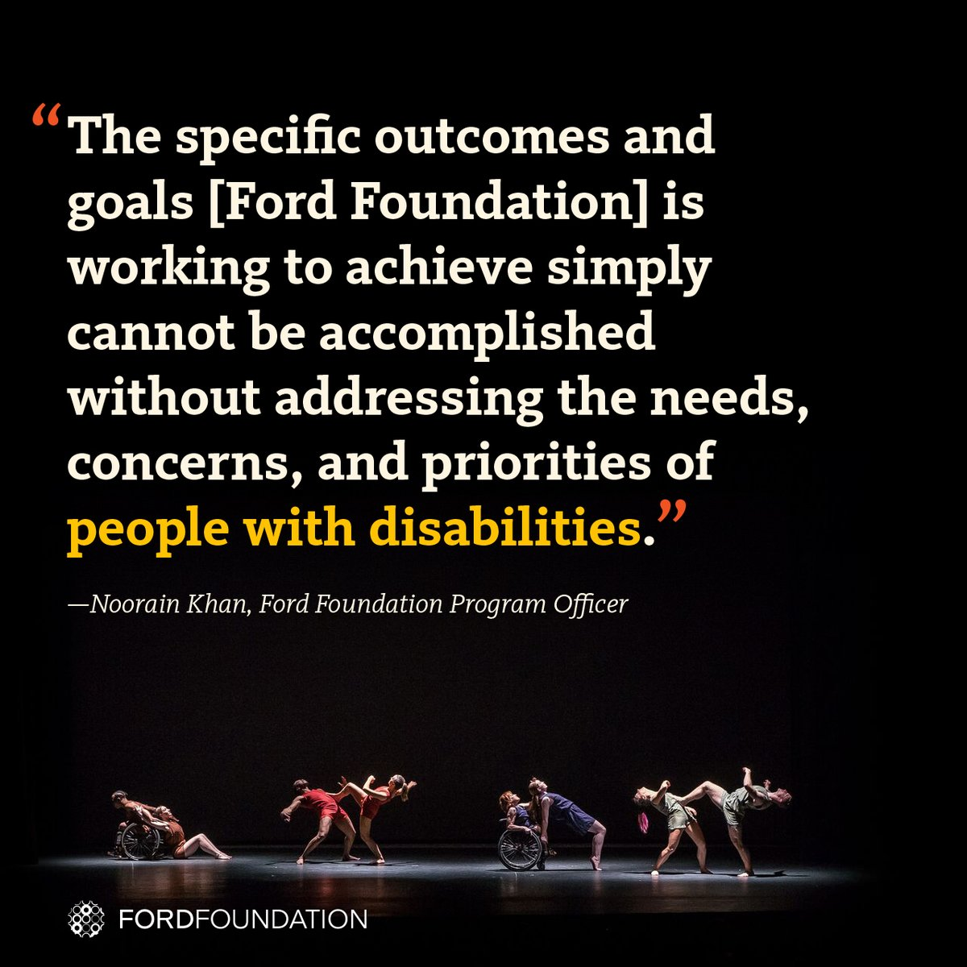
Ford Foundation Offers Model
The Ford Foundation recently has added the disability lens to their work http://bit.ly/2jOl3FL
Ford’s CEO Darren Walker spoke extensively on why this impacts other funders as well: http://bit.ly/2nr4moJ
Darren Walker’s original letter: http://bit.ly/2Bxy0Lk
Response of the co-authors of the Americans with Disabilities Act: http://bit.ly/2AueSyx
Darren Walker-Sen. Tom Harkin interview: http://bit.ly/2zrgFpE

Slide 45
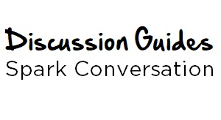
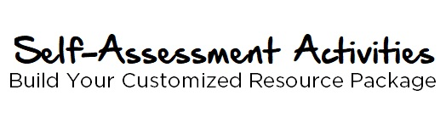
Jewish Federation of Greater Washington Toolkit
The discussion is designed to increase awareness and attitudinal adjustments through exploration of accommodations that enable an organization to be fully inclusive.
shalomdc.org/inclusiondiscussion
These interactive online activities are categorized by area of focus. After you fill in the self-assessment portion, the system will generate a customized resource package to help you advance your inclusive efforts.
shalomdc.org/inclusionassessment

Slide 46
Questions…
Has someone who uses a wheelchair personally checked the physical accessibility of your offices and programs for people who use wheelchairs?
Has a person who is blind and who uses adaptive computer technology checked your website and facilities for accessibility?
Do the videos you use have captions? Do you have a way to communicate with people who are deaf or use other adaptive supports?
Do you employ individuals who have disabilities? If so, what are their jobs? Do they receive the same compensation and benefits as other employees?
How do you educate your staff and other key people about serving and partnering with people with disabilities?
Has your organization considered how the language it uses may affect its ability to include and mobilize those people with disabilities whose values it shares?
Once your organization has decided that inclusion is important, how will you know that you have achieved it?

Slide 47
Next Steps
Read the toolkit yourself and learn how to advocate for, and include, people with a variety of disabilities.
Share the toolkit with everyone you know in the entertainment industry and beyond.
Speak with Lauren Appelbaum about your new ideas. The toolkit is a living document and we welcome additions.
Volunteer to work with Debbie Fink, our new Director of Community Outreach and Impact.
SPREAD THE WORD! Write and publish op-eds, push out social and traditional media on these issues and more!
Note: This past year there was a 4X improvement in the number of new jobs for people with disabilities. That’s 343,000 jobs! Together, we can do it!

Slide 48
Contact Information
Lauren Appelbaum, Author of Hollywood Disability Inclusion Toolkit and Communications Director, RespectAbility LaurenA@RespectAbility.org | 202-591-0703
Kate Folb, Director, Hollywood, Health & Society
kate.folb@usc.edu | (323) 782-3315 Jose Plaza, Manager at The California Endowment
jplaza@calendow.org | 916-558-8072
Donna R. Walton, Founder of the Divas with Disabilities Project
divaswithdisabilities@gmail.com
Gail Williamson, Talent Agent, Diversity Department at KMR Talent GWilliamson@KMRtalent.com | 818-769-9111
RespectAbility: 11333 Woodglen Drive #102, Rockville MD 20852 | www.RespectAbility.org

