Slide 1


RespectAbility
Long Beach – Tools to Drive Employment
March 22nd, 2018
Calvin Harris, Chairman, RespectAbility
Jennifer Laszlo Mizrahi, President, RespectAbility
Philip Kahn-Pauli, Policy Director, RespectAbility
Debbie Fink, Community Outreach Director, RespectAbility
www.RespectAbility.org

Slide 2
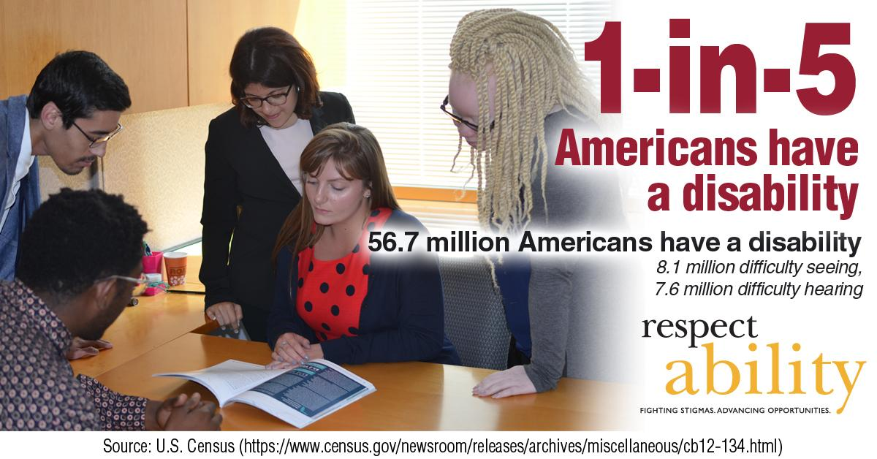
1 in 5 Americans

Slide 3

51 percent of Americans

Slide 4
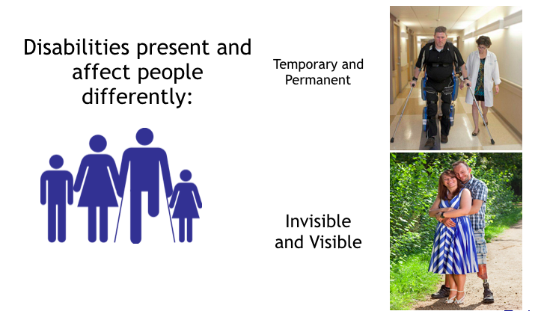
Not All Disabilities Can Be Seen

Slide 5
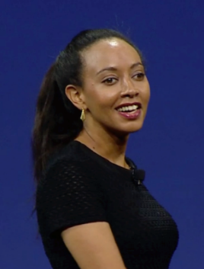





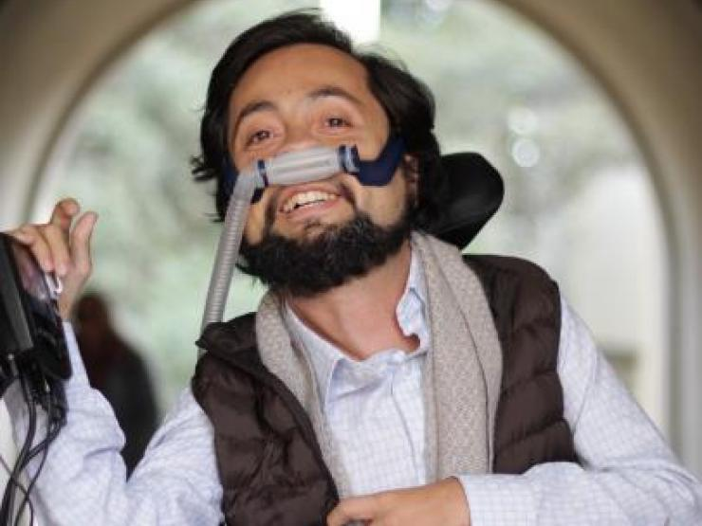

People with disabilities can be the MOST talented people
Haben Girma:
Deaf and Blind
Harriet Tubman: Seizures
Selena Gomez: Lupus
Simone Biles:
ADHD
Maya Angelou: Selective Mutism
Whoopi
Goldberg: Dyslexia
Daymond John: Dyslexia & Hearing Impaired
Victor Pañeda, Activist: Spinal muscular atrophy
Harry Belafonte: Dyslexia
Frida Kahlo:
Polio

Slide 6
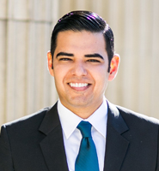
Long Beach Statistics
  Long Beach’s Labor Force Participation Rate (LFPR) is 64.3%. ¹
  In total, there are 46,573 LB residents with disabilities. ¹
  Only 9,417 LB residents with disabilities (ages 16-64) have jobs. ¹
  That means that less than one in four people with disabilities in LB have a job, are earning an income and becoming independent.
  Despite 1 in 10 LB residents having a disability, people with disabilities make up only 4% of your city’s workforce. ²
  25.1% of LB residents with disabilities live below the poverty line compared to 17.4% of LB residents without disabilities.
  Further, only 61.7 percent of students with disabilities in the Long Beach Unified School District completed high school.
  California ranks 34th in the country in terms of jobs for persons with disabilities. ⁴
2015 American Community Survey 1-Year Estimates
Census Bureau - 2015 American Community Survey
Long Beach Unified School District-Cohort Outcome Data 2015
Best and Worst States for Workers with Disabilities

Slide 7
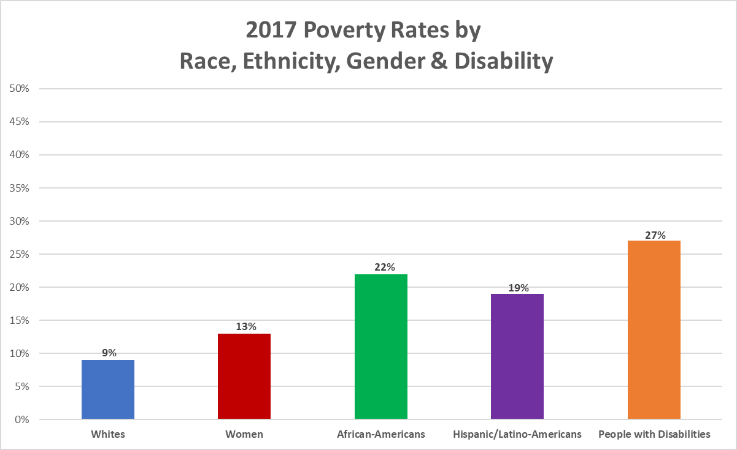
People with Disabilities are the Poorest of the Poor
In 2016, the poverty rate of working-age people with disabilities (26.7%) is more than twice that of people without disabilities (11.6%).
More people with disabilities live in poverty (27%) than any other minority. 22% of African Americans live in poverty while 19% of Hispanic/Latino Americans do. 13% of women live in poverty and just 9% of white people live in poverty.
Obviously, there is an even higher poverty rate for people who fall into multiple categories, such as an African American woman with a disability.
Notes:
Sources: KFF, Federal Safety Net, 2017 Disability Stat. Compendium

Slide 8

High School Graduation Rates in Long Beach
Special Ed Enrollment by Ethnicity in Long Beach:
  26 Native American students with disabilities
  612 Asian Americans students with disabilities
  5,360 Latino/Latina students with disabilities
  1,689 African American students with disabilities
  1,338 White students with disabilities
  416 students with disabilities of Multiracial status
Long Beach students with disabilities have an high school graduation rate of 62.4%
In total, 413 students with disabilities graduated Long Beach high schools in the class of 2016. (Out of 5,260 graduates overall)
Overall, LBUSD has a 84.2% high school graduation rate.
  81.8% of Latino/Latina students gradate high school
  68.8% of Native American students graduate high school
  90.4% of Asian American students graduate high school
  81.8% of African American students graduate high school
  88.7% of White students graduate high school
Source: Cohort Outcome Data for the Class of 2015-16 Long Beach USD –
http://dq.cde.ca.gov/dataquest/SearchName.asp?rbTimeFrame=oneyear&rYear=2015-16&cName=Long+Beach&Topic=Graduates&Level=District&submit1=Submit

Slide 9
Long Beach Students
Served Under IDEA
 | 2015-2016 | 2016-2017
All Disabilities | 9,151 | 9,499
Specific Learning Disability | 3694 | 3743
Speech or Language Impairment | 2071 | 1936
Intellectual Disability | 579 | 564
Emotional Disturbance | 308 | 288
Multiple Disability | 23 | 0
Hearing Impairment | 13 | 25
Orthopedic Impairment | 100 | 102
Other Health Impairment | 928 | 987
Visual Impairment | 0 | 0
Autism | 1435 | 1526
Deaf Blindness | 0 | 0
Traumatic Brain Injury | 0 | 0
Source: Special Education Enrollment by Age and Disability 1964725 - -Long Beach Unified – http://bit.ly/2vmCK6i

Slide 10
Absenteeism in LB
Long Beach Unified District
Group | # of Students | Percent
Students with Disabilities (grades 9-12) | 674 | 24.1%
Total (grades 9-12) | 3,494 | 13.9%
Students with Disabilities (grades K-8) | 1,172 | 15.6%
Total (grades K-8) | 5,449 | 9.9%
Source: https://dq.cde.ca.gov/dataquest/

Slide 11
Absenteeism in LA Co.
Los Angeles County
Group | # of Students | Percent
Students with Disabilities (grades 9-12) | 14,177 | 23.1%
Total (grades 9-12) | 75,506 | 14.9%
Students with Disabilities (grades K-8) | 18,487 | 14.1%
Total (grades K-8) | 91,460 | 8.6%
Source: https://dq.cde.ca.gov/dataquest/

Slide 12
Suspensions in LB Schools
Long Beach Unified District
Group | # of Students | Percent
Students with Disabilities (grades 9-12) | 243 | 8.7%
Total (grades 9-12) | 1,152 | 4.6%
Students with Disabilities (grades K-8) | 154 | 10.2%
Total (grades K-8) | 806 | 6.8%
Source: https://dq.cde.ca.gov/dataquest/

Slide 13
Suspensions in LA Co. Schools
Los Angeles County
Group | # of Students | Percent
Students with Disabilities (grades 9-12) | 3,776 | 6.2%
Total (grades 9-12) | 15,022 | 3%
Students with Disabilities (grades K-8) | 2,220 | 7.2%
Total (grades K-8) | 9,401 | 4%
Source: https://dq.cde.ca.gov/dataquest/

Slide 14
Progression Goals from
Head Start to Independence
HEADSTART – 5TH GRADE (ES) | 6TH – 8TH GRADE (MS) | 9TH–12TH GRADE (HS) GRADUATION! | POST SCHOOL: EMPLOYMENT / TRAINING | POST SCHOOL: HIGHER ED
Early Evaluations Identification of Disabiities Interventions / IEPs / therapies put in place | Reassessment Shadowing Opportunities Role Models | Internship Opportunities Testing Boundaries | Employment and Volunteer Opportunities e.g., Project SEARCH Bridges from School to Work (Marriott) | Community Colleges Colleges/Univ-ersities Graduate Schools Support Services / Accessibility
A collective work in progress …

Slide 15
Lunch Time!

Slide 16
National Lessons, Local Opportunities
As we built up our Long Beach Community of Practice (COP) we have been guided by the national lessons of the NGA’s Better Bottom Line Initiative.
For Long Beach to continue making progress on jobs for people with disabilities, our COP has the following local opportunities:
  Make the best of limited resources, raise public awareness and provide free resources to diverse audiences
  Find and support businesses that employ people with disabilities
  Prepare youth with disabilities for careers that use their full potential and ensure disability is a part of local workforce strategies
Adding to that, our COP has also shown the critical need to:
  More supports for parents and children with disabilities, especially in Long Beach’s linguistically and culturally diverse minorities.

Slide 17

Make the Best of Limited Resources -
Solving the Knowledge Gap
Sometimes, the biggest challenge that good people working in a community is simple – They don’t know what they don’t know.
Sometimes, people need a quick and easy way to find what out resources are already out there, how much they cost and how they can access them.

Slide 18

Make the Best of Limited Resources -
FREE Community Resource Guide
Between August and November 2017, RespectAbility staff and fellows contacted nearly community organizations in across the Long Beach community.
Soliciting their feedback, ideas and approval, we compiled their organizations, contact information and mission statements into a FREE resource guide.
We simultaneously developed the guide in English and in Spanish.

Slide 19


Make the Best of Limited Resources -
Raising Awareness and Decreasing Stigma
http://bit.ly/2FGSzIu
http://bit.ly/2kewVop

Slide 20
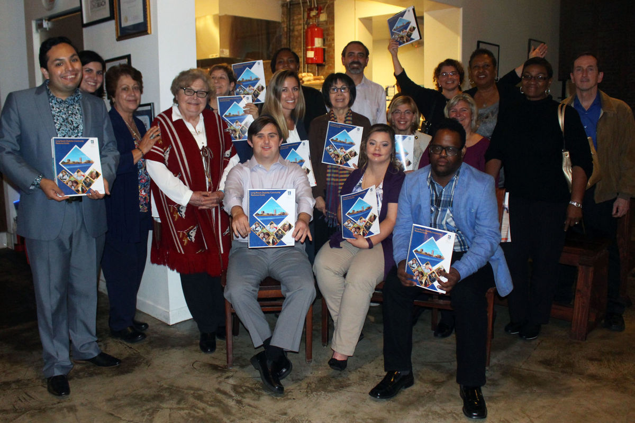
Decreasing Stigma with
Local Celebrities
Community members pose alongside cast member of "Born This Way" with copies of the Long Beach Disability Community Resource Guide.
MORE EVENTS, MORE CELEBRITIES AND MORE PUBLIC AWARENESS IS NEEDED
Work with public figures/celebrities (i.e. from Hollywood, sports or local news stations) to do PSAs or events throughout to encourage companies to see the advantage of hiring PwDs – Disability Employment First Planning Tool

Slide 21

Organizational Profiles
A Better Future for
Children & Young Adults with Disabilities
The Khmer Parent Association
The Regional Hispanic
Chamber of Commerce
4th & Olive Restaurant

Slide 22

Organizational Profiles Part 2
The Tichenor Clinic
The Stramski Children’s Development
Harbor Regional Center
SC Resource Services for
Independent Living

Slide 23

Make the Best of Limited Resources -
Free Resources to Diverse Audiences
Make the Best of Limited Resources -
Decreasing Stigma with Local Celebrities

Slide 24

Office of Disability
Employment Policy (ODEP)
The Office of Disability Employment Policy (ODEP) is the only non-regulatory federal agency that promotes policies and coordinates with employers and all levels of government to increase workplace success for people with disabilities.
https://www.dol.gov/odep/

Slide 25

ODEP Workforce Resources:
LEAD Center
National Center on Leadership for the Employment and Economic Advancement of People with Disabilities
(LEAD Center).
The LEAD Center is a collaborative of disability, workforce and economic empowerment organizations led by National Disability Institute.
The LEAD Center is dedicated to advancing sustainable individual and systems-level change to improve competitive, integrated employment and economic self-sufficiency for adults across the spectrum of disabilities.
The LEAD Center's work focuses on three core leadership areas: policy, employment and economic advancement.
Other resources:
  Employment First Website
  LEAD On! quarterly newsletter.

Slide 26

ODEP Youth Resources: NCWD
National Collaborative on Workforce and Disability for Youth (NCWD/Youth) is a partnership to promote success for youth with disabilities entering the world of work.
The NCWD/Youth website houses numerous youth-focused resources including:
  Guideposts for Success
  Career Development
  Professional Development
  Youth Development and Leadership
National Collaborative on Workforce and Disability for Youth (NCWD/Youth)

Slide 27

Technology Resources: PEAT
PEAT promotes the employment, retention, and career advancement of people with disabilities through the development, adoption, and promotion of accessible technology.
Selected Resources:
  PEATWorks.org, a central hub for accessible technology-related tools and resources
  TechCheck, a powerful but simple tool to help employers assess their technology accessibility practices and find tools
Partnership on Employment & Accessible Technology (PEAT)

Slide 28

Employer Resources
(EARN) helps employers recruit, hire, retain and advance people with disabilities.
EARN also maintains a website, AskEARN.org, which provides information on: recruiting and hiring; retention and advancement; laws and regulations; creating an accessible and welcoming workplace; and federal contractor requirements.
Other Resources:
  Primer on Disability Inclusion
  Business Strategies that Work: A Framework for Disability Inclusion
  Small Business & Disability: Steps to Success
  Fact Sheet on Self-Identification of Disability
Employer Assistance and Resource Network on Disability Inclusion (EARN)

Slide 29

Accommodations Resources
  Job Accommodation
  Network: AskJAN.org
JAN is the leading source of free, expert and confidential guidance on workplace accommodations and disability employment issues.
Working toward practical solutions that benefit both employer and employee, JAN helps people with disabilities enhance their employability, and shows employers how to capitalize on the value and talent that people with disabilities add to the workplace.
Recent JAN activities and areas of focus include:
  JAN Workplace Accommodation Toolkit
  JAN Just-In-Time Training Modules
  Workplace Accommodations: Low Cost, High Impact

Slide 30
WIOA Resources
1
The Playlists: Disability Resources for WIOA Practitioners
  Playlist 6 focuses on “Employer Engagement Strategies to Recruit and Retain Individuals with Disabilities.”
    https://disability.workforcegps.org/resources/2017/02/15/22/14/The_Playlists_Disability_Resources_for_WIOA_Practitioners
Work Opportunity Tax Credit
  Work Opportunity Tax Credit (WOTC) is a Federal tax credit available to employers for hiring individuals from different target groups including individuals with disabilities.
    https://www.doleta.gov/business/incentives/opptax/
Query WIOA State Plans
  RSA online site enabling users to conduct word search in State Plans such as “Business Services” or “Employer Engagement”
    https://rsa.ed.gov/ad-hoc-query-wioa.cfm?usp=Y
Disability Storyboards: AJC Customer Flow Scenarios
  The second storyboard focuses on an employer seeking guidance to hire and accommodate workers with disabilities.
    https://ion.workforcegps.org/resources/2017/07/19/10/02/AJC_Customer_Flow_Scenarios
An Emerging LifeChanger Program
  Pilot recently launched by Cisco that expanded worldwide to hire nearly 100 talented people with disabilities.
    https://www.cisco.com/c/dam/en_us/about/inclusion-collaboration/life-changer.pdf
ETA WorkforceGPS Tools
  ETA online resources to support strengthening employer engagement activities.
    https://businessengagement.workforcegps.org/
    https://apprenticeshipusa.workforcegps.org/resources/2017/03/10/16/09/Expanding-Apprenticeship-for-Individuals-with-Disabilities
    https://disability.workforcegps.org/
Notes:
On this page, we have listed 6 resources and would like to highlight some of them further:
The first is what we simply call “The Playlists” – This is a Disability Resource Guide for WIOA Practitioners that was jointly developed by Dept. of Education and Labor staff. There are 10 playlists that contains resources and Playlist 6 focuses on Employer Engagement strategies. The Playlist has been our most popular resource on our Disability Employment Page.
The second resource to highlight are Storyboards- This TA resource came out this summer. There are five storyboards in total and two of them have a disability theme focus. One storyboard is from the perspective of the employer named “Charles” in seeking to recruit PWD and the story goes through how that dialogue may occur. This is great resource for front line staff. Because of great continued interest, these have recently been made available in Spanish.
Finally, WorkforceGPS- At ETA, we are working hard to make sure you have the latest information. Three sites to highlight:
Business Engagement Page – A lot of good resources surrounding Sector Strategies
Apprenticeship Page – This link is focused on making the connection with disability community
Disability and EmploymentWorkforceGPS- An online Resource Destination ---

Slide 31
WIOA Resources 2
2
CSAVR Investing In America Publication – Spring 2017
  Highlights of success stories, business partnerships, and emerging initiatives occurring on the front lines across America.
    http://neweditions.net/products/business-roundtable-report-employer-engagement-vocational-rehabilitation-vr
An Emerging Autism Hiring Program
  Microsoft recruitment, retention, and career development strategy to increase employees with disabilities in its workforce.
    https://www.microsoft.com/en-us/diversity/inside-microsoft/cross-disability/hiring.aspx
Vocational Rehabilitation Business Roundtable Report
  Employer Engagement in Vocational Rehabilitation Report. Resource outlining recommendations for (1) improved employer engagement and (2) meeting the needs of businesses.
    http://neweditions.net/products/business-roundtable-report-employer-engagement-vocational-rehabilitation-vr
CSAVR Online Resource Page
  Resource includes historical conference presentations, position papers, additional resource links, and listing of current State VR Directors.
    https://www.csavr.org/resources

Slide 32
WIOA RESOURCES 3
3
Policy Matters
  Resource that contains information pertaining to policies such as Section 508, ADA, WIOA, and other relevant topics.
    https://www.peatworks.org/policy-matters
Buy IT!
  Resource that supports employers and their purchasing staff in building accessibility and usability into their ICT procurement process.
    https://www.peatworks.org/buy-IT/
TalentWorks
  Resource that helps employers and HR professionals make their eRecruiting technologies accessible to all job seekers–including those with disabilities
    https://www.peatworks.org/talentworks
Creative Recruiting Strategies for the Digital Age
  A PowerPoint resource that outlines the top five creative recruitment strategies for the digital age.
    http://www.peatworks.org/content/webinars/2017/11/XceptionalHR
American Job Center (AJC) Resources to Support Accessibility
  Resource links to support AJCs to improve accessibility to people with disabilities.
    American Job Centers and Digital Access: A Guide to Accessible ICT
    WIOA and Accessible Technology: Five Things AJCs Need to Know
    Digital Accessibility Checklist for American Job Centers
    WIOA and Accessible Technology: A Presentation Deck for AJCs

Slide 33





Poses Workplace Initiative Case Studies
Pepsi’s Act Initiative
P&G’s Project WIN
UPS’ Transitional Learning Center
TD Bank’s Workplace Initative
Walgreens’ Workplace Initiative

Slide 34




Poses Workplace Initiative
Case Studies Part 2
Boston Scientific’s Workplace Initiative
GM’s Workplace Initiative
Grainger’s Workplace Initiative
McKesson’s Workplace Initiative

Slide 35


Finding Inclusive Employers
US Business Leadership
Network® (USBLN®)
National Organization
on Disability (NOD)
Disability Equality Index (DEI) is a free benchmarking tool for USBLN partners that provides a confidential opportunity to receive an objective score on disability inclusion policies and practices.
It’s an aspirational, educational, recognition tool that helps identify opportunities for continued improvement and helps establish a reputation as an employer of choice.
The NOD Leading Disability Employer Seal™ is a public recognition that applauds organizations that are leading the way in disability hiring and encourage additional companies to tap into the many benefits of hiring talent with disabilities.
The Leading Disability Employer Seal™ is awarded annually based on performance on the Disability Employment Tracker™.

Slide 36
2017 Disability Equality
Index Results
2017 Disability Equality Index Results – Companies that scored 100%
3M | Accenture | Aetna | AMC | Ameren | American Airlines
Anthem | Aramark | AT&T | BAE Systems | Bank of America | Blue Cross Blue Shield
BMO Harris Bank | Booz|Allen|Hamilton | Boston Scientific | Brown-Forman | Capital One | Cargill
Cigna | Comcast NBCUniversal | CVS Health | Delta | Dow | DTE Energy
DuPont | DXC Technology | Express Scripts | EY | Finra | Florida Blue
Freddie Mac | GM | Goldman Sachs | GSK | HCSC | Hewlett Packard
HP | Huntington | Intel | JP Morgan Chase | Kaiser Permanente | KPMG
Lincoln Financial | Lockheed Martin | Manpower Group | Mayo Clinic | Microsoft | Northrop Grumman
P&G | PG&E | PNC | Prudential | PWC | Qualcomm
Southern Company | Sprint | Starbucks | Synchrony Financial | T Mobile | TD Bank
The Hartford | United Airlines | Verizon | Walgreens | Walmart | Wells Fargo
Whirlpool
10

Slide 37
2017 NOD Leading Disability Employer
2017 LEADING DISABILITY EMPLOYER SEAL WINNERS
Abbott | Accenture | Aetna | Anthem | AT&T
Barclays | Bath VAMC | The Boeing Company | Booz Allen Hamilton | Capital One
Colorado Springs Utilities | Comcast Corporation | Consumers Energy | Dow Chemical Co. | DTE Energy
DXC Technology | Eli Lilly and Company | EY | The Hershey Company | Hilton
Horizon BCBS of New Jersey | Huntington | JetBlue | Kaiser Permanente | KeyBank
KPMG | Lexmark International | Lockheed Martin | Marriott International | MassMutual
Merck | Moffitt Cancer Center | National Security Agency | New Editions Consulting | Northrop Grumman
Old National Bank | Pacific Gas and Electric | Project HIRED | Prudential Financial | PwC
S&P Global | Sempra Energy | Syracuse VA Medical Center | TD Bank

Slide 38

Section 503 and Federal Contractors
Department of Labor released new rules, effective January 1st, 2015 that create opportunities for people with disabilities to work at federal contractors.
Section 503 prohibits federal contractors and subcontractors from discriminating in employment against individuals with disabilities (IWDs), AND requires these employers to take affirmative action to recruit, hire, promote, and retain these individuals.
This new rule establishes, for the first time, a 7% utilization goal for individuals with disabilities. In all job categories!
How do we find out who are federal contractors in our local area? https://www.fedspending.org
Regulations Section 503 https://www.dol.gov/ofccp/regs/compliance/section503.htm

Slide 39
Federal Contractors in Long Beach
TOP 12 FEDERAL CONTRACTORS IN CALIFORNIA’S 47TH CONGRESSIONAL DISTRICT
THE BOEING COMPANY
MCKESSON CORPORATION
CARDINAL HEALTH, INC.
SCIENTIFIC APPLICATION & RESEARCH ASSOCIATES
MERCURY SYSTEMS, INC.
MDU RESOURCES GROUP INC.
CITIGROUP INC.
FINMECCANICA SPA
CROWLEY HOLDINGS INC
USF HOLDING CORP.
RAYTHEON COMPANY
ODLE MANAGEMENT GROUP, L.L.C.

Slide 40
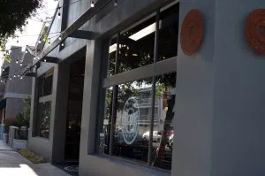
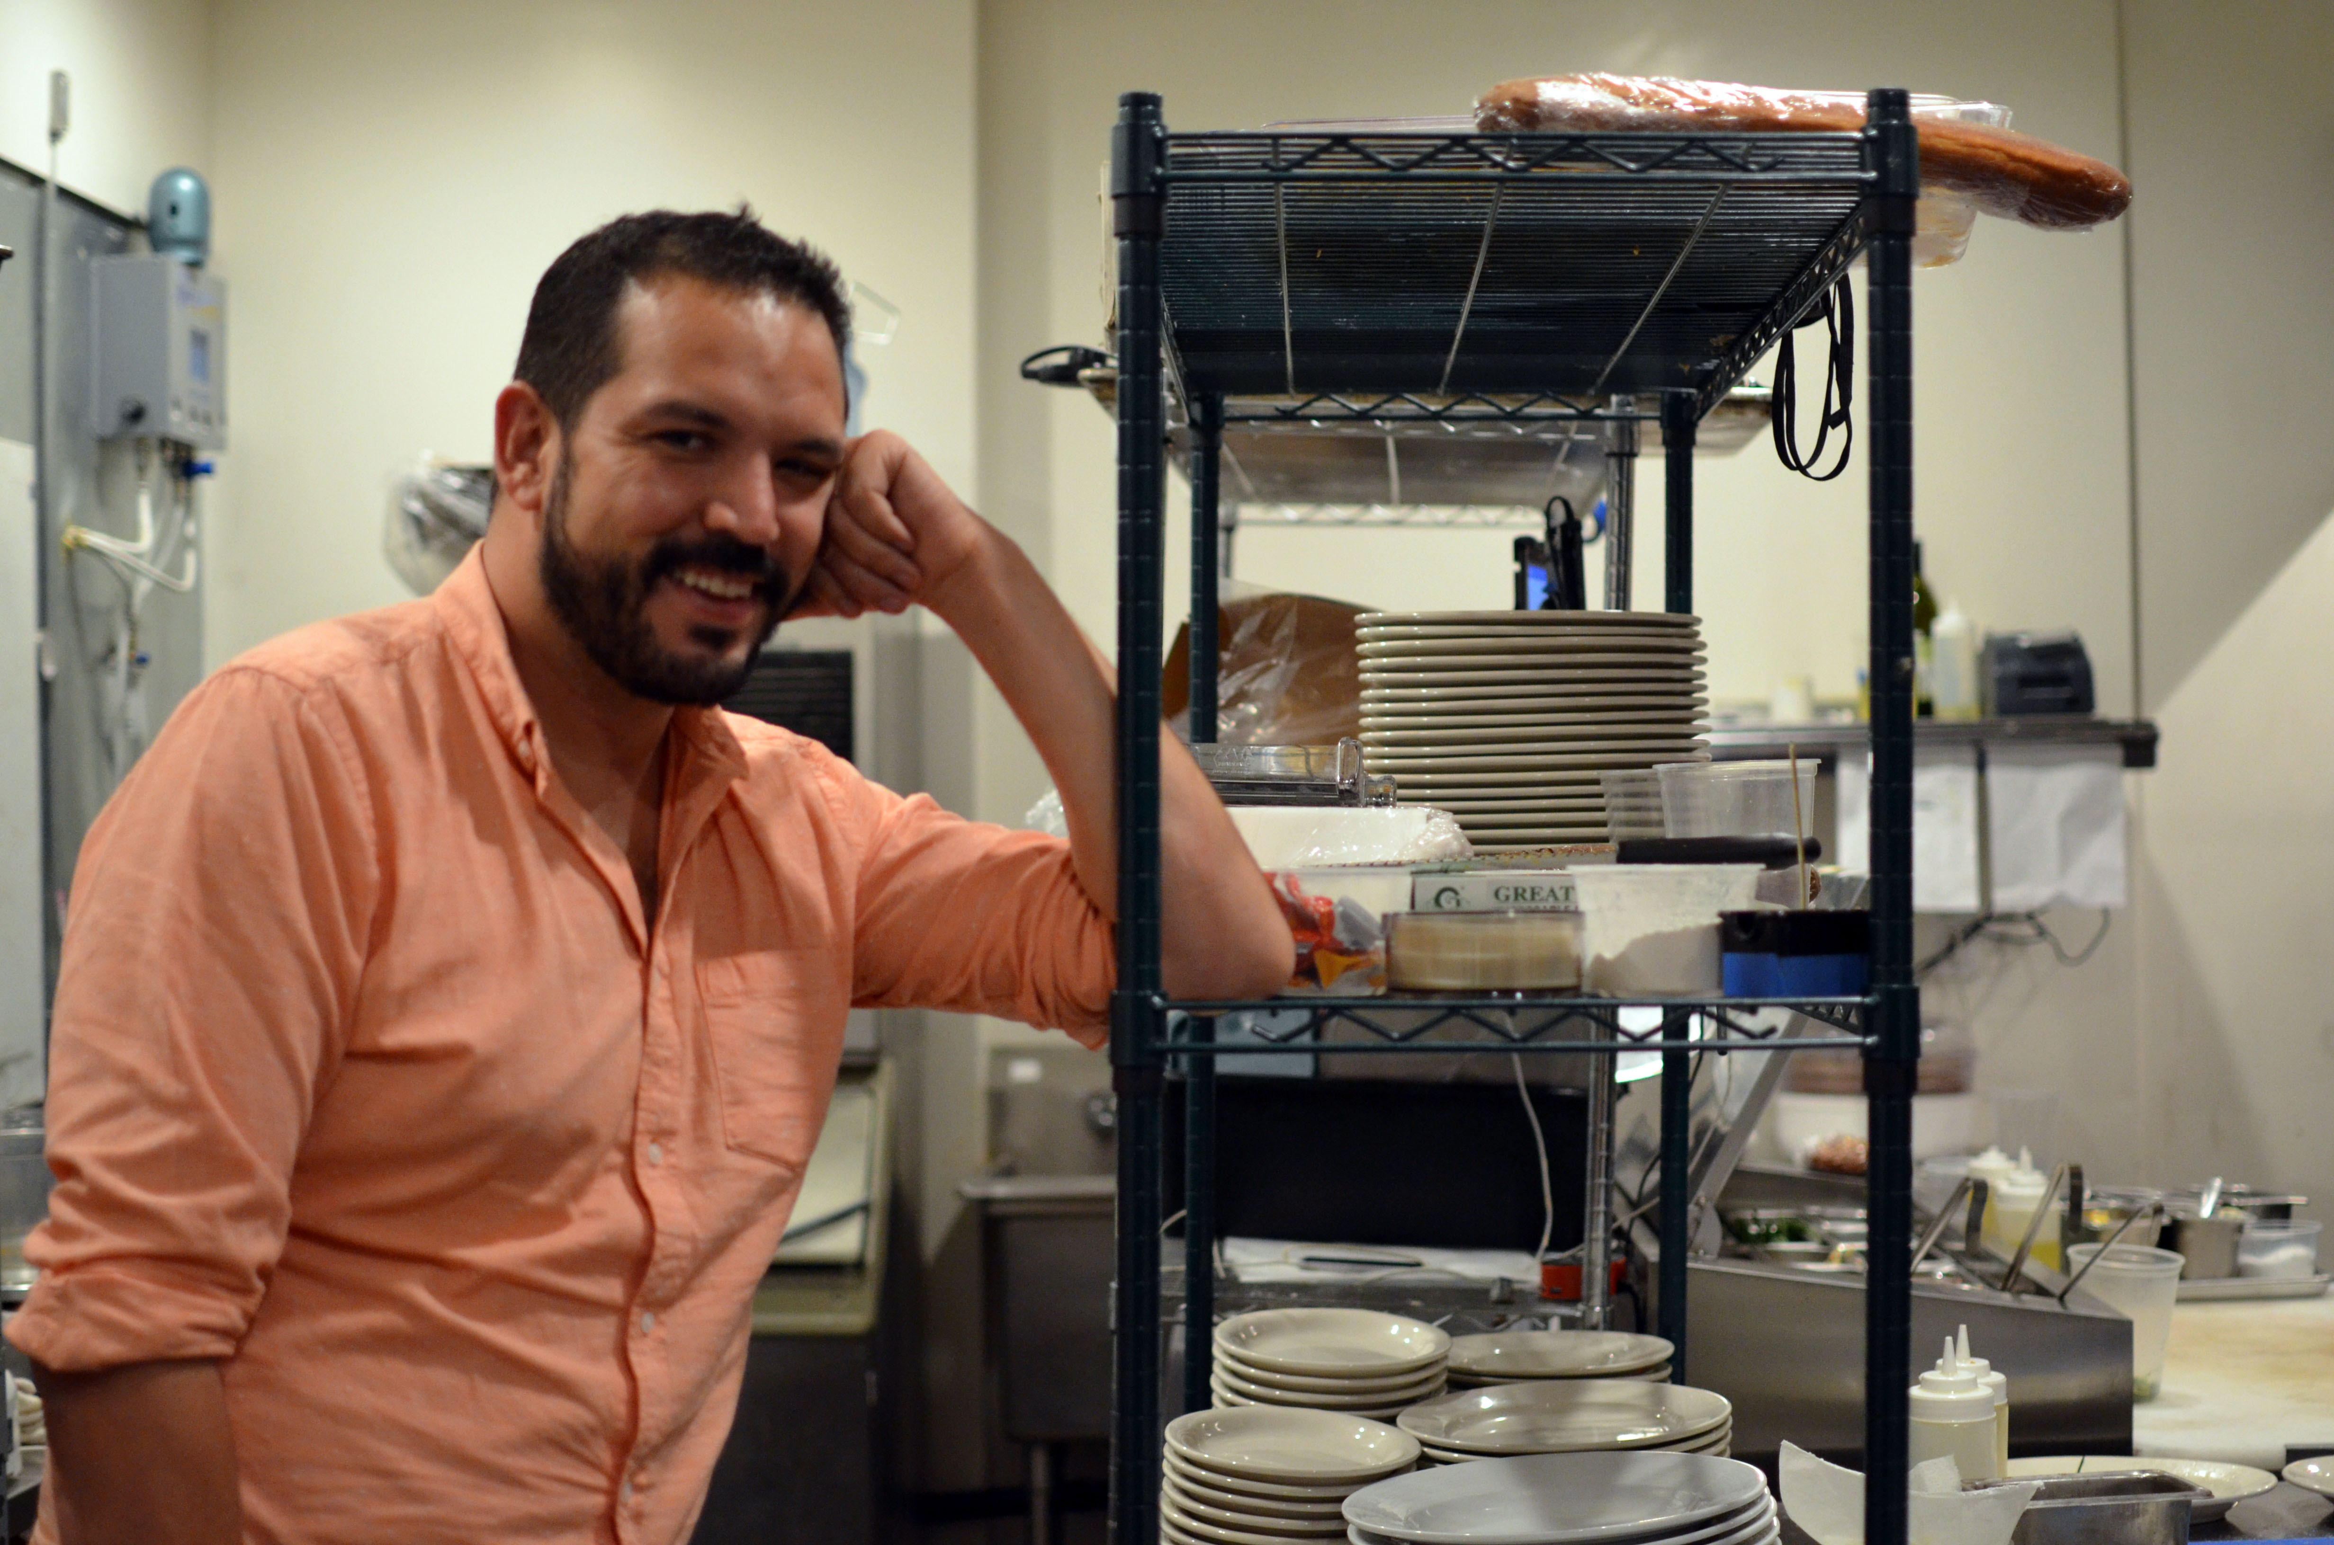
Finding and Supporting Local Businesses
Disabled Veteran In Half Marathon, Opens Eatery – The Grunion
This disabled vet employs wounded warriors at his awesome restaurant – We Are The Mighty
Disabled Vet Leads Restaurant, Hires Other Vets with Disabilities - RespectAbility

Slide 41
Preparing Youth with Disabilities for Success
Moving forward, Long Beach has two key opportunities:
  Maximize the impact of existing local programs through stronger partnerships.
  Ensure that local workforce strategies are working for job seekers with disabilities.

Slide 42

Local Best Practices – C2C Program
CollegeToCareer at Long Beach City College is an innovative post-secondary program for adults with developmental disabilities served by Harbor Regional Center.
The C2C Program offers an exciting opportunity to experience community college, student housing, and college life.
The Program is a partnership between students, families, Harbor Regional Center, Long Beach City College, HOPE, California MENTOR and Department of Rehabilitation.
C2C Frequently Asked Questions: http://www.harborrc.org/files/uploads/C2C_FAQ.pdf

Slide 43

CIP Long Beach 1
Postsecondary programs offering individualized college academic, social, career and life skills support for young adults with Autism, ADHD and other Learning Differences.
CIP’s centers of excellence are located in areas that promote healthy living, culture, and a wide variety of social, educational, and career opportunities.
Each CIP location has a unique setting, diverse college options, and staff who specialize in contributing to a student’s personal success.
CIP Berkeley · CIP Berkshire · CIP Bloomington · CIP Brevard · CIP Long Beach

Slide 44
CIP Long Beach 2
CIP Long Beach
CIP Long Beach assists students in career preparation and in building valuable employment skills. Each student’s interests are explored and developed through volunteering, internships and job placements.
Job and internship examples include
Disneyland Resorts
Long Beach City College Child Development Center
American Red Cross

Slide 45
CIP Long Beach 3
Postsecondary programs offering individualized college academic, social, career and life skills support for young adults with Autism, ADHD and other Learning Differences.
CIP’s centers of excellence are located in areas that promote healthy living, culture, and a wide variety of social, educational, and career opportunities.
Each CIP location has a unique setting, diverse college options, and staff who specialize in contributing to a student’s personal success.
CIP Berkeley · CIP Berkshire · CIP Bloomington · CIP Brevard · CIP Long Beach

Slide 46

CIP Long Beach 4
Career Skills Development for Young Adults on the Autism Spectrum and with Learning Differences
2018 Long Beach January Program: Mploy at the Beach
  10-Day program for young adults 18 to 26 interested in entering the workforce and transitioning to independent living
Gain insight into a range of industries and workplace settings
Develop more self-confidence and build social connections

Slide 47
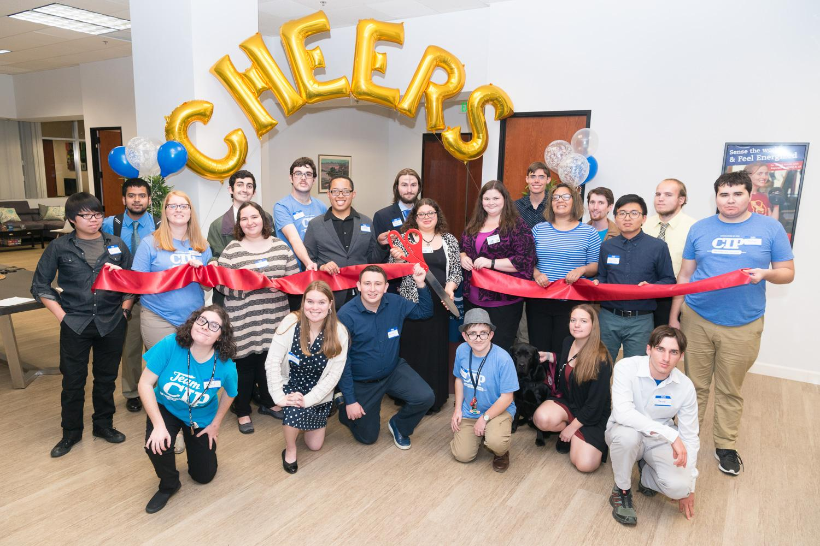
The average age of students at
CIP Long Beach is 21
100% of students completed community service with a total of 502 hours
91% of CIP Long Beach students are placed in an internship or paid job site

Slide 48

A COLLABORATION BETWEEN…
DOR is a state agency that serves as an employment and independent living resource for people with disabilities
Various office locations throughout California
WorkAbility is a sub-department of Disabled Student Services (DSS), but is housed in the Career Development Center (CDC)

Slide 49
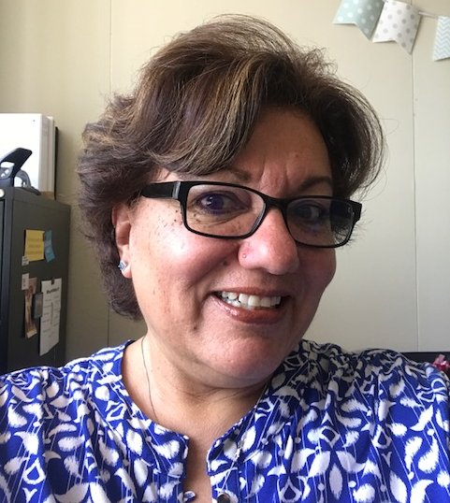

STAFF…
Monica Marquez-Savala
→ Program Coordinator
Monica.Marquez-Savala@csulb.edu
(562) 985-8038
Melissa Burdi
Program Assistant
Melissa.Burdi@csulb.edu
(562) 985-2343

Slide 50

CSULB
Collaborate with each student and their DOR Counselor to find internships and secure gainful employment aligned with their Individualized Plan for Employment (IPE)
Work with Career Development Center staff to coordinate career counseling services, workshops, and internship/job opportunities for students
Provide knowledge and resources to students on disability management and accommodations in the workplace

Slide 51
Back to the Class of 2016 for a moment….
Out of the 6,251 students in the Class of 2016 in Long Beach, 662 were students with disabilities.
Out of the 5260 Long Beach students who graduated, only 413 students with disabilities graduated.
110 dropped out, without completing their HS degree.
76 Long Beach students with disabilities left high school with only a certificate of completion.
Critical Need to expand school to work transition opportunities for students with disabilities.

Slide 52






Employer Advantages
Best Buddies has clearly documented the following business benefits:
Employers that hire people with IDDs report that they are highly motivated, bring an aspect of diversity that’s necessary for critical talent pools, and increase customer satisfaction.
    Many of these employers note higher customer retention as a result of customer engagement with employees with IDDs.
    Most employers polled review their employees with IDDs as dependable, engaged, motivated, having great schedule adherence, attentive, and productive.
    Employers polled report little to no difficulty with accommodations. Much lower than they expected.
    This is when support services – like profile matching and guided hiring/training – are readily available.
Highlighted Businesses Polled:
Notes:
Sources: i4CP report

Slide 53
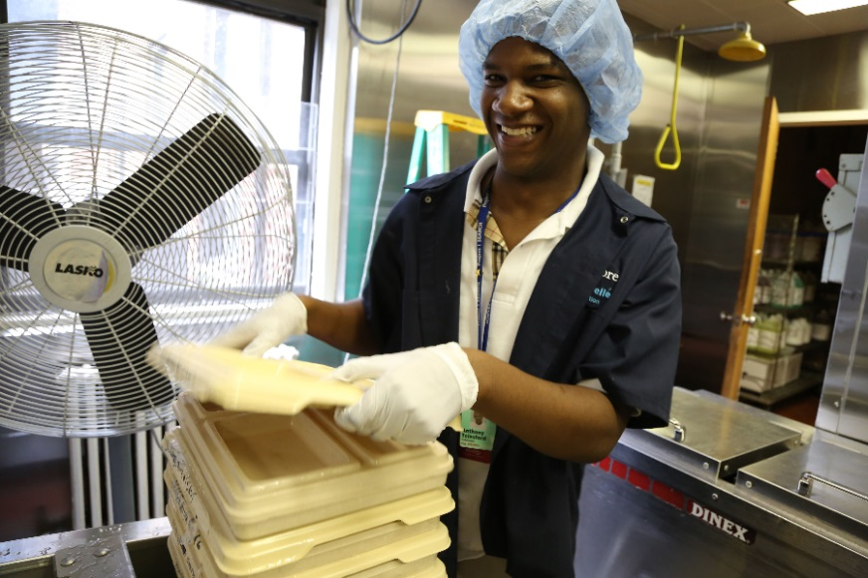
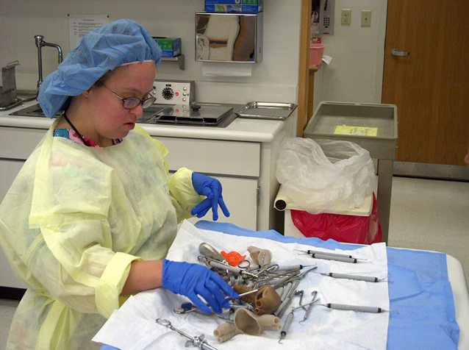
People with Disabilities can Succeed in Healthcare Jobs
  Between 2015 and 2016, LA County added more than 21,000 new healthcare/social assistance jobs.
  Molina Healthcare, Long Beach Memorial and St. Mary’s could all benefit from hiring youth with disabilities.
  Workers with disabilities help hospitals help
  Best Practices Webinar on Project SEARCH and Healthcare Jobs for PWDs

Slide 54

Connecting with Other Models
– Bridges from School to Work
Ease the transition from high school to the world of work
Youth with disabilities have multiple employment barriers.
Focus on disconnected youth
Employers seeking motivated entry-level employees can benefit from hiring young adults with disabilities.
Demand-driven and youth centered
Emphasizes abilities
Matches prescreened youth with age appropriate jobs
  Investing in people: Provide training opportunities that help associates grow professionally.
  Funding growth: Build financial capacity and diversify revenue streams to support our expansion.
  Telling story: Create powerful messages that inspire others to support the mission.
  Expanding student base: Find innovative ways to bring the Bridges experience to more young adults.
  Building new employer models: Work with businesses to craft enhanced partnerships.

Slide 55

Jobs in Government
❖ On Jan. 3, 2017, the EEOC issued a final rule about employment opportunities for PWDs in the fed government.
❖ Each federal agency has been directed to set a goal of having 12% of its workforce be people with disabilities, and 2% of its workforce be people with targeted disabilities.
❖ For more information, please visit EEOC’s website.
❖ State gov can also serve as a model employer of PWDs.
❖Learn from Delaware’s effort to hire talented employees with disabilities.

Slide 56

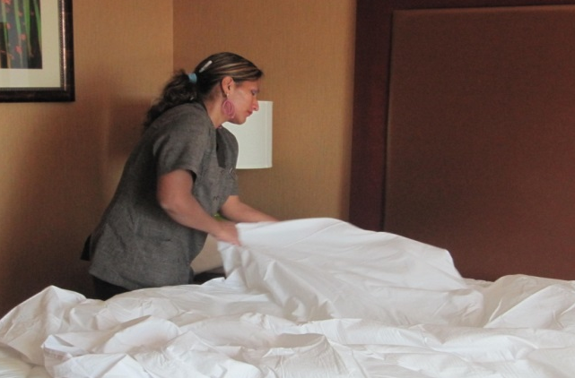
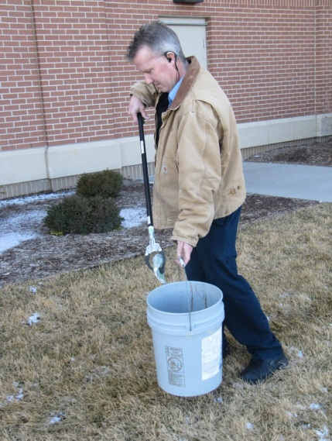
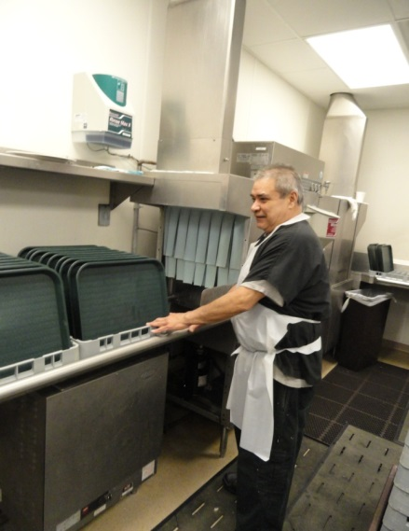
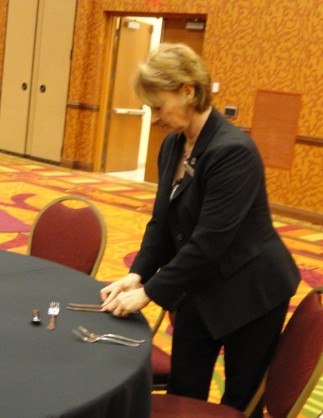
People with Disabilities and the Hospitality Industry
  Between 2015 & 2016, LA County added over 17,000 lesiure/hospitality jobs.
  Tourism is a critical part of LB’s local economic. This include hotels, major attractions and the Convention Center.
  Best Practices Webinar- Hospitality Sector for PWDs.
  People with disabilities are known to be loyal employees. In an industry with such high turnovers, hiring people with disabilities can benefit the bottom line.
Guest Services
Housekeeping
Engineering
Culinary
Banquets

Slide 57
Sector Strategies – Hospitality
Jobs for People with Disabilities
A 2013 survey of 320 U.S. hospitality and leasurie companies found that:
  23% of companies employ and 16% actively recruit people with disabilities
Top employer concerns include cost, lack of skills and experience, supervisors unsure how to discipline/evaluate/manage, low productivity and safety compared to typically abled
Customer attitudes biggest concern in hospitality compared to other industries

Slide 58
Sector Strategies –
Competitive Advantages
Benefits (competitive advantage):
  Lower turnover, increased psychological safety and productivity
  Improved innovation, problem solving abilities, ability to compete in all markets, react to expectations of diverse consumers.
  Establishing positive company image and increasing customer satisfaction
  Positive effects on workforce
Challenges:
  Stereotyping/skepticism / Productivity issues when there is a mismatch between position and abilities
Best practices:
  Leadership commitment
  Matching abilities with position through training
  Holding all employees to the same standards
  Dedicated department/person
  Partnering with school systems, local agencies and disability groups
  Establishing disability champions and ambassadors

Slide 59

Jobs in Entertainment / Culture
  In a culture where diversity has become more recognized, including people with disabilities in entertainment/culture shows will only make show business more of a trend setter, more progressive and most definitely more appealing!
  Combating stigma against people with disabilities needs to include engagement with showrunners / producers / actors.

Slide 60

People with Disabilities CAN Succeed

Slide 61

One Common Goal: Employment
High School Transition that Works: Lessons Learned from Project SEARCH By Maryellen Daston, Erin Riehle, and Susie Rutkowski
Paul H. Brookes Publishing Co.,
For more information go to:http://projectsearch.us/
Notes:
Need Erin’s Headshot

Slide 62
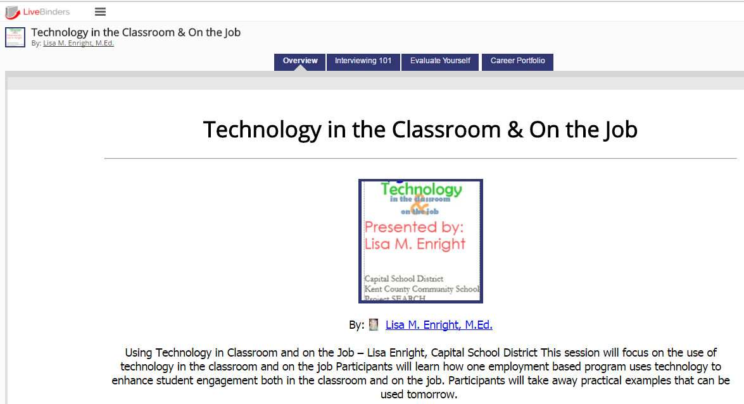
Putting Free Resources to Work
Livebinder resource:
http://bit.ly/DesignDeliver

Slide 63
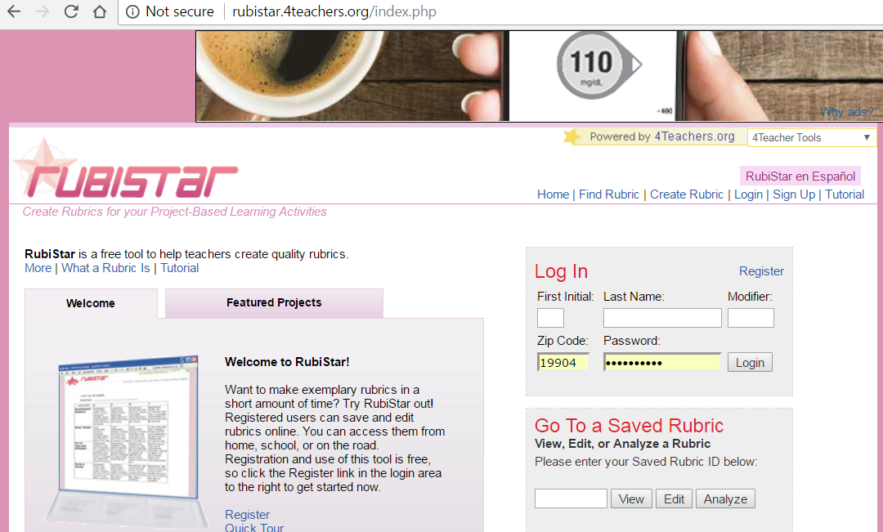
Rubistar: http://rubistar.4teachers.org/index.php

Slide 64
More Free Resources
LiveBinders: Organize online content or upload your own to bring the traditional static binder of information to life!
  Create an account and get started: http://www.livebinders.com/
YouTube: Find videos that provide helpful information or upload your own!
  Use your Google account for best results: https://www.youtube.com/
RubiStar: Create rubrics quickly and easily! You can also evaluate individual or class data on the site.
  Create an account and get started: http://rubistar.4teachers.org/index.php
Google Docs: Create, edit, collaborate and share documents with ease.
  Create or use your Google account: http://www.google.com
Google Drive: Store files, videos, pictures, and documents for easy access and sharing with your team! (Think sharing career portfolios of clients with VR, job developers and job coaches.)
  Create or use your Google account: http://www.google.com
Bitly: Shorten and customize lengthy website URLs.
  Use your Twitter or Facebook account or create an account with your email: https://app.bitly.com/bitlinks

Slide 65
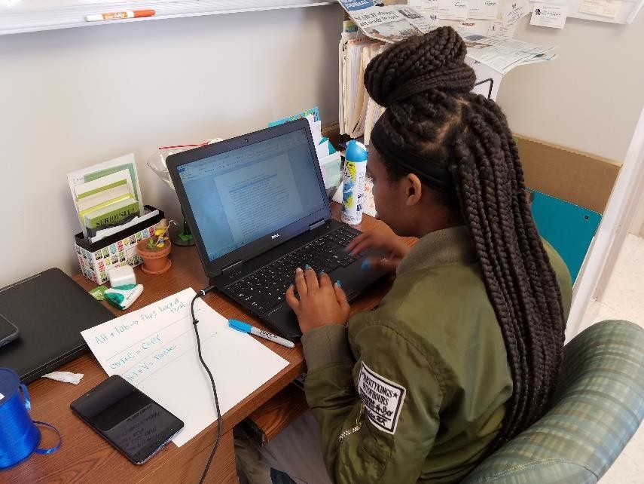
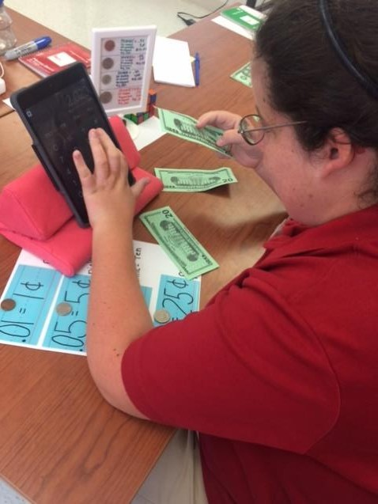
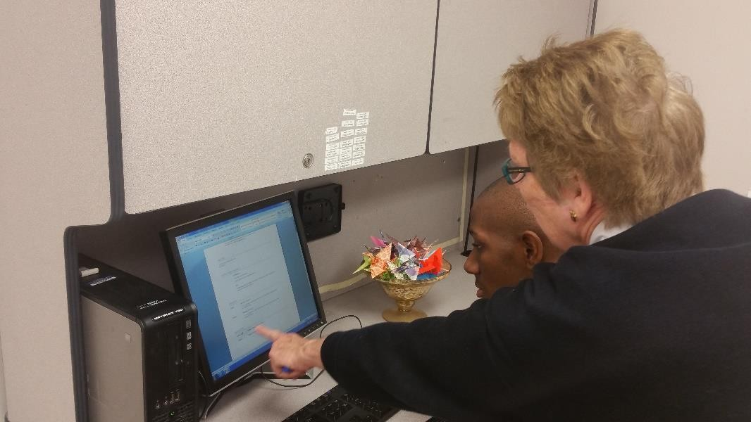
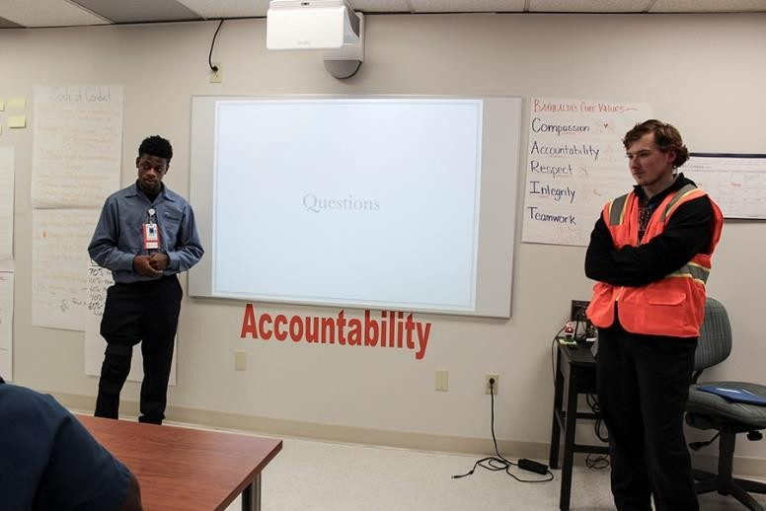
Utilizing Technology in the Classroom
Ashley uses an iPad to calculate money in preparation for banking at Del-One. She uses the Checkbook App to record deposits and withdraws. She uses the Del-One online banking app to reconcile her account on a monthly basis.
Dejah utilizes a laptop to complete a task. She alternated between two programs, copying text from Microsoft Word and pasting the data into a spreadsheet in Microsoft Excel.
Wayne and Daniel created a Prezi presentation on the iPad. They connected the iPad to the SMART Board and presented their presentation to Senator Carper.
Maliek utilizes a desktop computer and Microsoft Word to create, edit, and print his resume. Next he will upload the completed document to Google Drive, place it in his Career Portfolio, and share that folder with instructors, job coaches, job developers, and VR.

Slide 66
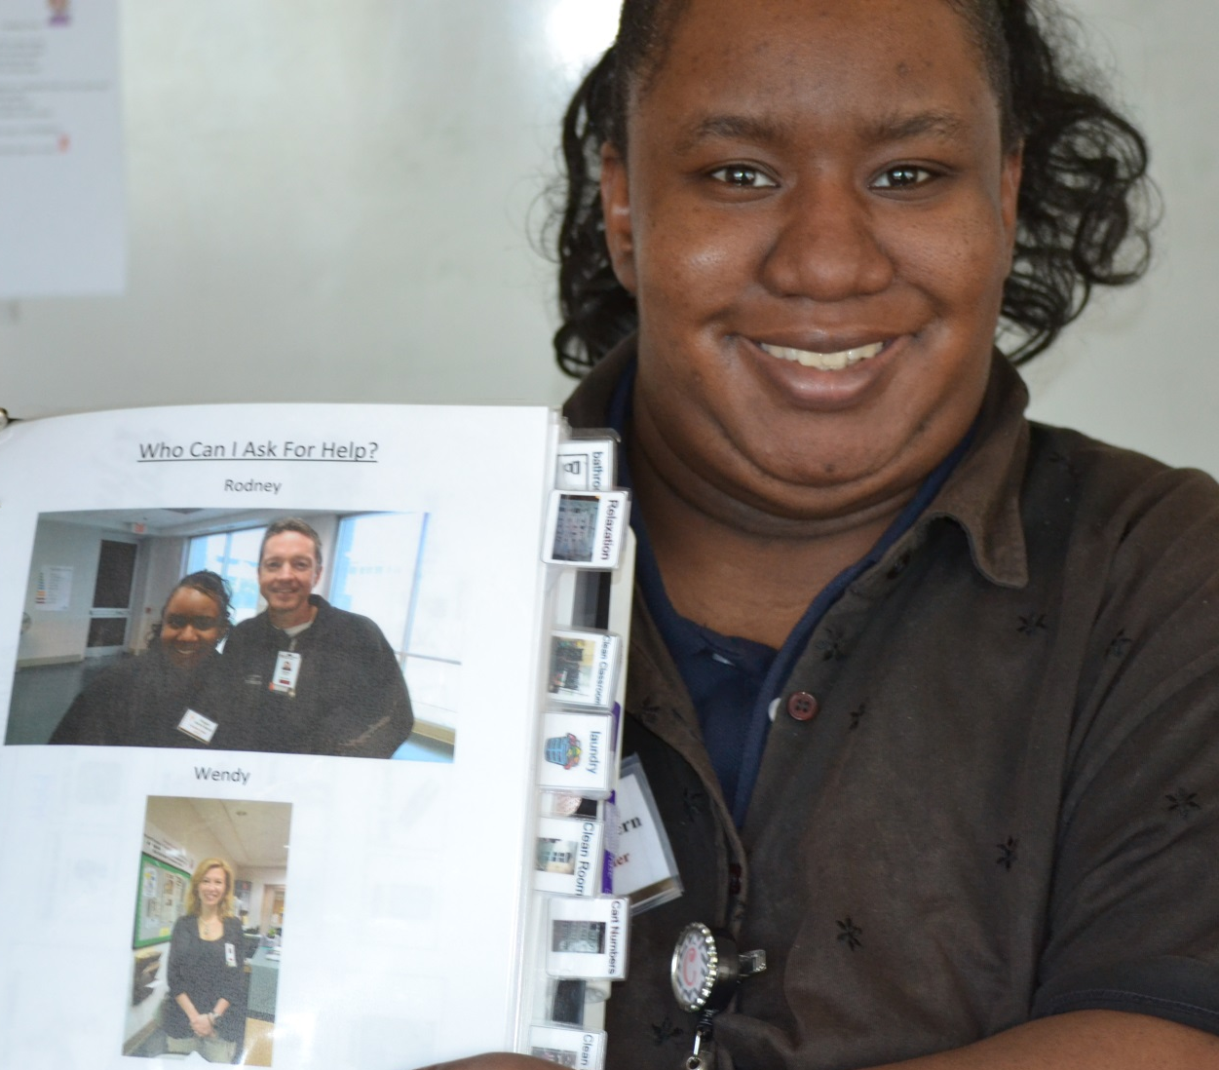
Accommodations & Supports

Slide 67
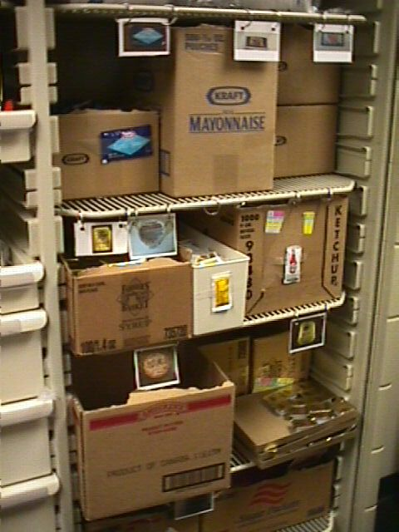
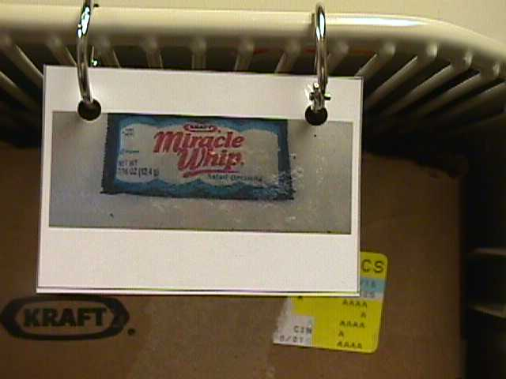
Use Pictures instead of Words

Slide 68
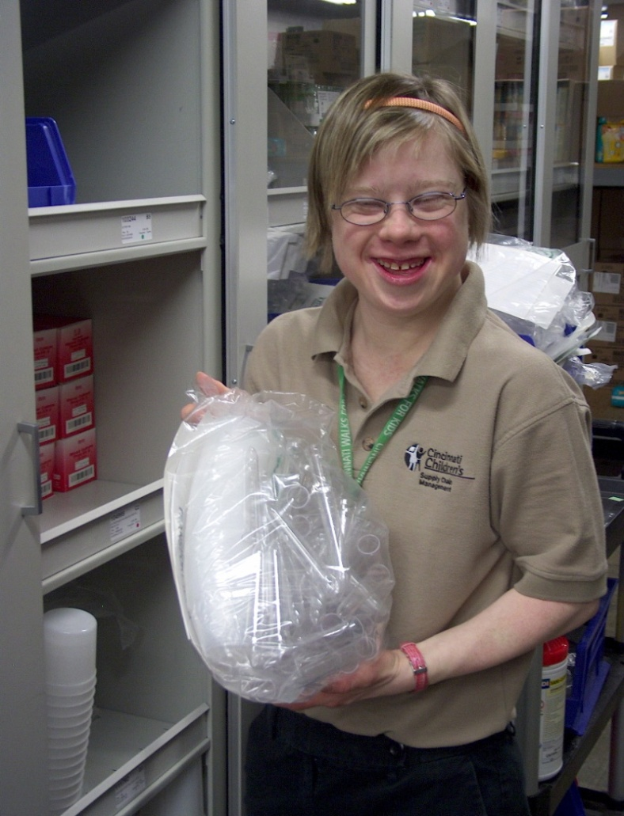
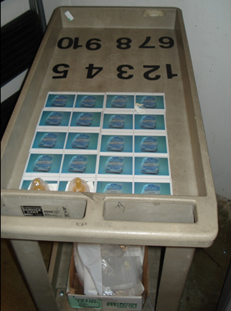
      Counting Cart to establish accuracy and efficiency!

Slide 69
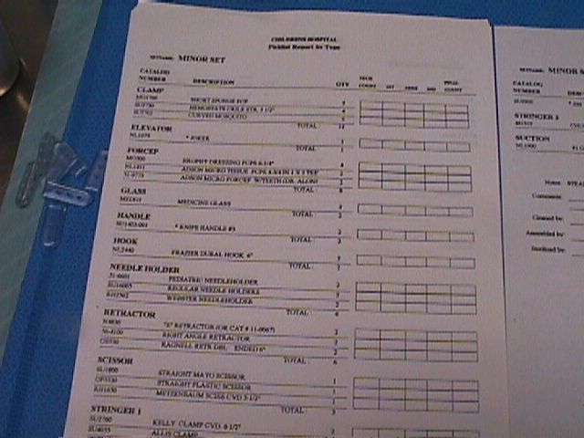
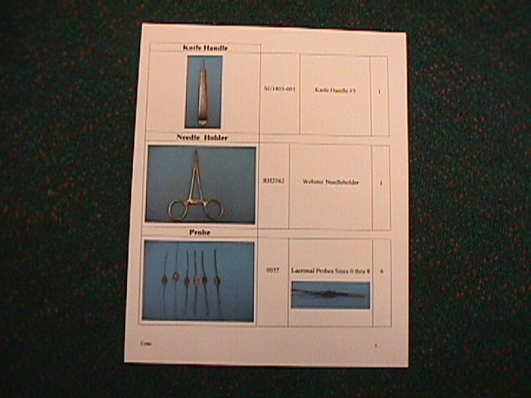
Inclusive Training Resources to Promote Skills
Before = A Pick List
After

Slide 70

Survey Reveals Key Need for
More Supports for Parents
Between October and December 2017, RespectAbility distributed a community survey to over 325 stakeholders in the Long Beach community.
Respondentss showed need for:
  A free resource fair to let parents know their rights, available services/resources for their children
  Online or in-person opportunities for parents and guardians of students with disabilities to meet, share ideas and get support

Slide 71

Resources on Learning Disabilities
Parents want the best for their children. We do, too. For the first time ever, 15 nonprofit organizations have joined forces to support parents of the one in five children with learning and attention issues throughout their journey.
With the right support, parents can help children unlock their strengths and reach their full potential. With state-of-the-art technology, personalized resources, free daily access to experts, a secure online community, practical tips and more, Understood aims to be that support.
https://www.understood.org/en

Slide 72
Resources / Contact Information
2015 Disability Status Report United States, Cornell University, 2015: www.disabilitystatistics.org
Fedspending: www.fedspending.org
Project SEARCH: www.projectsearch.us
Job Accommodation Network: https://askjan.org/
State Vocational Rehabilitation Agency: http://wdcrobcolp01.ed.gov/Programs/EROD/org_list.cfm?category_cd=SVR
Selected Economic Characteristics for Civilian Noninstitutionalized Population by Disability Status, 2011-2015 ACS (focused on Long Beach) http://bit.ly/LBDisabilityjobs
Local Disability Data for Planners (focused on Montgomery County) http://bit.ly/MontgomeryCountydisabilityjobs
Jennifer Laszlo Mizrahi
www.RespectAbility.org
Cell: (202) 365-0787
JenniferM@RespectAbility.org
Twitter: @respect_ability / @jewishinclusion
Facebook: https://www.facebook.com/RespectAbilityUSA and https://www.facebook.com/RespectAbility4All/

