Slide 1

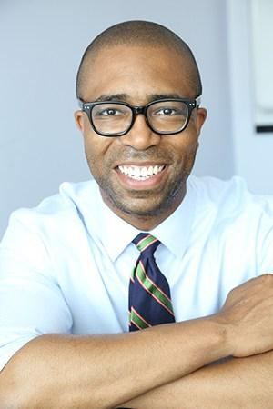
Hollywood Disability Toolkit: The RespectAbility Guide to Inclusion in the Entertainment Industry
Jennifer Laszlo Mizrahi, President, RespectAbility
Contact: JenniferM@RespectAbility.org
(202) 365-0787
Calvin Harris, Chairman

Slide 2
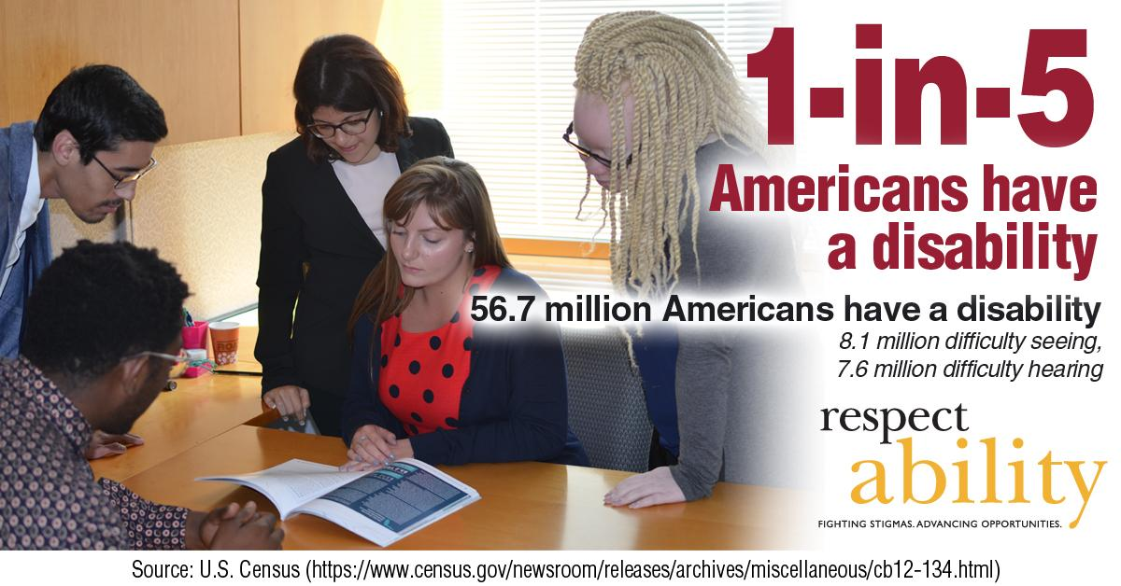
Who Has a Disability?
7
Notes:
"1 in 5 Americans have a disability. 56.7 Americans have a disability, 8.1 million difficulty seeing, 7.6 million difficulty hearing."
Source: U.S. Census

Slide 3
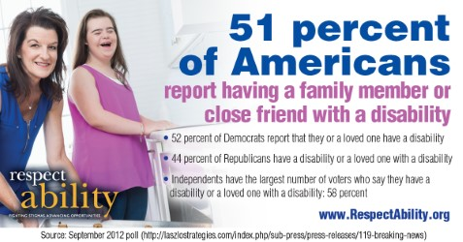
Forget 6 Degrees
8
Notes:
"51 percent of Americans report having a family member or close friend with a disability. 52 percent of Democrats report that they or a loved one have a disability. 44 percent of Republicans have a disability or a loved one with a disability. Independents have the largest number of voters who say they have a disability or a loved one with a disability: 58 percent."
Source: Laszlo Strategies September 2012 poll

Slide 4
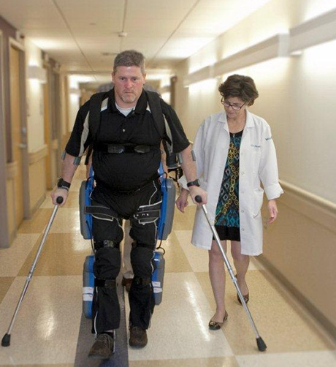

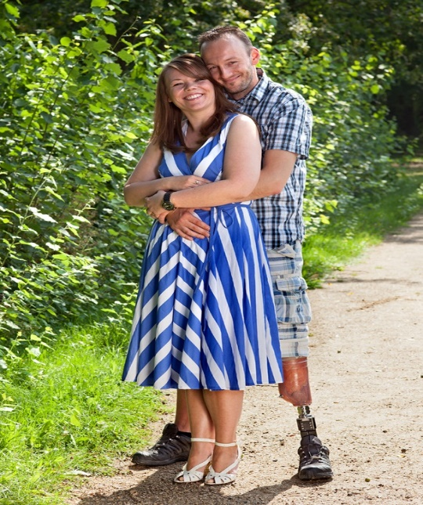
Not All Disabilities Can Be Seen
Disabilities present and affect people differently:
Temporary and Permanent
Invisible and Visible
9

Slide 5
Opportunity for the
Entertainment Industry
Entertainment professionals across all platforms are working to become more inclusive of minorities. This is our opportunity to ensure inclusion and equality for all people – including America’s largest minority – the one-in-five Americans with a disability.
Opening the inclusion umbrella is the right thing to do as well as economically smart given that the disability market is valued at more than $1 trillion.
According to Nielsen Research, consumers with disabilities represent a $1 billion market segment. When you include their families, friends and associates, that total expands to more than $1 trillion. Americans with disabilities represent the third largest market behind Baby Boomers and the mature market.
3
Notes:
By expanding access to programs dedicated to financial literacy, mathematical competence, and English literacy, the Silicon Valley Community Foundation promotes fundamental improvements in the quality of life of all Californians.

Slide 6
Opportunity for Inclusion
For generations, television and movies have represented people with disabilities as objects of pity. From the Jerry Lewis telethons to stories covering school teams as heroes for allowing one child with a disability to play on the court or field for a few minutes, society’s screens have propelled stigmas undermining people who have disabilities.
What we see and hear impacts our thoughts and feelings, which can have life and death consequences.
An increase in positive, diverse and accurate portrayals of people with disabilities in television and film would significantly help to end stigmas.
4

Slide 7
Portrayals of Disability in Film and TV
While people with disabilities are the largest minority in America (roughly 20 percent of the population), the disability community often is forgotten in conversations about inclusion and diversity.
While one in five people have a disability, according to GLAAD, fewer than two percent of scripted television characters (15 people) have disabilities.
95% of characters with disabilities in film and television are played by able-bodied actors. Many characters are shown in a negative and inaccurate light.
Almost all portrayals of people with disabilities in media are white, despite the fact that disability impacts all ethnicities.
Fewer than one percent of people employed by cultural institutions in New York City are people with disabilities.

Slide 8
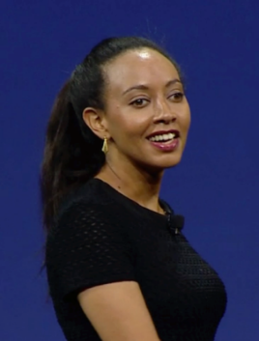


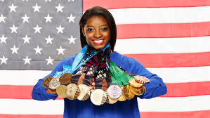
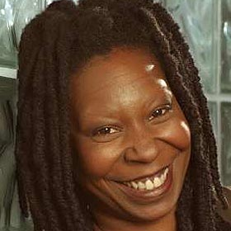
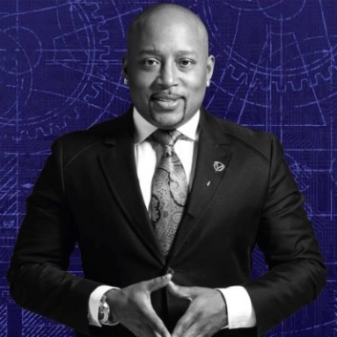
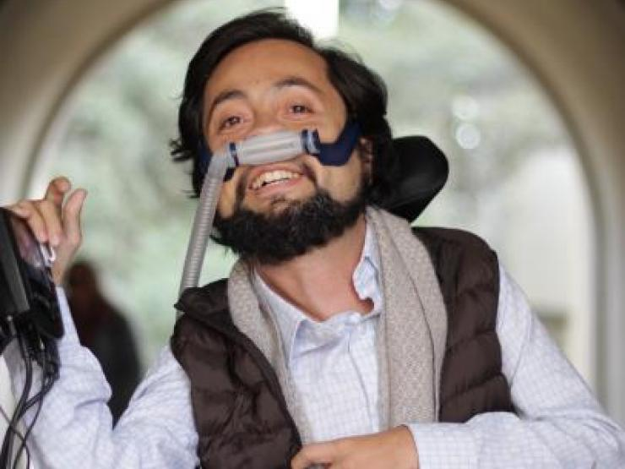

People with disabilities can be the MOST talented people
Haben Girma:
Deaf and Blind
Harriet Tubman: Seizures
Selena Gomez: Lupus
Simone Biles:
ADHD
Maya Angelou: Selective Mutism
Whoopi
Goldberg: Dyslexia
Daymond John: Dyslexia & Hearing Impaired
Victor Pañeda, Activist: Spinal muscular atrophy
Harry Belafonte: Dyslexia
Frida Kahlo:
Polio

Slide 9
Partnering with the
Entertainment Industry
Identify the diverse talent needed to reflect the fact that 56 million people in the U.S. and more than one-billion people with disabilities worldwide.
Create both entertaining content for and with people with disabilities and benefit the bottom line by tapping into this trillion-dollar market.
Access raw, real, compelling, diverse and inclusive stories that will make TV and film more relevant.
Set the bar higher in the creation of welcoming entertainment that powerfully resonates with audiences.
Become the go-to creative and marketing ally that can help established voices and a new generation of artists and filmmakers reach new heights.
Acquire facts, resources and contacts needed to tell authentic disability stories in a way that will win audiences and advance dignity for all.
Understand disability etiquette and ensure disability is not viewed through the “pity lens.”
Update lexicons to ensure that scripts are culturally sensitive to the one-in-five people with disabilities and the people who love them.

Slide 10

Resources for Hollywood

Slide 11
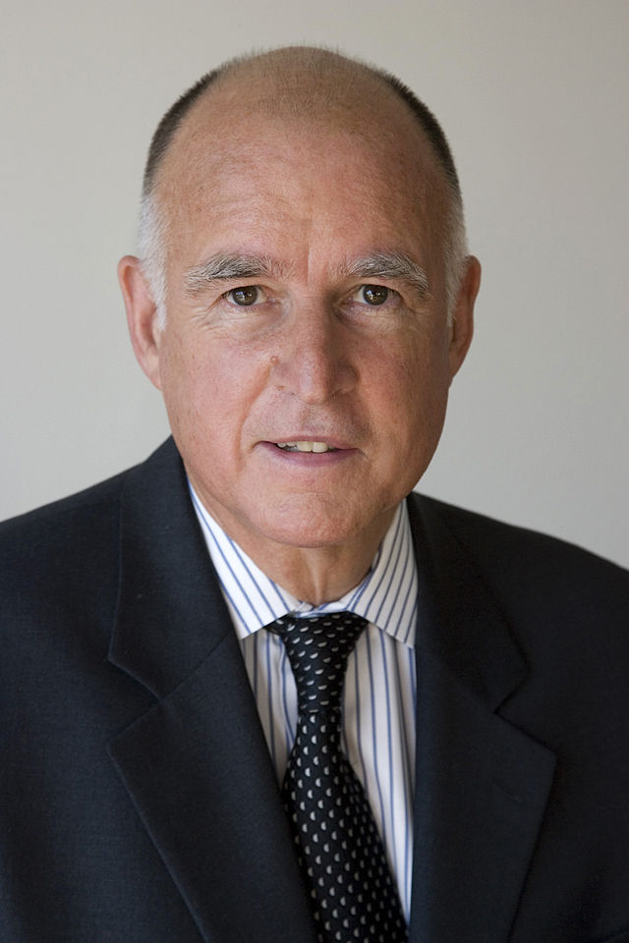
California Statistics
  71.1% of persons without disabilities aged 18 to 64 are employed.³
  32.7% of PwDs aged 18 to 64 in CA are employed.³
  California is 36th in the country in terms of jobs for PWDs.³
  There is a 38.4 point gap between the Labor Force Participation Rate (LFPR) of PWDs and those without disabilities. This is the most important performance metric to measure as this gap must be reduced.
  115,600 persons aged 16 to 20 have a disability.¹
  1,793,900 persons aged 21 to 64 have a disability.¹
  4,019,882 civilians in CA have a disability.³
  807,945 people ages 18-64 received SSDI or SSI benefits in the year 2012.³
  In 2012, total expenditure on SSDI benefits in CA for PwDs was $10,723,392,000.³
  Voc. Rehab. obtained 11,187 jobs for PwDs in CA in 2012.²
  Voc. Rehab. received 37,009 general applicants in CA in 2012.³
Gov. Jerry Brown (D)
2013 Disability Status Report: California, disabilitystatistics.org
StateData: The National Report on Employment Services and Outcomes, 2014
Annual Disability Statistics Compendium
Notes:
→Annual Disability Statistics Compendium, 2015
http://www.disabilitycompendium.org/docs/default-source/2015-compendium/compendium_2015_final.pdf
→Disability Status Report: California, 2013
http://www.disabilitystatistics.org/StatusReports/2013-PDF/2013-StatusReport_CA.pdf
→StateData: The National Report on Employment Services and Outcomes, 2014
http://www.statedata.info/bbstates/Louisiana.pdf
Exact Resources:
-% of Persons without disabilities aged 18 to 64 who are employed → Annual Disability Statistics Compendium, Pg 46. Table 2.2
-% of PwDs aged 18 to 64 who are employed → Annual Disability Statistics Compendium, Pg 45. Table 2.1.
-Civilians with a disability who live in LA. → Annual Disability Statistics Compendium, Pg 16. Table 1.3.
-Number of PwDs age 16 to 20 in LA→ Disability Status Report: Louisiana, Pg. 15
-Number of PwDs age 21 to 64 in LA→ Disability Status Report: Louisiana, Pg. 17
-The Employment Gap between PwDs and people with disabilities in LA decreased between 2013 and 2014. → Annual Disability Statistics Compendium, Pg 54. Table 2.10.
-Number of people in LA who received SSDI benefits in 2014→ Annual Disability Statistics Compendium, Pg. 138, Table 8.5a
-In December 2014, total expenditure on SSDI benefits for PwDs → Annual Disability Statistics Compendium, Pg 145. Table 8.6.
Voc. Rehab’s Applicants in LA in 2013. → Annual Disability Statistics Compendium, Pg 168. Table 10.1.
Voc. Rehab. Obtained 603 jobs for PwDs in LA in 2013. → StateData Report, Pg 167, Table 8; Compendium Pg. 170, Table 10.3

Slide 12
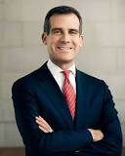
Los Angeles Statistics
Los Angeles’ Labor Force Participation Rate (LFPR) is 62.8%. ¹
70.6% of people without disabilities aged 18 to 64 in LA are employed. ²
36.7% of LA residents w/ disabilities (ages 18-64) have jobs. ²
There is a 33.9 point gap between the employment rates of PWDs and those without disabilities.
California ranks 34th in the country in terms of jobs for PWDs. ³
In total, there are 948,587 LA residents with disabilities. ²
Out of that number, there are 566,325 working age (18-64) people with disabilities living in Los Angeles. ⁴
31% of all LA residents with disabilities live in poverty.
Mayor Eric Garcetti (D)
California Labor Market Review-November 2016.
Census Bureau - 2015 American Community Survey
Best and Worst States for Workers with Disabilities
Census Bureau- 2015 ACS Disability and Employment Status
Notes:
http://respectabilityusa.com/Resources/RespectAbility%20California%20State%20Plan%20Comments%202016.pdf

Slide 13
Intersectionality,
Edu and Disability Stats
Six million students with diagnosed disabilities are enrolled in America’s public schools.
There are 1,107,606 African American/black students with disabilities enrolled in America’s public schools
Likewise, there are 1,531,699 Latino students with disabilities in our schools today.
Children with disabilities and students of color are disproportionately suspended and expelled, which can be a contributing factor to the school-to-prison pipeline. Many student of color and/or ESL learners do not get a needed disability diagnosis or get the wrong one.
Only 57 percent of black students with disabilities graduate high school compared to 76 percent of black students without disabilities.
Only 59 percent of Latino students with disabilities graduate high school, compared to 79 percent of Latino students without a disability.

Slide 14
LGBTQ INDIVIDUALS WITH DISABILITIES
Between 3 and 5 million Americans with disabilities identify as LGBTQ
Lesbian, gay and bisexual adults have a higher prevalence of disability than their heterosexual counterparts.
36 percent of lesbians and 36 percent of bisexual women self-identify as people with disabilities.
26 percent of gay men and 40 percent of bisexual men are people with disabilities.
Estimated size of LGBTQ population within the disability community:
953,000 bisexual women have disabilities
490,000 lesbian/gay women have disabilities
615,000 bisexual men have disabilities.
647,000 gay men have disabilities.
Source: NIH-Disability Among Lesbian, Gay, and Bisexual Adults: Disparities in Prevalence and Risk.

Slide 15
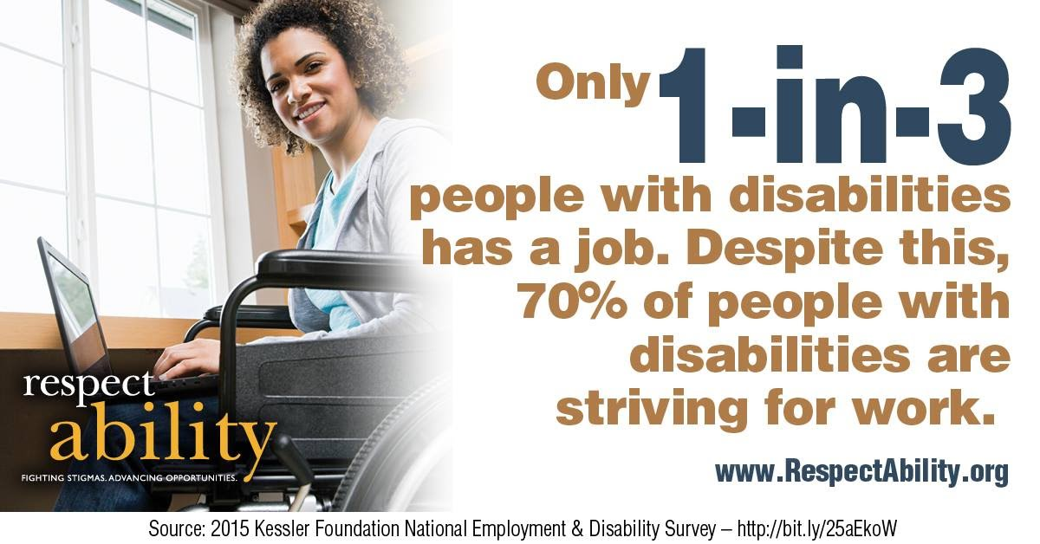
Lack of Employment Leads to Poverty

Slide 16
California Ranks 34th…
Table 1 – Top 10 States for Workers with Disabilities
State Ranking | State | Total # of PwDs (Aged 18-64) | # of PwDs Employed | Total # Jobs Gained + or Lost – | Percentage of PwDs Employed
1st | North Dakota | 43,089 | 23,286 | + 4,704 | 54%
2nd | South Dakota | 51,003 | 26,323 | – 96 | 51.5%
3rd | Minnesota | 302,274 | 145,080 | + 3,823 | 48%
4th | Alaska | 50,330 | 24,090 | + 4,139 | 47.9%
5th | Nebraska | 112,418 | 53,323 | + 3,838 | 47.4%
6th | Wyoming | 39,161 | 18,485 | – 3,023 | 47.2%
7th | Utah | 159,024 | 74,767 | + 3,582 | 47%
8th | Iowa | 175,367 | 80,416 | – 2,975 | 45.9%
9th | Kansas | 188,671 | 84,262 | + 5,130 | 44.7%
10th | Montana | 76,169 | 33,419 | + 4,459 | 43.9%
34th | CALIFORNIA | 2,023,714 | 701,791 | + 19,398 jobs | 34.7%

Slide 17

Failure to Complete High School
18
Notes:
Only 61% of young people with disabilities achieve a high school diploma, compared to 81% of people without disabilities - a 20 point gap.
Source: Public High School Four-Year-On-Time Graduation Rates and Event Dropout Rates - National Center for Education Statistics

Slide 18
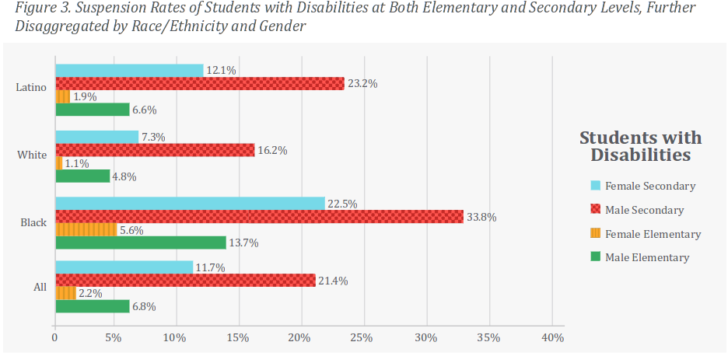
Intersectionality Example:
Minority Disability Suspension
Minority youth with disabilities are suspended at the highest rates of all.
19
Notes:
Source: https://civilrightsproject.ucla.edu/resources/projects/center-for-civil-rights-remedies/school-to-prison-folder/federal-reports/are-we-closing-the-school-discipline-gap/AreWeClosingTheSchoolDisciplineGap_FINAL221.pdf

Slide 19
Higher Education
Individuals with disabilities are largely underrepresented in higher education. Consider that:
  There are 1.2 million people with disabilities aged 16-20 in the U.S.
  Among people age 25 and older in 2014, only 16.4 percent of those with a disability had completed at least a bachelor’s degree. In contrast to this, 34.6 percent of people with no disability had completed at least a bachelor’s degree in the same year.
  In 2014, about one-in-five working-age (18-64) people with a disability have less than a high school diploma, compared to 1-in-10 people without a disability.
  Only half of college graduates with disabilities are employed, compared to the 89.9 percent employment rate for college graduates without disabilities.
Source: Bureau of Labor Statistics, U.S. Department of Labor, The Economics Daily, People with a disability less likely to have completed a bachelor's degree
20

Slide 20
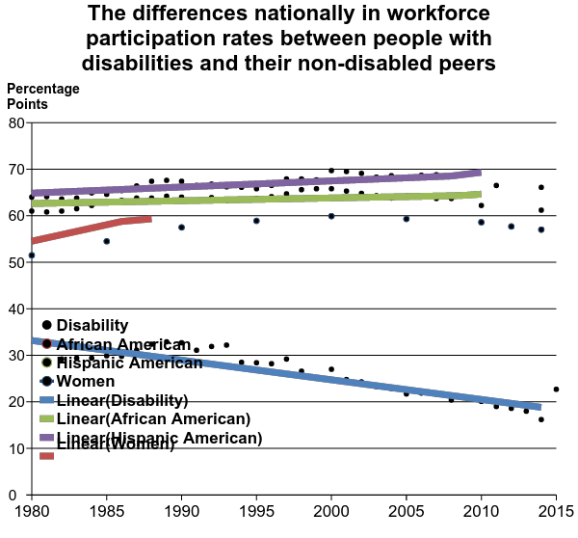
Labor Force Participation Rate
In recent years, while things have improved for African Americans, Hispanics and women, sadly the labor force participation rate (LFPR) for people with disabilities has decreased significantly.
27
Notes:
Source: Annual Disability Statistics Compendium, Table 2.22, U.S. Department of Labor, Bureau of Labor Statistics, Bureau of Labor Statistics
Labor force participation data points graphed, with trend lines illustrating that while there is an upward trend for women, African Americans and Hispanic Americans, the labor force participation rate has gone down for Americans with disabilities since the 1980s.

Slide 21
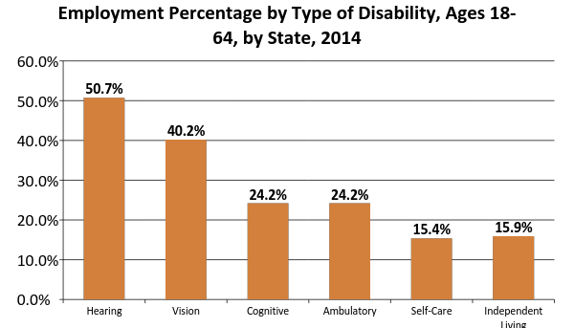
National Employment Rates by Disability
28
Notes:
Source: Annual Disability Statistics Compendium

Slide 22

Health and PWDs
  - “Adults with disabilities are 4 times more likely to report their health to be fair or poor than people with no disabilities (40.3% vs. 9.9%)”.¹
  - In LA, 42% of PWDs rated their health as fair or poor, compared to 16% of persons without a disability.³
  - Compared with the general California population, persons with I/DD are at higher risk of pedestrian accidents, falls, fires, and, especially, drowning.²
  - In LA, “PWDs reported three times as many unhealthy days as those without a disability” ³
Krahn GL, Walker DK, Correa-De-Araujo R. Persons with disabilities as an unrecognized health disparity population. Am J Public Health 2015;105
Strauss D1, Shavelle R, Anderson TW, Baumeister A. External causes of death among persons with developmental disability. Am J Epidemiol. 1998
Los Angeles County Department of Public Health, Adult Disability in Los Angeles County, LA Health; September 2006.

Slide 23
Disability Impacts Everyone
Disability impacts people of all races, genders, and backgrounds. However, youth with multiple minority status (i.e. person of color + disability) are most likely to enter the school-to-prison pipeline.

Slide 24
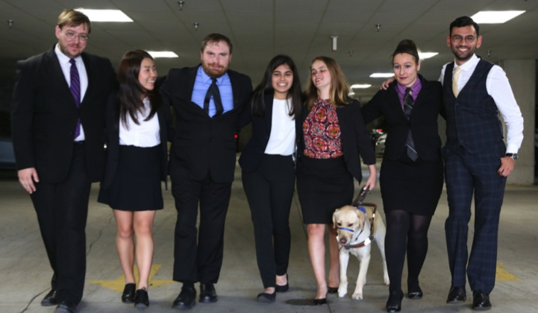
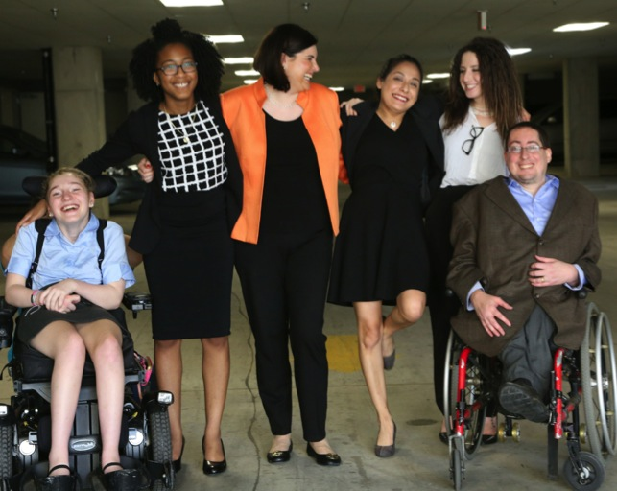
Fellowship: The Need For Authentic, Impactful Leaders
Goals:
Recruit and train talented leaders with disabilities
Enable these young leaders to gain skills and contacts they need to succeed in public policy, advocacy, nonprofits, journalism or communications roles
Empower them to further their careers so that they can work to enable millions of people with disabilities to have a better future.

Slide 25
IMPORTANT STEPS
MAKING HOLLYWOOD
MORE INCLUSIVE
41

Slide 26
Hollywood Toolkit –
Topic by Topic
Examples of Best Practices – Driving Inclusion through Compelling Story Telling
Terminology Tips – Using the Appropriate Lexicon
Common Acronyms
Disability Etiquette – Interacting with People with Disabilities

Slide 27
Examples of Best Practices
Not an ordinary reality show, Born This Way stars seven diverse young adults with Down syndrome as they move toward full independence and deal with issues around employment, independent living, education and romance. Born This Way has won 3 Emmy awards, including for being the best-unstructured reality show.
In scripted television, Speechless is a sitcom centered on a family that happens to include a son with cerebral palsy, J.J. The fact that J.J. is played by Micah Fowler, an actor with cerebral palsy, is important. Actors without disabilities play more than 95 percent of characters with disabilities on television.
Also in scripted television, NCIS: New Orleans features a character in a wheelchair, Patton Plame. Daryl “Chill” Mitchell, an African American actor who uses a wheelchair, plays Plame.
In children’s television, Sesame Street has been educating children since the early 1960s. The show recently introduced Julia, a puppet character who has autism. Sesame Workshop’s goal was simple – to create a better understanding of autism in children.
Also in children’s television, Pablo aims to educate society about autism spectrum disorder. Produced by Paper Owl Productions, Pablo voiced by a boy with autism but also many of the creators involved behind-the-scenes also have autism.

Slide 28
Terminology Tips: Using the Appropriate Lexicon
Disability language style guide: The National Center on Disability and Journalism (NCDJ) provides the industry’s only disability language style guide.
  http://ncdj.org/style-guide/
Use person-first language to keep the person first, not his or her disability. Language shapes perceptions, so a small word choice can make a big difference in communicating attitudes. Person-first language puts the person first instead of his or her disability. http://rtcil.org/products/media/guidelines#Person-First
If you are working with individuals with disabilities, ask them their preference. Some individuals with disabilities prefer identity-first (disabled person). Just as you may ask people for their gender pronoun preferences, you should ask people with disabilities you work with how they choose to be identified.
Think about other language that you use. What is considered acceptable language regarding disabilities has changed over time. Standards are changing as understanding evolves. Other terms are outdated medical or colloquial terms. Avoid terms like “wheelchair-bound” and “suffers from.” People with disabilities are not “victims.”
  http://ncdj.org/2015/09/terms-to-avoid-when-writing-about-disability/
People with disabilities should not be described as “inspirational” or “courageous” just because they have a disability.

Slide 29
Etiquette - Interacting With
People With Disabilities
People with disabilities are human. Acknowledge their differences as you would acknowledge anyone else’s uniqueness and treat them “as normal.”
Put the person first. Say “person with a disability” rather than “disabled person.”
Speak directly to a person with a disability, not to their companion or ASL interpreter.
Adults with disabilities are adults and deserve to be treated and spoken to as adults. Provide them with every option you provide those without disabilities.
If you are unsure of how you should interact with a person with a disability, just ask him or her. Just because someone has a disability, do not assume they need help.
A person’s mobility equipment, such as a wheelchair, scooter or cane, is part of his or her personal space. Do not touch or move it without permission, even if someone puts it down or chooses to leave it somewhere.
Listen attentively when you are talking with a person who has difficulty speaking. Be patient and wait for the person to finish, rather than correcting or speaking for the person
People who have psychiatric disabilities may have varying personalities and different ways of coping with their disability. Treat each person as an individual.
There are visible disabilities as well as invisible disabilities, meaning not all disabilities are apparent.
Please note it is considered offensive to pretend to have a disability, and disability simulation experiences should be done for design/navigational purposes only.
Learn more by reading the United Spinal Association’s Disability Etiquette booklet: https://unitedspinal.org/disability-etiquette/.

Slide 30
Key Terms: Disability
Disability can be physical (i.e. vision, hearing, mobility), cognitive, intellectual, mental, sensory, developmental, or some combination of these that substantially limits one or more major life activity.
The Americans with Disabilities Act of 1990 (ADA) prohibits discrimination and ensures equal opportunity for persons with disabilities in employment, State and local government services, public accommodations, commercial facilities, and transportation.
Accommodation is any change in the work environment or in the way things are done that enables an individual with a disability to enjoy equal access and treatment.
Ableism is discrimination in favor of able-bodied people; the belief that people who have disabilities are somehow less human, less valuable, and less capable than others.
10

Slide 31

Inclusion, Equity, Equality
& Disability
Looking through the lens of disability

Slide 32
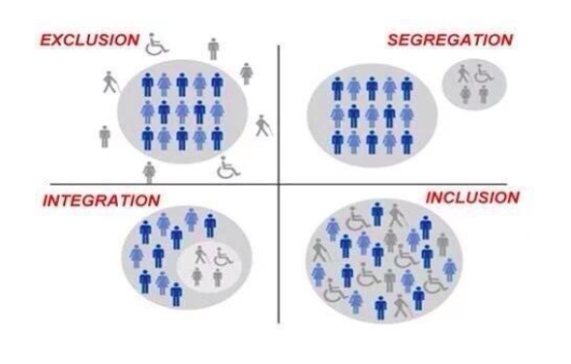
What Does Inclusion Look Like?
How to Raise Money for Great Causes!
42

Slide 33
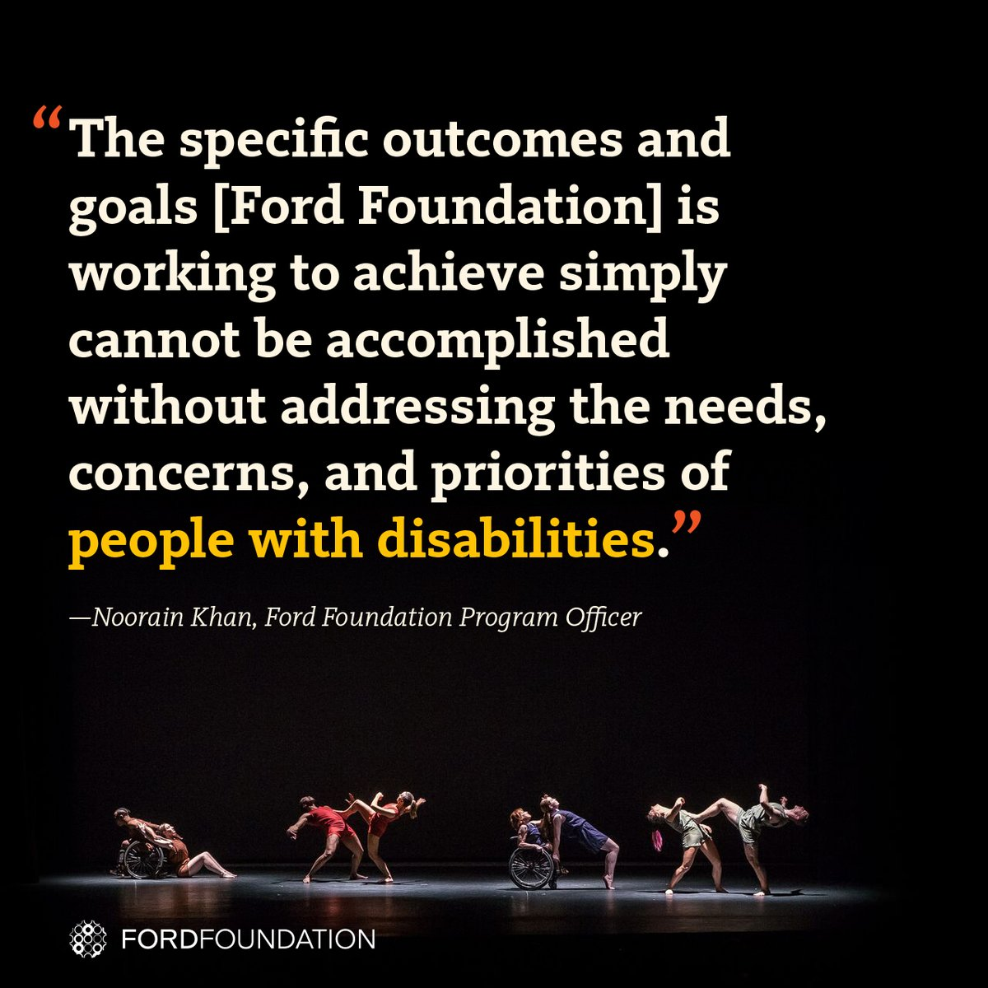
Ford Foundation offers model
The Ford Foundation has recently added the disability lens to their work http://bit.ly/2jOl3FL
Additionally, Ford’s CEO Darren Walker spoke extensively on why this impacts other funders as well: http://bit.ly/2nr4moJ
Here is Darren Walker’s original letter: http://bit.ly/2Bxy0Lk
This is the response of the co-authors of the Americans with Disabilities Act: http://bit.ly/2AueSyx
Watch the Darren Walker-Sen. Tom Harkin interview on YouTube: http://bit.ly/2zrgFpE
33

Slide 34
JP Morgan Chase initiative
Many non profits are NOT inclusive of PwDs. For example, their videos don’t have captions and events are held in buildings that are not accessible and more.
J.P. Morgan has funded and initiative to cover the direct disability accommodation costs for 10 10 major community development and civil rights conferences for people with disabilities: https://www.jpmorganchase.com/corporate/news/pr/new-conference-accessibility-initiative.htm
March 23, 2016 (Washington, D.C.) – JPMorgan Chase & Co. (NYSE: JPM), in collaboration with the World Institute on Disability (WID), today launches its Conference Accessibility Initiative. Through this initiative, 10 of the largest community development and civil rights conferences in the United States, including the NAACP, National Fair Housing Alliance, National Housing Conference, National Urban League and the Corporation for Economic Development, will for the first time, be fully inclusive of people with disabilities and enable them to both attend and fully participate in conference sessions.
“People with disabilities experience economic hardship at rates that exceed the national average. At JPMorgan Chase, we believe that the private sector has both a responsibility and role to play in helping address economic and social challenges. Through the Conference Accessibility Initiative, JPMorgan Chase is excited to create more inclusive advocacy and community development conversations and expand the way people think about diversity and inclusion.”- Naomi Camper, Head of the Office of Nonprofit Engagement, JPMorgan Chase

Slide 35

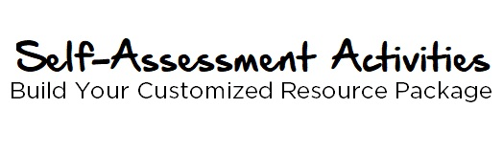
Toolkit from the Jewish
Federation of Greater Washington
The discussion is designed to increase awareness and attitudinal adjustments through exploration of accommodations that enable an organization to be fully inclusive.
shalomdc.org/inclusiondiscussion
These interactive online activities are categorized by area of focus. After you fill in the self-assessment portion, the system will generate a customized resource package to help you advance your inclusive efforts.
shalomdc.org/inclusionassessment
35

Slide 36
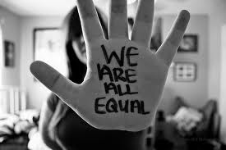
Leadership at the Top Needs
To Share Vision of Inclusion
The message that all people are of equal value and must be respected and heard fairly, must be communicated from top down.
Pictured: Words “We are all equal” handwritten on palm of hand
43

Slide 37
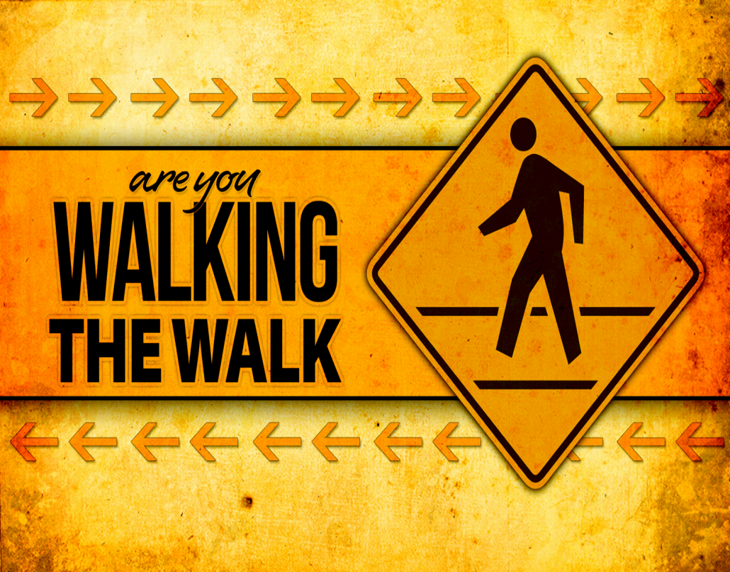
Walk The Walk
First impressions can be lasting
Have proper tools and aids to lead to success
Start with a specific and measurable goal
Use an inclusion committee to monitor the goal
44

Slide 38
Steps to Becoming More Inclusive
Decide that you want to be inclusive of people of disabilities in the same way that you are on other diversity measures.
Set a specific goal and timeline to achieve those goals.
Have a point person who is responsible for ensuring progress.
Establish an inclusion committee.
Request that grantees explore ways of becoming more inclusive of people from all backgrounds. (more detail in grantee section)
45

Slide 39
Steps Continued…
Show people with disabilities in all photos of your work in an inclusive way.
Ensure that people with disabilities are on panels and programs, especially those on poverty, healthcare and social justice.
Use vendors who are or who hire people with disabilities.
Invest in social enterprises that hire people with and without disabilities.
Ensure that all your events, and those of your grantees, are held in accessible locations and that accommodations (i.e. sign language) are provided when requested.
Ensure that the disability lens is put on all your program work. For example, the majority of people behind bars have disability issues, many school issues are due to failure to diagnose disability issues (especially for children of color).
46

Slide 40
Steps Continued…Part 2
Build a more inclusive environment by learning respectful language.
Include people with disabilities, who are experts in disability issues, on the board, senior staff and inclusion/diversity committees.
Put captions are on all videos, and ask grantees to do the same, so people with hearing impairments can access them.
Ensure screen reader accessibility so people with vision impairments can access your documents, social media and website. Ask grantees to do the same.
Recruit people with disabilities to be volunteers and care GIVERS (i.e. don’t see us through the lens of pity, see us through a lens of empowerment and people wanting to contribute).
Pro-actively reach out to enable people with disabilities to have access to the democratic process and to jobs.
47

Slide 41
PRACTICES AND POLICIES
INTERNAL FOCUS ON PRACTICES AND POLICIES
48

Slide 42
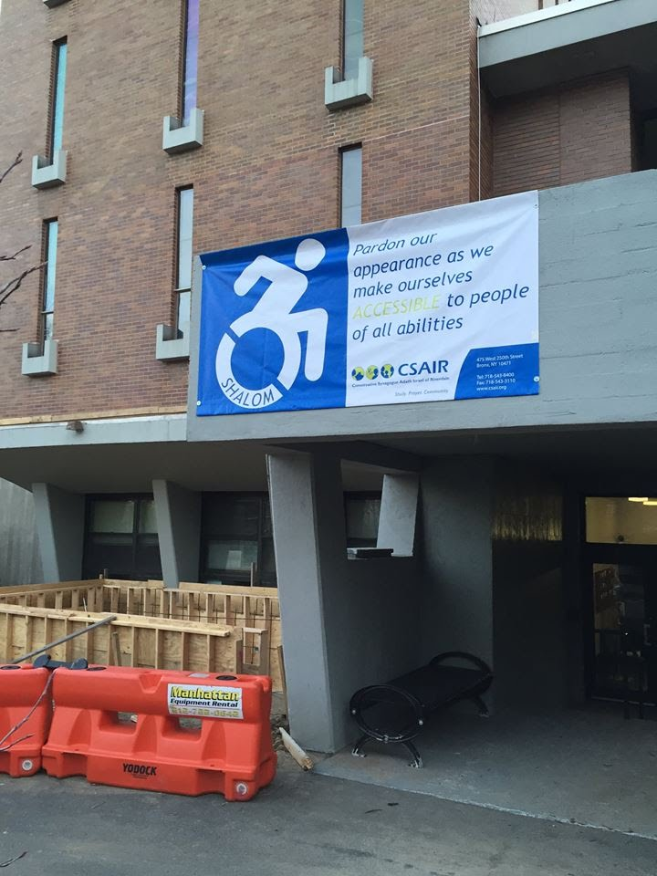

Physical and Web Accessibility
People with disabilities use the Internet so websites need to be set up for use by screen readers and people who need captions.
Perceive, understand, navigate, and interact
Encompasses all disabilities that affect Web access
See RespectAbility’s webinar on web accessibility.
49

Slide 43
Policies and Practices
Inclusion Coordinator (Central Address for accountability and implementation of this process)
Application forms need to have a place for people to request and accommodation
Mission Statement and Inclusion Policy should be on your website
Line on all program invites should Offer accommodations and note ADA accessibility
HR Evaluation and grant manager evaluation includes diversity as a performance metric.
How to Raise Money for Great Causes!
50

Slide 44

Programming
Remember: ATP- Ask the Person
Line on All Forms- ok to say you need notice
Checklist for Events
List of Volunteers or Staff for Meeting Key Needs
51

Slide 45
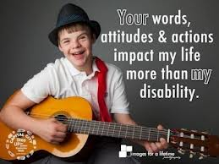
Best Practices
Everyone responds to language differently
Focus on being respectful and polite
Start out communication by introducing yourself as you would in any other situation
Adapt communication as necessary or requested
Pictured: Teenage boy with guitar, words on picture “your words, attitudes & actions impact my life more than my disability.”
52

Slide 46


Person First Language
Please say
Previously you may have said
  Person with a disability
  Person who has/had a stroke/Polio/MS
  Person who uses a wheelchair
  Person who is blind/person with a visual impairment
  Person who is deaf/person with a hearing impairment
  Person with a mental illness
  Handicapped/Disabled Crippled
  Stroke/MS/Polio VICTIM
  Wheelchair bound/confined
  Blind person
  The deaf, deaf and dumb, suffers a hearing loss
  Crazy, psycho, lunatic
53

Slide 47
Language Matters
People First Language
In all that you do, remember to respect individuals with disabilities as people, not projects or people to pity. This starts with the language that we use, in this case “people first language.” Respect human beings and their right to be appreciated for the strengths they have, and not be defined by their disabilities. For example, a person who uses a wheelchair is a person first, and their wheelchair is a tool. They are not “wheelchair bound.” We are “people with disabilities” (PwDs), not “handicapped” or “the disabled.
54

Slide 48
Potential Accommodation Language
The following examples support the Americans with Disabilities Act (ADA) and are provided by the Great Lakes ADA Center. These statements may be used to communicate that you are an inclusive organization and invite individuals to let you know about their need for special accommodations. The regulations implementing the ADA do not require specific language to be used in notifying the public. The obligation under the ADA is for entities covered to provide appropriate auxiliary aids and services in order to allow for individuals with disabilities to participate in the programs, activities or services.
Individuals needing accommodations to participate in the meeting should contact ______________ at 222-222-222, no later than _____________. (name) (deadline if appropriate)
Accommodation requests should be directed to __________ at 222-222-222 no later than _____________. (name) (deadline if appropriate)
Direct requests for accommodations to _________at 222-222-2222, no later than ______________. (name) (deadline if appropriate)
Requests for sign language interpreter or materials in alternative format should be made no later than ______________ to ___________ at 222-222-2222. (deadline if appropriate)(name)
Individuals with disabilities requiring additional services to participate in the meeting should call 222-222-2222 by _________________. (deadline if appropriate)
Additional language may be added to state that requests for accommodations made after the advertised date will be honored to the maximum extent feasible.
55

Slide 49
Example Non-Discrimination Language
This foundation provides equal employment opportunities (EEO) to all employees and applicants for employment without regard to race, color, religion, sex, national origin, age, disability or genetics. In addition to federal law requirements, this synagogue complies with applicable state and local laws governing nondiscrimination in employment. This policy applies to all terms and conditions of employment, including recruiting, hiring, placement, promotion, termination, layoff, recall, transfer, leaves of absence, compensation and training. This foundation expressly prohibits any form of workplace harassment based on race, color, religion, gender, sexual orientation, gender identity or expression, national origin, age, genetic information, disability, or veteran status.
56

Slide 50
Example Event Checklist
Invitation/Notification of Event
Does the invitation clearly indicate that people with all abilities are welcome?
Do appropriate icons appear e.g., physical access, sign language interpreter available etc.?
Is the writing clear, in an easily legible font and size?
Is the information embedded in an email as well as an attachment?
Do the visual images depict inclusion, e.g., people with special needs?
Have you included a contact name and number for inquiries regarding special accommodations?
Is notification of the event on the website as well as in hard copy?
57

Slide 51
Example Event Checklist Continued…
Facilities
Is the facility accessible – for wheelchairs, walkers, scooters?
Are the bathrooms accessible? Are there designated information/ rest areas available?
Is there handicapped parking?
If transportation is being provided, is it accessible?
Is the lighting appropriate for people with visual impairments?
Communication
Will there be a sign language interpreter?
If there are videos, will there be subtitles?
Will there be assistive listening devices?
Have you made sure that signers, etc. will be visible to those in wheelchairs?
Is the website where the event is posted accessible?
Is the event available as a webcast?
Staff/Volunteers
Have you arranged for volunteers?
Have they received orientation/sensitization and training to respond to inquiries?
58

Slide 52
Hiring and Intentional Diversity
In our focus groups of foundation professionals, representatives of foundations that were successful in becoming more diverse noted that they made a conscious decision and effort to seek out and include certain demographic groups whether that was gender, race, or sexual orientation.
That is consistent with previous research that the U.S. Department of Labor commissioned from the Wharton School of Business. It found that for profit companies who have gender or race diversity policies and acquisition strategies are the best targets to becoming inclusive of people with disabilities.
“People with disabilities just don’t apply.”
“I do a lot of interviewing. But I don’t think I’ve ever seen or interviewed a person with a disability. I have not, in my 14 years, seen a candidate who would fit. People just don’t apply. We don’t go out and look for them. I would say there are other groups that we are actively looking for – women and people of color.” -- Foundation professional, focus group participant
59

Slide 53
Partner with Hiring Resources
Being a truly inclusive employer of people with disabilities will not happen by accident, it must be an INTENTIONAL decision and process.
Use established resources to increase the qualified candidates with disabilities in your hiring pool:
  TAPAbility, which can source talent
  AskJan.org, which can problem solve inclusive employment questions for free.
60

Slide 54
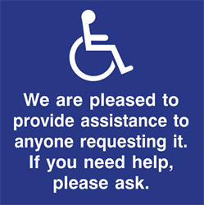
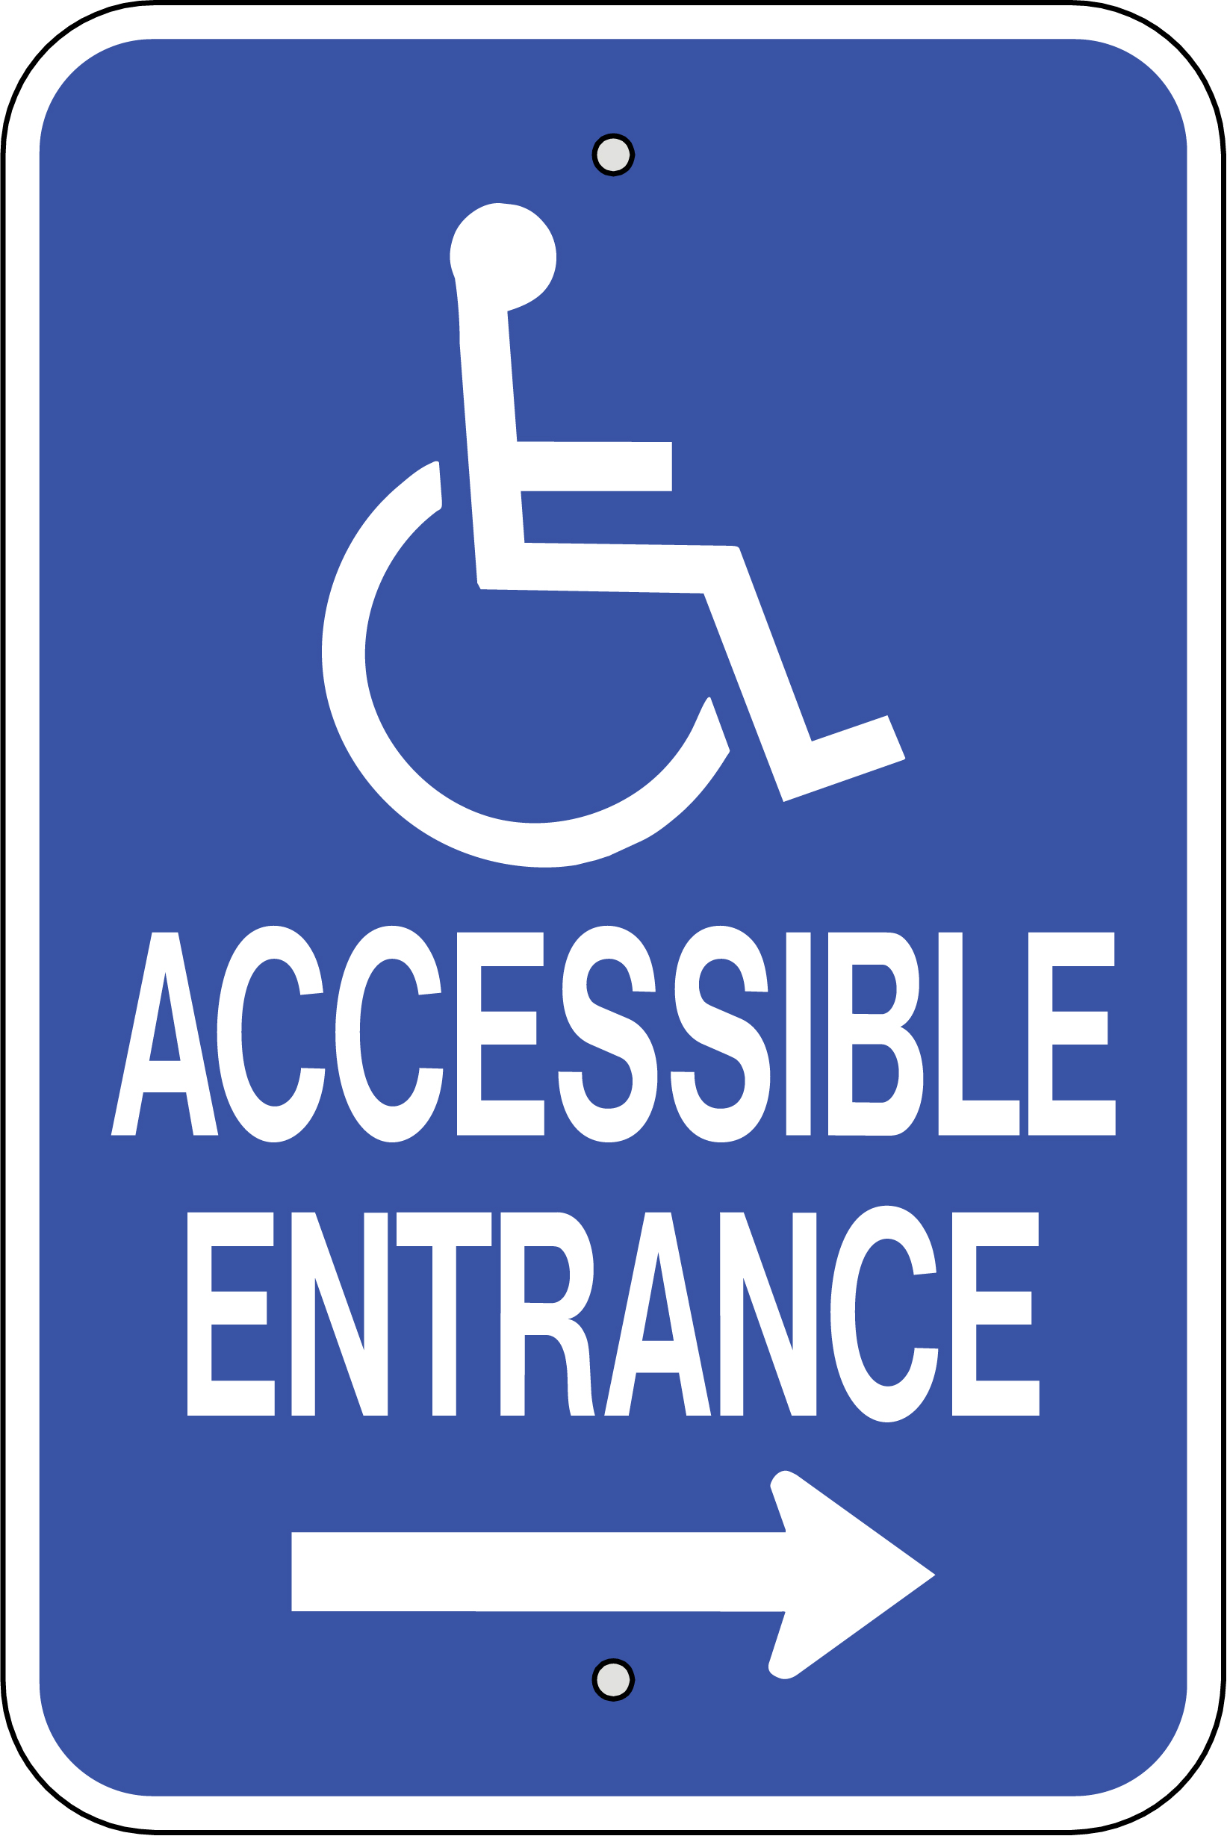




Signage
Signs can help demonstrate that the foundation is being inclusive of people with disabilities.
These clear signs can provide information about important locations, such as restrooms, a quiet room, water fountains, emergency exits, plus any accommodations specifically for people with disabilities.
61

Slide 55

ADA Accessible Resource Guide
  The Chicago Community Trust
http://www.cct.org/wp-content/uploads/2015/08/2015ADAComplianceGuide.pdf
62

Slide 56
Questions…
Has someone who uses a wheelchair personally checked the physical accessibility of your offices and programs for people who use wheelchairs?
Has a person who is blind and who uses adaptive computer technology checked your website and facilities for accessibility?
Do the videos you use have captions? Do you have a way to communicate with people who are deaf or use other adaptive supports?
Do you employ individuals who have disabilities? If so, what are their jobs? Do they receive the same compensation and benefits as other employees?
How do you educate your staff, board of directors, trustees and other key people about serving and partnering with people with disabilities?
Has your organization considered how the language it uses may affect its ability to include and mobilize those people with disabilities whose values it shares?
Once your organization has decided that inclusion is important, how will you know that you have achieved it?
67

Slide 57
What you can do:
Read the toolkit yourself and learn how to advocate for, and include, people with a variety of disabilities
Share the toolkit with everyone you know in the entertainment industry and beyond
Speak with Lauren Appelbaum about your new ideas
Volunteer to work with Debbie Fink, our new director of Community Outreach and Impact
SPREAD THE WORD! Write and publish opeds, push out social and traditional media on these issues and more!
Note: This past year there was a 4X improvement in the number of new jobs for people with disabilities. That’s 343,000 jobs! Together, we can do it!
45

Slide 58
RESPECTABILITY’S MISSION
RespectAbility’s mission is to fight stigma and advance opportunities so that people with disabilities can fully participate in all aspects of community. We are unique in our national focus on enabling people with disabilities to get the education, skills, and opportunities they need to achieve competitive, integrated employment and independence.
RespectAbility is a nonprofit, nonpartisan organization that understands we are a stronger community when we live up to our values – when we are welcoming, diverse, moral and respect one another.
We work with entertainment, policy makers, educators, self-advocates, nonprofits, employers, faith-based organizations, philanthropists, journalists and online media to fight stigmas and advance opportunities for people with disabilities.
Led by people with disabilities and those who love them, we know that people with disabilities and their families have the same hopes and dreams as everyone else, even if they face different challenges.

Slide 59
CONTACT INFORMATION
RespectAbility
11333 Woodglen Drive #102
Rockville MD 20852
Jennifer Laszlo Mizrahi, President
JenniferM@RespectAbility.org
Ben Spangenberg, Manager, National Leadership Program, BenS@RespectAbility.org
www.RespectAbility.org

