Slide 1
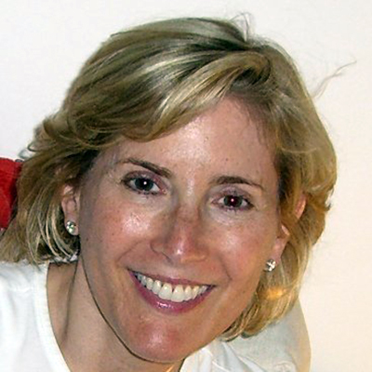
STARTING WITH “YES!”
Tips for Making Your Faith Institution More Inclusive of People with Disabilities
Shelley Richman Cohen

Slide 2
A Practical Guide to enhanced inclusion
Shelley Richman Cohen
February 27, 2018
Notes:
_______________________________________________________________________________________________________________________________________________________________________________________________________________________________________________________________________________________________________________________________________________________________________________________________________________________________________________________________________________________________________________________________________________________________________________________________________________________________________________________________________________________________________________________________________________________________________________________

Slide 3
18.6%
Notes:
_______________________________________________________________________________________________________________________________________________________________________________________________________________________________________________________________________________________________________________________________________________________________________________________________________________________________________________________________________________________________________________________________________________________________________________________________________________________________________________________________________________________________________________________________________________________________________________________

Slide 4
Inclusion of people with disabilities
A Religious Obligation
not
an Act of Kindness
A proactive process

Slide 5
Bridge the gap between ideal and real
$$ is not an excuse

Slide 6
Inclusion involves….
Empathy
Action
Accountability

Slide 7
Barriers
Architectural
Attitudinal
Communication

Slide 8
Ask Questions
How can I help you?
What do you need?
How can we make this happen?
What are the next steps?

Slide 9
Be a good listener. Validate. Be compassionate.
Approach things as a problem solver
Brainstorm, partner to find solutions with staff members, professionals in and out of congregation
Create infrastructure through programming
Be creative
The Power of Google

Slide 10
Architectural Barriers
Short and long term capital fundraising goals
Purchase/build temporary ramps
Re-purpose room usage
Signage
Communicate plans to involve entire community

Slide 11
Attitudinal and Awareness Barriers
Staff training
Lay leadership training
Mission Statement
Sermons
Website
Weekly Newsletter
Social Media

Slide 12
Practices and Policies
Disability Etiquette
Inclusion Committee
Inclusion Coordinator
Inclusion Policy
Buddy Systems (for both PwDs and families)
Support Groups

Slide 13
Inclusive Synagogue Infrastructure

Slide 14
Inclusion Programming
Shabbat Morning Groups
Sensory Calming Room
Adaptive Holiday programming
Bar/Bat Mitzvah programming

Slide 15
Synagogues can be a portal to better living for People with Disabilities

Slide 16
“You don’t have to be great to start, but you do have to start to be great!”

Slide 17
KEEP IN TOUCH WITH US
Shelley Richman Cohen
Founder and Director, The Jewish Inclusion Project
shelco123@gmail.com
Jennifer Laszlo Mizrahi, RespectAbility President
JenniferM@RespectAbility.org
Cell: 202-365-0787
11333 Woodglen Drive #102, Rockville MD 20852
www.RespectAbility.org

