Slide 1

RespectAbility
RespectAbility WIOA Breakfast
Friday, November 3rd, 2017
Calvin Harris, Chairman, RespectAbility
Jennifer Laszlo Mizrahi, President, RespectAbility
Philip Kahn-Pauli, Policy Director, RespectAbility
www.RespectAbility.org

Slide 2
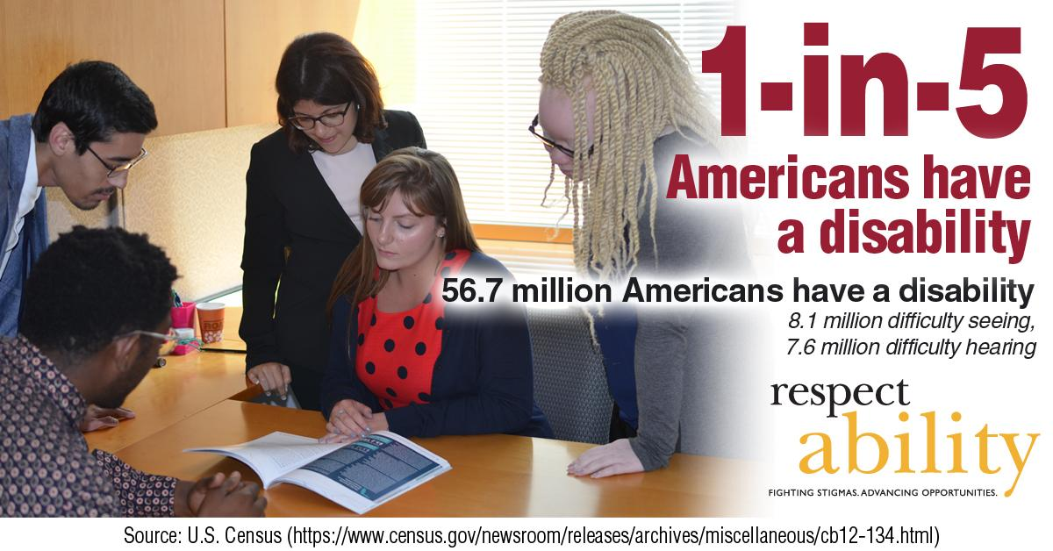
1 in 5 Americans

Slide 3

51 percent of Americans

Slide 4
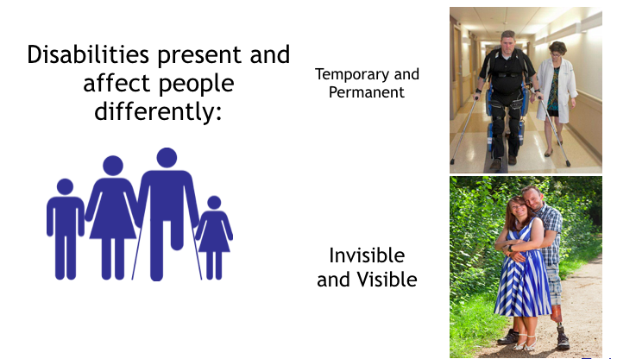
Not All Disabilities Can Be Seen

Slide 5







Role Models with Disabilities
Derrick Coleman: Deaf
Stephen Hawking: ALS
Peter Orfalea: ADD/ADHD & Dyslexia
Ludwig van Beethoven: Deaf
Harriet Tubman: Seizures
Albert Einstein:
Asperger Syndrome
Richard Branson: Dyslexia

Slide 6
New York City Stats
  NYC’s Labor Force Participation Rate (LFPR) is 60.2%. ¹
  70.4% of people without disabilities aged 18 to 64 in New York City are employed. ²
  32.3% of NYC residents w/ disabilities (ages 18-64) have jobs. ²
  There is a 38.1 point gap between the employment rates of PWDs and those without disabilities. “The employment gap is greater in NYC than it is at the State or national level.” ³
  New York ranks 37th in the country in terms of jobs for PWDs. ⁴
  In total, there are 948,208 NYC residents with disabilities. ⁵
  Out of that number, there are 460,425 working age (18-64) people with disabilities living in New York City. ⁵
  31% of all NYC residents with disabilities live in poverty.⁵
    39.3% (116,313) of Hispanics with disabilities in NYC live in poverty.
    34.5% (84,066) of African Americans with disabilities in NYC live in poverty.
    28.9% ( 24,868) of Asians with disabilities in NYC live in poverty.
Mayor Bill de Blasio
(D)
NYC Comptroller-2016-The State of the City’s Economy and Finances
Census Bureau - 2015 American Community Survey
CID-NY ADA at 26 in New York City
Annual Disability Statistics Compendium
MOPD-NYC PWDs Statistics Updated 2016
Notes:
http://www.nyc.gov/html/mopd/downloads/pdf/ACCESS_NYC_updated.pdf
http://respectabilityusa.com/Resources/RespectAbiltiy%20NY%20WIOA%20State%20Plan%20Comments.pdf

Slide 7
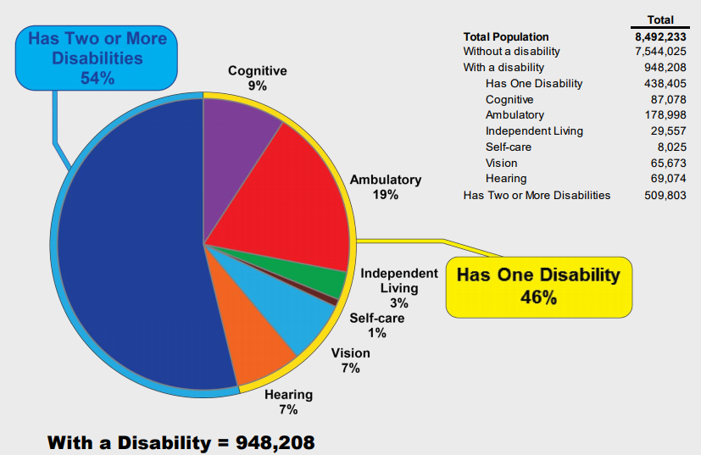
Population by Disability Type
New York City, 2014
Sources: U.S. Census Bureau, 2014 American Community Survey-Public Use Microdata Sample Population Division-New York City Department of City Planning / MOPD NYC People with Disabilities Statistics Updated 2016

Slide 8
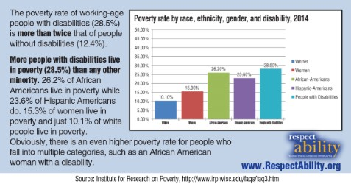
People with Disabilities are the Poorest of the Poor
Notes:
Sources: EPI Chart, Annual Disability Statistics Compendium, Disability Statistics, by Cornell University, U.S. Census Data

Slide 9

New York City Women
In total, there are 251,089 working-age women with disabilities living in New York City.¹
In total, there are 111,236 women living in New York City aged 21-64 with a disability who have an income below the poverty level.²
1 U.S. Census Bureau, 2016 American Community Survey 1-Year Estimates
2 U.S. Census Bureau, 2005-2007 American Community Survey

Slide 10

Intersectionality in
New York City Women
  In total, there are 96,478 working-age African American women with disabilities living in NYC.
  Only 28,806 or 29% of working-age African American women with disabilities living in NYC have jobs.
  There are 113,604 working-age Latina women with disabilities living in NYC.
  27,879 or only 24% working-age Latina women with disabilities have jobs in NYC.
Source:1 U.S. Census Bureau, 2016 American Community Survey 1-Year Estimates

Slide 11

High School Graduation Rates in NYC
NYC has an overall high school graduation rate of 70.5%
NYC students with disabilities have an high school graduation rate of only 44.8%
Out of the 74,172 students in the class of 2016 in NYC, 12,938 were students with disabilities.
439 NYC students with disabilities left high school with only an IEP Diploma (not equivalent to a GED or HS diploma).
In total, 5,800 students with disabilities graduated NYC high schools in the class of 2016. (Out of 53,848 graduates overall)
NYC Special Ed. Enrollment by Ethnicity:
295 Native American students with disabilities
1,637 Asian Americans students with disabilities
9,189 Latino/Latina students with disabilities
8,719 African American students with disabilities
3,080 White students with disabilities
From The New York Times: “…white students remained far more likely to receive a diploma than black or Hispanic students. And high school graduation remained out of reach for many students with disabilities.”

Slide 12

Vast Majority Outside the Workforce
Notes:
"70 percent of the 21 million working-age people with disabilities are outside of the workforce. For people without disabilities, this is less than 22 percent."
Source: Bureau of Labor Statistics

Slide 13
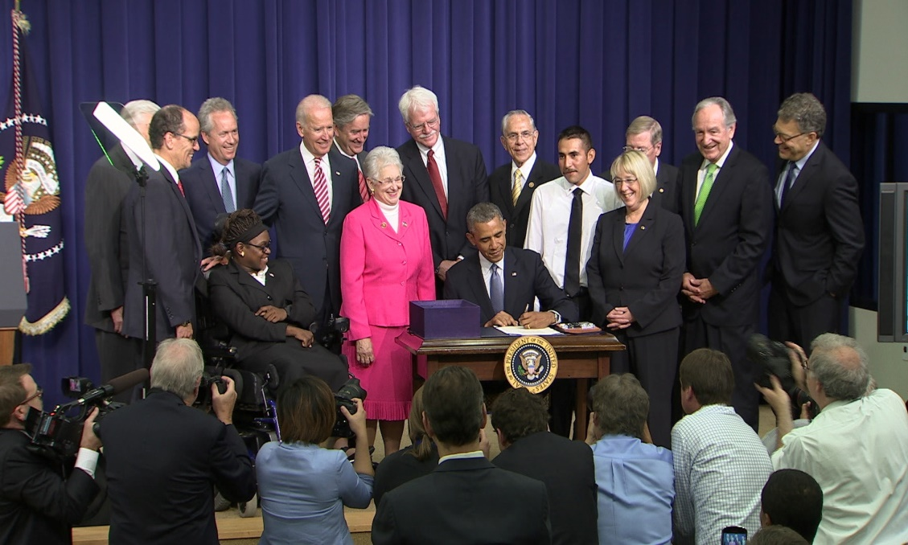
That is where WIOA comes in…
Think about the main goals of the Workforce Innovation and Opportunity Act (WIOA):
1 Increase access to education, training, and employment--particularly for people with barriers to employment.
2 Create a comprehensive, high-quality workforce development system.
3 Improve the quality and labor market relevance of workforce efforts.
4 Promote improvement in the structure and delivery of services.
5 Increase the prosperity of workers and
employers.
6 Reduce dependency, increase self-sufficiency, meet employer needs, and enhance the productivity and competitiveness of the nation.
What are the disability
dimensions of each of those goals?

Slide 14
Discussion Time:
How has WIOA changed your work? Your organization? Your client base?
What has been WIOA’s most positive impact in New York City?
Where are there areas for improvement?
Has WIOA’s requirements around people with disability impacted your organization?
What have you done around Section 188? Programmatic Accessibility? Physical Accessibility?

Slide 15


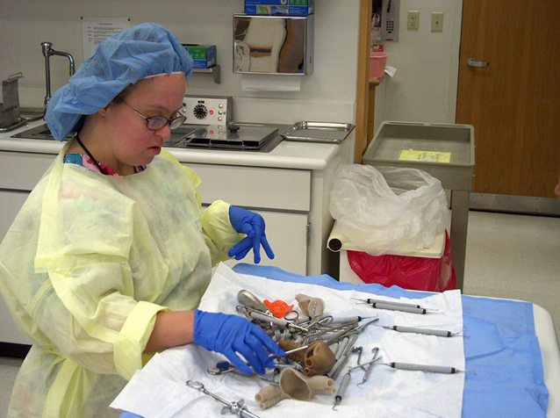
People with Disabilities can Succeed in Healthcare Jobs
  Workers with disabilities help hospitals help
  Best Practices Webinar on Project SEARCH and Healthcare Jobs for PWDs
  Young people with disabilities help senior citizens– Example of Project SEARCH in New York

Slide 16

Jobs in Government
❖ On Jan. 3, 2017, the EEOC issued a final rule about employment opportunities for PWDs in the fed government.
❖ Each federal agency has been directed to set a goal of having 12% of its workforce be people with disabilities, and 2% of its workforce be people with targeted disabilities.
❖ For more information, please visit EEOC’s website.
❖ State gov can also serve as a model employer of PWDs.
❖Learn from Delaware’s effort to hire talented employees with disabilities.

Slide 17


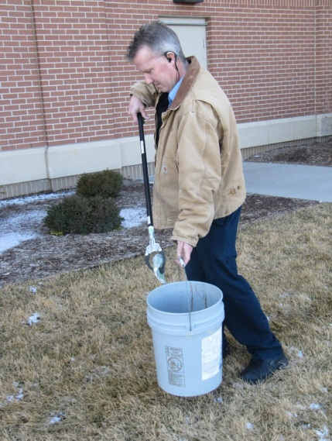
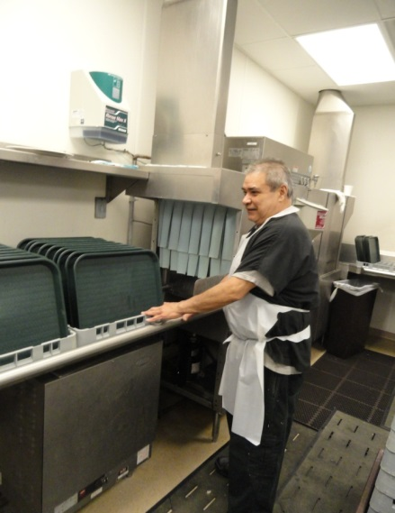
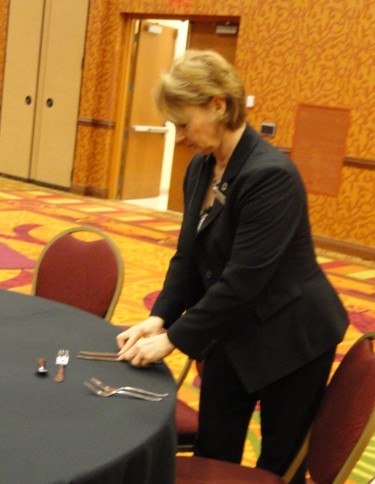
People with Disabilities and the Hospitality Industry
  NYC employs more than 340,000 people in this sector.
  Best Practices Webinar- Hospitality Sector for PWDs.
  From the NYC Workforce Board’s 2016 Regional Plan: “Sizable labor shortage of qualified talent...and very high turnover.”
  People with disabilities are known to be loyal employees. In an industry with such high turnovers, hiring people with disabilities can benefit the bottom line.
Guest Services
Housekeeping
Engineering
Culinary
Banquets

Slide 18
Sector Strategies – Gov’t Contractors
Top contractors include:
  Brookhaven Science Association
  Truth North Communications
  Leidos Holdings, Inc.
  Continental Sciences Group
  Bank of New York
For complete list go to: https://www.usaspending.gov/Pages/TextView .aspx?data=StateMostFundedRecipientsByAwardType&AwardType=C&statecode=NY&fiscalyear=2017
Complete federal lists of 2006-2013 → Federal Procurement Data System

Slide 19
Jobs in Entertainment / Culture
  NY State Dept of Labor Report on Motion Picture Industry
    The motion picture industry in New York City has always played a visible role in the city’s culture.
    In 2013, California had the most film jobs (138,000) of any state. New York State ranked second, with slightly less than 56,000.
    Over the last ten years, New York State’s share of U.S. motion picture jobs has risen dramatically...
    However, fewer than one percent of people employed by cultural institutions in New York City are PwDs.
  Combating stigma against PWDs needs to include engagement with showrunners / producers / actors.
  See the example and success of Born this Way.

Slide 20

People with Disabilities CAN Succeed

Slide 21

One Common Goal: Employment
High School Transition that Works: Lessons Learned from Project SEARCH By Maryellen Daston, Erin Riehle, and Susie Rutkowski
Paul H. Brookes Publishing Co.,
For more information go to:http://projectsearch.us/
Notes:
Need Erin’s Headshot

Slide 22

MOPD NYC: ATWORK
The Mayor’s Office for People with Disabilities is proud to announce NYC: ATWORK, a public-private partnership to provide unemployed or underemployed New Yorkers with disabilities access to jobs, and build a sustainable pipeline of qualified talent in high-growth industries.
NYC: ATWORK is funded by the the Poses Family Foundation, Kessler Foundation, Institute for Career Development, and New York State Adult Career and Continuing Education Services-Vocational Rehabilitation (ACCES-VR).
The program will be grant-funded for three years before transitioning in-house at the NYC Department of Small Business Services.
  NYC: ATWORK Video Series

Slide 23

NYC Leadership - Accessible NYC
Download the PDF

Slide 24

Resources on Learning Disabilities
Parents want the best for their children. We do, too. For the first time ever, 15 nonprofit organizations have joined forces to support parents of the one in five children with learning and attention issues throughout their journey.
With the right support, parents can help children unlock their strengths and reach their full potential. With state-of-the-art technology, personalized resources, free daily access to experts, a secure online community, practical tips and more, Understood aims to be that support.
https://www.understood.org/en

Slide 25
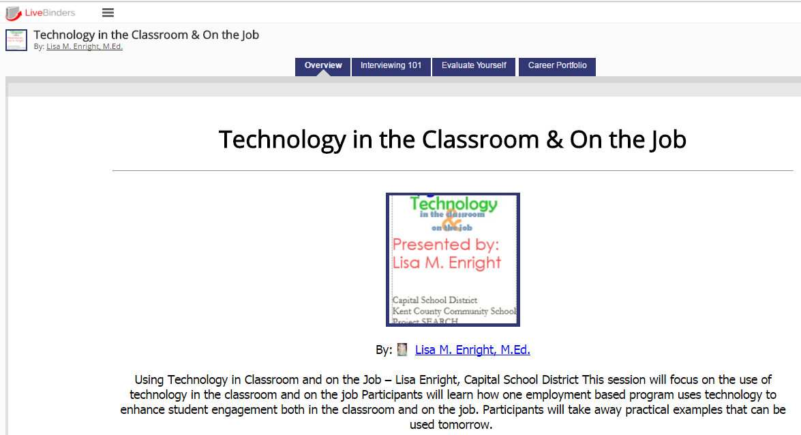
Putting Free Resources to Work
Livebinder resource:
http://bit.ly/DesignDeliver

Slide 26
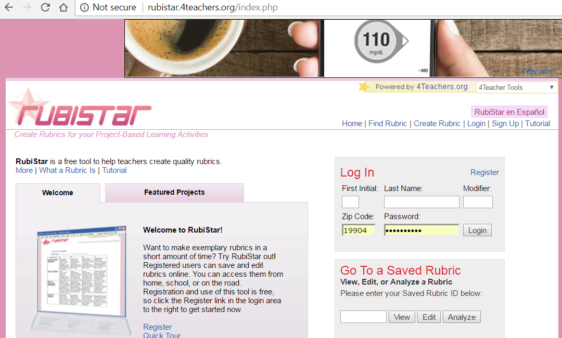
Rubistar: http://rubistar.4teachers.org/index.php

Slide 27
LiveBinders: Organize online content or upload your own to bring the traditional static binder of information to life!
  Create an account and get started: http://www.livebinders.com/
YouTube: Find videos that provide helpful information or upload your own!
  Use your Google account for best results: https://www.youtube.com/
RubiStar: Create rubrics quickly and easily! You can also evaluate individual or class data on the site.
  Create an account and get started: http://rubistar.4teachers.org/index.php
Google Docs: Create, edit, collaborate and share documents with ease.
  Create or use your Google account: http://www.google.com
Google Drive: Store files, videos, pictures, and documents for easy access and sharing with your team! (Think sharing career portfolios of clients with VR, job developers and job coaches.)
  Create or use your Google account: http://www.google.com
Bitly: Shorten and customize lengthy website URLs.
  Use your Twitter or Facebook account or create an account with your email: https://app.bitly.com/bitlinks

Slide 28
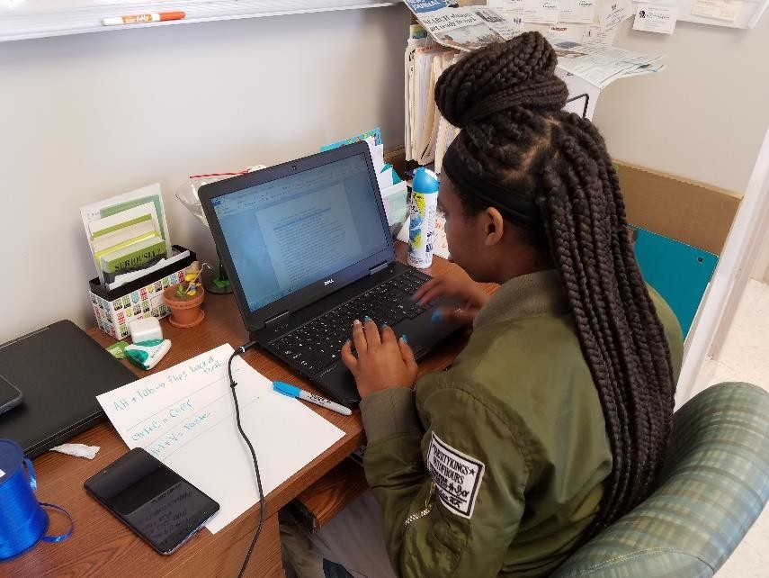
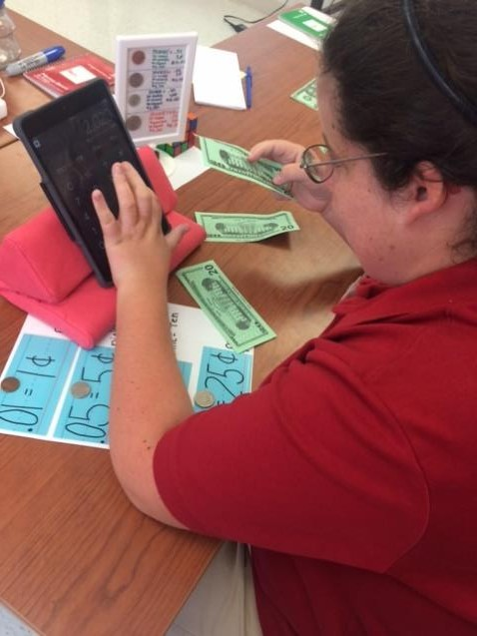
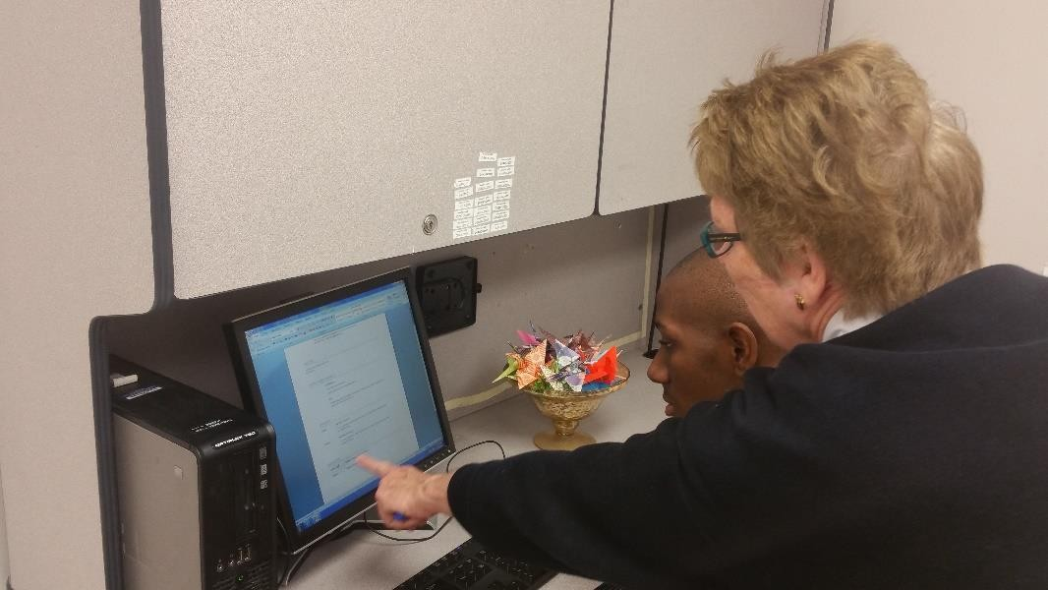
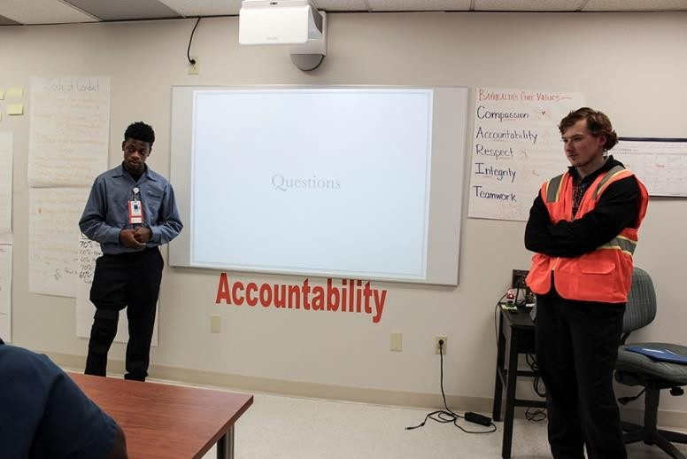
Utilizing Technology in the Classroom
Ashley uses an iPad to calculate money in preparation for banking at Del-One. She uses the Checkbook App to record deposits and withdraws. She uses the Del-One online banking app to reconcile her account on a monthly basis.
Dejah utilizes a laptop to complete a task. She alternated between two programs, copying text from Microsoft Word and pasting the data into a spreadsheet in Microsoft Excel.
Wayne and Daniel created a Prezi presentation on the iPad. They connected the iPad to the SMART Board and presented their presentation to Senator Carper.
Maliek utilizes a desktop computer and Microsoft Word to create, edit, and print his resume. Next he will upload the completed document to Google Drive, place it in his Career Portfolio, and share that folder with instructors, job coaches, job developers, and VR.

Slide 29
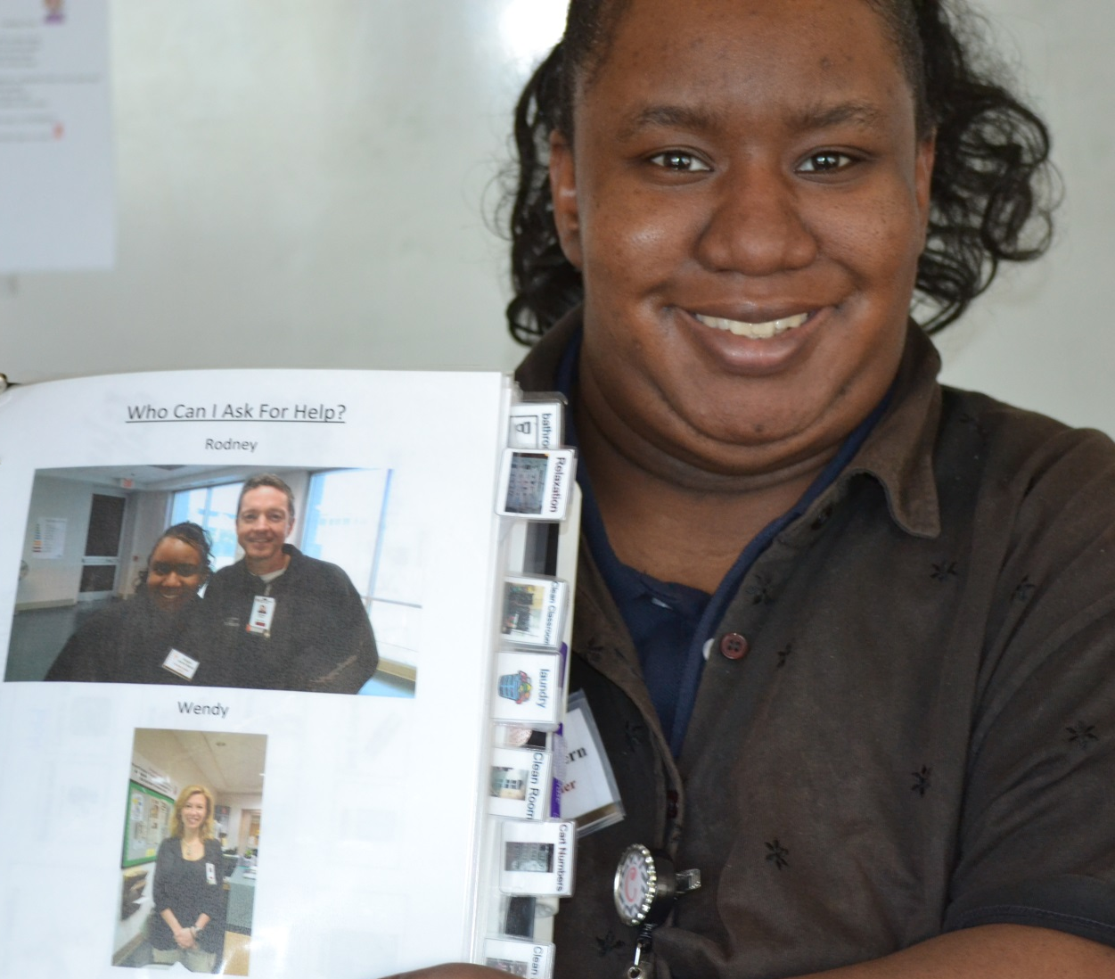
Accommodations & Supports

Slide 30
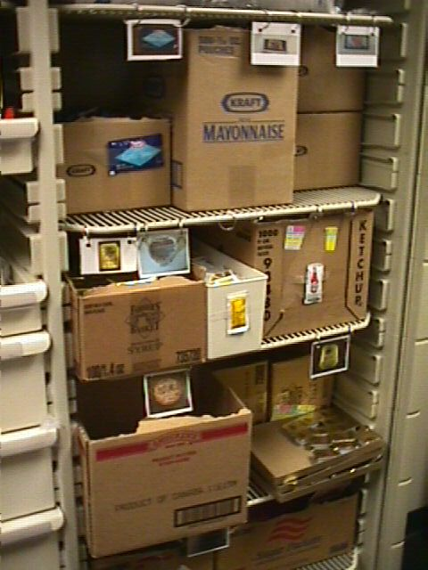

Use Pictures instead of Words

Slide 31
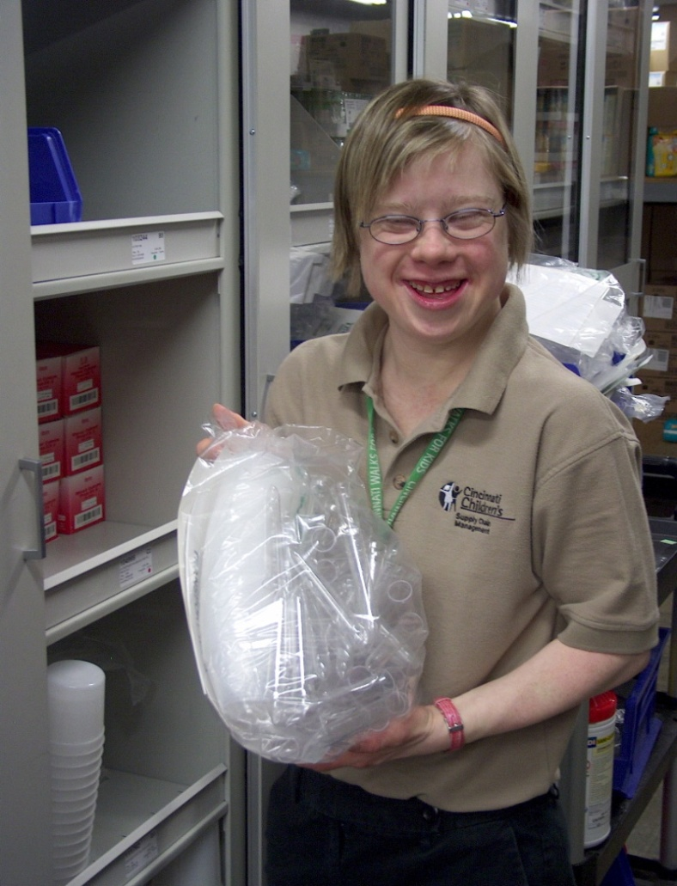
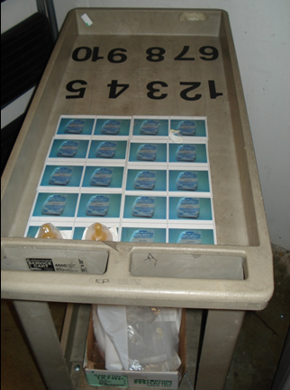
      Counting Cart to establish accuracy and efficiency!

Slide 32
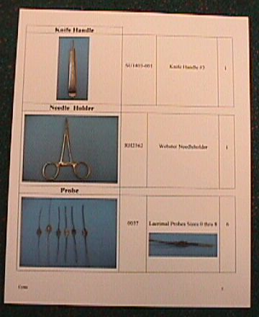
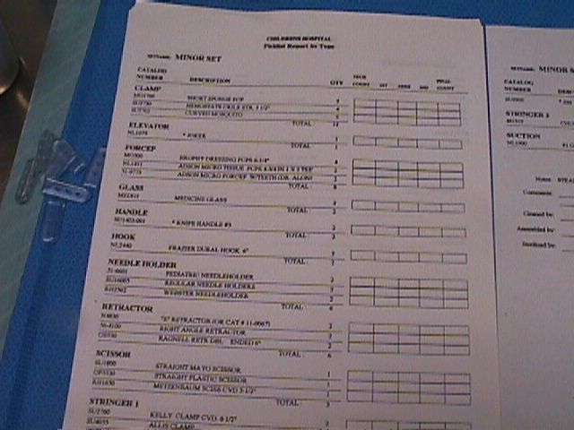
Inclusive Training Resources to Promote Skills
Before = A Pick List
After

Slide 33

Office of Disability
Employment Policy (ODEP)
The Office of Disability Employment Policy (ODEP) is the only non-regulatory federal agency that promotes policies and coordinates with employers and all levels of government to increase workplace success for people with disabilities.
https://www.dol.gov/odep/

Slide 34

ODEP Workforce Resources: LEAD Center
National Center on Leadership for the Employment and Economic Advancement of People with Disabilities
(LEAD Center).
The LEAD Center is a collaborative of disability, workforce and economic empowerment organizations led by National Disability Institute.
The LEAD Center is dedicated to advancing sustainable individual and systems-level change to improve competitive, integrated employment and economic self-sufficiency for adults across the spectrum of disabilities.
The LEAD Center's work focuses on three core leadership areas: policy, employment and economic advancement.
Other resources:
  Employment First Website
  LEAD On! quarterly newsletter.

Slide 35

ODEP Youth Resources: NCWD
National Collaborative on Workforce and Disability for Youth (NCWD/Youth) is a partnership to promote success for youth with disabilities entering the world of work.
The NCWD/Youth website houses numerous youth-focused resources including:
  Guideposts for Success
  Career Development
  Professional Development
  Youth Development and Leadership
National Collaborative on Workforce and Disability for Youth (NCWD/Youth)

Slide 36

Technology Resources: PEAT
PEAT promotes the employment, retention, and career advancement of people with disabilities through the development, adoption, and promotion of accessible technology.
Selected Resources:
  PEATWorks.org, a central hub for accessible technology-related tools and resources
  TechCheck, a powerful but simple tool to help employers assess their technology accessibility practices and find tools
Partnership on Employment & Accessible Technology (PEAT)

Slide 37

Employer Resources
(EARN) helps employers recruit, hire, retain and advance people with disabilities.
EARN also maintains a website, AskEARN.org, which provides information on: recruiting and hiring; retention and advancement; laws and regulations; creating an accessible and welcoming workplace; and federal contractor requirements.
Other Resources:
  Primer on Disability Inclusion
  Business Strategies that Work: A Framework for Disability Inclusion
  Small Business & Disability: Steps to Success
  Fact Sheet on Self-Identification of Disability
Employer Assistance and Resource Network on Disability Inclusion (EARN)

Slide 38

Accommodations Resources
  Job Accommodation
  Network: AskJAN.org
JAN is the leading source of free, expert and confidential guidance on workplace accommodations and disability employment issues.
Working toward practical solutions that benefit both employer and employee, JAN helps people with disabilities enhance their employability, and shows employers how to capitalize on the value and talent that people with disabilities add to the workplace.
Recent JAN activities and areas of focus include:
  JAN Workplace Accommodation Toolkit
  JAN Just-In-Time Training Modules
  Workplace Accommodations: Low Cost, High Impact

Slide 39


Finding Inclusive Employers
US Business Leadership
Network® (USBLN®)
National Organization
on Disability (NOD)

Slide 40
Resources / Contact Information
2015 Disability Status Report United States, Cornell University, 2015: www.disabilitystatistics.org
Fedspending: www.fedspending.org
Project SEARCH: www.projectsearch.us
Job Accommodation Network: https://askjan.org/
State Vocational Rehabilitation Agency: http://wdcrobcolp01.ed.gov/Programs/EROD/org_list.cfm?category_cd=SVR
Selected Economic Characteristics for Civilian Noninstitutionalized Population by Disability Status, 2011-2015 ACS (focused on Long Beach) http://bit.ly/LBDisabilityjobs
Local Disability Data for Planners (focused on Montgomery County) http://bit.ly/MontgomeryCountydisabilityjobs
Jennifer Laszlo Mizrahi
www.RespectAbility.org
Cell: (202) 365-0787
JenniferM@RespectAbility.org
Twitter: @respect_ability / @jewishinclusion
Facebook: https://www.facebook.com/RespectAbilityUSA and https://www.facebook.com/RespectAbility4All/

