Slide 1
New York City, Stigma And Jobs for People with Disabilities
Jennifer Laszlo Mizrahi, President
www.RespectAbilityUSA.org

Slide 2

Who Has a Disability?
Notes:
"1 in 5 Americans have a disability. 56.7 Americans have a disability, 8.1 million difficulty seeing, 7.6 million difficulty hearing."
Source: U.S. Census

Slide 3
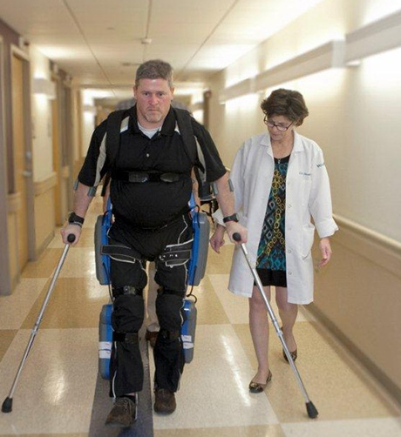

Not All Disabilities Can Be Seen
Disabilities present and affect people differently:
Temporary and Permanent
Invisible and Visible

Slide 4
New York City Stats
  New York City’s Labor Force Participation Rate (LFPR) is 60.2%. ¹
70.4% of people without disabilities aged 18 to 64 in New York City are employed. ²
32.3% of NYC residents w/ disabilities (ages 18-64) have jobs. ²
There is a 38.1 point gap between the employment rates of PWDs and those without disabilities. “The employment gap is greater in NYC than it is at the State or national level.” ³
New York ranks 37th in the country in terms of jobs for PWDs. ⁴
In total, there are 948,208 NYC residents with disabilities. ⁵
Out of that number, there are 460,425 working age (18-64) people with disabilities living in New York City. ⁵
31% of all NYC residents with disabilities live in poverty.⁵
  39.3% (116,313) of Hispanics with disabilities in NYC live in poverty.
  34.5% (84,066) of African Americans with disabilities in NYC live in poverty.
  28.9% ( 24,868) of Asians with disabilities in NYC live in poverty.
Mayor Bill de Blasio
(D)
NYC Comptroller-2016-The State of the City’s Economy and Finances
Census Bureau - 2015 American Community Survey
CID-NY ADA at 26 in New York City
Annual Disability Statistics Compendium
Mayor’s Office for People with Disabilities-New York City PWDs Statistics Updated 2016
Notes:
http://www.nyc.gov/html/mopd/downloads/pdf/ACCESS_NYC_updated.pdf
http://respectabilityusa.com/Resources/RespectAbiltiy%20NY%20WIOA%20State%20Plan%20Comments.pdf

Slide 5


Necessary vs. Sufficient
A + B + C = D
Steam Engine
Warm water VS. Water at 212F

Slide 6


Theory of Change
Blueprint describing how an organization/policy/actions changes some domain of the world for the better
Articulates a TESTABLE hypothesis of how change will occur
Sieve through which to make decisions and trade-offs
MUST HAVE DATA

Slide 7
A Good TOC Will Answer
Key Strategic Questions
Are we doing the right things to get the outcomes we want?
  Do we need to improve activities?
  Do we have the right mix of activities?
  Do we have extraneous activities?
How should we increase our impact?
  Do we deepen our current activities?
  Do we extend activities to new areas?
  Do we aim to influences new beneficiaries and/or audiences?
  Do we expand our geographic reach?
What do we need to learn and measure?
  How will we answer our open questions?
  What do we need to track internally and externally?

Slide 8
Stigma Impacts Jobs
While one in five people have a disability, according to GLAAD, fewer than two percent of scripted television characters (15 people) have disabilities.
Most PwDs in film and TV are played by able-bodied actors and are shown in a negative, inaccurate light.
Almost all portrayals of PwDs in media are white, despite the fact that disability impacts all ethnicities.
Fewer than one percent of people employed by cultural institutions in New York City are PwDs.

Slide 9
Employment Messages that Work
Our nation was founded on the principle that anyone who works hard should be able to get ahead in life. People with disabilities deserve the opportunity to earn an income and achieve independence, just like anyone else.
People with disabilities bring unique characteristics and talents to workplaces that benefit employers and organizations. Stephen Hawking is a genius who happens to use a wheelchair. People with disabilities can work in hospitals, hotels, be super talents in developing computer software and in many other fields.
Companies including Starbucks, Pepsi, Ernst & Young and others have shown that employees with disabilities are loyal, successful and help them make more money. If we find the right jobs for the right people it can and does increase the bottom line of companies.

Slide 10

Stigma - Born This Way
A&E Network’s new Emmy-winning original docu-series Born This Way. A group of seven young adults with Down syndrome along with their family and friends in Southern California.
Focus on jobs and independence!!
RespectAbility brought A&E and Best Buddies together for a powerful public service announcement.

Slide 11
Stigma: RespectAbility Op-Eds on Jobs for PWDs
Birmingham News (AL) Stigmas Persist, but Alabama's Disable Deserve to Work
Southwest Times Record (AR) Guest Commentary: Arkansas with Disabilities Seek Jobs, Independence
The Arizona Republic (AZ) There's Too Little to Celebrate on ADA's 25 Anniversary
The Colorado Statesman (CO) Pauli: Coloradans with Disabilities Want to Work
Washington Examiner (DC) People with Disabilities Want to Work
The News Journal (DE) Jobs for People with Disabilities
Tallahassee Democrat (FL) 25 Years After the ADA, There's Still a Long Way to Go
South Florida Sun Sentinel (FL) Floridians with Disabilities in Workforce are Underused Resources
Atlanta Journal Constitution (GA) We Must Do Better for People with Disabilities
Honolulu Star Advertiser (HI) 'Employment First' Should be Standard
Des Moines Register (IA) Iowans with Disabilities Want to Work
Idaho Statesman (ID) Idaho's Citizens with Disabilities Want to Work
Louisville Journal- Courier (KY) People with Disabilities Look for Success
Daily World (LA) People with Disabilities Want to Work
Times of Acadiana (LA) People with Disabilities Want to Work
Salem News (MA) Letter: Brother was a Strong Advocate for those with Disabilities
Capital Gazette (MD) Marylanders with Disabilities Want Jobs, Independence
Portland Press Herald/ Maine Sunday Telegram (ME) Maine Voices: People with Disabilities are Often Overlooked as Potential Employees
Lansing State Journal (MI) Empower Michiganers with Disabilities
The Jackson Clarion- Ledger (MS) Mississippians with Disabilities want Jobs
Billings Gazette (MT) Montanans with Disabilities want to Work
The Herald Sun (NC) North Carolinians with Disabilities want Jobs and Diginity
The Charlotte Observer (NC) Don't Let Barham's Dream of Disability Rights Die
Grand Forks Herald (ND) North Dakotans with Disabilities want to Work
The Star Leger (NJ) On Anniversary of Americans with Disabilities Act, a Call to Bring Disabled New Jerseyans into Workforce
Albuquerque Journal (NM) People with Disabilities Deserve the Dignity of a Job
Reno Gazette Journal (NV) Nevadans with Disabilities want Jobs
The Buffalo News (NY) New Yorkers with Disabilities want to Hold Jobs
Statesman Journal (OR) People with Disabilitites want Jobs and Independence
The Providence Journal (RI) Rhode Islanders with Disabilities want to Work
Anderson (SC) S.C. Residents with Disabilities want Jobs
Sioux Falls Argus Leader (SD) S.D. Proves People with Disabilities want to Work
Fort Worth Star-Telegram (TX) ADA Anniversary: Disabled Texans want to Work
Ogden Standard Examiner (UT) People with Disabilities want to Work
Rutland Herald (VT) Vermonters with Disabilities want Jobs
Casper Star Tribune (WY) Wyoming Must do More for those with Disabilities
These op-eds discuss the number of people with disabilities who are striving for work, the value they bring to the workplace and the opportunities created by WIOA.
They not only underline current problems, but celebrate past achievements
and offer suggestions for further change.

Slide 12
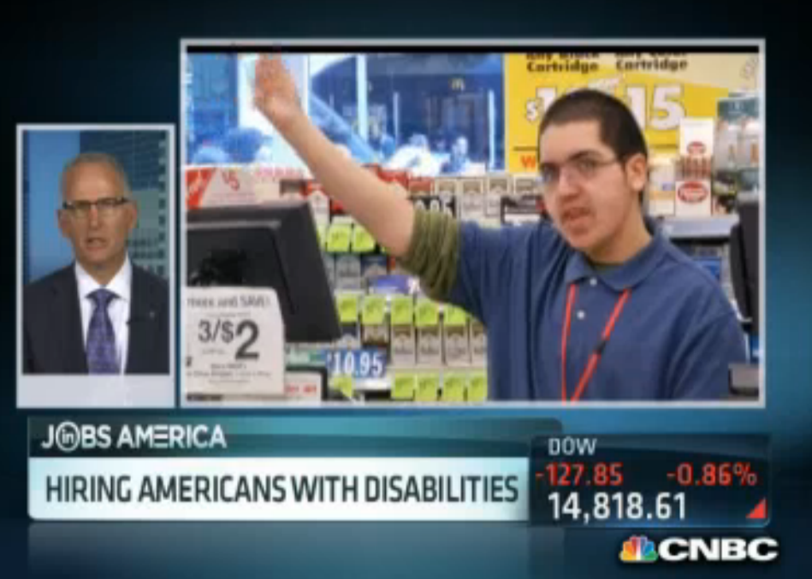
Hiring Americans w/ Disabilities – CNBC 2013
Discussing what hiring people with disabilities means for an organization, with Rodger DeRose, Kessler Foundation CEO, and Gregory Wasson, Walgreen CEO. "People with disabilities want to work, and can absolutely be qualified to work," explains Wasson.
Watch the full interview here.

Slide 13
Workforce Innovation and Opportunity Act
July 22, 2014: President Obama signed the Workforce Innovation and Opportunity Act (WIOA) into law.
  Create a more diverse and inclusive workforce
  Gives New Yorkers the opportunity to work hard to improve outcomes in terms of competitive, integrated employment for PwDs
We are the only disability organization in the country to have reviewed and commented on all 50 state WIOA plans
Our comments, data and feedback have already been directly integrated in the state plans for CA, CO, HI, ID, NV, OK, OR and WY.
Key Contacts Communicated with: | #
Governor Meetings 2015 - 2016 | 43 of 50
WIOA Conference Calls 2015 - 2016 | 50 of 50
Public Comments on WIOA Plans | 50 of 50
Key State Contacts | 637
Governor-appointed Business Leaders Contacts (NAWB) | 1,377
Service Providers Contacts (NAWDP) | 1,122

Slide 14

Jackie Robinson Strategy
First African American to play in Major League Baseball in the modern era, starting in 1947.
By starting him at first base, the Brooklyn Dodgers ended racial segregation in the MLB under the leadership of Branch Rickey with the full support of the team.
When they hired Jackie, the Dodgers enjoyed more athletic success, sold more tickets, and gained a larger fan base.
Jackie’s Athletic Awards:
  Selected for six consecutive All-Star Games (1949 – 1954)
  Won the National League Most Valuable Player Award in 1949
  Inducted into the Baseball Hall of Fame in 1962

Slide 15

Jobs for Youth with Disabilities is Key
Notes:
"300,000 young people with disabilities age into what should be the workforce each year. 1.3 million young Americans ages 16-20 with disabilities."
Source: Disability Statistics, by Cornell University

Slide 16

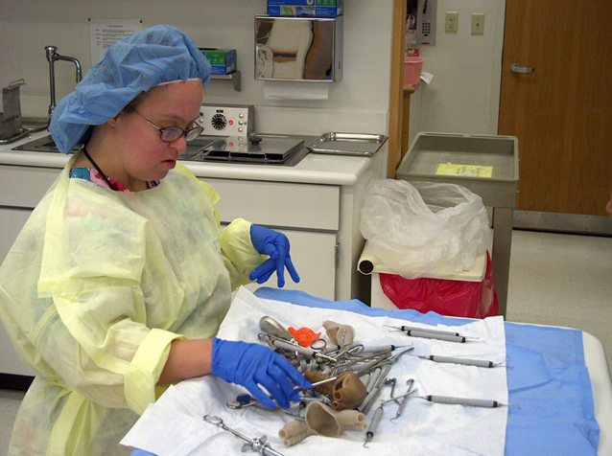
Hospitals/Healthcare
There are over 647,060 health care and social assistance jobs in NYC.
Workers with disabilities help hospitals help.
Best Practices Webinar on Project SEARCH and Healthcare Jobs for PWDs.

Slide 17
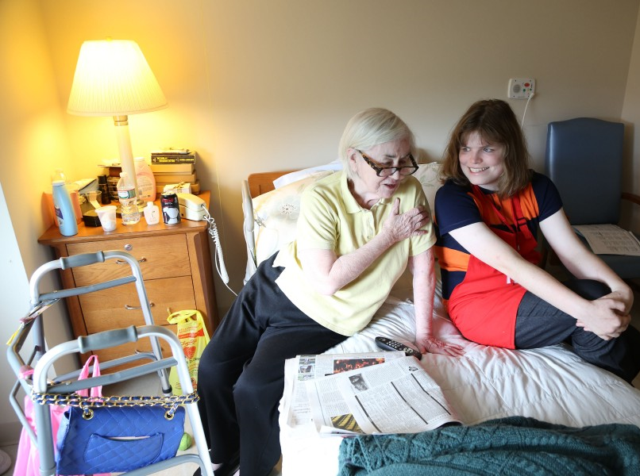

Eldercare
Young people with disabilities help senior citizens– Example of Project SEARCH in New York
Between 2010 & 2014, this job market grew by 11%, adding 63,000 new jobs in NYC.
This market will only grow as many New Yorkers age.

Slide 18


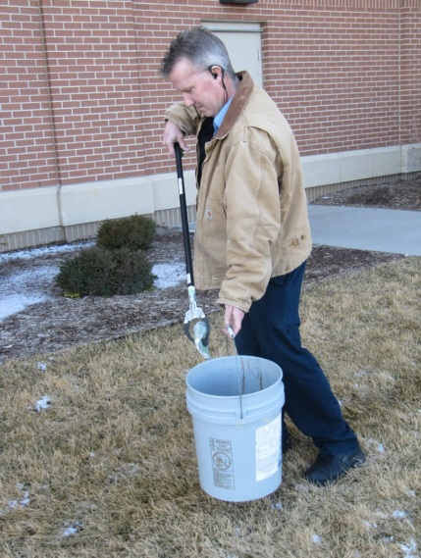
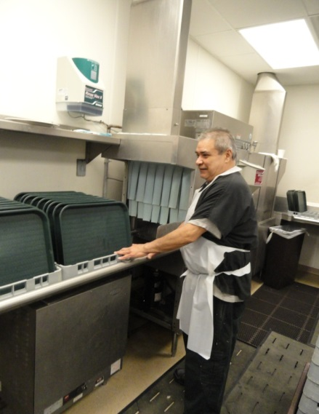
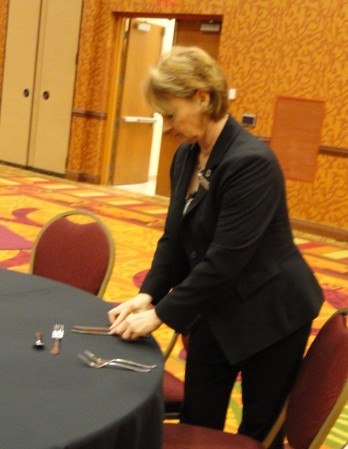
Tourism/Food Service/Accommodation
  NYC employs more than 340,000 people in this sector.
“Sizable labor shortage of qualified talent...and very high turnover.”
Best Practices Webinar- Hospitality Sector for PWDs.
Guest Services
Housekeeping
Engineering
Culinary
Banquets
Notes:
Hospitality offers a variety of jobs throughout the hotel, most typical departments include: Guest Services, Housekeeping, Food Services and Engineering. Many full-service properties may also offer job opportunities in Culinary, Banquets, Administrative and Sales Areas as well.

Slide 19

Government Jobs
On Jan. 3, 2017, the EEOC issued a final rule about employment opportunities for PWDs in the fed government.
Each federal agency has been directed to set a goal of having 12% of its workforce be people with disabilities, and 2% of its workforce be people with targeted disabilities.
For more information, please visit EEOC’s website.
State gov can also serve as a model employer of PWDs.
Learn from Delaware’s effort to hire talented employees with disabilities.

Slide 20
Sector Strategies - STEM
  From State WIOA PLAN - “NYC, sometimes referred to as “Silicon Alley,” is home to a thriving tech sector with over 300,000 employees.”
  Some people on the autism spectrum can have the very best skills in science, math and engineering (STEM Fields).
With the right educational, training and support, talented young people with diverse disabilities > esp. those on the Spectrum.
Example from Specialisterne’s Partnership with SAP on jobs for people on the Autism spectrum.

Slide 21
Sector Strategies – Gov’t Contractors
Top contractors include:
  Brookhaven Science Association
  Truth North Communications
  Leidos Holdings, Inc.
  Continental Sciences Group
  Bank of New York
For complete list go to: https://www.usaspending.gov/Pages/TextView .aspx?data=StateMostFundedRecipientsByAwardType&AwardType=C&statecode=NY&fiscalyear=2017
Complete federal lists of 2006-2013 → Federal Procurement Data System
How to get started:
Job Accommodation Network → https://askjan.org/
US Business Leadership Network → http://usbln.org/
New York BLN → http://bit.ly/2cmXkty

Slide 22
Jobs in Entertainment / Culture
  NY State Dept of Labor Report on Motion Picture Industry
    The motion picture industry in New York City has always played a visible role in the city’s culture.
    In 2013, California had the most film jobs (138,000) of any state. New York State ranked second, with slightly less than 56,000.
    Over the last ten years, New York State’s share of U.S. motion picture jobs has risen dramatically...
    However, fewer than one percent of people employed by cultural institutions in New York City are PwDs.
  Combating stigma against PWDs needs to include engagement with showrunners / producers / actors.
  See the example and success of Born this Way.

Slide 23

One Common Goal: Employment
High School Transition that Works: Lessons Learned from Project SEARCH
By Maryellen Daston, Erin Riehle, and Susie Rutkowski
Paul H. Brookes Publishing Co., Inc.
For more information go to:
http://projectsearch.us/
Notes:
Need Erin’s Headshot

Slide 24
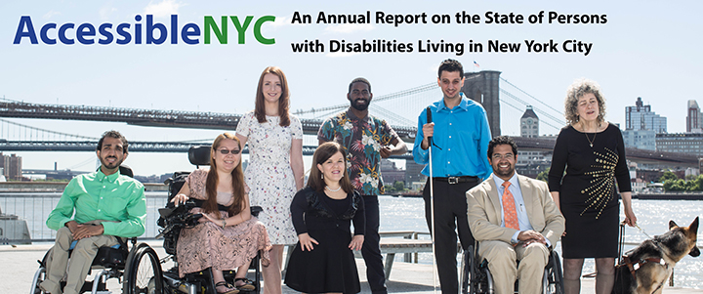
NYC Leadership – AccessibleNYC
Download the PDF

Slide 25


Transportation
Employment
Access
Education

Slide 26
Resources
NYC Mayor’s Office for Persons with Disabilities (MOPD): http://www.nyc.gov/html/mopd
New York State Department of Labor: https://labor.ny.gov
National Conference of State Legislatures: http://www.ncsl.org
Bureau of Labor Statistics: https://www.bls.gov/news.release/disabl.nr0.htm
Art Beyond Sight: http://www.artbeyondsight.org
Project SEARCH: www.projectsearch.us
Job Accommodation Network: https://askjan.org/
FrameWorks Institute: http://www.frameworksinstitute.org
State Vocational Rehabilitation Agency: http://wdcrobcolp01.ed.gov/Programs/EROD/ org_list.cfm?category_cd=SVR
Acces VR http://www.acces.nysed.gov/vr
NY State Commission for the Blind http://ocfs.ny.gov/main/cb/
NY Office for People with Developmental Disabilities https://opwdd.ny.gov/
NY State Office of Mental Health https://www.omh.ny.gov/
New York City Department of Health and Mental Hygiene (DOHMH) http://www1.nyc.gov/site/doh/about/about-doh.page
RespectAbilityUSA: www.respectabilityusa.org
Notes:
SOURCES
Significant Industries: A Report to the Workforce Development System:
https://labor.ny.gov/stats/PDFs/Significant-Industries-Capital-Region.pdf
AccessibeNYC (2016): http://www.nyc.gov/html/mopd/downloads/pdf/ACCESS_NYC_updated.pdf
RespectAbility Public Comments (2016): http://respectabilityusa.com/Resources/RespectAbiltiy%20NY%20WIOA%20State%20Plan%20Comments.pdf
Bureau of Labor Statistics (2016): https://www.bls.gov/news.release/disabl.nr0.htm
Art Beyond Sight (2013): http://www.artbeyondsight.org/dic/disability-statistics-and-demographics/
FrameWorks Institute (2016): http://files.constantcontact.com/34889ab5001/d62d451c-ddff-4d24-b517-c8576cc91f31.pdf
MOPD (2016): New York City People with Disabilities Statistics Updated 2016 PowerPoint Slides
National Governors Association (NGA): https://www.nga.org/files/live/sites/NGA/files/pdf/2013/NGA_2013BetterBottomLineWeb.pdf
The Council of State Governments and National Conference of State Legislatures (2016): http://www.csg.org/NTPWD/documents/SEED_Report_2016.pdf

Slide 27
THANK YOU
RespectAbility wants partners to fight stigmas and expand opportunities for people with disabilities in NYC!
Jennifer Laszlo Mizrahi
JenniferM@RespectAbilityUSA.org
www.RespectAbilityUSA.org
202 365 0787

