Slide 1


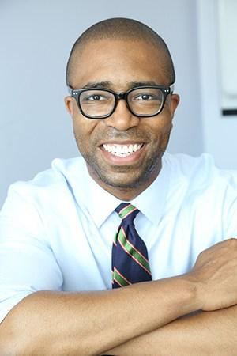
Jennifer Laszlo Mizrahi, President
Getting to Success: Education, Justice and Disability
– Background for US Commission on Civil Rights.
Jennifer Laszlo Mizrahi, President, RespectAbility
Contact: JenniferM@RespectAbility.org
202-517-6272
Calvin Harris, Chairman
1

Slide 2
Disability & Discrimination – Causing a School to Prison Pipeline
Background on Opportunity for Improvement
Students with Disabilities: The Minority Group with the Lowest Graduation Rates
Students with Disabilities Enter School-to-Prison-Pipeline; Lack of Jobs & Independence
Desire for Education, Skills, Work & Independence
VI. Students with Disabilities CAN Succeed

Slide 3
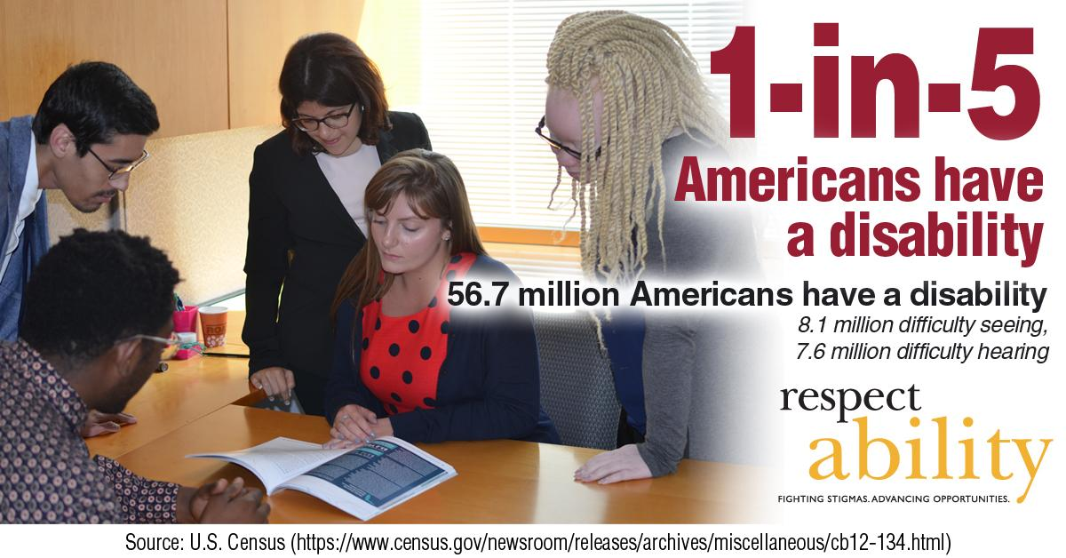
1-in-5

Slide 4
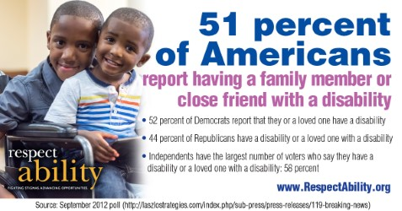
Notes:
"51 percent of Americans report having a family member or close friend with a disability. 52 percent of Democrats report that they or a loved one have a disability. 44 percent of Republicans have a disability or a loved one with a disability. Independents have the largest number of voters who say they have a disability or a loved one with a disability: 58 percent."
Source: Laszlo Strategies September 2012 poll

Slide 5
Key Terms: Disability
Disability can be physical (i.e.
vision, hearing, mobility), cognitive, intellectual, mental, sensory, developmental or some combination of these that substantially limits one or more major life activity.
The Americans with Disabilities
Act of 1990 (ADA) prohibits discrimination and ensures equal opportunity for persons with disabilities in employment, state and local government services, public accommodations, commercial facilities and transportation.
Accommodation is any change in the school or work environment or in the way things are done that enables an individual with a disability to enjoy equal access and treatment.
Ableism is discrimination in favor of able-bodied people; the belief that that people who have disabilities are somehow less human, less valuable, and less capable than others.

Slide 6
Ages 6 to 21 IEPs by Category US
Disability Category | 2011 | 2012
All Disabilities | 5,670,680 | 5,693,441
Specific Learning Disability | 2,293,861 | 2,268,098
Speech or Language Impairment | 1,043,781 | 1,032,729
Intellectual Disability | 422,401 | 415,697
Emotional Disturbance | 370,049 | 359,389
Multiple Disability | 123,762 | 124,722
Hearing Impairment | 68,494 | 68,069
Orthopedic Impairment | 53,939 | 52,052
Other Health Impairment | 722,993 | 757,904
Visual Impairment | 24,811 | 24,987
Autism | 404,544 | 440,592
Deaf Blindness | 1,294 | 1,281
Traumatic Brain Injury | 24,224 | 25,020
Developmental Delay | 115,454 | 122,901
Source: Annual Disability Statistics Compendium
Notes:
SOURCES:
Data for 2011, Charts 11.3a to 11.3d: Annual Disability Statistics Compendium, 2013
Data for 2012, Charts 11.3a to 11.3d: Annual Disability Statistics Compendium, 2014
6

Slide 7
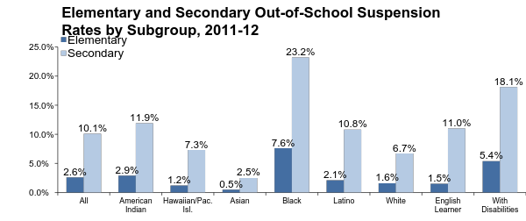
School Suspensions Lead to Dropping Out
Youth with Disabilities are suspended at much higher rates than the average.
Source: The Civil Rights Project
Notes:
Source: The Civil Rights Project

Slide 8
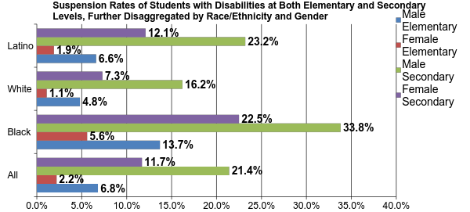
Minority Disability Suspension
Minority youth with disabilities are suspended at the highest rates of all.
Source: The Civil Rights Project
Notes:
Source: The Civil Rights Project

Slide 9
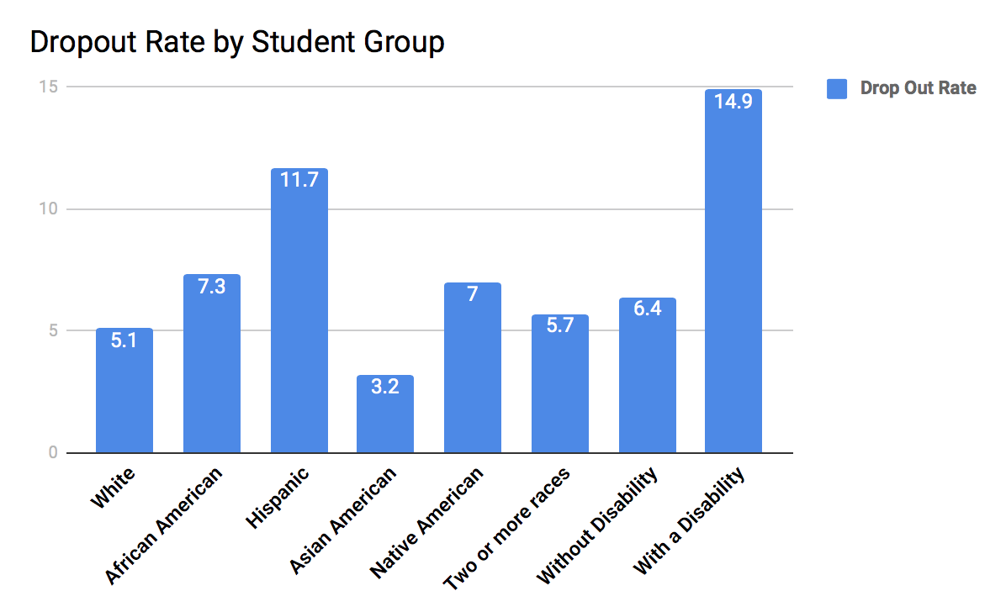
Students with disabilities drop out at <twice the rate of
students without disabilities

Slide 10
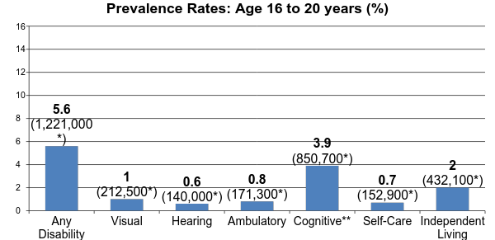
Prevalence of Disability Among Non-Institutionalized
People Ages 16 to 20 in U.S. in 2013
*Total numbers reported
**Because of a physical, mental, or emotional condition, does this person have serious
difficulty concentrating, remembering, or making decisions?
Source: Cornell University
Notes:
Source: Cornell University
*Total numbers reported
Any Disability – 1,221,000
Visual – 212,500
Hearing – 140,000
Ambulatory – 171,300
Cognitive – 850,700
Self-Care – 152,900
Independent Living – 432,100

Slide 11

High School Diplomas

Slide 12
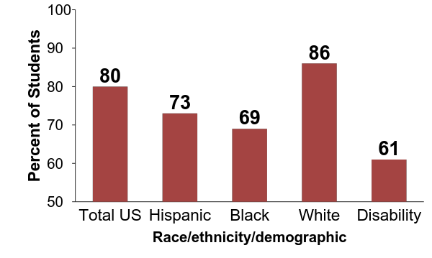
Lowest High School Graduation
Public high school four-year adjusted cohort graduation rate (ACGR), by race/ethnicity and selected demographics for the United States, the 50 states, the District of Columbia, and other jurisdictions, school year 2011–12
Source: National Center for Education Statistics
Notes:
Source: National Center for Education Statistics

Slide 13
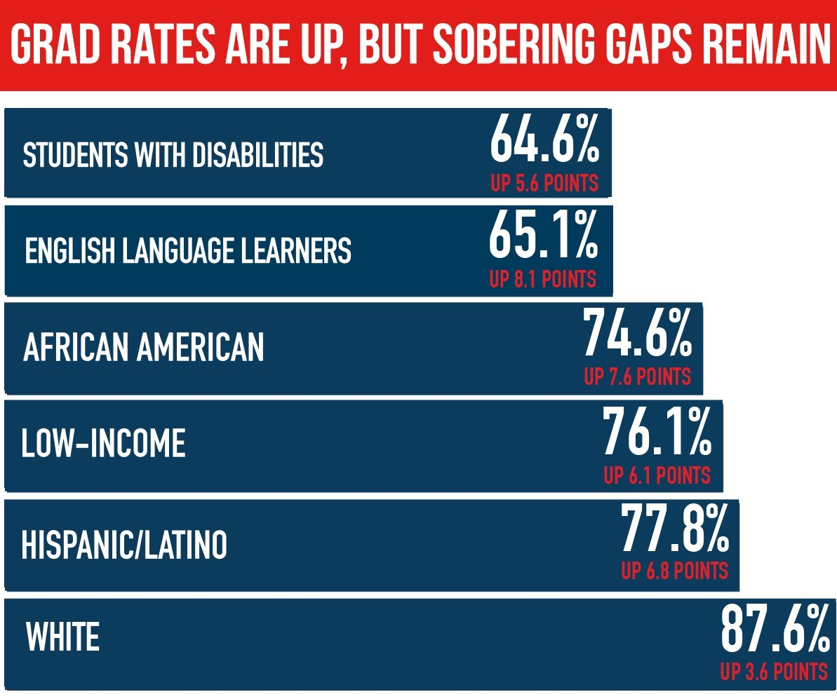
Disabled Students w/ “Multiple Minority Status”
(PoCs/ESL) At Greatest Risk

Slide 14
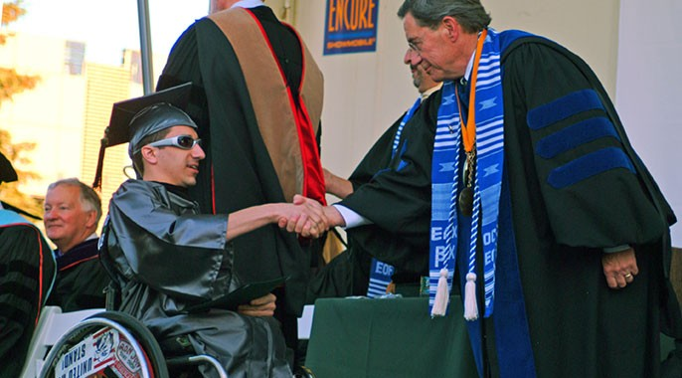
Students with disabilities are underrepresented in education
  In 2014, about one-in-five working-age (18-64) people with a disability have less than a high school diploma, compared to 1-in-10 people without a disability.
Nationally, less than 7% of people born with disabilities have bachelor’s degrees or higher, compared with 13% for people
without disabilities. Many adults with disabilities who have degrees obtained them BEFORE they acquired their disabilities due to accident, aging or illness.
Source: An Uneven Playing Field: The Lack of Equal Pay for People with Disabilities (2014)

Slide 15
Higher Education and
Students with Disabilities
People with disabilities are underrepresented in higher education.
  Among people age 25 and older in 2014, only 16.4% of those with a disability had completed at least a bachelor’s degree compared to 34.6% of people without disabilities who had completed at least a bachelor’s degree.
  Many who have degrees acquired their education before they gained a disability due to an accident, aging or illness.
  Only 1-in-3 working-age people with a disability have a job, making people with disabilities the poorest group in America.

Slide 16
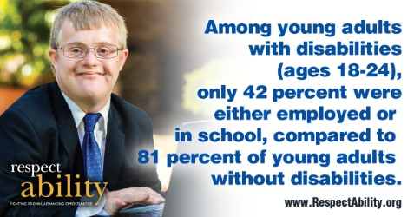
42% of People with Disabilities are
Employed/In School
Notes:
SOURCES (2012)
Poverty among Persons (PwD) Ages 18 - 64. 2013 Annual Disability Statistics Compendium. Pg. 53, 54. Table 4.1 and Table 4.2
Smoking among Persons Ages 18 and over. 2013 Annual Disability Statistics Compendium. Pg. 72. Table 8.3
Obesity among Persons Ages 18 and over. 2013 Annual Disability Statistics Compendium. Pg. 73. Table 8.4
Employment among Persons Ages 18 – 64. 2013 Annual Disability Statistics Compendium. Pg. 28, 29. Table 2.1 and Table 2.2
Available on: http://www.disabilitycompendium.org/docs/default-source/2013-compendium/2013_compendium.pdf
SOURCES (2013)
Poverty among Persons (PwD) Ages 18 - 64. 2014 Annual Disability Statistics Compendium. Pg. 53, 54. Table 4.1 and Table 4.2
Smoking among Persons Ages 18 and over. 2014 Annual Disability Statistics Compendium. Pg. 72. Table 8.3
Obesity among Persons Ages 18 and over. 2014 Annual Disability Statistics Compendium. Pg. 73. Table 8.4
Employment among Persons Ages 18 – 64. 2014 Annual Disability Statistics Compendium. Pg. 28, 29. Table 2.1 and Table 2.2
Available on: http://www.disabilitycompendium.org/docs/default-source/2014-compendium/2014_compendium.pdf

Slide 17
Disability Impacts Everyone
Disability impacts people of all races, genders, and backgrounds. However, youth with multiple minority status (i.e. person of color and/or ESL learner + disability) are least likely to get the education and training they need to succeed, and the most likely to enter the school-to-prison pipeline.

Slide 18
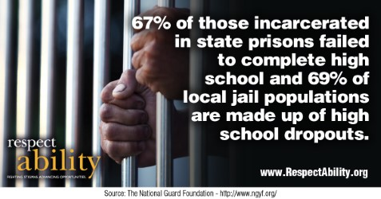
School-to-prison-pipeline for youth with disabilities

Slide 19

Ameer Baraka
“For many years, I allowed Dyslexia to control my life and rob me of my God given potential.”
“At age 23, I entered into a prison correctional facility reading at a 3rd grade level. I didn't feel so bad because many of the men there were just like me. We all read poorly.”
“A GED teacher noticed that I struggled with phonics and had me tested. After testing me, he said I had a reading disability and it could be corrected if I was willing to work hard.”
Ameer is now a successful actor and is a series regular on American Horror Story.

Slide 20
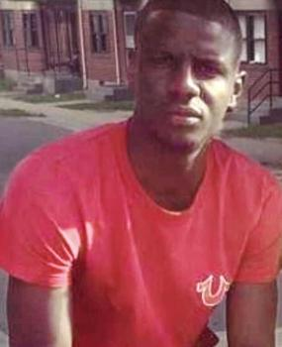
Freddie Gray had
an Invisible Disability
Freddie Gray had unaddressed disability issues that helped set him up for failure. “Before Freddie Gray was injured in police custody…his life was defined by failures in the classroom, run-ins with the law and an inability to focus on anything for very long.”
Executive Functioning Disorder

Slide 21
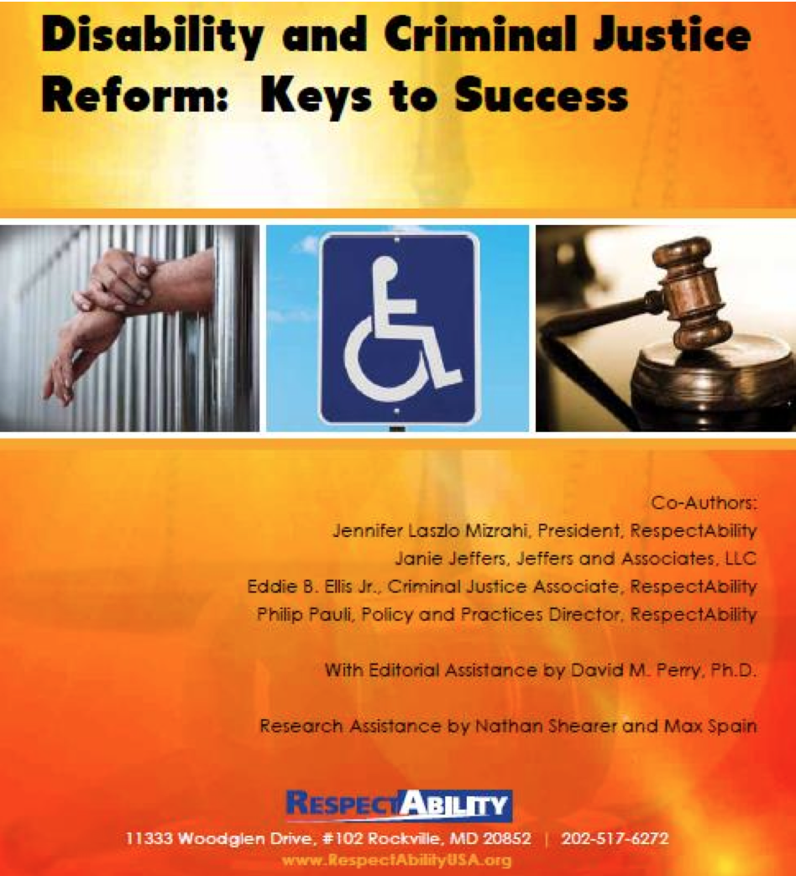
Criminal Justice Report
RespectAbility’s Criminal Justice Report helped lead to enthusiasm about new ESSA law to assess youth offenders for disabilities and get them needed IEPs and/or 504s.
Criminal Justice Report PDF
Video of Panel Discussion of Criminal Justice Reform on Capitol Hill
Transcript of Panel Discussion
PBS NewsHour on our Report

Slide 22

From College to Careers…
The plurality of students with disabilities see going to school or college as a means of j0b attainment.

Slide 23
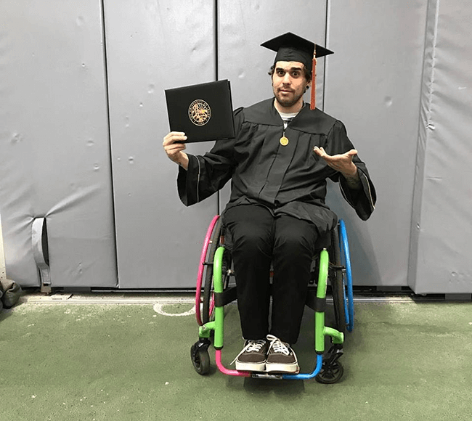
Disability Issues are Education Issues
Disabilities are both visible and invisible, and do not discriminate on race, ethnicity, gender or socioeconomic status.
While they currently have the lowest rate of post-secondary attainment, individuals with disabilities have the desire and capacity to succeed.
By investing in students with disabilities, you enable more students to achieve degrees, certificates, and other credentials.

Slide 24
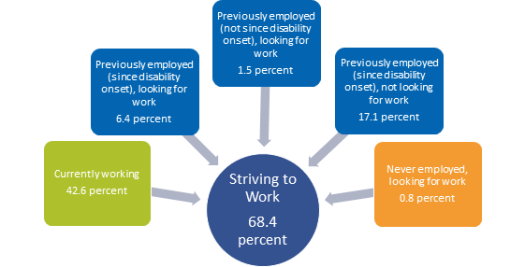
The Desire to Work
The majority of students see going to school or college as a means of job attainment.
Source: https://kesslerfoundation.org/kfsurvey15

Slide 25

Successful Transition is Necessary
Notes:
"300,000 young people with disabilities age into what should be the workforce each year. 1.3 million young Americans ages 16-20 with disabilities."
Source: Disability Statistics, by Cornell University

Slide 26
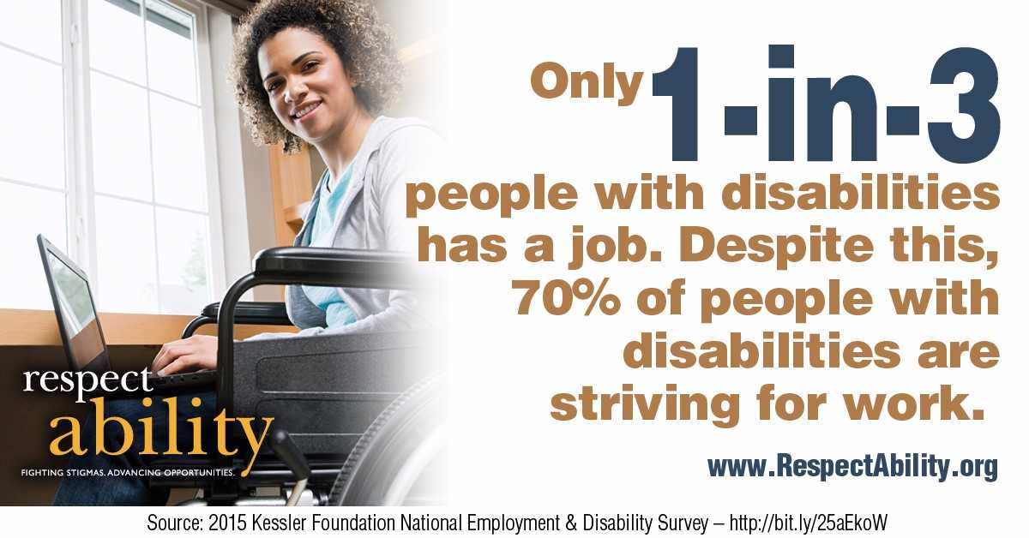
Only 1 in 3…

Slide 27
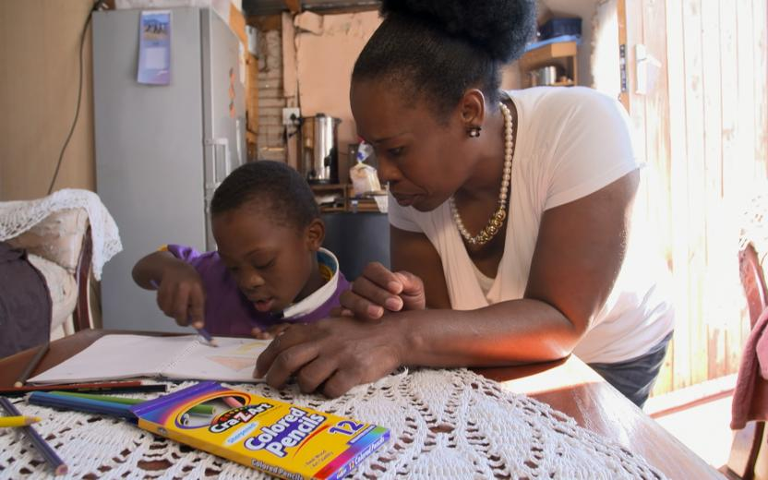
People with Disabilities Need Jobs
Only 34% of people with disabilities aged 18 to 64 are employed.
9,850,966 people with disabilities aged 18 to 64 receive government benefits. Most want jobs & independence.
In 2012,US’s total expenditure on SSDI benefits was $127,941,612.

Slide 28
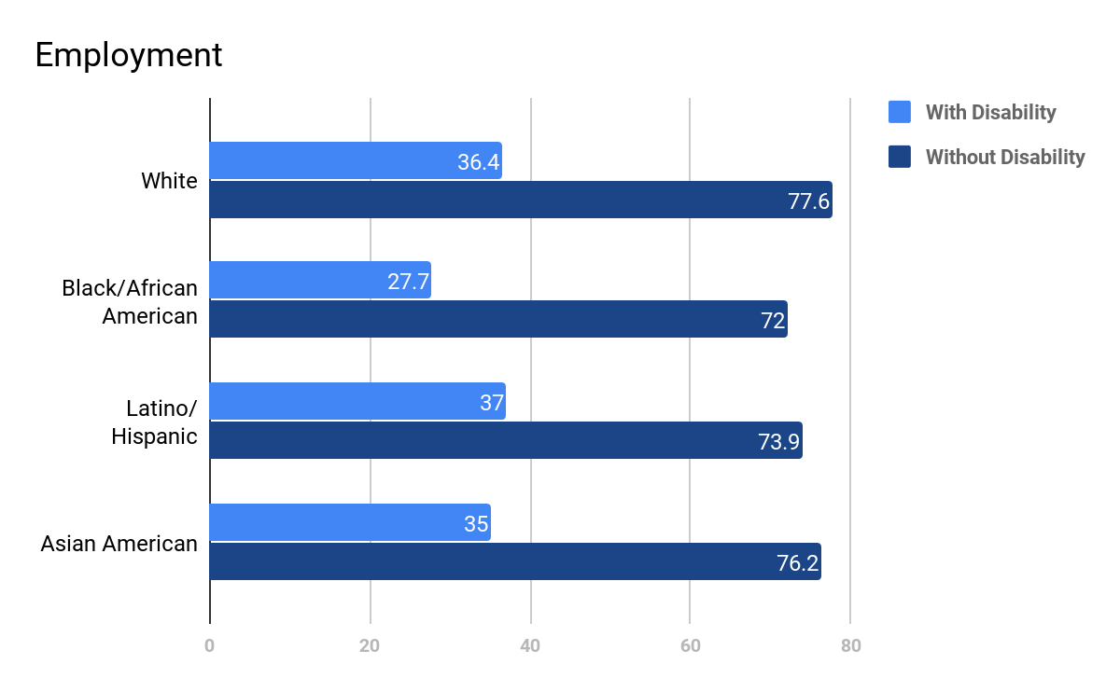
Employment Rates
Between People With
and Without Disabilities

Slide 29

Apprenticeships Are Needed
Notes:
Source: Mathematica Project Search Report

Slide 30
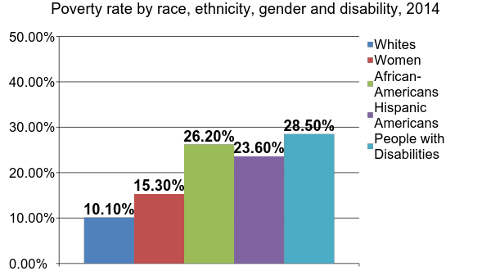
PwDs are the Poorest of the Poor
Notes:
Sources: EPI Chart, Annual Disability Statistics Compendium, Disability Statistics, by Cornell University, U.S. Census Data

Slide 31
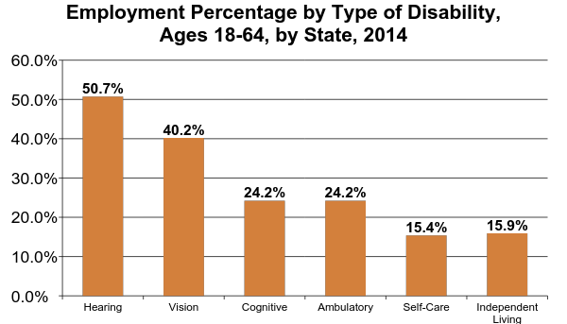
National Employment Rates by Disability
Notes:
Source: Annual Disability Statistics Compendium

Slide 32

When the right things are done, 70% are able to work!

Slide 33


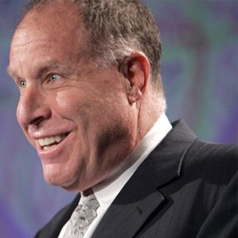




Role Models with Disabilities
Derrick Coleman: Deaf
Stephen Hawking: ALS
Peter Orfalea: ADD/ADHD & Dyslexia
Ludwig van Beethoven: Deaf
Harriet Tubman: Seizures
Albert Einstein:
Autism?
Richard Branson: Dyslexia

Slide 34
Resources/Contact Information
StateData: The National Report on Employment Services and Outcomes, 2015 (data from 2014)
2015 Disability Status Report United States, Cornell University, 2015: www.disabilitystatistics.org
Fedspending: www.fedspending.org
Project SEARCH: www.projectsearch.us
Job Accommodation Network: https://askjan.org/
State Vocational Rehabilitation Agency: http://wdcrobcolp01.ed.gov/Programs/EROD/org_list.cfm?category_cd=SVR
RespectAbilityUSA: www.respectabilityusa.org
Selected Economic Characteristics for Civilian Noninstitutionalized Population by Disability Status, 2011-2015 ACS (focused on Long Beach) http://bit.ly/LBDisabilityjobs
Local Disability Data for Planners (focused on Montgomery County) http://bit.ly/MontgomeryCountydisabilityjobs
Jennifer Laszlo Mizrahi
www.RespectAbility.org
Cell: (202) 365-0787
JenniferM@RespectAbility.org
Twitter: @respect_ability
Facebook: https://www.facebook.com/RespectAbilityUSA

