Slide 1

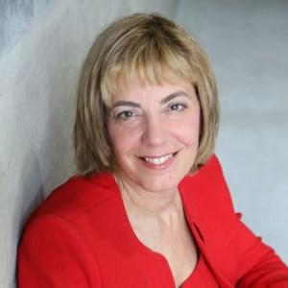
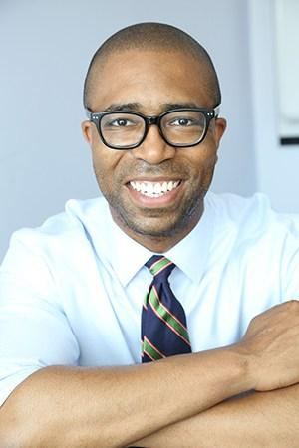
Jennifer Laszlo Mizrahi, President
Disability Inclusion Planning Toolkit Workshop
Jennifer Laszlo Mizrahi, President, RespectAbility
Contact: JenniferM@RespectAbility.org
202-517-6272
www.RespectAbility.org
Calvin Harris, Chairman
1

Slide 2

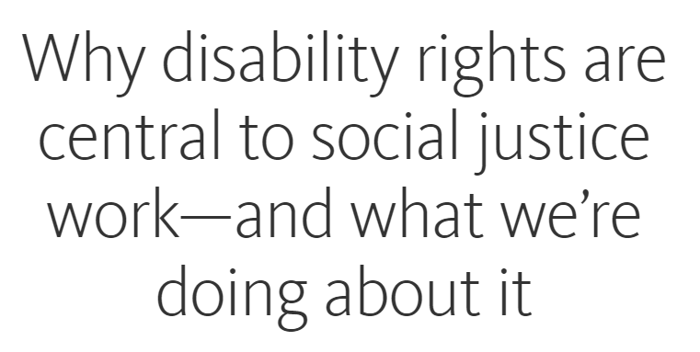
Congratulations to the Ford Foundation
The Ford Foundation has recently added the disability lens to their work. They just published this brilliant piece by Noorain Khan on what they are doing. See: https://www.fordfoundation.org/ideas/equals-change-blog/posts/why-disability-rights-are-central-to-social-justice-work-and-what-we-re-doing-about-it
Additionally, Ford’s CEO Darren Walker spoke extensively on why this impacts other funders as well: https://www.pscp.tv/w/1yoJMMnyQywJQ?t=192.
Here was Darren Walker’s original letter: https://www.fordfoundation.org/ideas/equals-change-blog/posts/ignorance-is-the-enemy-within-on-the-power-of-our-privilege-and-the-privilege-of-our-power
This is the response of the co-authors of the Americans with Disabilities Act:http://www.mnialive.com/articles/ford-s-push-on-disability-rights-should-be-a-model-for-philanthropy
Watch the Darren Walker-Sen. Tom Harkin interview on YouTube: http://bit.ly/2zrgFpE

Slide 3


Congratulations to the
MacArthur Foundation
The MacArthur Foundation has also recently added the disability lens to their work with their new 100 Million Dollar Grant
See: https://www.macfound.org/press/perspectives/nothing-about-us-without-us
And: https://www.macfound.org/media/files/Checklist_for_MacArthur_100Change_Semifinalists.pdf
Plus: https://www.macfound.org/programs/100change

Slide 4
Other Links on
Disability Inclusion in Philanthropy
https://www.philanthropy.com/article/How-Foundations-Can-Ensure/238720
https://www.huffingtonpost.com/jennifer-laszlo-mizrahi/lessons-from-failed-givin_b_5810628.html
https://www.ncrp.org/2015/07/respect-is-key-to-inclusive-funding.html
http://www.d5coalition.org/2015/06/celebrating-ada-its-time-to-add-a-disability-lens-to-our-philanthropy
http://ejewishphilanthropy.com/a-primer-on-making-the-jewish-community-inclusive

Slide 5
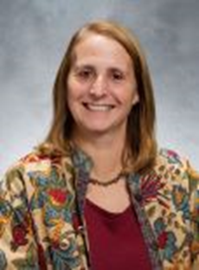
Meet Today’s Speaker: Lisa Handelman
Lisa Handelman is the Community Disabilities Inclusion Specialist at The Jewish Federation of Greater Washington, Department of Jewish Life and Learning. She has worked in Jewish education and inclusion for over 20 years, including leadership roles at the Yeshiva of Greater Washington, SULAM, CESJDS and at Capital Camps where she designed and led the nationally recognized inclusion-based program for the past 13 summers. Lisa’s commitment to inclusion in is based on the proposition that inclusion benefits and strengthens the Jewish community.

Slide 6


Disability Inclusion
Planning Toolkit
Lisa Handelman
Community Disability Inclusion Specialist
Jewish Federation of Greater Washington

Slide 7


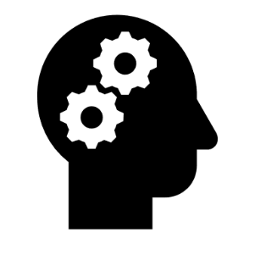

Disability Inclusion is About Culture Change
Paradigm shift:
  Helping others
  Strengthening the collective
  Particular program
  Making all accessible
Kindness
  Social justice

Slide 8
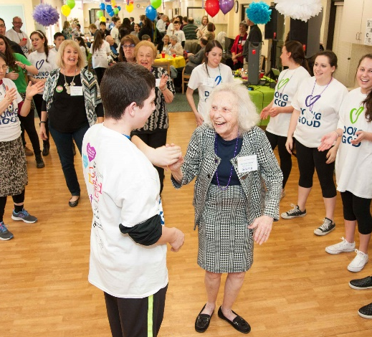



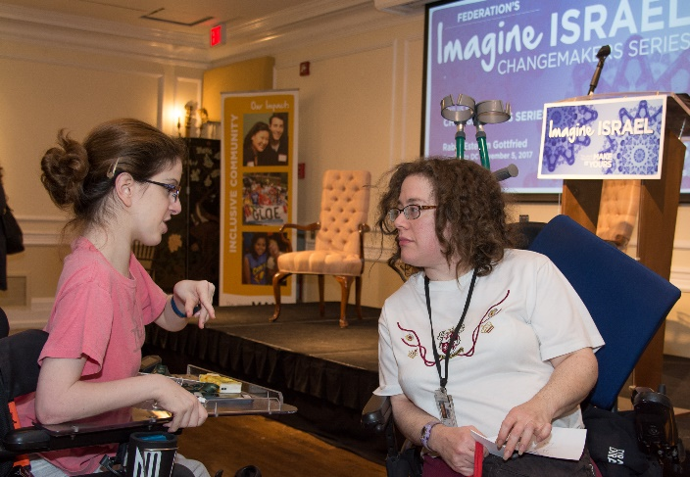
Start with a Commitment to Inclusion
Recognizing the need
Building a welcoming and inclusive community for all by growing the ways in which individuals are invited and encouraged to participate in Jewish Life.
Providing accommodations & pre-employment opportunities
Imagine Israel, Jteen Philanthropy, Resource Fair
Creating website accessibility & online resources
  The Jewish Federation of Greater Washington welcomes the participation of interfaith couples and families, and people of all abilities, backgrounds, gender identities and sexual orientations. Building an inclusive community is a priority; we strive to accommodate all needs whenever possible.

Slide 9



Disability Inclusion is a Journey
Welcoming
Accommodating
Inclusive
What accommodations are needed?
What are our attitudes?
What about funding?
Who needs to be involved?
There is always more we can do.
There is still work to be done

Slide 10
It Requires Thoughtful Conversations
“It’s essential that we make room for conversation about our personal responses to people with disabilities and how each of us can overcome anxiety or concern and move into friendship and understanding.”
Gabrielle Kaplan-Mayer, Director of Whole Community Inclusion
Jewish Learning Venture
Embracing The Stranger Within And Without: How We Respond To Disability
[Disability wisdom is] “a way of including people with disabilities that goes beyond following legal requirements. It involves building person-to-person relationships with them and learning from their life experiences as you build a culture of inclusion together.”
Arielle Silverman
Disabled activist and social scientist
Disability Wisdom Consulting

Slide 11









The Jewish Federation of Greater Washington’s Disability Inclusion Planning Toolkit
Designed as a conversation starter
Recognizes every organization may be at a different stage on this journey
Provides tools and resources to increase awareness, encourage attitudinal change and create enduring change
shalomdc.org/inclusionplanningtool

Slide 12
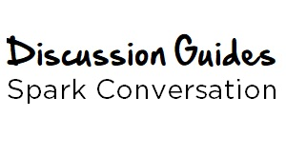
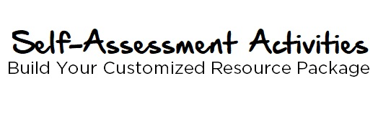
The Inclusion Planning Toolkit has
Two Interactive Components
The discussion is designed to increase awareness and attitudinal adjustments through exploration of accommodations that enable an organization to be fully inclusive.
shalomdc.org/inclusiondiscussion
These interactive online activities are categorized by area of focus. After you fill in the self-assessment portion, the system will generate a customized resource package to help you advance your inclusive efforts.
shalomdc.org/inclusionassessment

Slide 13
We recommend designating an Inclusion Toolkit Manager
The Inclusion Toolkit Manager will act as point of contact between your organization and Federation
Share information about the Discussion Guides with your organization
Disseminate “user ID” needed to access the Self-Assessment activities
Lead review of Customized Resource Package
Share ideas and resources
Create an action plan and track progress
Continue the inclusion journey
Recognizes every organization may be at a different stage in this journey
shalomdc.org/inclusionplanningtoolkit

Slide 14






The Discussion Guides are Categorized into
Six Areas of Engagement
Celebrate success.
Explore attitudinal changes and ways to be more welcoming.
Strategically plan to add specific accommodations.
Involve individuals with disabilities.
Physical Accessibility
Making the physical space welcoming and inclusive
Communication
Opening up involvement and participation
Worship & Ritual
We are all created in the image of God
Volunteer & Employment
Expanding opportunities for all is good for business
Education
Every Jewish student deserves a meaningful Jewish education
Social, Recreation & Leisure
Participation by the entire community
shalomdc.org/inclusiondiscussion

Slide 15
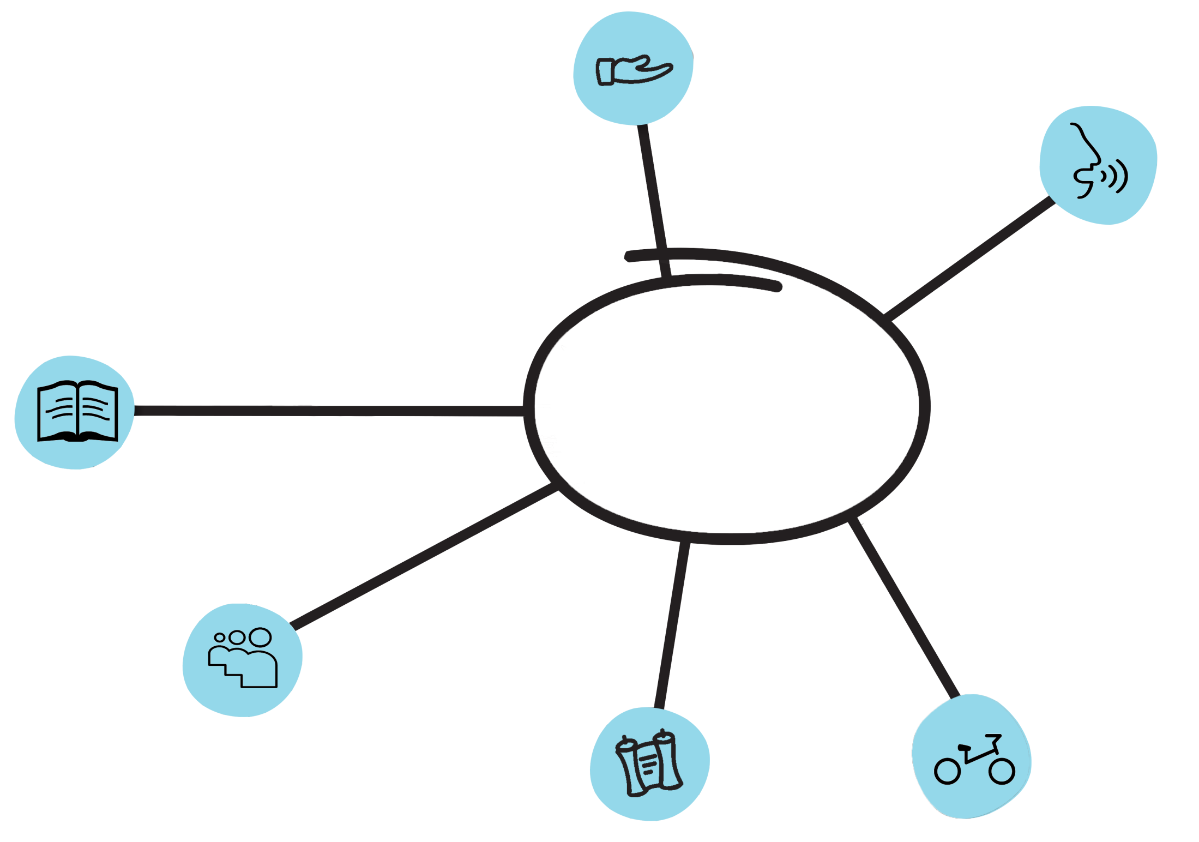
Self-Assessment Activities
Physical Accessibility
Communication
Answer yes or “not yet "questions online
Build Your Customized Resource Package
Education
Volunteer & Employment
Social, Recreation & Leisure
Worship & Ritual
shalomdc.org/inclusionassessment

Slide 16
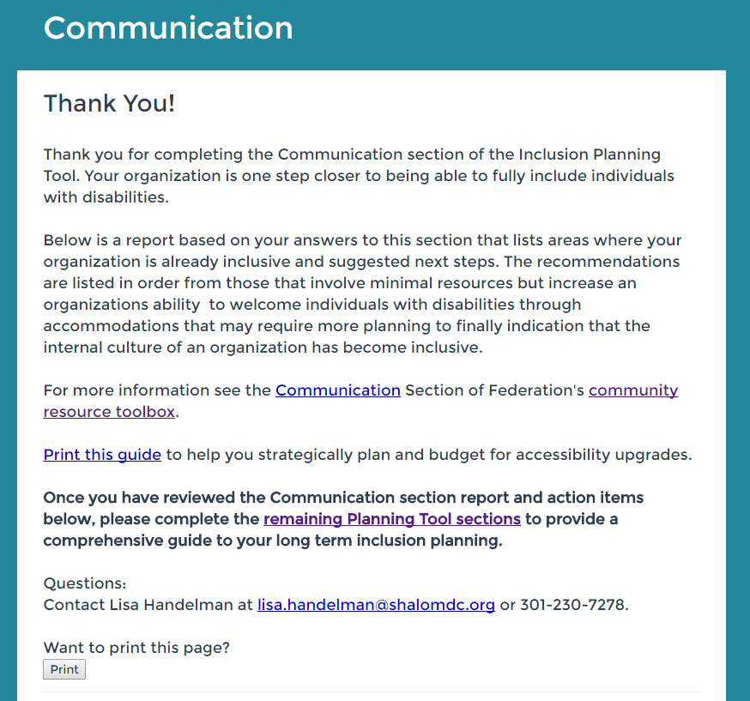
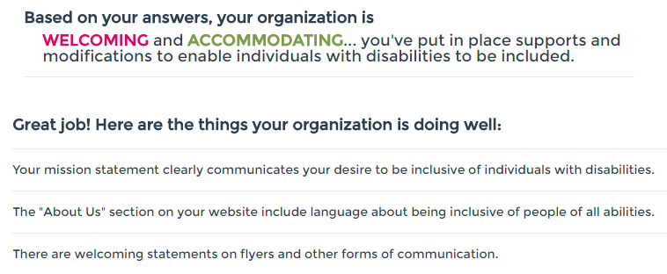
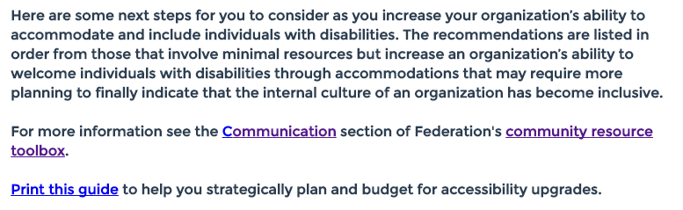

Self-Assessment Activities Help You Plan Next Steps
After you complete a section, the system generates a Customized Resource Package, complete with a list of accomplishments and next steps linked to specific resources.

Slide 17
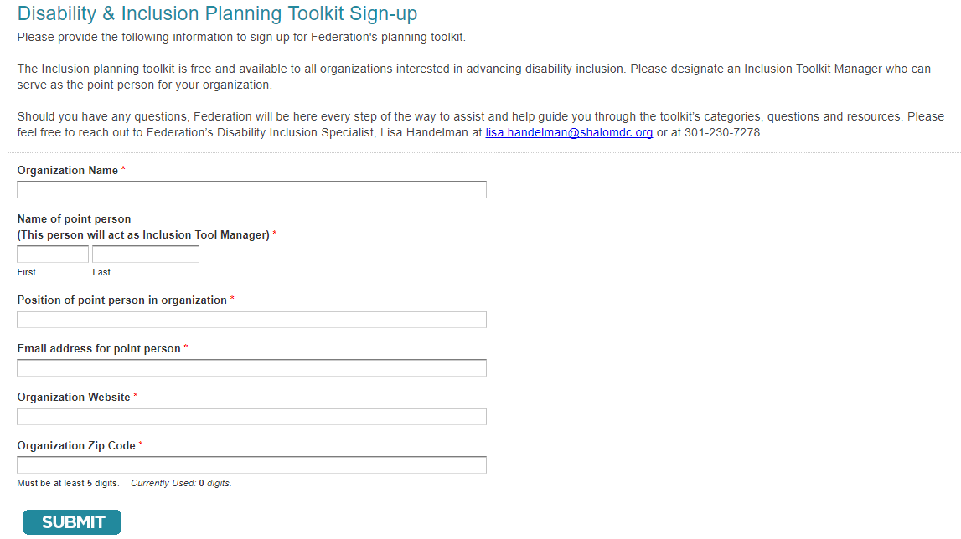
Sign Up to Access the Self-Assessment Activities
Step 1: Inclusion Toolkit Manager signs up for Self-Assessment Activities to receive organization’s User ID #
Step 2: Disseminate User ID # to access the 6 Self-Assessment Activities
Step 3: Activities are designed to be used by multiple users and to be repeated as necessary
Step 4: Each user should share and discuss the Customized Research Package

Slide 18
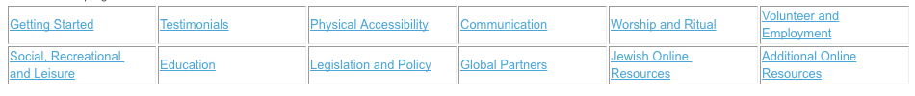
Federation Has a Database of Online Community Resources
Explore the online resources
Submit additional resources
An Inclusive Community…
Is a stronger community. Jews with disabilities and their families have needs that are universal to all families. Advancing this ideal of disability inclusion requires the active involvement of those already involved as well as those outside the disability community. While this quest is universal, Jewish tools, values and traditions provide teachable moments and lessons to advance inclusion.

Slide 19
Who should use the Toolkit?
Clergy
Professionals
Parents
Department chairs
Those not yet involved
Individuals with disabilities
Lay leaders

Slide 20
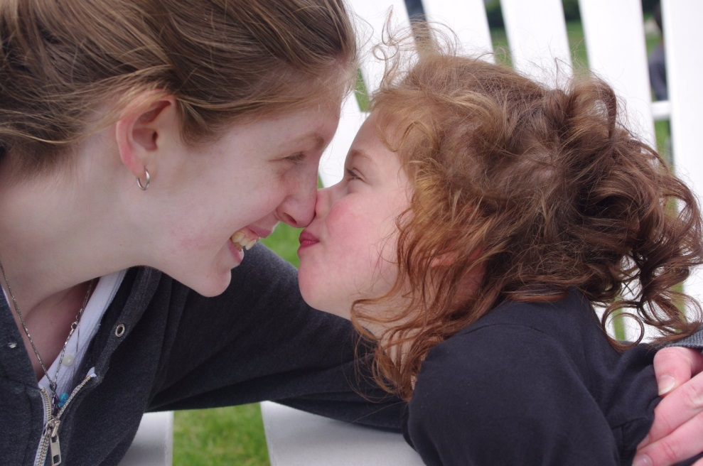
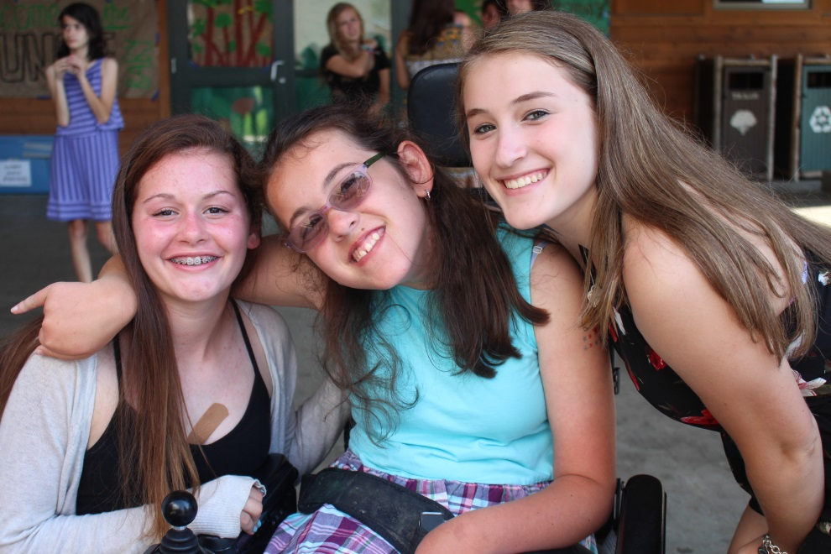
Working Toward Full Inclusion is a Journey
Welcoming
Accommodating
Inclusive
  Proudly celebrate your accomplishments
  Strategically plan and implement change
  Involve individuals with disabilities
  Keep the conversations going

Slide 21
The Jewish Federation of Greater Washington is Here to Help You on Your Journey.
Inclusion Planning Toolkit
shalomdc.org/inclusionplanningtoolkit
Lisa Handelman
Questions?
Lisa.Handelman@Shalomdc.org

Slide 22
For More Information /
Please Contact Us
THANK YOU FOR ATTENDING TODAY’S WEBINAR!
Jennifer Laszlo Mizrahi
www.RespectAbility.org
Cell: (202) 365-0787
JenniferM@RespectAbility.org
Twitter: @respect_ability / @jewishinclusion
Facebook: https://www.facebook.com/RespectAbilityUSA and https://www.facebook.com/RespectAbility4All/

