Slide 1
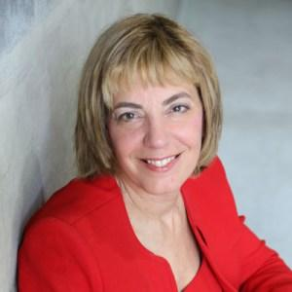
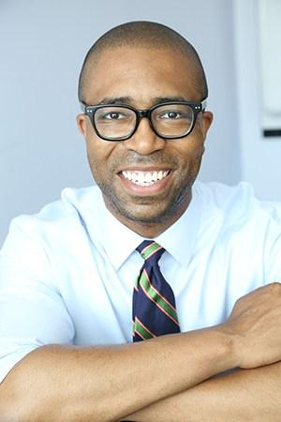
Baby Boomers, Acquired Disabilities & Stay-at-Work Strategies with
Jennifer Christian, MD
December 13th, 2017
Jennifer Laszlo Mizrahi, President
Jennifer Laszlo Mizrahi, President, RespectAbility
Contact: JenniferM@RespectAbility.org
202-517-6272
Calvin Harris, Chairman
1

Slide 2
Affected People Thrust into a Maze
Disability Benefits
Wellness Coach
Specialist
Physician
RTW Coordinator
MRI
FMLA
Health status changes
Emergency Room
Union
Attorney
ADA
Walk-in Clinic
Health Plan
IME
LTD
Primary Care
Practitioner
FCE
SSDI
Normal rhythm of life resumes
X-ray
Surgery
Mental Health Practitioner
Rx
Disability Evaluation
PBM
Chiropractor
Workers’ Comp.
Voc. Rehab.
Internet
Pain Clinic
UR
Case Manager
© Copyright 2016 Webility Corporation
Notes:
12

Slide 3
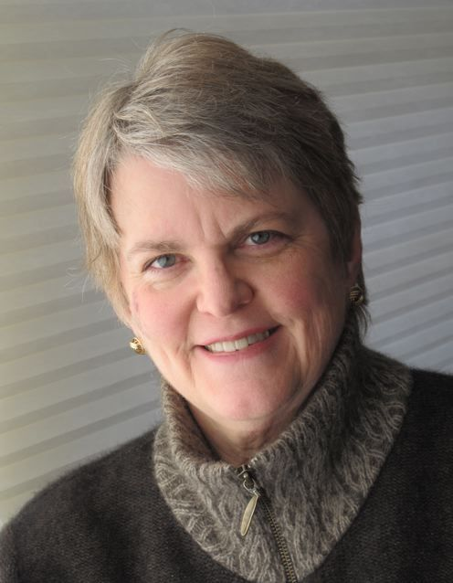
Jennifer Christian, MD MPH, FACOEM
Training: Univ of Wash; Board certified. in occupational and environmental medicine. ACOEM fellow.
Expertise: Leadership, outcomes improvement (health & function, work disability), innovation & pilot programs.
Clients: Employers, healthcare providers, managed care companies, disability and workers’ compensation insurers, government agencies. Long-term injured workers; US Dept of Labor SAW/RTW Policy Collaborative.
Phone: 508-358-5218
Jennifer.Christian@webility.md
Notes:
3

Slide 4
Many Years, Many Chairs, Many Perspectives
Emergency room physician, West Virginia
Primary care, migrant workers’ clinic, West Virginia
Medical Director, Bath Iron Works shipbuilders, Maine
Medical officer (public health) for Anchorage, Alaska.
Orchestrated public campaign to preserve fluoridation
Chaired tasks forces on health reform and disaster planning
Talk show host - scientific medicine vs. quackery
Private practice of occupational medicine, Anchorage,
Medical association president (Alaska)
Medical director, occupational medicine, staff model HMO (CIGNA Los Angeles)

Slide 5
Many Years, Many Chairs, Many Perspectives
CMO, VP of a workers’ comp managed are company designed a by-invitation network with payment for SAW/RTW protocols, plus report cards, & incentives.
Chair, (15 yrs) ACOEM Work Fitness & Disability Section
Founder and Moderator, multi-stakeholder Work Fitness & Disability Roundtable list-serv (2001)
Founder, multi-stakeholder 60 Summits Project (4 awards) and Praxis Partners Consortium
Developer, Maze-Masters – non-medical coaching program to strengthen capability of patients “lost in the system” to get their lives back on track. ($$$ claims)
Member, SAW/RTW Policy Collaborative, US Dept. of Labor, Office of Disability Employment Policy

Slide 6
Question Time – Question #1
How did you get first interested in the issue of preventing needless work disability?

Slide 7
Question Time – Question #2
How does the focus of your work differ from that of the typical organizations that advocate for employment of PWD?

Slide 8
Question Time – Question #3
Why are you so committed to this issue?

Slide 9
Question Time – Question #4
Why should we pay attention to this issue?

Slide 10
Question Time – Question #5
Could you explain to us why these sad outcomes happen – and what can be done to prevent them?

Slide 11
Audience Questions?
Do you have any questions for Dr. Christian?

Slide 12
Question Time – Question #6
What is Webility.md and how does it help people?

Slide 13
Question Time – Question #7
What is Maze-Masters? What is unique about it’s approach? And how was it developed?
http://www.webility.md/maze-masters/index.htm

Slide 14
Question Time – Question #8
In your work you talk about Creeping Catastrophes? What do you mean? And how can they be prevented?

Slide 15
Small sub-groups of interest
“Classic” Catastrophes
Look serious from day 1
Obvious immediate or imminent anatomical or functional destruction or multi-system insult -- often irreversible loss.
Can be congenital issue, devastating illness, major trauma, etc.
More likely to receive outpouring of support and encouragement for fullest possible recovery.
“Creeping Catastrophes”
Start out looking like common health problems
Recovery stalls; nothing works; Illness > disease
Desperation drives search for expensive / destructive measures
Go downhill over time
Life has been ruined
“Lost causes” leave the workforce, stay on disability
PREVENTABLE over-impairment and worklessness
Notes:
15

Slide 16
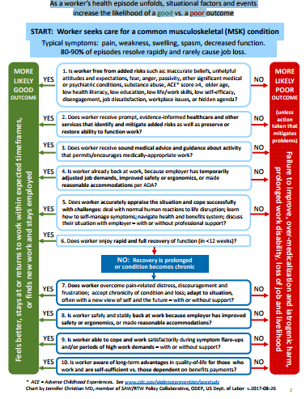
How to Mitigate Risk Factors for Long-Term Musculoskeletal Work Disability Part 1

Slide 17
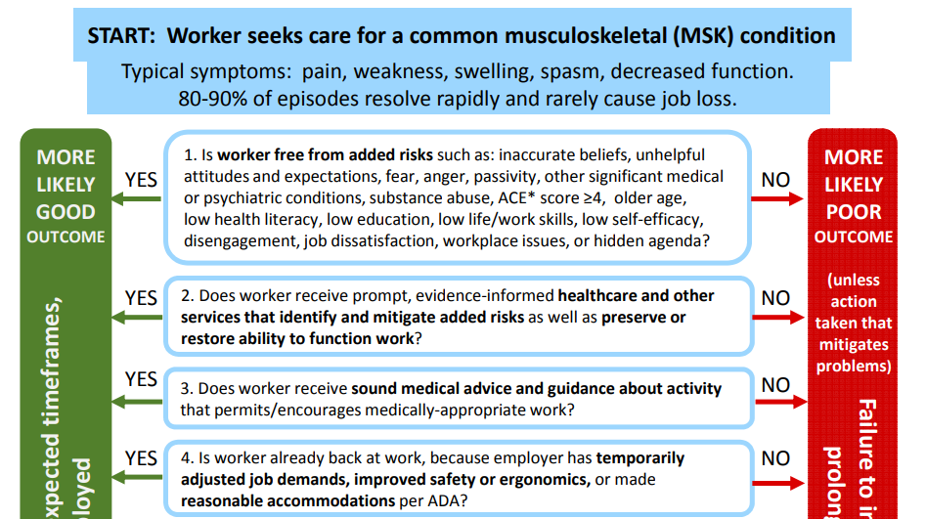
How to Mitigate Risk Factors for Long-Term Musculoskeletal Work Disability Part 2
As a worker’s health episode unfolds, situational factors and events increase the likelihood of a good vs. a poor outcome

Slide 18
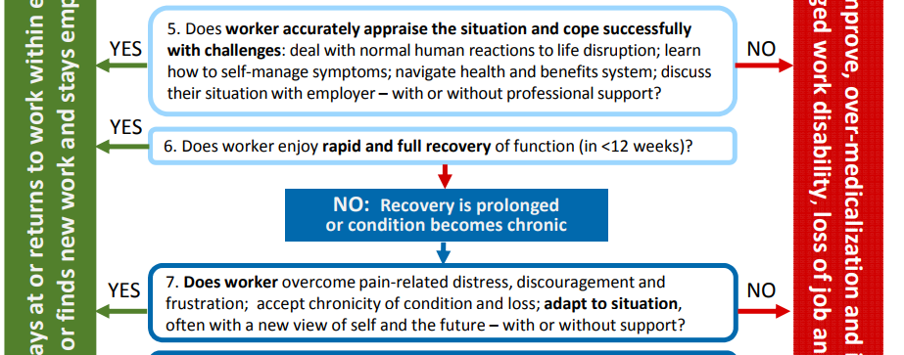
How to Mitigate Risk Factors for Long-Term Musculoskeletal Work Disability Part 3

Slide 19
How to Mitigate Risk Factors for Long-Term Musculoskeletal Work Disability Part 4
ACE = Adverse Childhood Experiences. See www.cdc.gov/violenceprevention/acestudy
Chart by Jennifer Christian MD, member of SAW/RTW Policy Collaborative, ODEP, US Dept. of Labor v.2017-08-26

Slide 20
4 key facts & concepts relevant to Creeping Catastrophes
ACEs are a major unaddressed root cause of BOTH subjective illness & organic disease.
Distress > Disease in creeping catastrophes.
ALL human experience is created by the brain; the body is the carrying case for the brain.
More medical care is not usually the answer; strengthening the person’s ability to cope is.
Notes:
22

Slide 21
Stop Creeping Catastrophes
The problem has appeared in the medical domain, but the solution lies elsewhere.
Illness ≠ Disease in most of these cases.
Strengthen people; get them “whole” enough to recover and cope.
Timely intervention with integrated multi-dimensional approach to care will address root causes, improve outcomes, & control costs.

Slide 22
Question Time – Question #9
Talk to us about your SSDI Solutions Initiative. What did you propose to reform SSDI and to improve outcomes?

Slide 23
Proposal for a Community-Focused Health & Work Service
Jennifer Christian
Kim Burton
Thomas Wickizer

Slide 24
How to Avoid Needless Impairment & Work Disability
Minimize residual impairment and maximize preservation / recovery of functions affected by the medical condition by:
Improving access / reducing delays in care.
Increasing effectiveness of treatment.
Paying specific attention to function.
Restore / strengthen the worker’s motivation & ability / willingness to cope.
Arrange workplace and logistical support to enable timely SAW/RTW.
©Copyright 2015 Webility Corporation – Reprinted by SSDI-SI with permission .

Slide 25
6 Key Distinctions
Work-disability vs. Impairment- disability
Common health conditions vs. typically disabling conditions (“classic” disabilities)
Potentially avoidable / remediable adverse secondary consequences of common health conditions vs. irrevocable loss.
Immediate response vs. early intervention
Functional recovery vs. functional restoration
Jobs are lost at the speed of life, not bureaucracy. Early events, expectations, and concerns are key.

Slide 26
Final Questions?
Do you have any final questions for Dr. Christian?

Slide 27
Happy Holidays from RespectAbility!

Slide 28
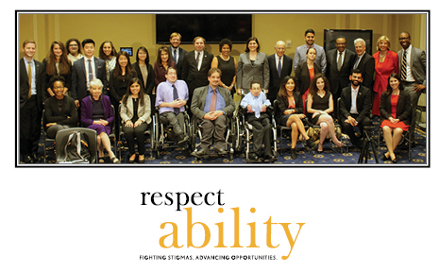
RespectAbility Contact Information
We have many resources for policy makers and employers on our website and are ready to help!
RespectAbilityUSA
11333 Woodglen Drive, #102
Rockville, MD 20852
www.RespectAbilityUSA.org
Cell: (202) 365 – 0787
Jennifer Laszlo Mizrahi
President
JenniferM@RespectAbility.org

