Slide 1
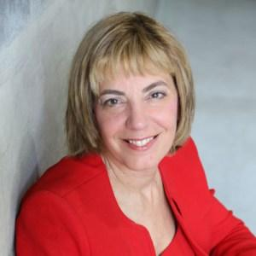
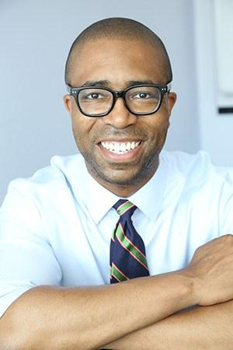
Jennifer Laszlo Mizrahi, President
Changing Minds, Changing Lives through Disability Inclusion
December 6th, 2017
Jennifer Laszlo Mizrahi, President, RespectAbility
Contact: JenniferM@RespectAbility.org
202-517-6272
Calvin Harris, Chairman
1

Slide 2
Changing Minds & Changing Lives through true Disability & Inclusion
Notes:
Good Morning! My name is Julie Sowash and I am so excited to be here with you for a few minutes this morning.
I am a senior consultant with disability solutions and I am a person with a disability, a hidden disability.
I have background in the private and public sector, including retail and restaurant management while I completed my undergrad….then I moved into HR and Recruiting systems, OFCCP Compliance, and how people in my community can have more successful careers in companies that will benefit from hiring us.

Slide 3
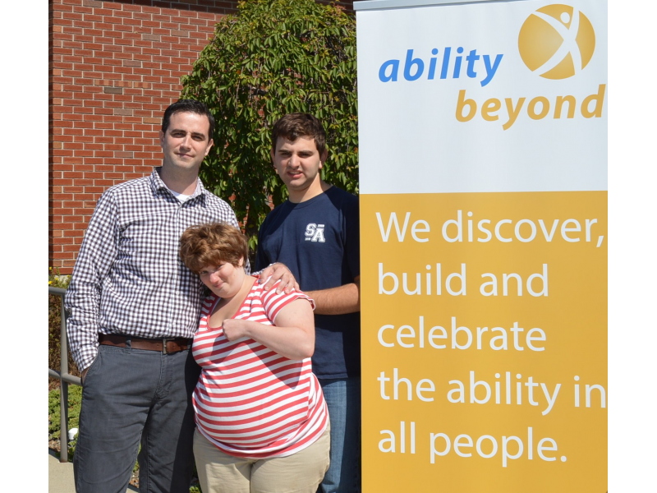
ABILITY BEYOND
60+ years working with corporations to:
Employ people with disabilities
Employ veterans with disabilities
Offices in Connecticut & New York
Disability Solutions is a part of Ability Beyond

Slide 4
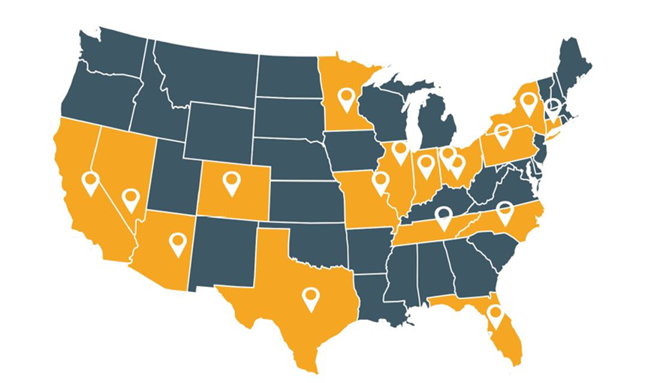
DISABILITY SOLUTIONS
Team of consultants working
with leading corporations globally
Pepsi
Staples
Synchrony Financial
Aramark
Aon
…and more.
Focus on
Strategy Development
Partnership Development
Recruitment
Training
Compliance
Human Resources

Slide 5
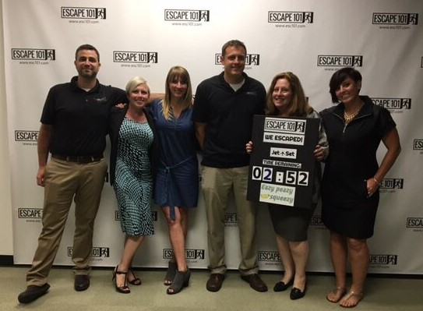
DISABILITY SOLUTIONS
#Changing Minds
Changing Lives
Website:
www.disabilitytalent.org
Career Center:
www.disabilitysolutionstalent.org

Slide 6
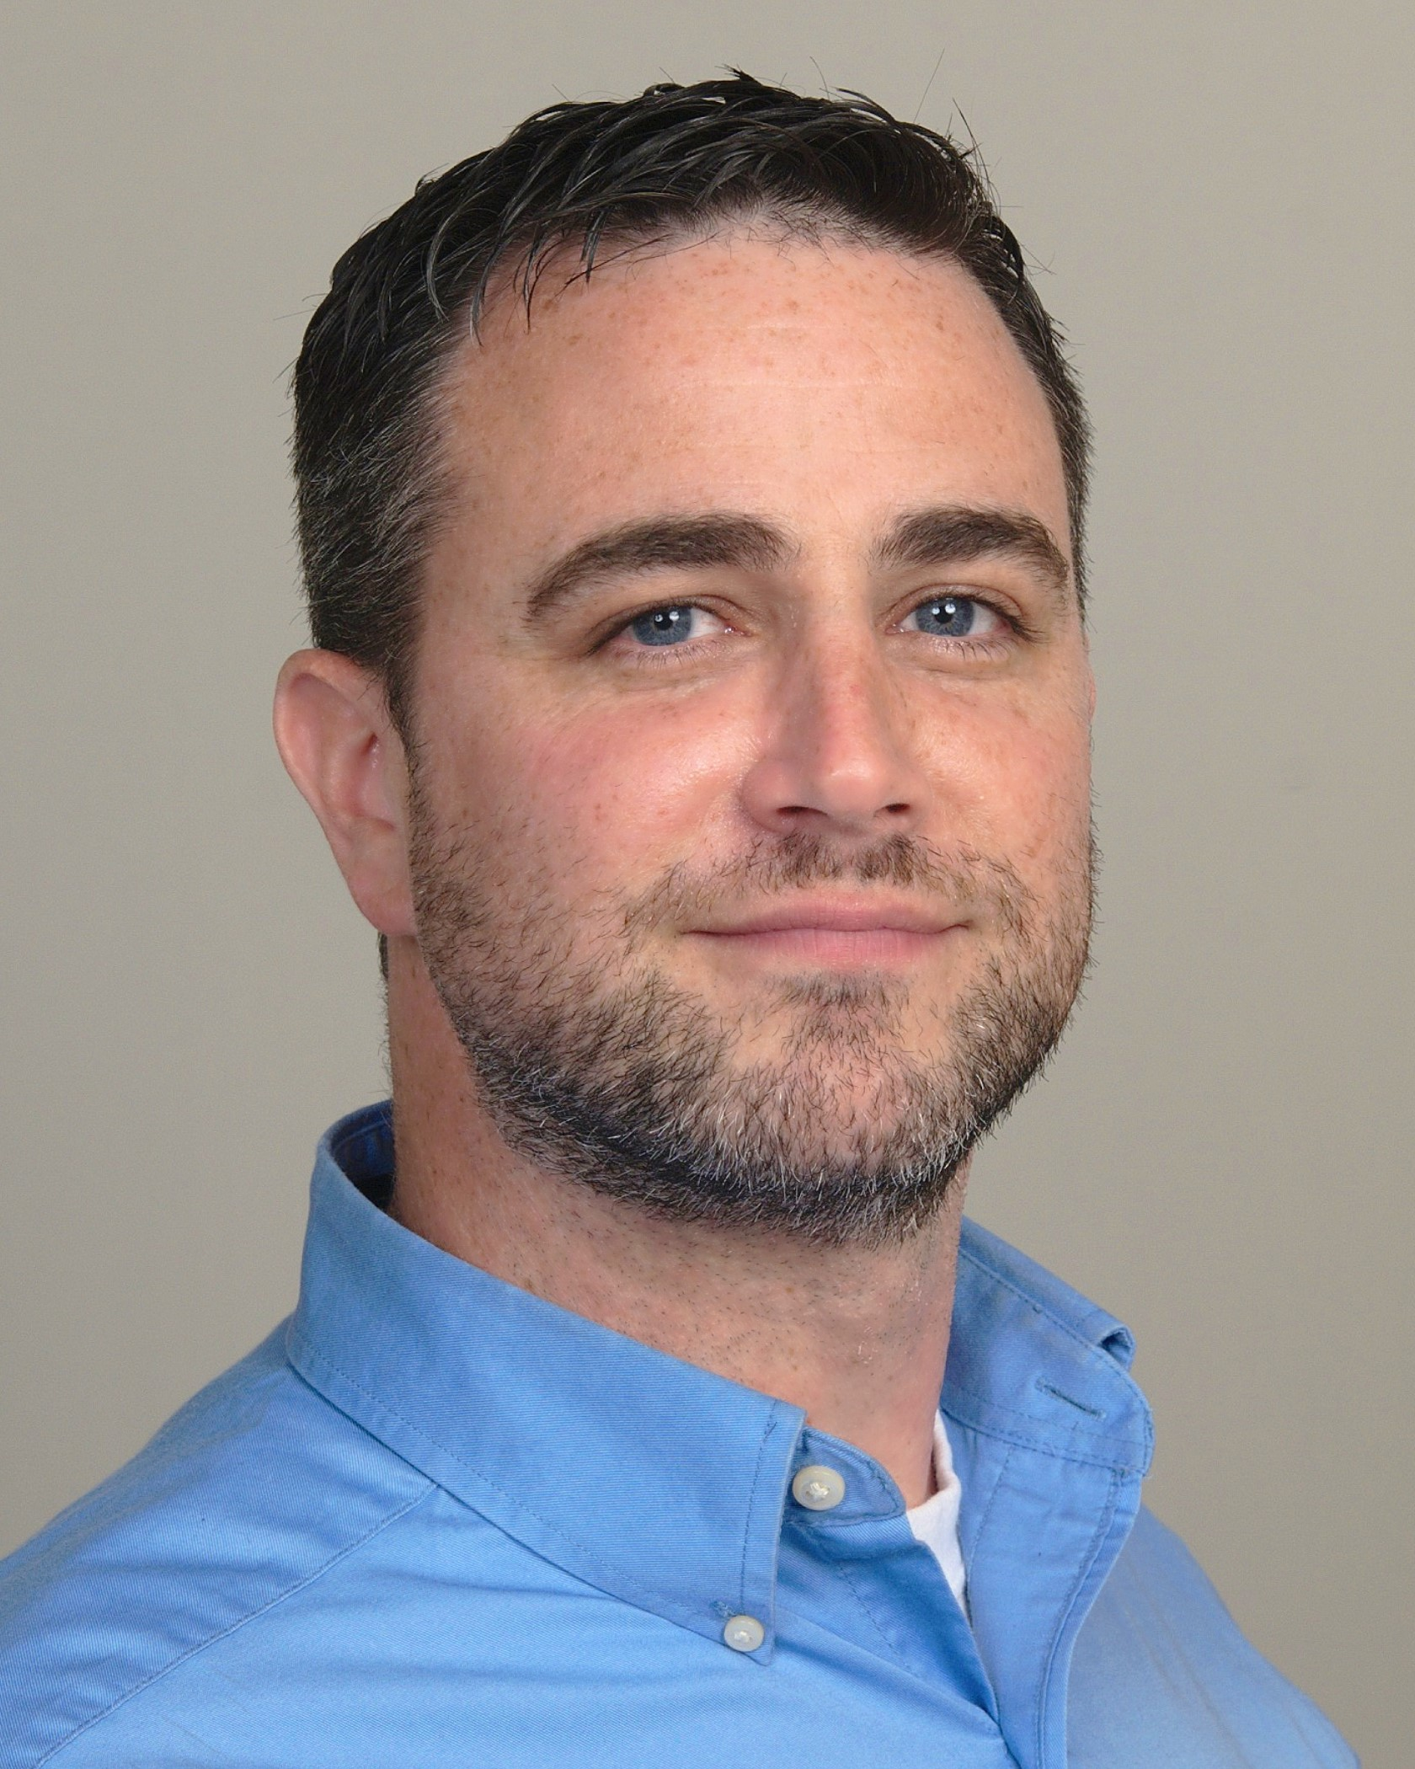
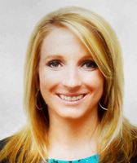
PRESENTERS
Kevin McCloskey
Director of Partnership Development
Julie Sowash
Senior
Consultant

Slide 7
OUR MISSION
Change conversation from charity to talent value.
Create sustainable business driven model that results in an aligned cost per hire.
Create strong case studies of successful engagements with business outcomes.
Utilize consulting revenue to continue to provide services to PWD through our parent company, Ability Beyond.
Changes the conversation from what PWD can’t do to what we CAN do.
Change systems from within….so more people with disabilities nationally can be engaged in meaningful employment at all levels.

Slide 8
VALUE
“This is the next frontier from both a brand and workforce perspective. Ensuring that people with disabilities see themselves and their needs reflected in our products and the services we offer is important. It’s important to our customers, as well as to our workforce.” - L. Kevin Cox, CHRO American Express
Forbes, July 30, 2015
BRAND
Employer
Products & Services
Culture
Engage Workforce
TALENT
Untapped pool
Innovation
Diversity within Disability
Perspective
COMPLIANCE
OFCCP
503
4212
Beyond Good Faith
Outcomes
Evaluation
MARKET
56.7MM PWD
Disposable Income = $645.3B
105MM Family & Friends
Disposable Income = $3.9T
Source: US Census, US Department of Labor, Statistics Canada, European Central Bank, The Return on Disability Group

Slide 9
EMPLOYERS

Slide 10
SECTION 503
7% Goal
Each job grouping
By location
Self-ID (pre and post offer)
Survey of employees
Training
Recordkeeping
Evaluation of Sources

Slide 11
SECTION 4212
6.8% hiring benchmark
Goal adjusts annually
List jobs with state workforce
Self-ID (pre and post offer)
Recordkeeping

Slide 12
INTERNET APPLICANT

Slide 13
INTERNET APPLICANT
WHAT IS THE INTERNET APPLICANT RULE?
Defines “Internet Applicant”
Prescribes the records contractors must maintain
Dispositions
Hiring
Demographics
Recordkeeping Requirements
Type
Format
Retention
Am I an Applicant?
WHO IS AN APPLICANT?
Person expresses interest
Meets the BQEs
Does not self-select out

Slide 14
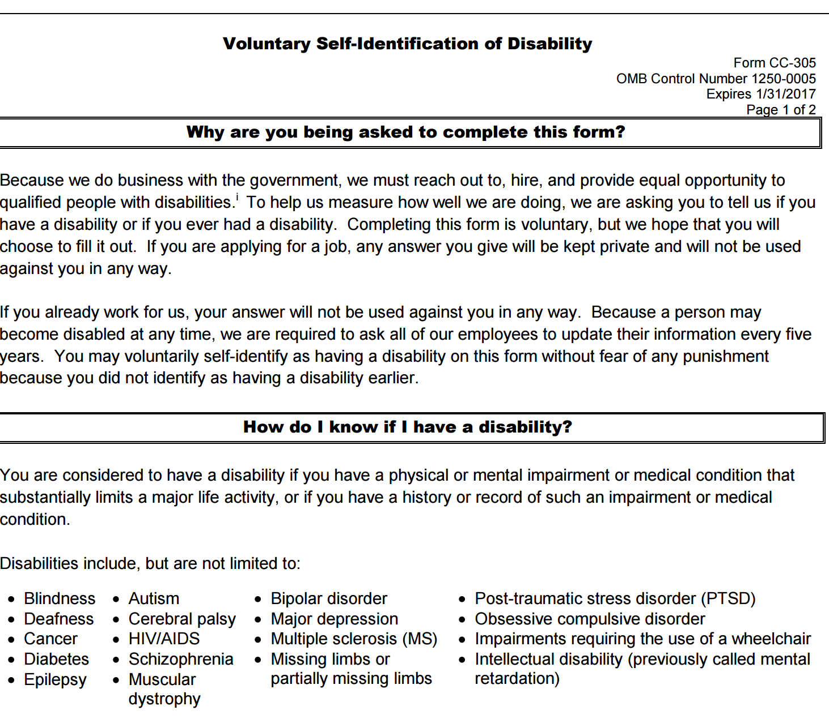
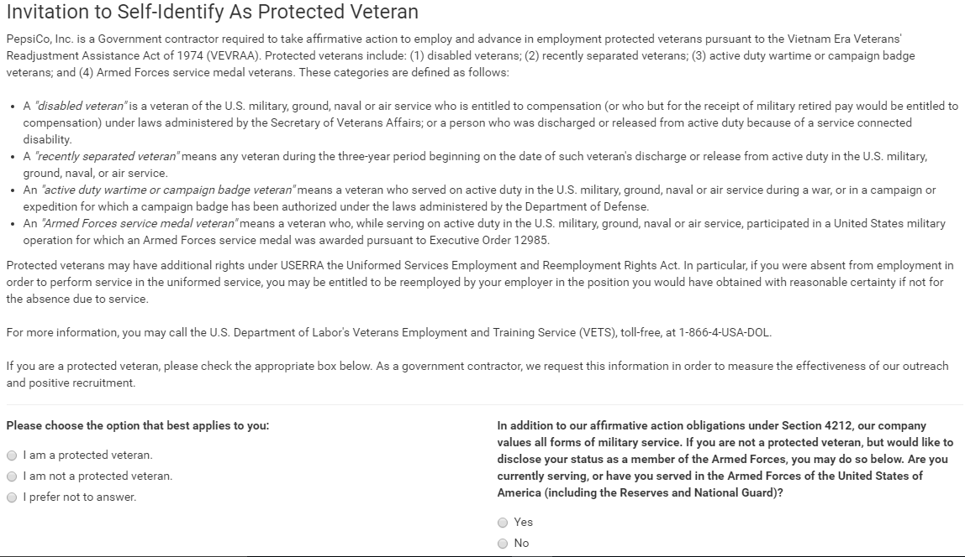
EMPLOYEE ID

Slide 15
DISCOVERY
ACTIVITIES
EXPERIENCE
SYSTEMS
POLICIES
INTERVIEWS
LEARNINGS
RECOMMENDATIONS
PLAYS
IMPACT AREAS
$$$
IMPACT
BRAND
RECRUIT
CULTURE
ENGAGE

Slide 16
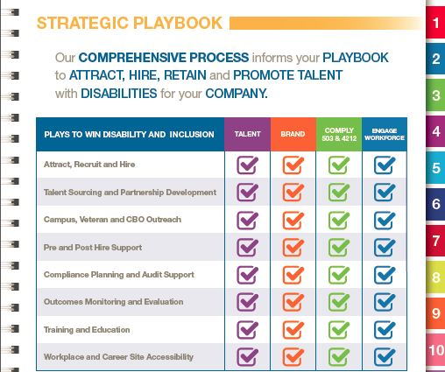
DISCOVER
SOLUTIONS PLAYBOOK
DEEP DIVE:
CANDIDATE EXPERIENCE
VENDOR PROCESSES
INTERNAL PROCESSES
©Disability Solutions @Ability Beyond
Ability Beyond Disability, Inc. 2016

Slide 17
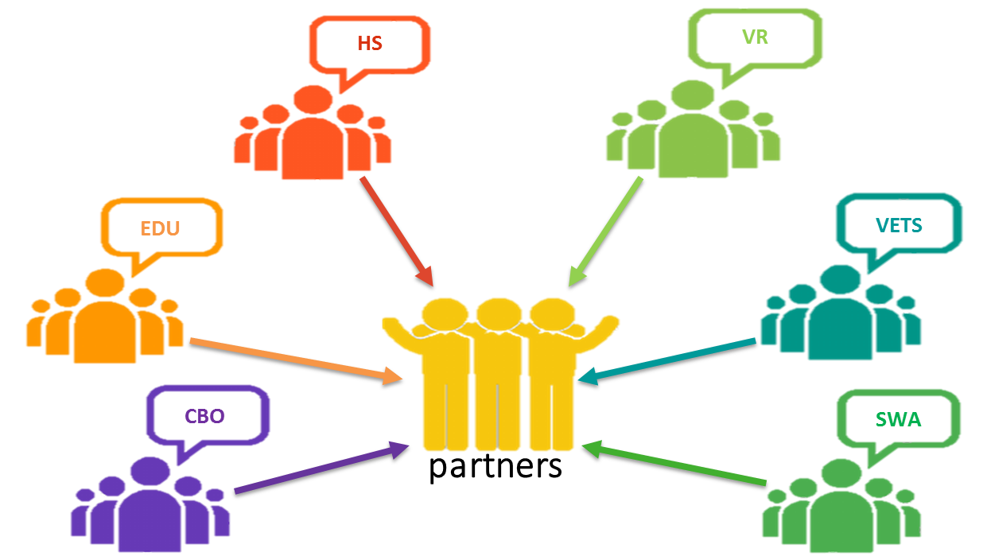
DESIGN & BUILD
PARTNERS
MANAGE
ATTRACT
ENGAGE
GROW
RESULTS
TRAIN
REFER
EMPLOYEE RESOURCE GROUPS
LEVERAGING ASSETS

Slide 18
DELIVER AND GO LIVE
DEPLOY customized and tested solutions nationally & globally
Go Live:
Refine model based on learnings/outcomes from pilot sites & programs
Implement site & program sustainability model
Create scaled expansion model and timeline
Finalize tools

Slide 19
DELIVER & GO LIVE
“WHAT JOBS CAN PWD DO?”
“WE ARE ONLY
HIRING PWD
IN THESE JOBS.”
“PWD CAN’T LIFT THINGS”

Slide 20
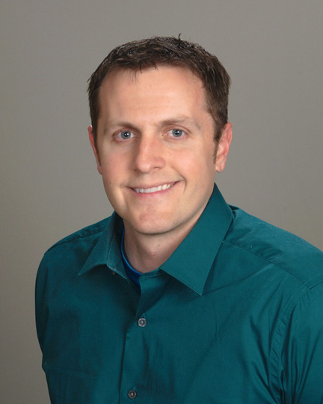
WHAT IS A
DISABILITY?
The term disability includes, but is not limited to, hidden disabilities such as depression, PTSD, anxiety disorders or ADD/ADHD, developmental disabilities such as Downs Syndrome or Autism, Physical Disabilities that impact mobility, dexterity, vision or hearing, and disability due to medical conditions, injury, or aging such as Parkinson’s, stroke, brain injury or cancer.

Slide 21
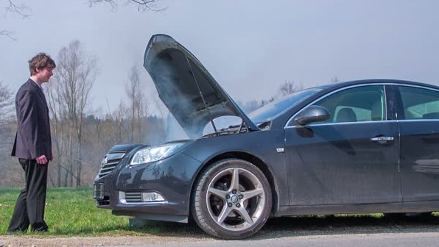
PERSON FIRST LANGUAGE
The “Disabled”
Handicapped
“R” word
Differently abled
Special
Challenged
--------------
Disabled Keith
vs.
Keith with a disability

Slide 22
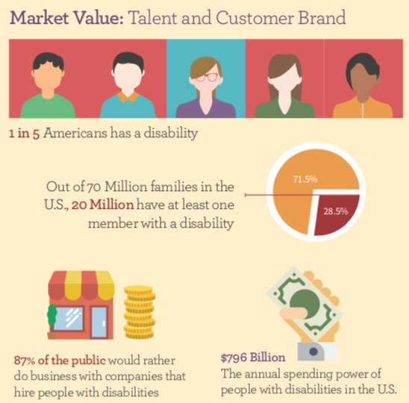
MARKET VALUE
Largest minority in US
Untapped Talent Pool
Spending POWER
It makes business sense

Slide 23
CASE STUDIES

Slide 24
PEPSI ACT
Pepsi ACT: Achieving Change Together
Actively recruit, train, hire and retain individuals with all types of disabilities including veterans with disabilities within all areas of Pepsi's operations.

Slide 25
Rationale
PEPSI ACT
Strengthen the Workforce
Broaden the Consumer Base
Lower Absenteeism & Turnover
Builds Morale and Raises Awareness; Increases Loyalty
Supports Federal Regulations Around Hiring Practices
Annual Spending Power >$800B
20 Million Families Have at Least One Member w/ Disability
Reflect Community in Which We Operate
Pepsi ACT Embodies Performance with Purpose
Notes:
Rationale was fairly simple:
Strengthen the workforce while expanding the consumer base
INTERNAL
Studies have shown that people with disabilities have a lower absenteeism and turnover than the average employee
EXTERNAL
At $800B in spending power, the disability community is xxx larger than t

Slide 26
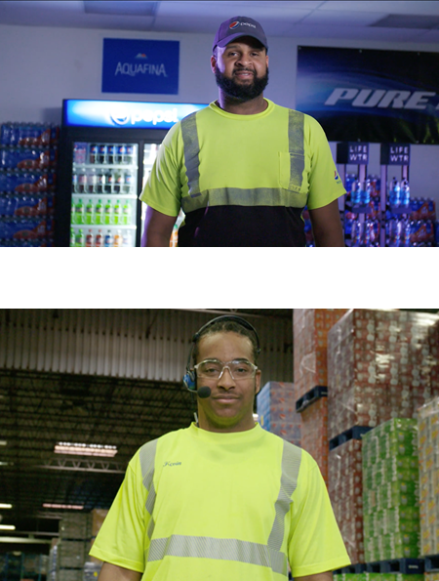
PEPSI ACT
Nine sites launched
Houston, Burnsville, Las Vegas, Winston-Salem, Phoenix, Nashville, Orlando, Indianapolis and Denver
Over 285 hires
Over 10 distinct roles
14% hiring retention
20% veterans with disabilities
National Recognition

Slide 27
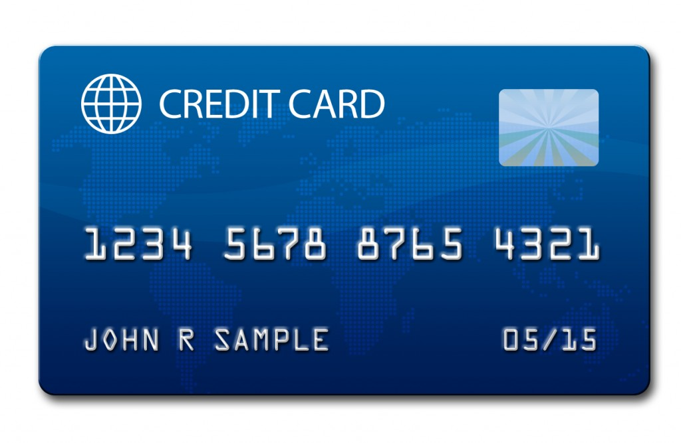
SYNCHRONY FINANCIAL
Customer Service Representative
handle inbound customer calls
address inquiries and resolve issues
review accounts
Collections Representative
inbound and outbound calls to/from past due accounts
assist customers with setting up payments
provide customer-centered positive experience

Slide 28
SYNCHRONY FINANCIAL
60 hires in Dayton, OH in 1 year
Multiple types of disabilities
Retention above company average
2017 Expansion site in Phoenix, AZ (17 hires to date)
Synchrony looking to company-wide expansion of program
National Recognition

Slide 29
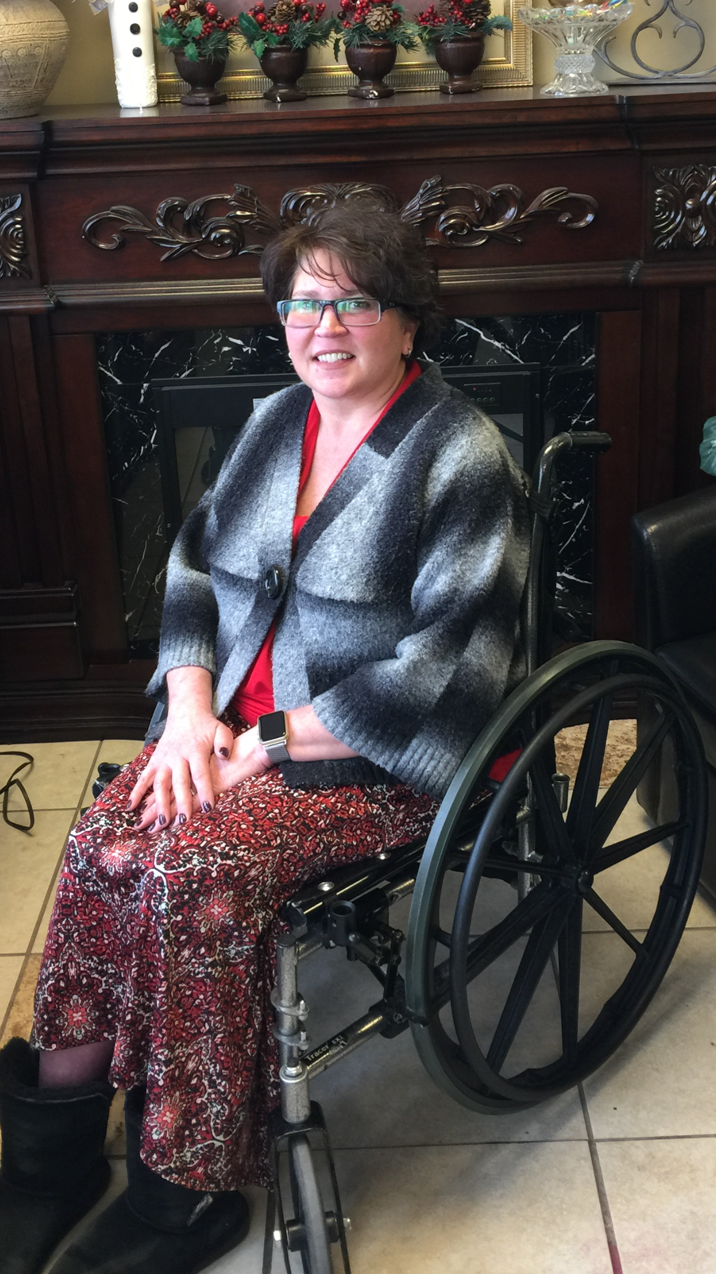
HORROR STORIES
“When I come rolling in…they’ve already decided ‘she’s not gonna fit.’” - Julie, SYF

Slide 30
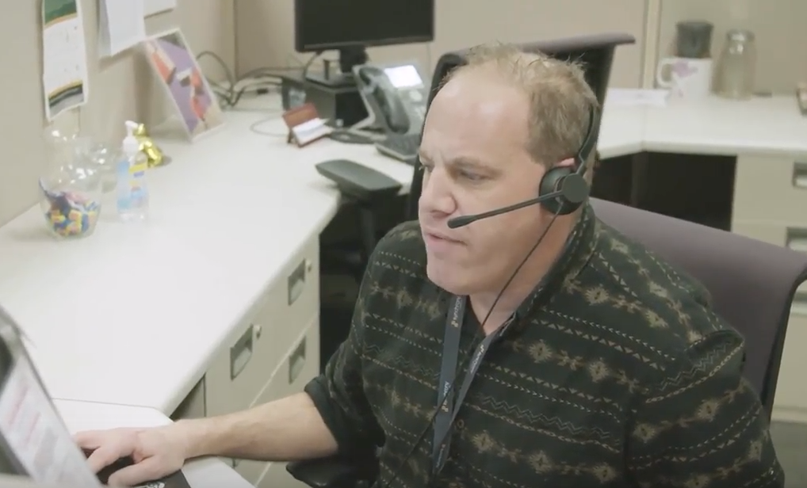
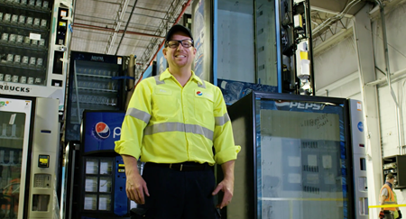
SUCCESS STORIES
Mark, SYF
Pete, Pepsi

Slide 31
Synchrony Financial People With Disabilities Network
SUCCESS STORIES

Slide 32
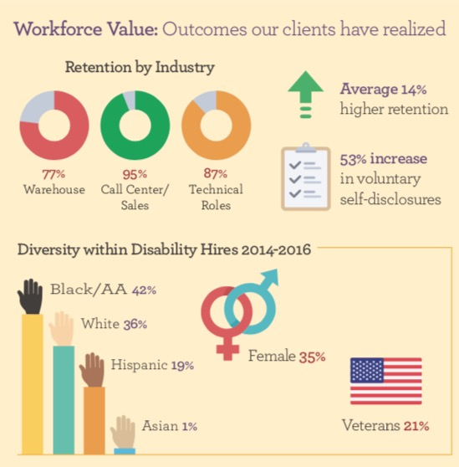
THE PUDDING
Our clients have seen…
Higher retention
Multiple jobs types
Enter level to management
Increase in self disclosures
Diversity within disability

Slide 33
Research and Development Bridging the Gap Increasing The Pipeline Support and Feedback
PARTNERSHIPS

Slide 34
State and county partners Vocational Rehabilitation, Workforce Centers, etc.
TYPES OF PARTNERS
Community based organizations (CBO's)
nonprofit groups that work at a local level to improve life for residents.
Nationally Known
Goodwill, Easter Seals, etc.
Veteran Groups
VA, Wounded Warrior Project, etc.

Slide 35
PARTNER RESEARCH
50-75 community based organizations serving jobseekers with disabilities
Research
Multiple partnerships
Outreach

Slide 36
PARTNER DEVELOPMENT
Meet & Greet
Mean What You Say
Listen to Partners
Make them feel important!

Slide 37
BRIDGING THE GAP

Slide 38
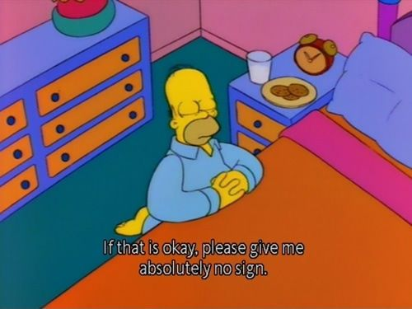
BRIDGING THE GAP
Beg, Place and Pray

Slide 39
BRIDGING THE GAP
Education
Job Description vs. Day in the Life
Applicant Lifecycle
Hiring Needs

Slide 40
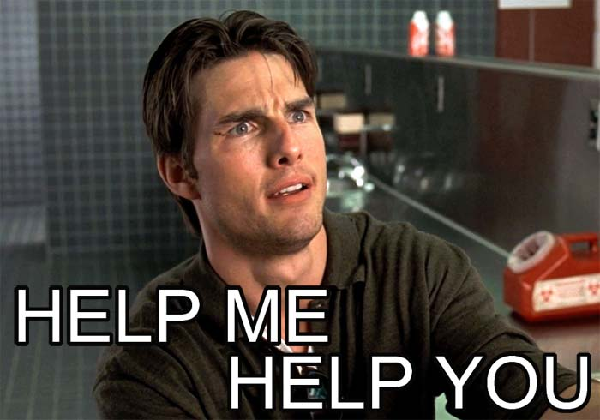
INCREASING THE
PIPELINE

Slide 41
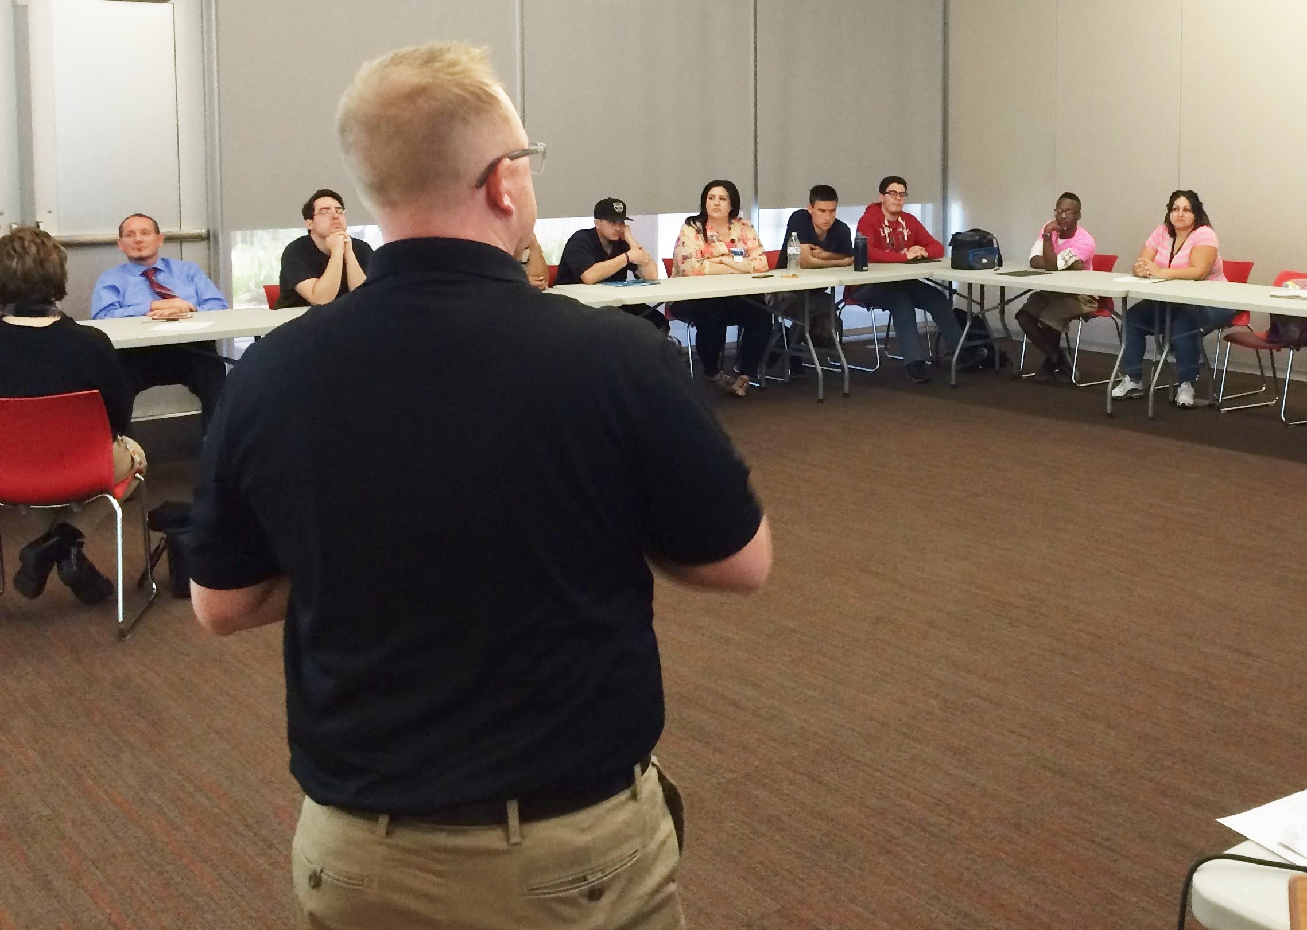
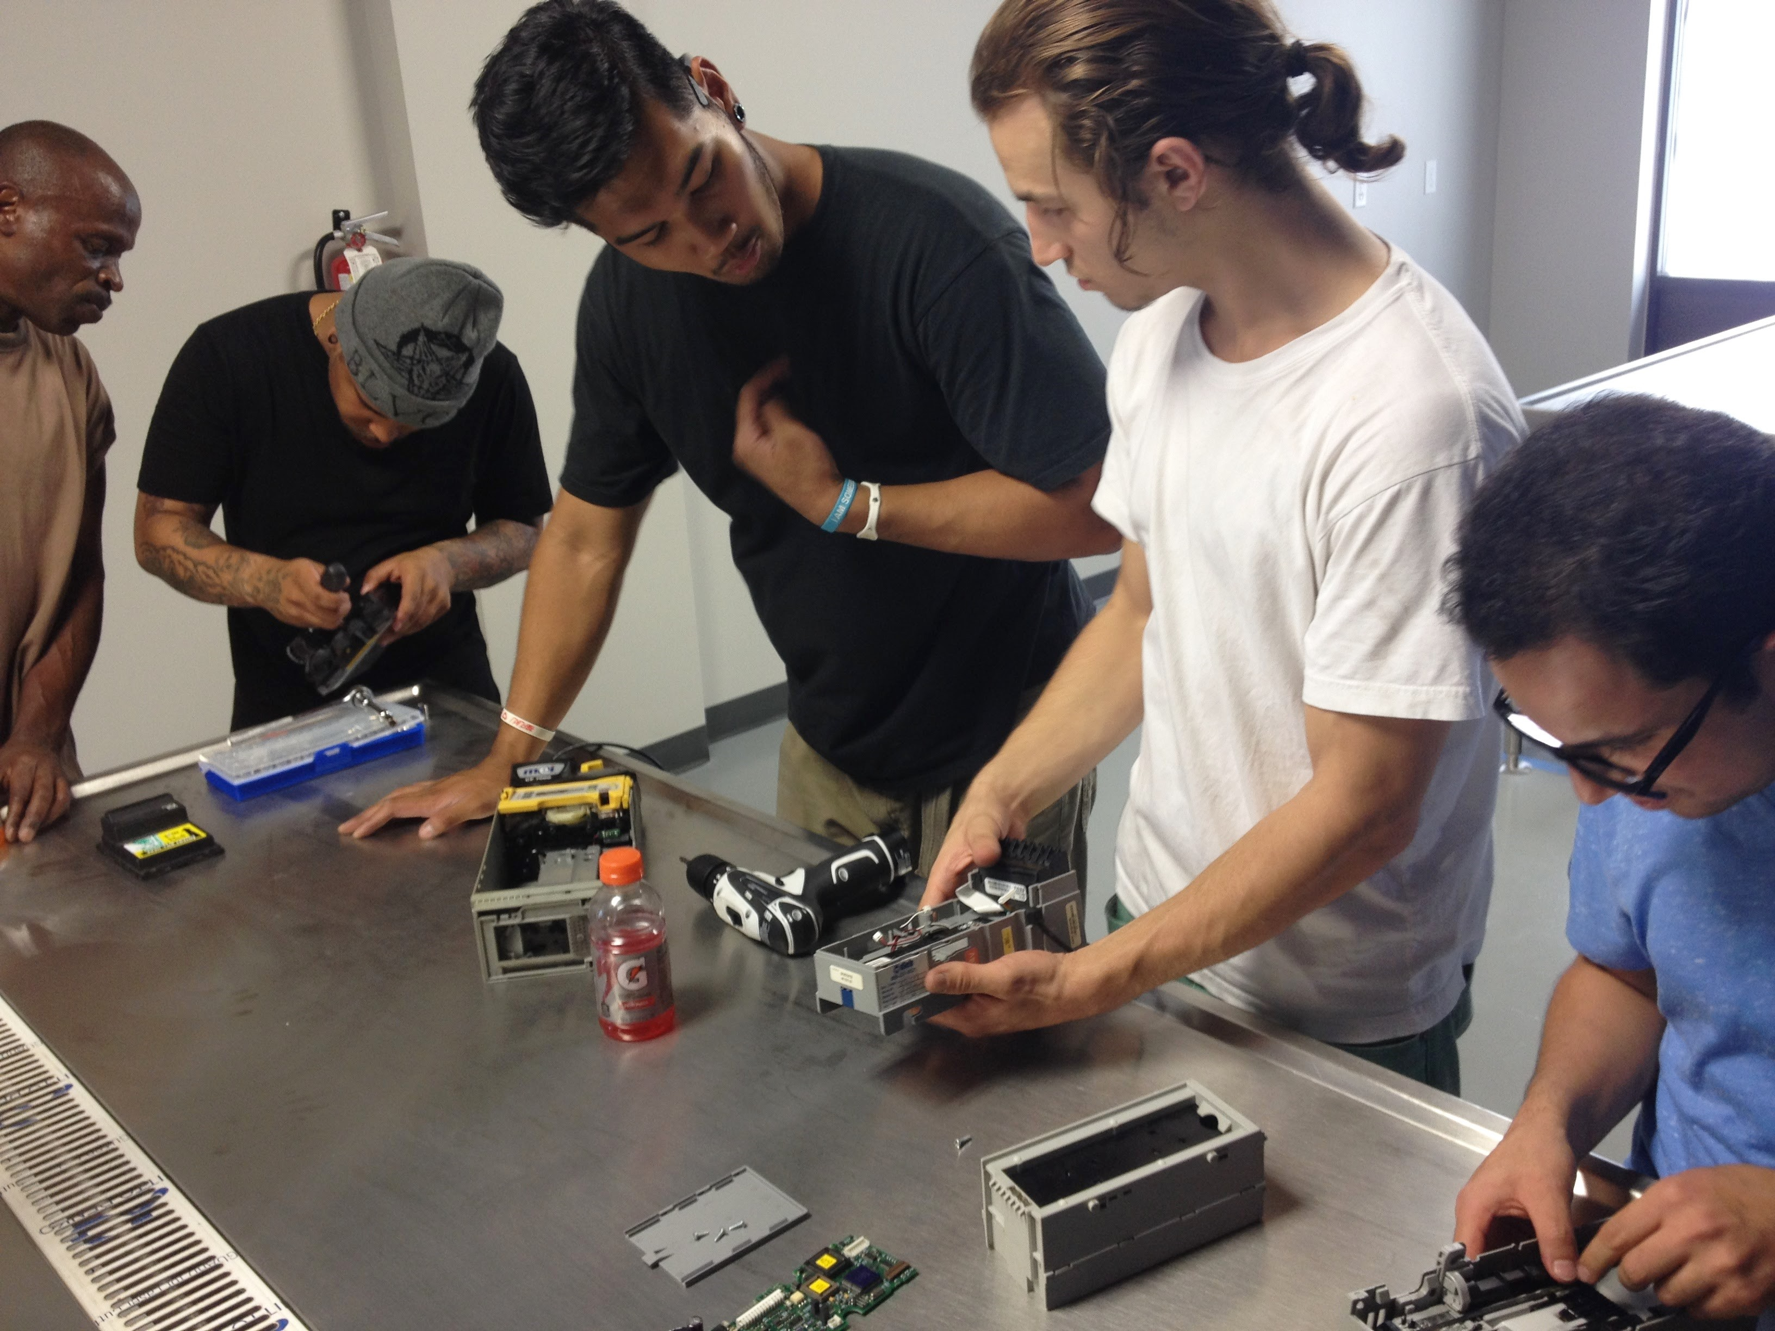
Training and Recruiting Programs
INCREASING THE
PIPELINE

Slide 42
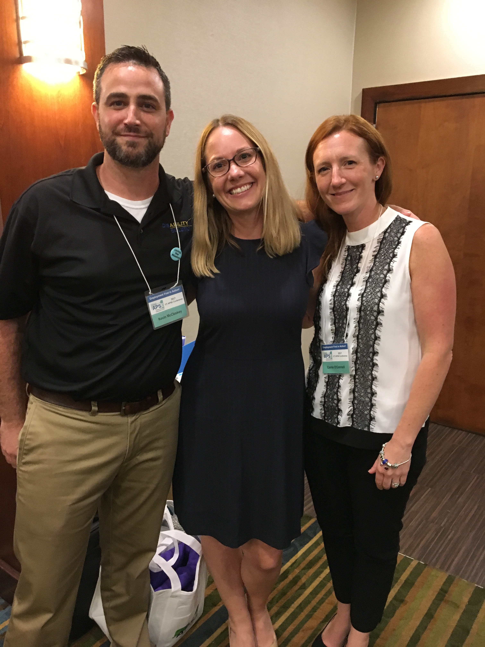
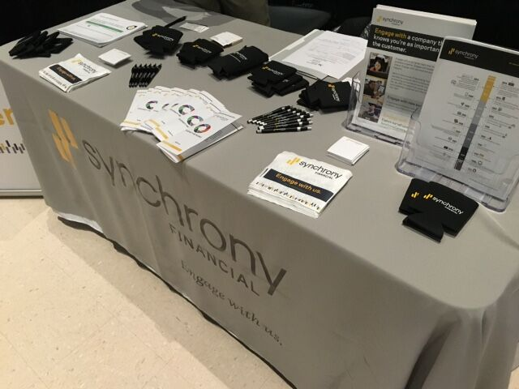
Career Fairs and Hiring Events
INCREASING THE
PIPELINE

Slide 43
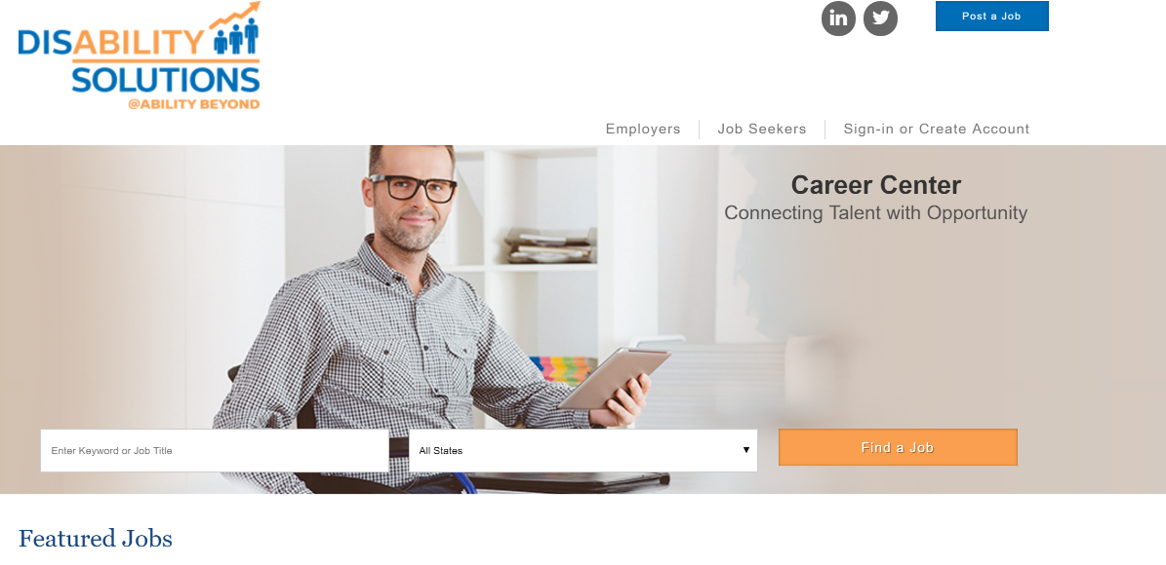
CAREER CENTER
Benefits:
Free
Anonymous
All Levels and Experiences
Job Alerts
Companies that WANT to Hire
More to come….
Disability Solutions Career Center

Slide 44
Tax Incentives and Spending Power
ADDITIONAL BENEFITS

Slide 45
COMMUNICATION
Celebrate the wins
Learn from mistakes
Solutions

Slide 46
TRICK OF RETENTION
“We realized when we invested in supporting our struggling new employees early, they were able to be successful and productive later on.”
– Pepsi HR

Slide 47
Natural Supports
TRICK OF RETENTION
Mentorships
Additional trainings
Support
Rule In vs. Rule Out

Slide 48
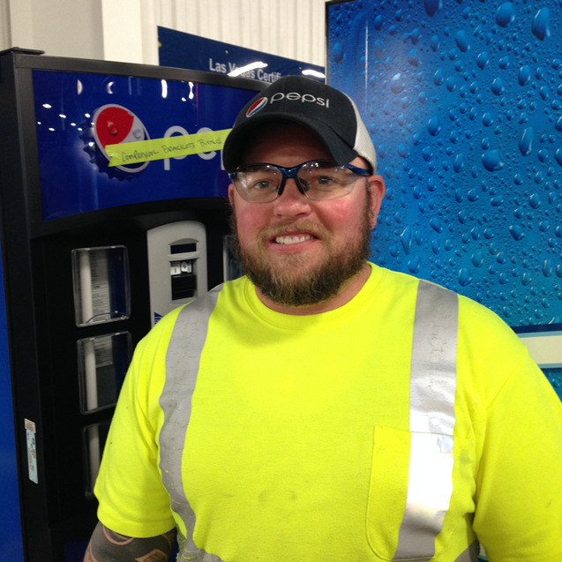
Accommodations
TRICK OF RETENTION
Adjustment of differences
Examples
Screen reader
Service dog
Adjusted schedule
Ergonomic chair and/or desk
Hearing aid
Braille
Large print materials
Refrigerator for medication

Slide 49
Feedback
TRICK OF RETENTION
Communication
Celebrate the wins
Learn from mistakes
Team approach

Slide 50
Q & A

Slide 51
HOW TO FIND US?
Kevin McCloskey
Director of Partnership Development
Julie Cook
Senior Consultant
#Changing Minds, Changing Lives
Website: www.disabilitytalent.org/Career
CareerCenter:www.disabilitysolutionstalent.org

Slide 52
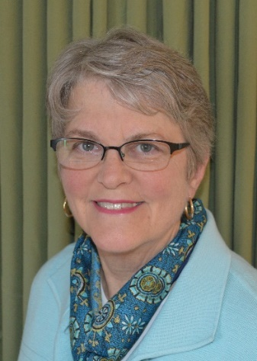
Join us for a special conversation about return-to-work/stay-at-work strategies.
Baby Boomers, Acquired Disabilities & Stay-at-Work Strategies with Jennifer Christian, MD
Wednesday, December 13th, 1:30pm Eastern Time
Live Captioning Provided. Free of Charge.
RSVP Required*
https://secure.confertel.net/tsRegisterD.asp?course=6269052

Slide 53
RespectAbility Contact Information
We have many resources for policy makers and employers on our website and are ready to help!
RespectAbilityUSA
11333 Woodglen Drive, #102
Rockville, MD 20852
www.RespectAbilityUSA.org
Cell: (202) 365 – 0787
Jennifer Laszlo Mizrahi
President
JenniferM@RespectAbilityUSA.org

