Slide 1
THE NATIONAL LEADERSHIP PROGRAM
The National Leadership Program
Reporting from September 2016 to August 2017

Slide 2
RESPECTABILITY’S MISSION
RespectAbility’s mission is to fight stigma and advance opportunities so that people with disabilities can fully participate in all aspects of community. We are unique in our national focus on enabling people with disabilities to get the education, skills, and opportunities they need to achieve competitive, integrated employment and independence.
RespectAbility is a nonprofit, nonpartisan organization that understands we are a stronger community when we live up to our values – when we are welcoming, diverse, moral and respect one another.
We work with entertainment, policy makers, educators, self-advocates, nonprofits, employers, faith-based organizations, philanthropists, journalists and online media to fight stigmas and advance opportunities for people with disabilities.
Led by people with disabilities and those who love them, we know that people with disabilities and their families have the same hopes and dreams as everyone else, even if they face different challenges.

Slide 3
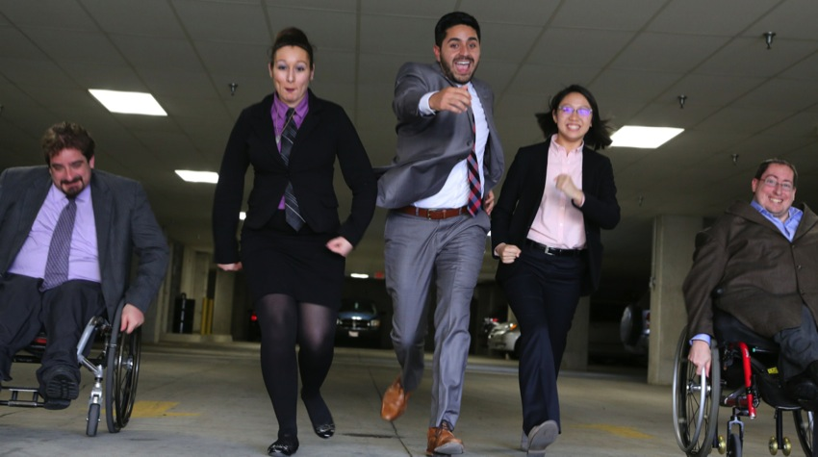
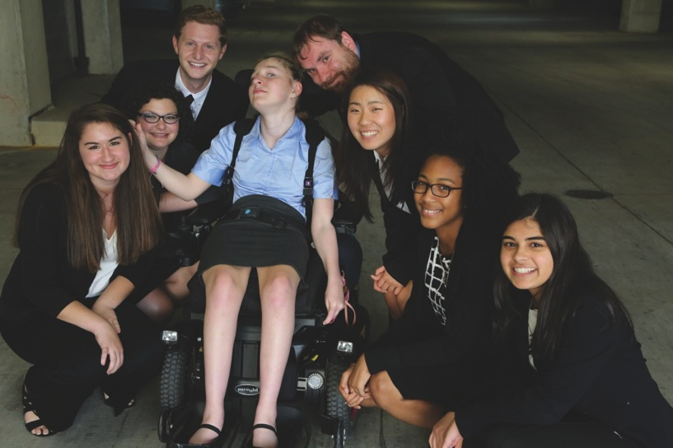
THE NATIONAL LEADERSHIP PROGRAM
The National Leadership Program has three cohorts of Fellows – fall, spring and summer – for a total of at least 24 Fellows.
There have been 105 Fellows since the Spring of 2014.
Pictures of our Summer 2017 Fellows

Slide 4
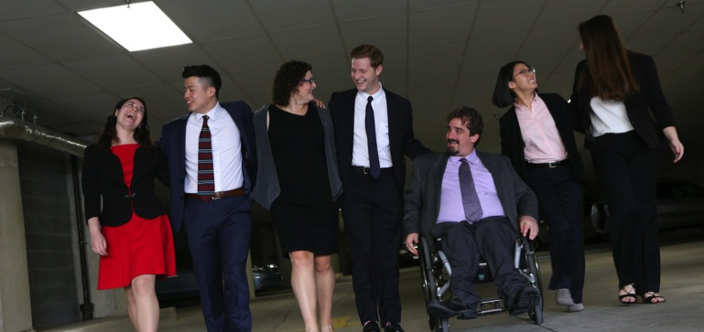
GOALS OF THE FELLOWSHIP
1) It will provide intensive job-training in strategic communications for at least 24 college students and graduates each year, as well as online training for thousands of others;
2) Participants will directly help RespectAbility’s work on inclusive employment and stigma reduction (including in mental health);
Summer 2017 Development and Jewish Inclusion Fellows

Slide 5
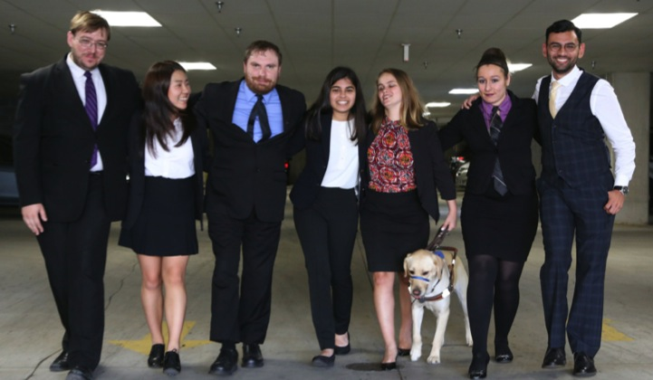
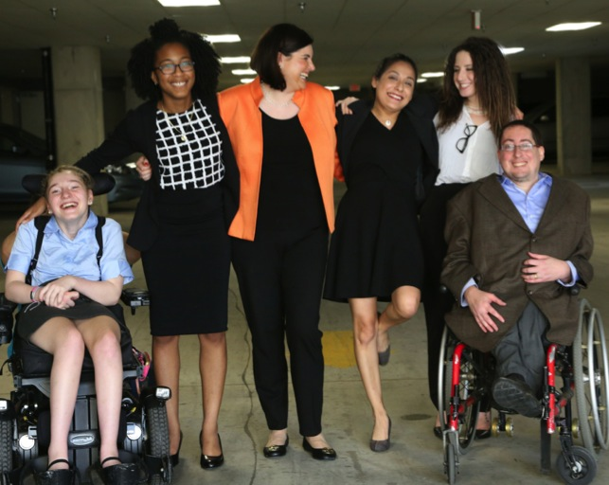
GOALS OF THE FELLOWSHIP
3) It will develop a successful and replicable model to enable college graduates with disabilities (including mental health differences) to successfully enter the career ladder;
4) It will develop confident leaders and self-advocates trained to solve issues in the future.
Top: Summer 2017 Policy Fellows
Right: Summer 2017 Communications Fellows

Slide 6
THANKS TO YOU, WE WERE ABLE TO:
Provide intensive job-training in strategic communications for 26 college students and graduates, as well as online training for thousands of others;
Directly help RespectAbility’s work on Jewish inclusion, inclusive employment, and stigma reduction;
Develop a successful and replicable model to enable college graduates with disabilities to successfully enter the career ladder;
Develop confident leaders and self-advocates trained to solve issues in the future.

Slide 7
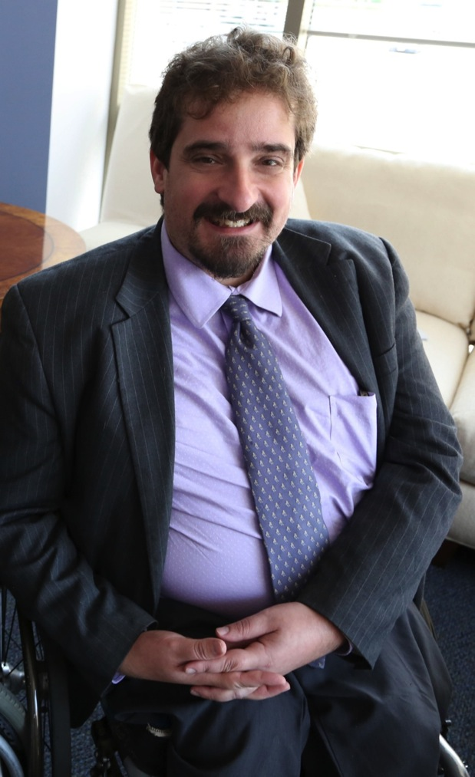
BEN SPANGENBERG
NATIONAL LEADERSHIP PROGRAM MANAGER
Spangenberg is the manager of RespectAbility’s National Leadership Program where he recruits and trains leaders for careers in public policy, advocacy and media. He was previously RespectAbility’s Special Assistant to the President. He also assisted with RespectAbility’s democracy work.
Read his full bio on our newly updated website.

Slide 8
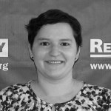
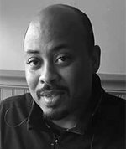
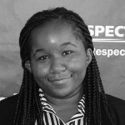
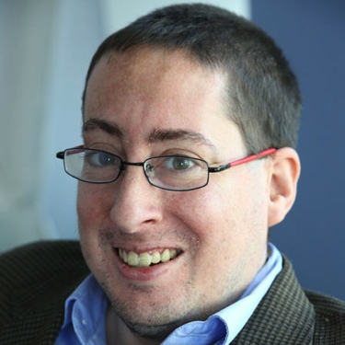
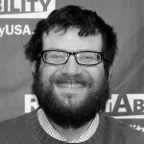
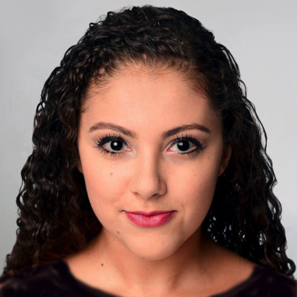
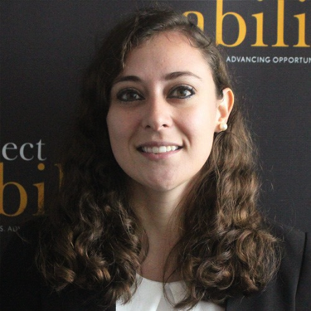
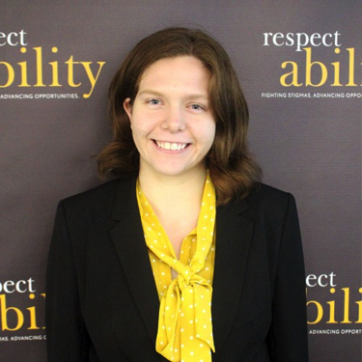
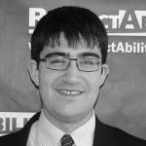
FALL 2016 FELLOWS
Jennifer Bohlman
Social Media & Communications
Eddie B. Ellis Jr.
Criminal Justice Reform
Dionne Joseph
Communications & Stigma
David Richman
Communications & Stigma
Adam Rothstein
Public Policy & Employment

Slide 9
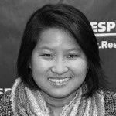
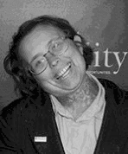
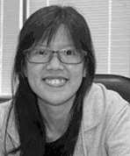
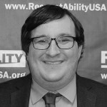
SPRING 2017 FELLOWS
Ming Canaday
Public Policy
Nicole Leblanc
Public Policy
Clara Loh
Public Policy
Matthew Wagner
Development & Policy

Slide 10
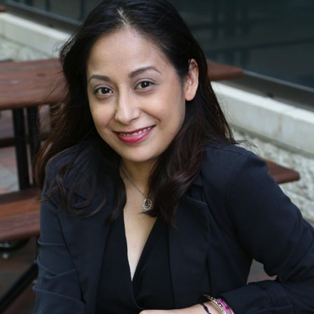
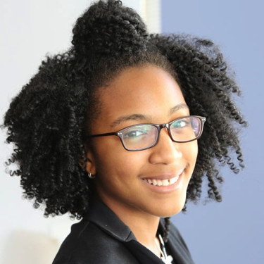
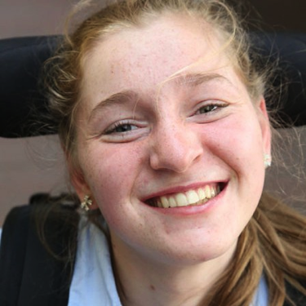
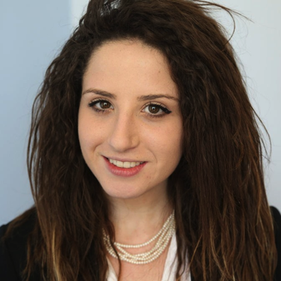
SUMMER 2017 COMMUNICATIONS & STIGMA FELLOWS
Marisela Rivera
Full Bio
Brieanna Iyomahan
Full Bio
Lilly Grossman
Full Bio
Justin Chappell
Full Bio
Ella Issacharoff
Full Bio
Brilynn Rakes
Full Bio

Slide 11
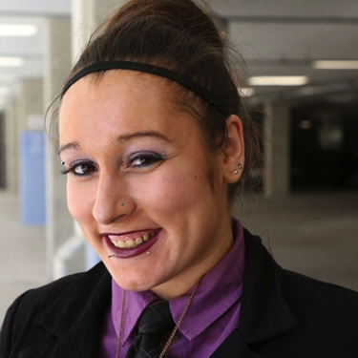
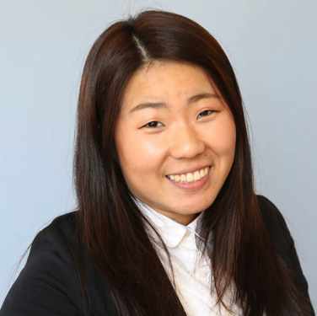
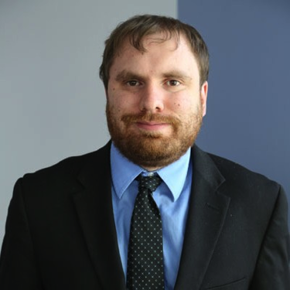
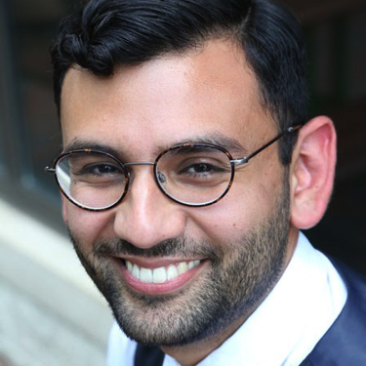
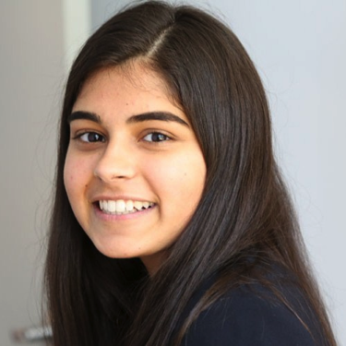
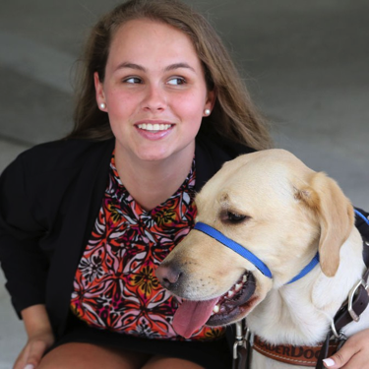
SUMMER 2017 PUBLIC POLICY & EMPLOYMENT FELLOWS
Amelia Heiden
Full Bio
Ana (Hee Jae) Song
Full Bio
James Trout
Full Bio
Ricky Rendon
Full Bio
Sneha Dave
Full Bio
Stephanie Flynt
Full Bio

Slide 12
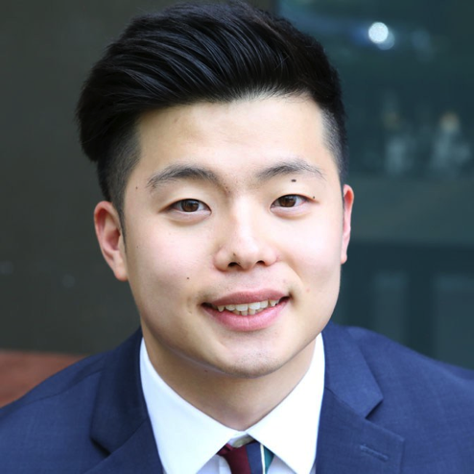
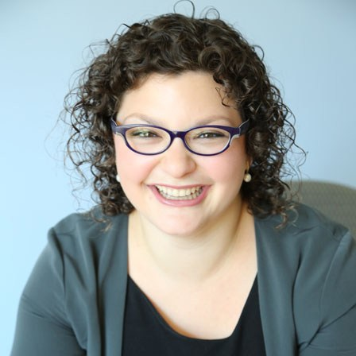
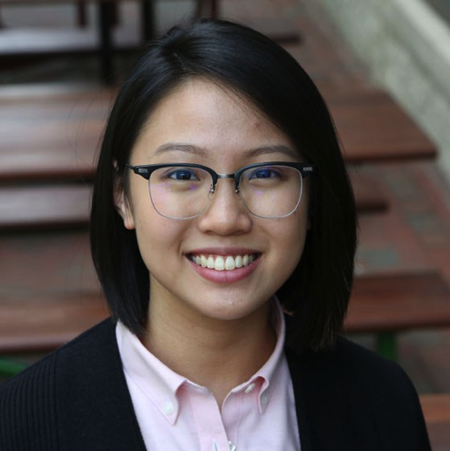
SUMMER 2017 DEVELOPMENT & FUNDRAISING FELLOWS
D.H. Lee
Full Bio
Emma Adelman
Full Bio
Judith Lao
Full Bio

Slide 13
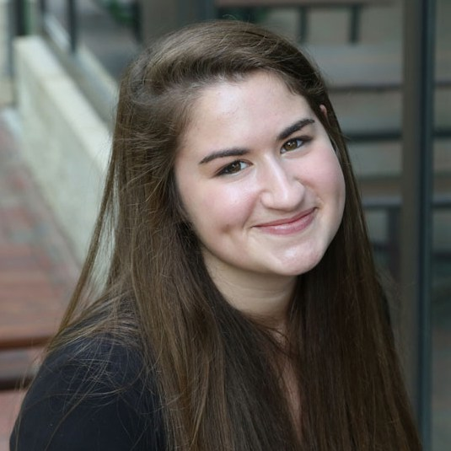
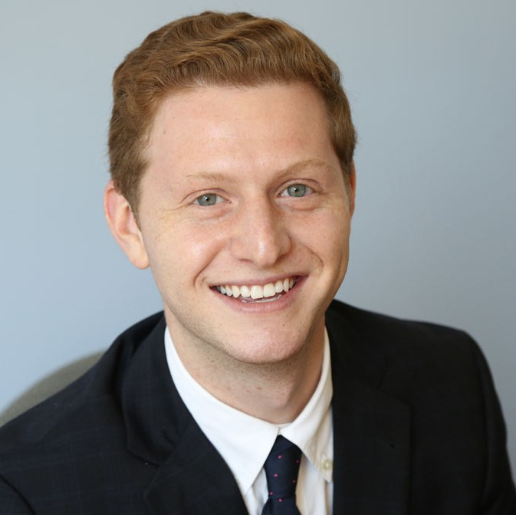
SUMMER 2017 JEWISH INCLUSION FELLOWS
Rachael Schindler
Full Bio
Matthew Lerner
Full Bio

Slide 14
FELLOWS: BACKBONE OF OUR MAJOR EVENTS
Without our Fellows, we would not be able to achieve all of the successes we have in the past year in Hollywood, Long Beach and on Capitol Hill:
Tuesday, Feb. 21: Summit on Inclusion and Diversity in Hollywood in Sherman Oaks, California
Monday, July 31: From Hollywood to Capitol Hill – The Future of Americans with Disabilities All-Day Summit in Washington, D.C.
Monday, August 14: Bettering Lives in Long Beach, California All-Day Summit
Wednesday, August 16: Diversity, Equality and Inclusion in Hollywood Breakfast in Glendale, California

Slide 15
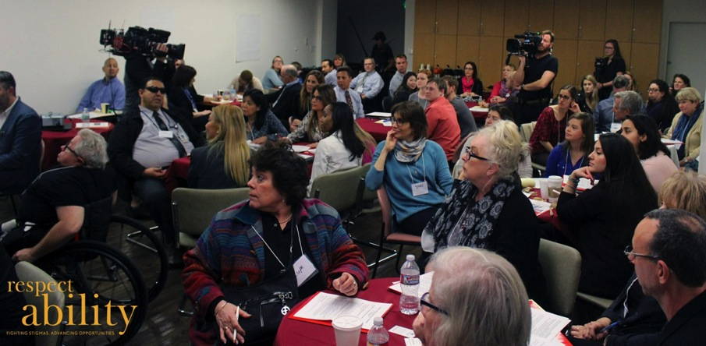
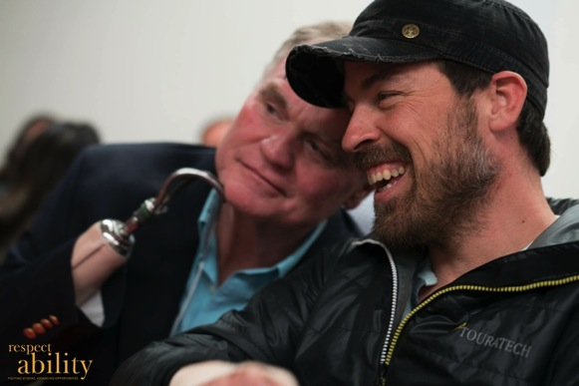
SUMMIT ON INCLUSION AND DIVERSITY IN HOLLYWOOD
Various stakeholders attending the summit
Actors with disabilities John Lawson and Kurt Yaeger attending the summit
On Tuesday, February 21, 2017, nearly 100 people joined us in Sherman Oaks, California for an afternoon summit, which addressed ways to moved the needle on two core issues: inclusion and diversity in Hollywood and employment of people with disabilities, hosted by Rep. Brad Sherman. Fellows created lists of relevant stakeholders and invited them via phone. View the Photos

Slide 16
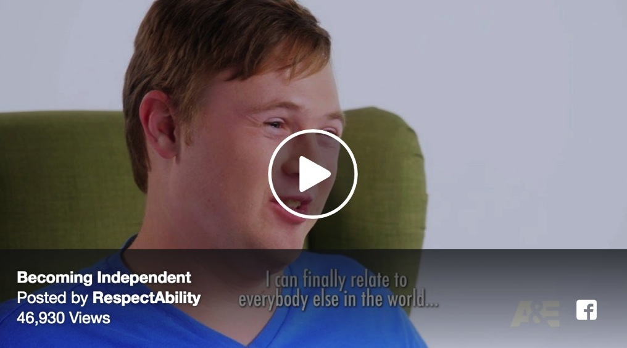
RESPECTABILITY ON BORN THIS WAY
On June 6, RespectAbility’s February summit was featured on Born This Way. “I get to have more freedom,” Cast Member Steven Clark said about the importance of having a successful career being key in becoming independent. “I get to be more adult-oriented. I can finally relate to everyone else in the world who gets up early in the morning for a job.” Learn More

Slide 17
RESPECTABILITY ON BORN THIS WAY
In coordination with the episode and with the help of our Fellows, RespectAbility released the Born This Way Fan Guide with free resources for a variety of individuals with disabilities. The guide includes free tools, contacts, information and services around job seekers, employers, education, policy makers, entertainment, sex education, ending the school-to-prison pipeline and inclusive philanthropy. Learn More

Slide 18
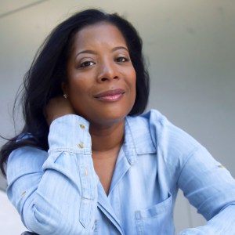
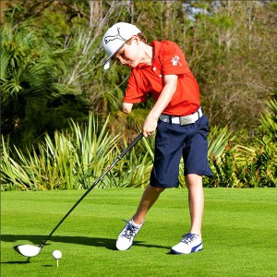
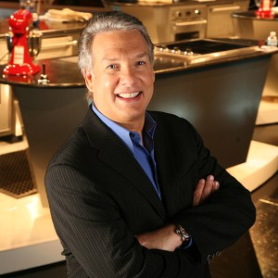
FROM HOLLYWOOD TO CAPITOL HILL: THE FUTURE OF AMERICANS WITH DISABILITIES
Leah Daniels-Butler
Casting Director & Producer
Tommy Morrissey
One-Arm Golfer
Marc Summers
Television Host, The Food Network
This summit, held on Monday, July 31, 2017, featured Marc Summers of The Food Network, Casting Director and Producer Leah Daniels-Butler and Tommy Morrissey, the one-arm golfer. The entire event aired live on C-SPAN 2. Learn More

Slide 19
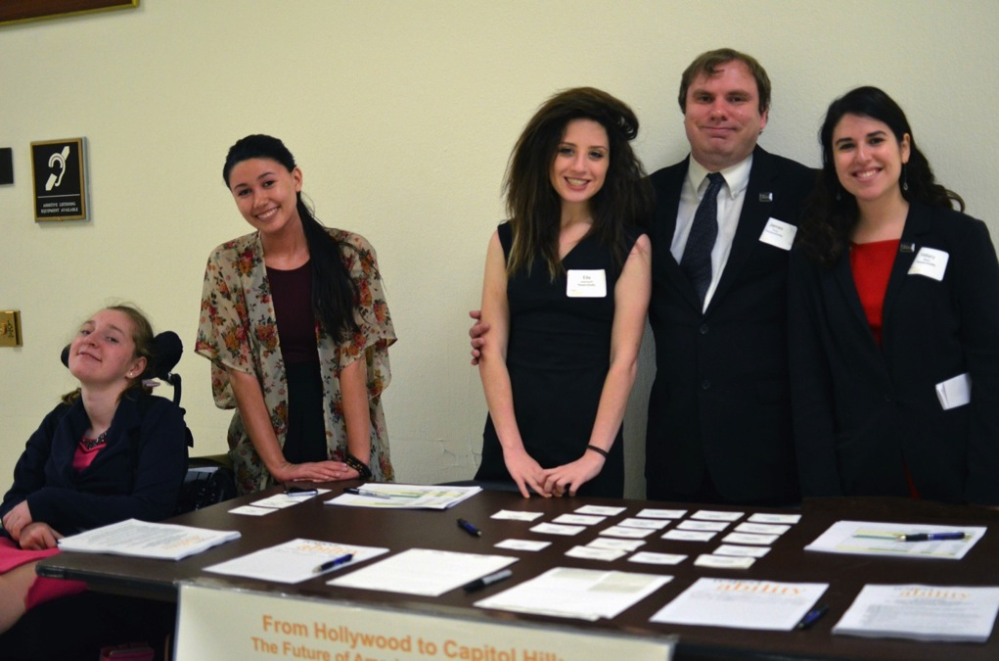
FROM HOLLYWOOD TO CAPITOL HILL: THE FUTURE OF AMERICANS WITH DISABILITIES
Fellows assisted with inviting speakers and attendees, as well as working the event – from running the registration table to social media.
Fellows working the registration table

Slide 20
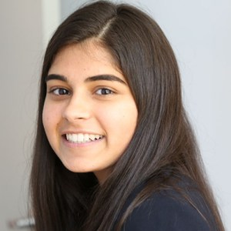
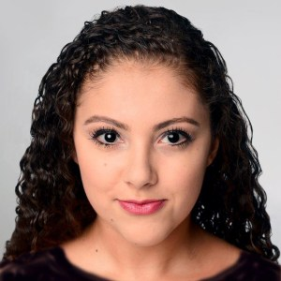
FROM HOLLYWOOD TO CAPITOL HILL: THE FUTURE OF AMERICANS WITH DISABILITIES
Two of our Summer 2017 Fellows spoke at the event:
Sneha Dave
Chronic Illness and Disability Advocate
Watch Panel on C-SPAN
Brilynn Rakes
Visually-Impaired Dancer
Watch Clip on C-SPAN

Slide 21
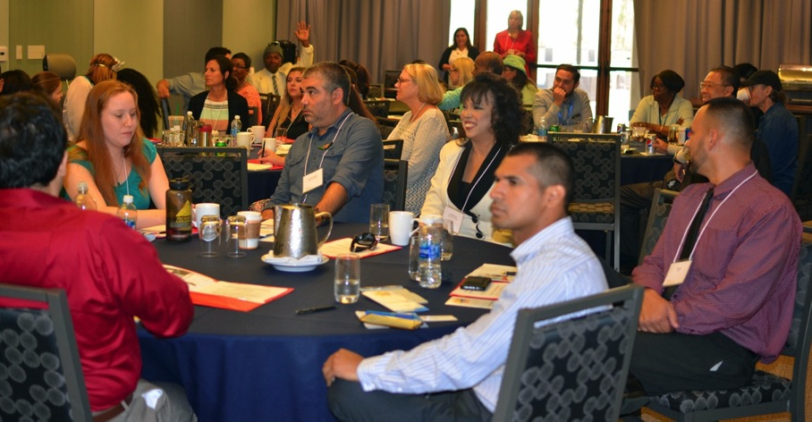
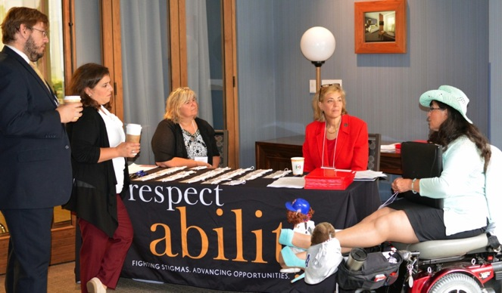
BETTERING LIVES IN LONG BEACH, CALIFORNIA
Various stakeholders attending the day-long meeting
Members of the community registering
On Monday, August 14, 2017 nearly 50 stakeholders gathered to learn about the challenges facing people with disabilities in Long Beach, with a focus on education and transitioning to the workforce. This was just the kickoff to a Community of Practice in Long Beach. Fellows created lists of relevant stakeholders and invited them via phone. Learn More

Slide 22
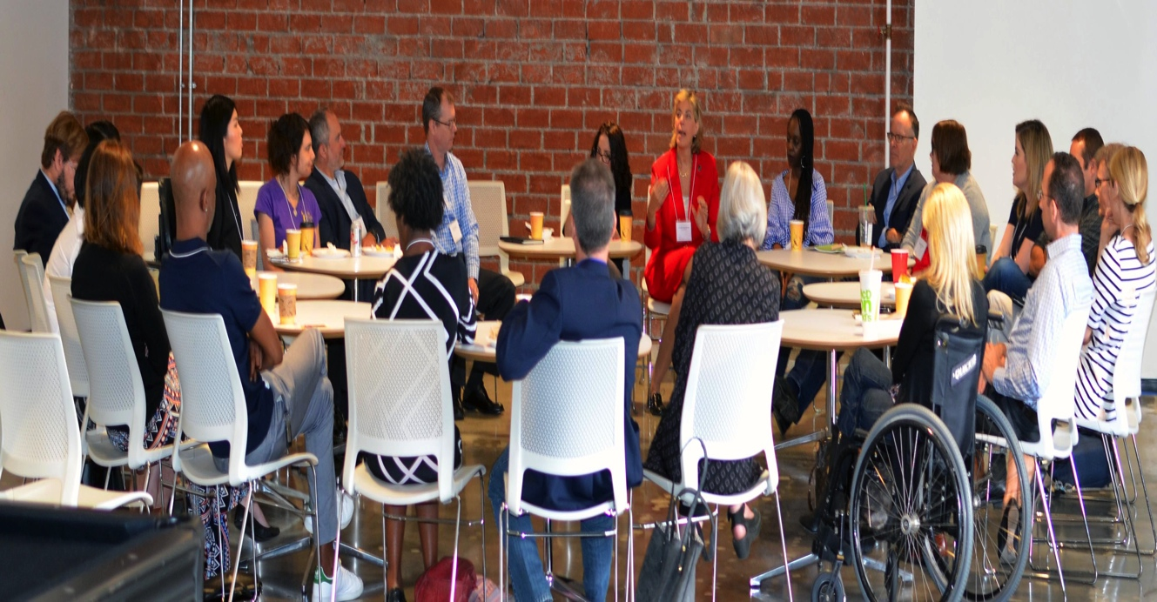
DIVERSITY, EQUALITY AND INCLUSION IN HOLLYWOOD
On Wednesday, August 16, 20 stakeholders from the entertainment and disability communities gathered for breakfast to talk about diversity and inclusion in Hollywood.
Fellows created lists of relevant stakeholders and invited them via phone.
Learn More

Slide 23
WEBINARS: ATTENDED BY MORE THAN 900 PEOPLE
Tapping Into Hidden Capital: Debra Ruh on Practical Solutions for Employers for People with Disabilities, Sept. 7, 2016
Best Practices in Action: Montgomery County, Maryland on Jobs for People with Disabilities – Local Lessons from a National Role Model, Oct. 5, 2016
Best Practices in Action: The Iowa Able Foundation – Micro-Enterprise, Micro-Lending and Financial Security for Iowans with Disabilities, Oct. 18, 2016
Disabilities to Diverse Abilities at Ernst & Young: How EY is Educations Their People About Mental Illness and Addiction, Nov. 22, 2016
Disability & Criminal Justice Reform: Key to Success and Challenges Ahead, Dec. 6, 2016
Bridges from School to Work & Transformative Power of a Job for Youth with Disabilities: Discussion with Tad Asbury, Dec. 7, 2016
Powerful Role that Mentorship can Play in Supporting Employment Opportunities for Youth with Disabilities: Derek Shields of the National Disability Mentoring Coalition, Dec. 13, 2016

Slide 24
WEBINARS: ATTENDED BY MORE THAN 900 PEOPLE
Special Conversation with Special Olympics about Violence, Police Training and People with Disabilities: Disability Training for Police – Lessons from Special Olympics, Jan. 17, 2017
Hollywood, Media and Disability: Fighting Stigmas and Expanding Opportunities for People with Disabilities, Feb. 1, 2017
Leadership, Process and Results: Lessons from South Dakota’s Jacqueline Sly, Feb. 22, 2017
Sexual Violence and People with Disabilities: Lessons on Prevention, Protection and Survival from RAINN, March 10, 2017
Youth with Disabilities, Training and Employment Success: Lessons on Best Practices from Project SEARCH, April 19, 2017
The Best Buddies Difference: Friendship and Skills Leading to Success, April 26, 2017
Lessons on Putting Faith to Work: A Conversation about Faith, Disability and Inclusion Resources with Bill Gaventa, M.Div., and Joe Timmons of the Institute on Community Inclusion, June 20 2017

Slide 25
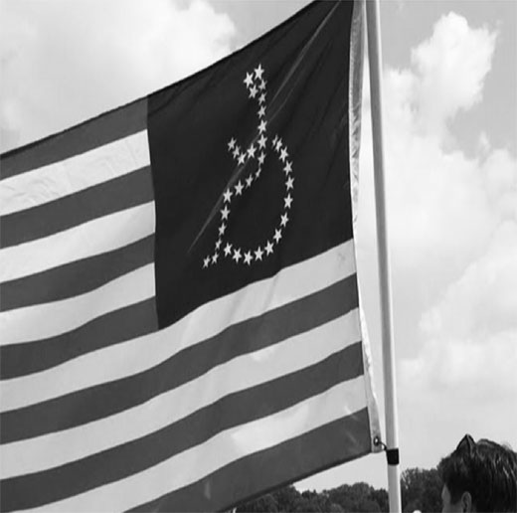
FELLOWS SPEAKER SERIES
RespectAbility is a nonprofit organization fighting stigmas and advancing opportunities for and with people with disabilities. This summer 17 Fellows had the opportunity to learn from more than 40 guest speakers.

Slide 26
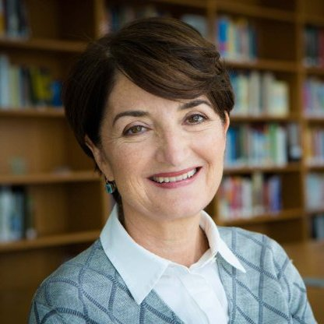
ELLEN ALBERDING: FINDING DIRECTIONS THROUGH AWARENESS
As president and board member of the Joyce Foundation, Ellen Alberding oversees the charitable distribution of $45 million annually from assets of $930 million. She spoke to RespectAbility Fellows via Skype on the importance of staying aware of both our introspection and our surroundings.
Joyce Foundation President Ellen Alberding

Slide 27
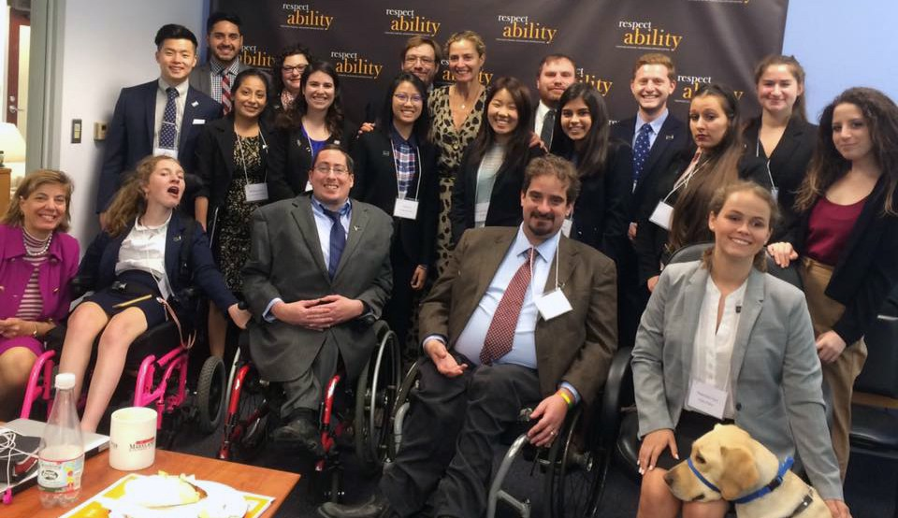
AMI ARONSON: THINKING OUTSIDE THE BOX
Ami Aronson with RespectAbility Fellows and Staff
Executive Director for the Bernstein Family Foundation Ami Aronson shares her motto of “never take no for an answer” as she discusses her extensive career in advocating for women’s rights. Read the full story

Slide 28
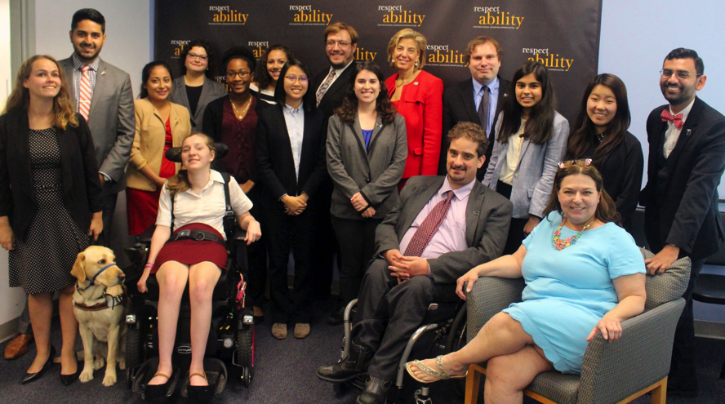
NANCY BOCSKOR: THE ROLE OF STOYTELLING IN DEVELOPMENT
Nancy Bocskor with RespectAbility Fellows and Staff
RespectAbility Fellow Sneha Dave with Nancy Bocskor
Democracy coach Nancy Bocskor outlines the leadership and storytelling skills that are needed to lead an organization to success, specifically when it comes to development and fundraising. Read the full story

Slide 29
LINDA BURGER: LEAVING LIFE IN A BETTER PLACE THEN WE FOUND IT
Linda Burger with RespectAbility Fellows and Staff
Jewish Family Services’ Linda Burger talks about her work in reducing the stigma surrounding mental health issues and intellectual disabilities within the Jewish community. Read the full story
RespectAbility Board Member Linda Burger

Slide 30
OLLIE CANTOS: BUILDING LEADERSHIP AND ADDING VALUE
Ollie Cantos with RespectAbility Fellows and Staff
Ollie Cantos speaking to RespectAbility Fellows
Special Assistant to the Secretary for Civil Rights Ollie Cantos shares his story of how he embraces his disability and the ways in which he advocates for other people with disabilities. Read the full story

Slide 31
ELEANOR CLIFT: SEIZING OPPORTUNITIES
RespectAbility Board Member Eleanor Clift with RespectAbility Fellows and Staff
Award-winning journalist Eleanor Clift shares her experience of growing up during the tumultuous time of the 1960’s and how the advocacy tips she learned then can be applied to today’s political climate. Read the full story

Slide 32
JUDITH CREED: FINDING LIFE IN STRUGGLES
RespectAbility Board Members Judith Creed and Linda Burger with RespectAbility Fellows and Staff
Founding member of Judith Creed Homes for Adult Independence Judith Creed shares her son’s story as a member of the disability community and the impact she has made for people with disabilities everywhere.
Read the full story

Slide 33
GIDEON CULMAN: A NEW VIEW OF OBSTACLES
Gideon Culman with RespectAbility Fellows and Staff
Gideon Culman and RespectAbility Brilynn Rakes
Gideon Culman runs and operates K Street Coaching, an executive coaching firm. He helps people get to where they want to go in their careers. As a group, RespectAbility Fellows made a list of what they need to succeed. Read the full story

Slide 34
WILLIAM DAROFF: STAYING POST PARTISAN WHILE ADVOCATING FOR DISABILITY RIGHTS
William Daroff with RespectAbility Fellows and Staff
The Jewish Federation of North America’s Senior Vice President for Public Policy William Daroff discusses the importance of disability rights remaining a nonpartisan issue. Read the full story
William Daroff and RespectAbility Fellow Ella Issacharoff

Slide 35
CURT DECKER: TRANSLATING GOOD POLICY INTO GOOD PRACTICE
Curt Decker with RespectAbility Fellows and Staff
Curt Decker speaking to RespectAbility Fellows
“Disability policy – we need to make sure that our policies and good intentions are followed up with good practices and actions,” says Executive Director of the National Disabilities Rights Network Curt Decker while speaking about federal legislation. Read the full story

Slide 36
RON DRACH: FINDING LUCK AND OPPORTUNITY IN THE MIDST OF DISABILITY
Ron Drach with RespectAbility Fellows and Staff
Now working for Disabled American Veterans, Ron Drach discusses how his battle scars opened his eyes to the willingness of new opportunities.
Read the full story

Slide 37
RANDALL DUCHESNEAU: STRIVING FOR COMMON GROUND
RespectAbility Board Member Randy Duchesneau with RespectAbility Fellows and Staff
Randy Duchesneau speaking to RespectAbility Fellows
RespectAbility Board Member and former National Leadership Director Randall Duchesneau discusses the intersectionality between ethnicity, culture and disability. Read the full story

Slide 38
STEVEN EIDELMAN: BREAKING OUT OF INEQUITABLE PRACTICES IN AMERICA
Steven Eidelman with RespectAbility Fellows and Staff
Professor Steven Eidelman’s impassioning spirit encouraged RespectAbility Fellows to step up as advocates as he talked about the journey of workforce integration for people with disabilities. Read the full story
Steven Eidelman and RespectAbility Fellow Ricky Rendon

Slide 39
STANLEY B. GREENBERG: PRACTICAL LESSONS IN POLLING
Stan Greenberg with RespectAbility Fellows and Staff
New York Times best selling author and pollster Stanley B. Greenberg discusses his work on projects that promote diversity and inclusion. Read the full story

Slide 40
RICK GUIDOTTI: CHANGE HOW YOU SEE CHANGE
RespectAbility Board Member Rick Guidotti in front of RespectAbility Staff and Fellows
Former ELLE and LIFE Magazine photographer Rick Guidotti talks about redefining societal standards and the raw beauty he sees in everyone. Read the full story
Rick Guidotti taking a photo of Cal Harris, RespectAbility Chair

Slide 41
CALVIN HARRIS: LISTENING IS AN ACT OF COMPASSION
Calvin Harris with with RespectAbility Fellows and Staff
RespectAbility Chairman and Bipartisan Policy Center’s Calvin Harris shared his three-pronged plan for disability representation in leadership positions. Read the full story
Calvin Harris, RespectAbility Chairman

Slide 42
JULIAN A. HAYNES: HOW TO MAKE REAL CHANGE PHILANTHROPY AND NONPROFIT
Julian A. Haynes with RespectAbility Fellows and Staff
The Meyer Foundation’s Julian A. Haynes addresses the reality that philanthropic donations alone will not be able to solve racial and economic disparities. Read the full story
Julian A. Haynes with RespectAbility Fellow D.H. Lee

Slide 43
DAN HAZELWOOD: THE POWER OF PERUSASION
Dan Hazelwood with RespectAbility Fellows and Staff
Nationally recognized political campaign professional Dan Hazelwood discusses the importance of being able to see life through someone else’s eyes. Read the full story

Slide 44
RODNEY E. HOOD: INVESTING IN INCLUSIVE GROWTH
Rodney Hood with with RespectAbility Fellows and Staff
Rodney Hood and RespectAbility Fellow Ricky Rendon
JPMorgan Chase’s Rodney E. Hood talks about his efforts that are advancing successful disability inclusion. Read the full story

Slide 45
DAVID HOPPE: REACHING ACROSS THE AISLE
Beyond his work as a giant in the world of public policy and as former Chief of Staff to Speaker Paul Ryan, David Hoppe and his wife are the proud and successful parents of a now grown son with Down syndrome. Hoppe’s experience and compassion have inspired him to work hard on policies that help thousands of students with disabilities every year. He spoke to RespectAbility Fellows about his experience working across the aisle as well as his personal life story.
David Hoppe

Slide 46
ANDY IMPARATO: A NEW GENRATION OF DISABILITY ACTIVISTS
Andy Imparato with RespectAbility Fellows and Staff
Andy Imparato speaking to RespectAbility Fellows
Disability advocate Andy Imparato of AUCD shares where he believes the fight for disability civil rights begins and ends. Read the full story

Slide 47
JONATHAN KESSLER: WHAT’S YOUR GOAL?
Jonathan Kessler with RespectAbility Fellows and Staff
Director of Strategic Initiatives for AIPAC Jonathan Kessler discusses redefining inclusion specifically for people with disabilities. Read the full story
Jonathan Kessler speaking to RespectAbility Fellows

Slide 48
CELINDA LAKE: EYE OF THE LIONESS
Celinda Lake with RespectAbility Fellows and Staff
Co-author of What Women Really Want and pollster Celinda Lake talks about the stereotypical ways that the media represents women. Read the full story

Slide 49
GEOFFREY MELADA: A “CHUTES & LADDERS” CAREER TRAJECTORY
Geoffrey Melada with RespectAbility Fellows and Staff
Fellow Brieanna Iyomahan with Geoffrey Melada
Like many of the speakers RespectAbility featured this summer, Geoffrey Melada has not had a traditional career journey. However, his “chutes and ladders” trajectory taught him many lessons along the way. Read the full story

Slide 50
DANA MARLOWE: USING TECHNOLOGY TO IMPROVE ACCESIBILITY
RespectAbility Board Member Dana Marlowe with RespectAbility Fellows and Staff
Principal partner and co-founder of Accessibility Partners LLC, an accessibility advocacy and IT consulting firm, Dana Marlowe discusses her daily work ensuring that technology is accessible for people with disabilities. Read the full story
Dana Marlowe with Fellow Brilynn Rakes

Slide 51
DONNA MELTZER: BECOMING A DISABILITY ADVOCATE
RespectAbility Board Member Donna Meltzer with RespectAbility Fellows and Staff
Donna Meltzer speaking with RespectAbility Fellow James Trout, President Jennifer Laszlo Mizrahi and Policy Director Philip Kahn-Pauli
CEO of The National Association of Councils on Developmental Disabilities Donna Meltzer talks about the history of disability advocacy and the Americans with Disabilities Act (ADA). Read the full story

Slide 52
FLOYD MILLS: FINDING YOUR PLACE IN THE MELTING POT OF DIVERSITY
Floyd Mills with RespectAbility Fellows and Staff
Founder of Accenture’s first affinity group, Floyd Mills discusses the importance of creating a culture of diversity and inclusion within the workplace. Read the full story
RespectAbility Sumer 2017 National Leadership Director Christopher Trujillo, Floyd Mills, Fellow Stephanie Flynt and her guide dog Nala

Slide 53
JONATHAN MURRAY: IMPORTANCE OF DIVERSITY ON TELEVISION
RespectAbility Board Member Jonathan Murray with RespectAbility Fellows and Staff
Creator of Emmy-winning reality television show Born This Way, Jonathan Murray discusses the importance of diversity as well as advocacy for all different types of people both on and off screen. Read the full story
RespectAbiility Fellow Brilynn Rakes and Jonathan Murray

Slide 54
MICHAEL MURRAY: NO PITY: EMPLOYMENT ADVICE FOR PEOPLE WITH DISABILITIES
Michael Murray with RespectAbility Fellows and Staff
Senior Advisor to the Director of the Office of Diversity and Inclusion at the U.S. Office of Personnel Management, Michael Murray talks about increasing the federal employment of people with disabilities.
Read the full story
Michael Murray and Fellow Ana Song

Slide 55
MORNA MURRAY: A GLANCE INTO DISABILITY FROM A PARENTS PERSPECTIVE
Morna Murray with RespectAbility Fellows and Staff
Morna Murray expresses the importance of having a web of supports as well as a united front within the community when advocating for disability employment rights. Read the full story
Morna Murray with RespectAbility Fellow Stephanie Flynt

Slide 56
STEVE RAKITT: CHOOSING TO LAUGH
Steve Rakitt with RespectAbility Fellows and Staff
Steve Rakitt with RespectAbility’s Summer 2017 Jewish Inclusion Team: Hillary Steen, Rachael Schindler and Matthew Lerner
Steve Rakitt shares how his journey to becoming the champion of Jewish disability inclusion began with a single decision to laugh. Read the full story

Slide 57
PRAS RANAWEERA: THE VALUE OF LISTENING
Pras Ranaweera with RespectAbility Fellows and Staff
Senior Portfolio Officer of K-12 Education at the Gates Foundation, Pras Ranaweera talks about the importance of being an active listener when advocating for students with disabilities. Read the full story
Pras Ranaweera and Fellow Rachel Schindler

Slide 58
DEBORAH RATNER SALZBERG: WHAT IT MEANS TO BE A LEADER IN A NONPROFIT
Debbie Ratner Salzberg with RespectAbility Fellows and Staff
RespectAbility Fellow Judith Lao with Debbie Ratner Salzberg
Debbie Ratner Salzberg talked about how she carefully puts together a board like a puzzle, because of how important other people’s excitement and passion are. Read the full story

Slide 59
GERARD ROBINSON: MINDFULNESS AND ITS IMPACT TO CREATE CHANGE
RespectAbility Board Member Gerard Robinson with RespectAbility Fellows and Staff
Gerard Robinson talking to Fellows
Gerard Robinson of the American Enterprise Institute displayed how a willingness to explore viewpoints opposite or different than one’s own can create a opportunity for individual growth and expand one’s perspective. Read the full story

Slide 60
JONATHAN SALANT: TELLING A COMPELLING STORY OF SOMETHING YOU OVERCAME
Jonathan Salant with RespectAbility Fellows and Staff
“What really is a news story?” asked Jonathan Salant, an award-winning political and investigative reporter who graduated from Columbia University Graduate School of Journalism. He posted this question to RespectAbility Fellows.

Slide 61
CAL THOMAS: LIVING BEYOND THE SUPERFICIAL
Cal Thomas with RespectAbility Fellows and Staff
Fox News Contributor Cal Thomas discusses how far being a compassionate and positive person can take someone in life. Read the full story
Cal Thomas and RespectAbility Fellow Brilynn Rakes

Slide 62
LISA THOMAS: COHESIVE, CONSISTENT MESSAGING
Lisa Thomas with RespectAbility Fellows and Staff
Special Education Policy Analyst at the American Federation of Teachers’ Dr. Lisa Thomas says, “the lack of cohesive, consistent messaging is the Achilles heel of the disability community,” while talking about employing people with disabilities. Read the full story

Slide 63
DAVID TRONE: LEADERSHIP: EMPATHY, FAILURE, RESPECT
David Trone with RespectAbility Fellows and Staff
David Trone, founder of Total Wine and More, reveals how his personal struggles taught him that leaders can come from all walks of life. Read the full story
David Trone with Fellow Emma Adelman

Slide 64
DONNA WALTON: UNDERSTANDING INTERSECTIONALITY AND SELF ADVOCACY
Donna Walton with RespectAbility Fellows and Staff
CEO of LEGGTALK Inc. and Respectability Board Member, Donna Walton talks about challenging the influence of negative societal stereotypes that women of color with disabilities face everyday. Read the full story

Slide 65
FRAN KATZ WATSON: FAIL AT SOMETHING AT LEAST ONCE
Fran Katz Watson with RespectAbility Fellows and Staff
Founder and President of The Katz Watson Group, Fran Katz Watson shares the way she “caught the political bug” and how that brought her to where she is today.
Read the full story
Fran Katz Watson with RespectAbility Fellow Matt Lerner

Slide 66
KEVIN WEBB: DISABILITY AS A PHILANTHROPIC NICHE
Kevin Webb with RespectAbility Fellows and Staff
Mitsubishi Electric America Foundation’s Kevin Webb talks about the importance of empowering young people with disabilities in the work place. Read the full story
Kevin Webb with RespectAbility Fellow Judith Lao

Slide 67
RICHARD WOLF: THE VALUE OF BEING UNBIASED
Richard Wolf speaking to RespectAbility Fellows and Staff
Editor and writer for USA Today, Richard Wolf urges the importance of unbiased news and ensuring that reporters remain nonpartisan. Read the full story
Richard Wolf with RespectAbility Communications Fellow Lilly Grossman

Slide 68
FALL 2017 FELLOWS (SEPTEMBER – DECEMBER)
Brooke Castagna
Development & Fundraising
Christopher Coleman
Public Policy & Employment
Adam Fishbein
Public Policy & Employment
Julia Luh
Public Policy & Employment
Theresa Maher
Communications & Stigma

Slide 69
FALL 2017 FELLOWS (SEPTEMBER – DECEMBER)
Zein Al Maha Oweis
Communications & Stigma
Jeanette Marquez Rocha
Public Policy & Employment
Adam Srayi
Public Policy & Employment
Katie Townes
Communications & Stigma
Julia Wood
Communications & Stigma

Slide 70
NATIONAL LEADERSHIP PROGRAM: FUTURE COHORTS
We are accepting applications for Spring 2018, for dates between January 2 and May 25, 2018 for a minimum of nine weeks.
Applications for Summer 2018 also are open. The dates for Summer 2018 are June 4 – August 10, 2018, with room for flexibility.

Slide 71
THANK YOU FOR MAKING THIS POSSIBLE!
RespectAbility
11333 Woodglen Drive #102
Rockville MD 20852
Jennifer Laszlo Mizrahi, President
JenniferM@RespectAbility.org
Cell: 202-365-0787
www.RespectAbility.org

