Slide 1

Putting Faith to Work
Tapping the Power of Congregations as Pathways to Employment

Slide 2
AUCD and UCEDDs
A network of interdisciplinary centers advancing policy and practice for and with individuals with developmental and other disabilities, their families, and communities
University Centers for Excellence in Developmental Disabilities (UCEDDs) have been working to accomplish a shared vision that foresees a nation in which all Americans, including Americans with disabilities, participate fully in their communities.
Independence, productivity, and community inclusion are key components of this vision.
Currently, sixty-seven UCEDDs in every state and territory are located in a university setting.

Slide 3
Collaborative on Faith and Disability
The mission of the Collaborative on Faith and Disability is to support people with disabilities, their families, and those who support them by providing national and international leadership in the areas of research, education, service, and dissemination related to disability, religion, and inclusive supports.
Collaborative partners include University Centers for Excellence in Developmental Disabilities (UCEDDs) and affiliated faculty and staff, seminaries and Divinity Schools, individual affiliated members, and partnering organizations. The Collaborative currently consists of 13 UCEDD partners and will grow to include groups above.

Slide 4
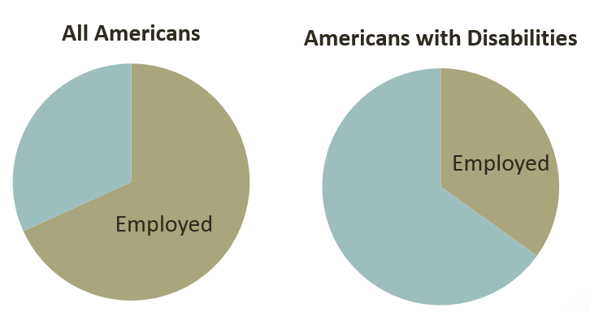
Critical Need for New Approaches
Persistent and pervasive problems of unemployment
Lack of other valued avenues for community contribution
Service systems beyond their capacities to meet deep needs
Natural support systems regularly overlooked, yet research shows they are the crucial missing piece
Notes:
ERIK (30 SECONDS)
As you all know, there have been many public and private sector initiatives focused on improving employment rates for individuals with disabilities. Yet, overall employment rates have remained virtually unchanged. And this is true in each of our respective states. The unpredictability or lack of funding, limited programs, complicated eligibility requirements, long waiting lists, and myriad other factors we mentioned in our application all highlight the need for pursuing new avenues and new partnerships if we are going to change the employment landscape. Indeed, with our service hats on, we are all hearing renewed calls for engaging more meaningfully with natural partners in communities if we are going truly change the employment landscape.

Slide 5
State Data
75%
are unemployed
19%
participate in the labor force
5%
integrated
settings
29%
poverty
rate
https://statedata.info/statedatabook/bluebook2012_final.pdf

Slide 6
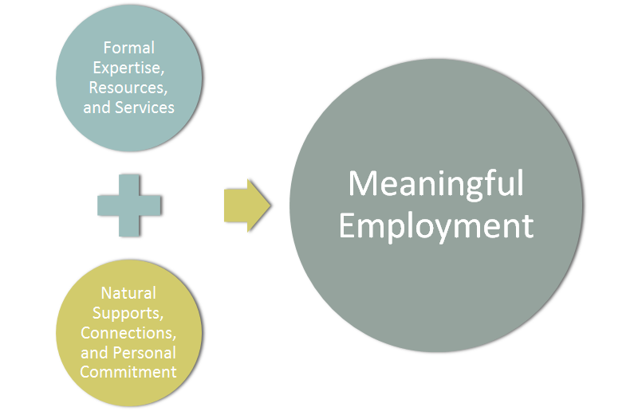
The Need for Innovation
Notes:
The field desperately need new, innovative approaches if the employment landscape is really going to every change. And so our goal is not to replace or supplant formal services and agencies that address employment, but rather to supplement those resources by tapping into the natural supports, connections, and personal commitments of fellow congregation members. Vocational service providers, employment agencies, and others charged with increasing access to employment for people with disabilities are in need of partners in the community who can help expand opportunities and supports in this domain. They are being asked to draw on natural partnerships in their community, but they don’t always know how to do so. And faith communities want to support well their members with and without disabilities to flourish, but they may not know how to do so when the topic is employment.
And so we see the need for a model that stiches these supports together in compelling ways that lead to meaningful employment for people with disabilities. The research literature is clear on this point. Formal and informal supports…neither can and should go it alone. We will work with congregations to help them do what they do best: adopt person-centered approaches that focus on gifts and strengths, support people’s sense of calling and vocation, draw upon their existing (and often deep) connections to communities and employers, and to commit to walking alongside one of their members in this dimension of life. And we combine this with what we have learned through our service systems about evidence based and recommended practices for addressing the vocational needs of people with disabilities. Thus, we see a model that enables congregations to work both independently and in concert with local disability organizations and service providers to address employment needs.

Slide 7
How do most people find jobs?
Friends
Connections
Personal Networks
Otherwise known as:
Natural Supports

Slide 8
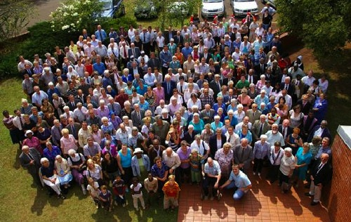
Equipping Natural Supports
More Than 335,000
Congregations
Nationally
Average of
186 Attenders
(200 million people of faith)
Notes:
ERIK (30 SECONDS)
Our initiative focuses on building the capacity of individual congregations and networks of faith communities to address the employment of their members with disabilities, to connect them to quality employment opportunities, and then to provide other appropriate, individualized supports. While at first glance this might sounds like a novel approach, the reaction we often get is “of course, that makes sense.” Because here are more than 335,000 churches, synagogues, mosques and other places of worship nationally. And so our model is engaging what ends up being among the most extensive networks of employers in any community. The average congregation has 186 attenders who themselves are connected to so many different employment sectors. It also recognizes most jobs are obtained through personal connections, including jobs traditional job developers are unlikely to know about. And it engages community members who already have a vested interest in an individual and affirms the call of scriptural traditions that individuals use their gifts in service and that communities recognize the dignity of work.

Slide 9
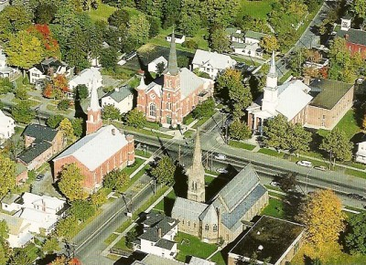
Ubiquity of Congregations

Slide 10
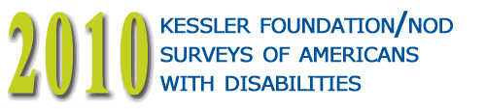
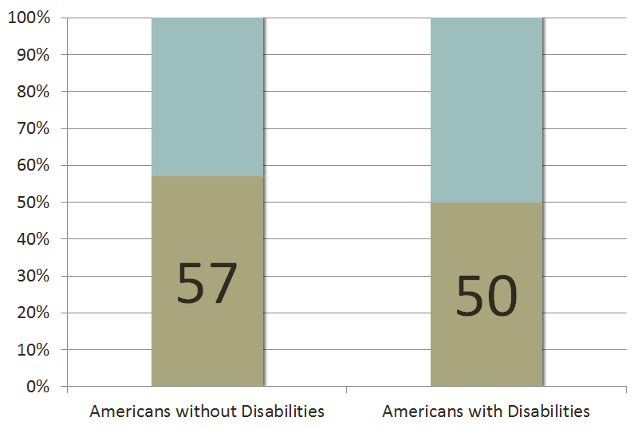
Goes to church, synagogue, or any other place of worship at least once a month
Notes:
ERIK: 30 SECONDS
But it also recognizes that most people with disabilities are already connected in some way to a faith community. A national study you are all certainly familiar with, funded in part by Kessler, found that half of all Americans with disabilities attend a church, synagogue, or other place of worship at least once per month (just slightly less than the percentage of Americans who do not yet have a disability).

Slide 11
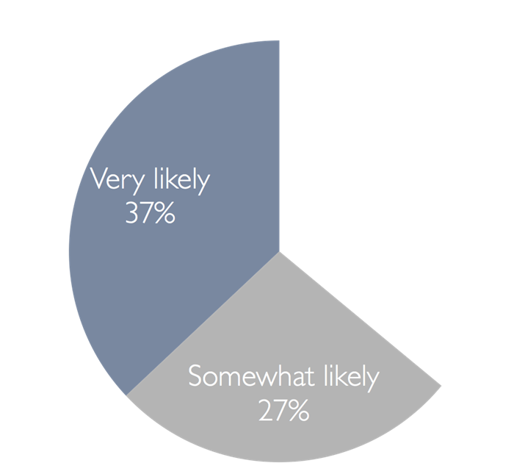
Willingness to Ask?
How likely would you be to draw upon the support of your faith community for help connecting to employment?

Slide 12

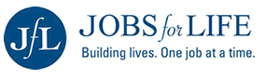
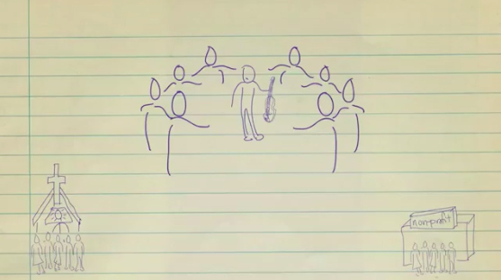




A Sampling of Generic Faith-Based Employment Initiatives
Crossroads Career Network
Notes:
WE HAVE DONE SOME RESEARCH ON WHAT IS OUT THERE SINCE SUBMITTING THE GRANT.
Note these are generic…not disability related, but a bit about Jobs for Life.

Slide 13
Foundational Beliefs
Work is both a gift and a responsibility. There are scriptural, theological, and historical understandings in all the major faith traditions that affirm:
  the importance of everyone using their gifts in service to God and community,
  God’s is call to service to everyone, no matter ability or disability

Slide 14
Biblical Traditions
Righteousness was frequently judged by the ways it treated those at the margins. The issue was not simply one of care but of justice and opportunity.
In an economy that was primarily agrarian, farmers (employers) were commanded to leave a tenth of their field so that the “widow and orphan” might harvest their own food (Leviticus 19:9; 23:22; Deuteronomy 24:19-21, Ruth 2:2-23).

Slide 15
Everyone belongs
When the dream of a return from exile in Babylon was foretold, the vision was that everyone returned, including the “blind” and the “lame” (Jeremiah 31: 8-9). Everyone was to belong. All had a part. To be faithful meant integrating that faith in the realms of daily personal, civic, and economic life.
White paper on PFTW

Slide 16
Talmud
No labor, however humble, is dishonoring
.
Though it is not incumbent upon thee to complete the work, thou must not therefore cease from pursuing it. If the work is great, great will be thy reward, and thy Master is faithful in His payments.

Slide 17
Islam
With works comes dignity…no one enjoys a meal more than a person who actually gives their time, effort, and labor to go out and to provide a way to take care of themselves and their families. 22
The Prophet Muhammad (peace be upon him) was asked what type of earning was best, and he replied: ” A man’s work with his hands and every (lawful) business transaction.”
        Al-Tirmidhi, Hadith 846.

Slide 18
Buddhism
Your work is to discover your work, and then with all your heart give yourself to it.

Slide 19
Paradox: Gift and Responsibility.
The path to employment for some may first start with their human spirit, the belief that they have gifts to share.
Plus a call to contribute and use, not bury, one’s talents.
The community is responsible to help that happen through opportunity and justice.

Slide 20
Vocation
What brings us “deep gladness”:
Neither the hair shirt nor the soft berth will do. The place God calls you to is the place where your deep gladness and the world’s deep hunger.
- Frederick Beuchner

Slide 21
Next Step in Inclusive Ministries
The focus has been on accessibility, welcome and belonging.
Beyond Inclusion and beyond the Sabbath:
  help members with disabilities find jobs and other ways to contribute within and beyond their congregation.

Slide 22
Work begins in the community
People with disabilities are also called to be people who live out their faith and respond to God’s call, whether that is defined as “being disciples,” “doing mitzvah,” “following the Five Laws,” or other forms of giving to others and the life of the community.
People with disabilities, like everyone, value the opportunity to have their gifts recognized, to be “givers” as well as “receivers.”
The very life and flourishing of a faith community depends on the multiple gifts of its members in support of others and its life together. Putting faith to work can thus start right at home.

Slide 23
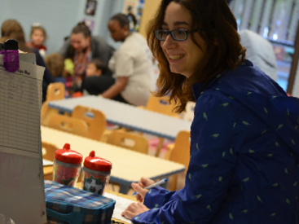
Meaningful Work
Congregations as a Pathway to Employment

Slide 24
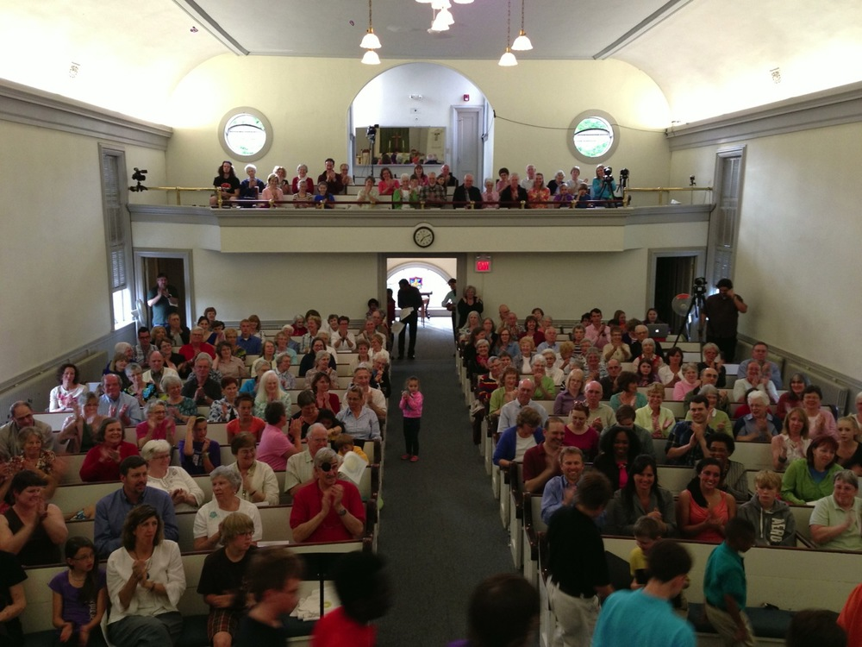
Congregation Connections
Southeastern Dental
Works at
a grocery store
Does odd jobs around town
Hmmmm...
I should probably ask
Byron Orthodontics
Is a frontline supervisor
Works at the municipal offices
Castle Dental
Owns a nursery
Works at the university
Runs a temp agency
Runs a local bank
Family Dental Center
Owns a landscaping business
Operates a day care
Leads her HR department
Is a vocational rehab counselor
Is a construction contractor
Forest River
Dental
Works at a restaurant
Works in
a law firm
Coordinates a non-profit network

Slide 25
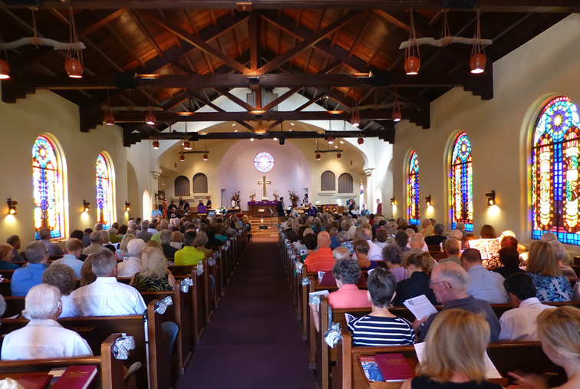
Congregation Connections Part 2
Golfs with the VP of Big Company
Serves on the
city council
Always “knows a guy” who...
Rotary club member
From a prominent family in town
Knows the mayor
Involved in a running club
Is a regular at Tim Horton’s
Garden club member
Volunteers with Habitat
Is the “real” mayor
Is a Chamber member
In a book club (Jane Eyre)

Slide 26
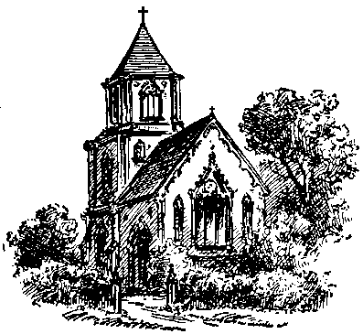
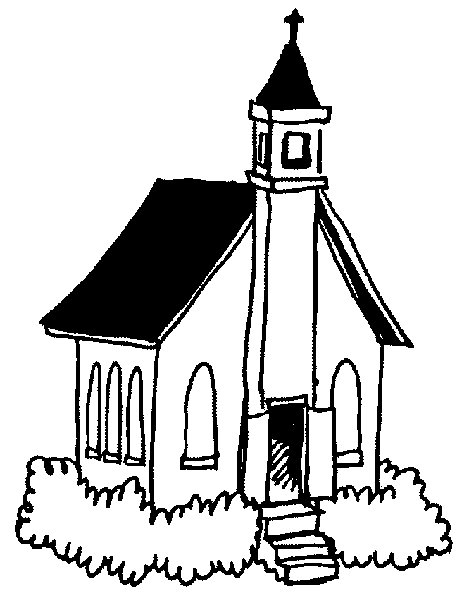
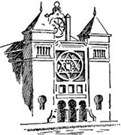



Putting Faith to Work Model
Training
Technical Assistance
Linkages to Services & Resources
Connections to Other Congregations
Congregation
Members
Arrow
Community Groups
Businesses & Employer Networks
Other Associa-tions
Civic Groups
Non-Profits
Other Churches Synagogues Mosques
Schools and Colleges
Friends & Relatives
Access to Meaningful Work
For People with Disabilities
Notes:
BILL: 2 MINUTES
We’ve put on your screen an illustration that summarizes and illustrates core features of our Putting Faith to Work model. Congregations have a long history of supporting individual members in both immediate crises and over the long term. This is part what they are about. Our four UCEDD’s are in a prime position to utilize their current networks and projects to recruit congregations who will be both interested and intrigued by new ways to support members with disabilities who do not have jobs. Some congregations already have employment supports programs [about 10% nationally]. Many others have inclusive ministries with people with disabilities. Others have neither, but may be very interested in helping an individual member and his or her family. We will use the capacity of congregations to act in support of individuals they know along with the potential networking power of the members of the congregation (most of whom are employees or employers), and the community networks to which they are connected, to determine a person’s core strengths and interests, enlist the congregation in seeking potential work sites, and provide ongoing support. The UCEDD’s will provide training to interested congregations in basic person-centered approaches and supported/customized employment , ongoing technical assistance, help the participating congregations learn from one another, and enable linkages to other public resources that can be of assistance. Together, we will develop training and technical assistance resources that can then be both adopted and adapted by other congregations and employment programs.
As Derek will share, we have already demonstrated this is possible.

Slide 27
Concentric Rings of People
800
70
Friends and
Close Companions
Family
Members
Acquaintances
(Coworkers, Neighbors)
People Paid
to Be There

Slide 28
Recruiting Congregations and People with Disabilities
Building an initiative project around one person
Person with disability and/or family member asking
Word of mouth among disability networks
Helping a young adult with transition
Beginning a new ministry in line with mission
Expanding scope of current employment ministry or Job Club
Expanding scope of inclusive or “special” ministries
Tapping gifts of members in a new way
Agency invitation for collaboration…start with one.
And ways yet to be found…..

Slide 29
Training Design and Delivery
Not intended as a traditional supported employment training for professionals
Blended approach through
  Face-to-face personalized training
  Complemented by quality Internet-based options
  Technical assistance, problem solving
  Networking with other congregations involved in the project
Builds on commitment, gifts, skills, and connections of congregation members with the wider community
Notes:
MILT/HAROLD: 1 MINUTE
Our goal is not to replace or supplant formal services and agencies that address employment, but rather to supplement those resources by tapping into the natural supports, connections, and personal commitments of fellow congregation members. We also recognize that effective training is not so much “stand and deliver” as it is a blended approach that 1) takes into account the context and needs of each congregation, 2) provides Internet-based options such as webinars and conference calls that respect everyone’s time, 3) includes ongoing technical assistance focused on removing barriers and solving problems, and 4) links congregations to each other, so that they can share the richness of their own learning experience with one another.
In this way, diverse faith communities and faith traditions can, we hope, form true communities of practice, as they build upon their learning together in ways that elucidate their fundamental, shared values.

Slide 30
Long-Term Outcomes
A flexible, step-by-step model is available for use by virtually any congregation
Multiple, diverse exemplars of congregational supports will be compiled and disseminated
Congregations, service systems, and employers increase their capacity, confidence, and commitment to work in concert
Individuals with disabilities gain access to a broader range of natural supports to draw upon to find and maintain employment
67 UCEDDs in every state have access to guidance on how to engage new partners in improving employment outcomes
Relationships between faith communities using the model and with private and public sector employment resources are enhanced.
A model of ministry in this area is articulated to help congregations catch a vision for this work
Notes:
MILT/HAROLD: 1 MINUTE
Our Long Term Outcomes – What Do We Expect Ultimately to Achieve?
A flexible, step-by-step model is available for use by virtually any congregation (this is the value of working across states with very different religious and cultural landscapes)
Multiple, diverse exemplars of congregational supports will be compiled and disseminated (this is part and parcel of having a flexible approach…congregations will not work well with recipes, but rather they need a menu of options)
Congregations, service systems, and employers increase their capacity, confidence, and commitment to work in concert with one another, as well as learn the unique role that each can play.
Individuals with disabilities gain access to a broader range of natural supports to draw upon to find and maintain employment (right now, the only player for many people is the formal service system, and that by itself, has is not proven sufficient)
67 UCEDDs in every state have access to guidance on how to engage new partners in improving employment outcomes – this is the value of our national network
Relationships between faith communities using the model and with private and public sector employment resources are enhanced.
A model of ministry in this area is articulated to help congregations catch a vision for this work
Finally, have we created a nationally disseminated set of resources to sustain the work of this project beyond the life of this grant?
Penny Seay will briefly examine how we will sustain our work.

Slide 31
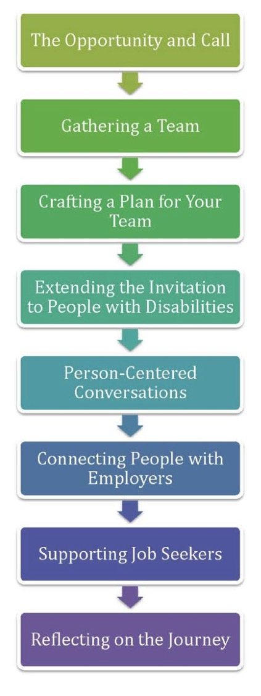
The PFTW model
The Approach in Minnesota

Slide 32
OUR OUTCOMES
Piloted first year beginning in February, 2013
Very active employment ministries in faith-based congregations
Approached 10 congregations in 2013
Five congregations agreed to participate
Large variation in size
Limited understanding of disability issues
40 job seekers with disabilities found employment
100 job seekers without disabilities participated in groups/strengths

Slide 33
OUR INTERVENTION
Support congregation staff and volunteers
Work one-on-one with participants who need extra supports (assessment and counseling)
Work in groups on strengths and resiliency
Referrals to vocational rehabilitation, SSA, and CBOs
Referrals to healthcare providers (mental and physical)
Support other disability awareness efforts in congregations

Slide 34
SUSTAINING THIS WORK
Formalizing relationships and resources for congregations and CBOs
Consulting with original FBOs
Presentations on Strengths and Resilience
Serving as volunteer on disability awareness committee at one congregation
Continuing development of national network

Slide 35
A FEW LESSONS LEARNED
This approach holds great promise
The benefits extend beyond just finding employment
The benefits are reciprocal—for congregations too
This is new territory for some individuals, congregations, and service providers
Congregations often move at a different pace
Our inclination is to replicate formal supports, but they are not always appropriate or needed
Building capacity and continuity of support among volunteers is a challenge

Slide 36
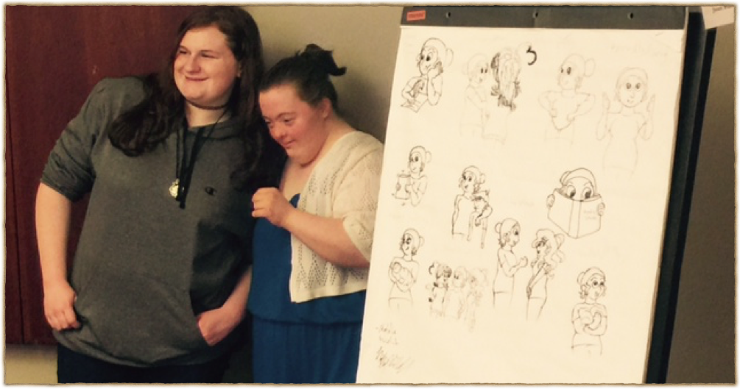
Quote from Participants
“It helps these individuals be known, and broaden the circle of acquaintances, aware congregants, friends, potential advocates, supporters, networkers and potential employers!”
~PFTW Team Member

Slide 37
What’s Next for PFTW?
A free “Practice Guide”
Online portal for PFTW Resources (puttingfaithtowork.org)
Articles for faith-based magazines
Academic Journal articles
puttingfaithtowork.org

Slide 38
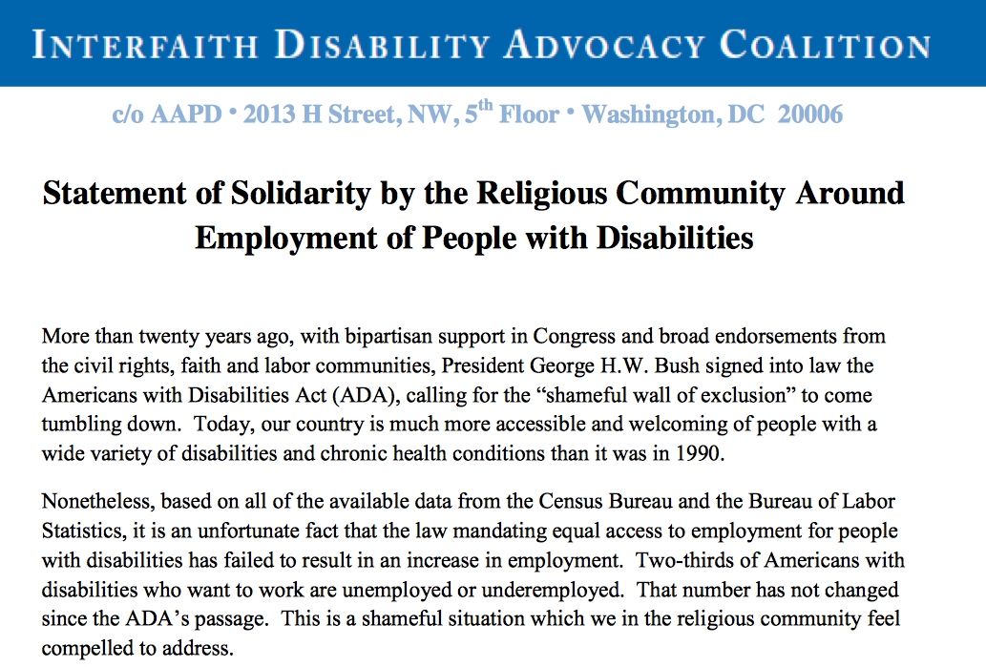
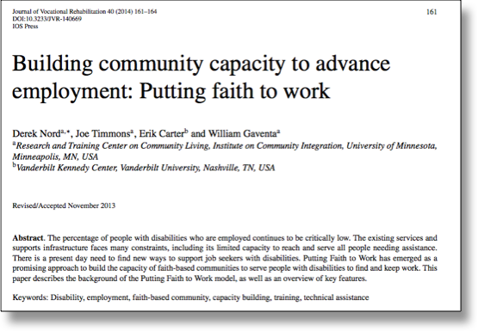
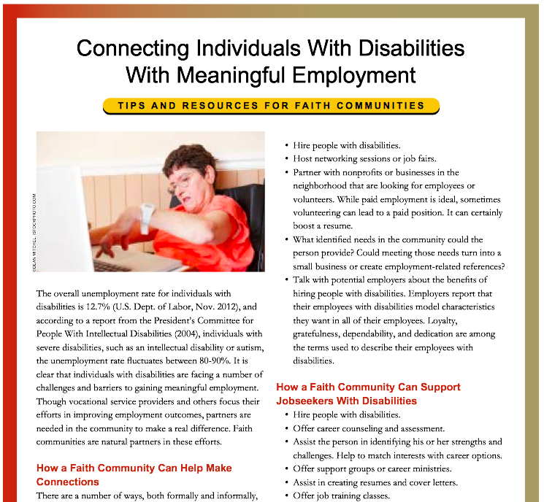
www.puttingfaithtowork.org
Putting Faith to Work: A White Paper
The Call and Opportunity for Faith Communities to Transform the Lives of People with Disabilities and their Communities
By Bill Gaventa, Wesley Allen, Harold Kleinert, and Erik W. Carter

Slide 39
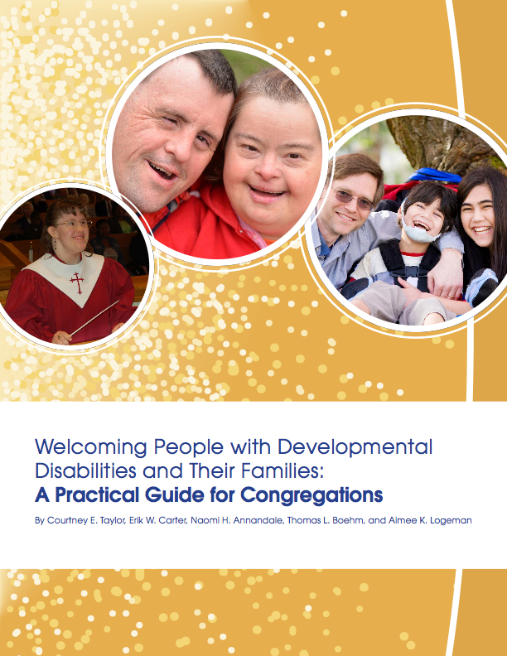
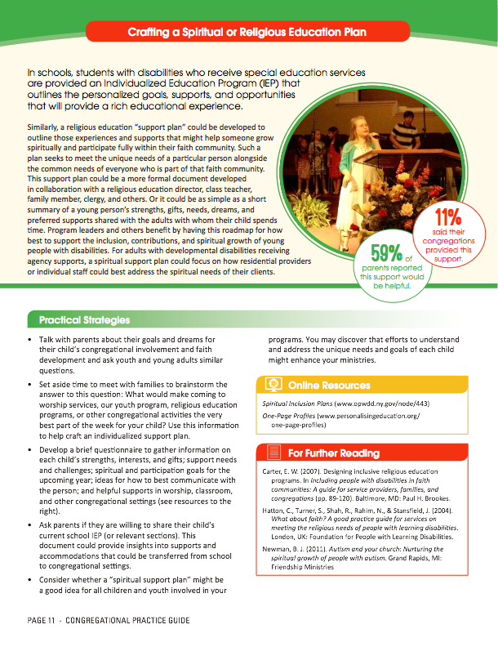
http://vkc.mc.vanderbilt.edu/vkc/resources/religionspirituality/

Slide 40
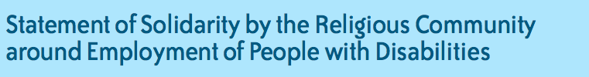
http://www.aapd.com/idac-statement-of-solidarity.pdf
Arizona Temple Emanuel of Tempe, AZ
California Congregation Beth AM - Los Altos Hills, CA Kalsman Institute on Judaism and Health, HUC-JIR - Los Angeles, CA National Council of Jewish Women, California State Public Affairs Committee - San Diego, CA Temple Beth Hillel - Valley Village, CA Temple Ramat Zion - Northridge, CA Temple Sinai of Oakland, CA Ziegler School of Rabbinic Studies - Los Angeles, CA
Connecticut All Abilities Ministry, Inc. - New Haven, CT Congregation B'nai - Bridgeport, CT Congregation Beth Shalom Rodfe Zedek - Chester, CT Gishrei Shalom Jewish Congregation - Southington, CT
Florida Presentation Brothers - Kissimmee, FL
Georgia Centenary Unitied Methodist Church - Macon, GA Jewish Family and Career Services of Atlanta, GA Temple Beth Tikvah - Roswell, GA Temple Sinai of Sandy Springs, GA The Amit Program - Atlanta, GA
Illinois Lutheran Social Services of Illinois - Des Plaines, IL National Council of Jewish Women, Illinois State Public Affairs Committee - Chicago, IL Temple Jeremiah - Northfield, IL
Indiana Anabaptist Disabilities Network - Goshen, IN First Baptist Church of South Bend, IN Temple Beth-El - South Bend, IN
Massachusetts Andover Newton Theological School - Newton Centre, MA Falmouth Jewish Congregation - East Falmouth, MA Jewish Vocational Service - Boston, MA Temple Emunah - Lexington, MA
Maine Henderson Memorial Baptist Church - Farmington, ME
Maryland Brown Memorial Park Avenue Presbyterian Church - Baltimore, MD Jewish Social Services Agency - Rockville, MD Shaare Tefila Congregation - Olney, MD University Baptist Church - College Park, MD
Michigan Christian Reformed Church in North America - Grand Rapids, MI
Minnesota Jewish Family and Children’s Service of Minneapolis, MN Lutheran Social Service of Minnesota - Saint Paul, MN
North Carolina Beth Meyer Synagogue - Raleigh, NC
New Jersey American Baptist Churches of New Jersey - Trenton, NJ Congregation Beth Mordecai - Perth Amboy, NJ Jewish Vocational Service of MetroWest - East Orange, NJ Living Word Baptist Church - Toms River, NJ National Council of Jewish Women, New Jersey State Public Affairs Committee - Elizabeth, NJ Or Chadash - Flemington, NJ State Association of Jewish Federations - Union, NJ Temple Beth-El - Hillsborough, NJ Temple Emanu-El - Westfield, NJ Temple Ner Tamid - Bloomfield, NJ
New York Capital Regional Ecumenical Organization - Malta, NY Central Conference of American Rabbis - New York, NY Congregation Rodeph Sholom - New York, NY Congregation Sons of Israel - Upper Nyack, NY Jewish Labor Committee - New York, NY Temple Israel of South Merrick - Merrick, NY Temple Sinai of Roslyn - Roslyn Heights, NY
Ohio Jewish Family Service Association of Cleveland, OH Jewish Family Services of Columbus, OH Ohio Jewish Communities - Columbus, OH
Pennsylvania Congregation Dor Hadash - Pittsburgh, PA Developmental Programs Division of Catholic Social Services, Archdiocese of Philadelphia, PA International Association of Jewish Vocational Services - Philadelphia, PA JEVS Human Services - Philadelphia, PA Jewish Community Relations Council of Jewish Federation of Greater Philadelphia, PA Jewish Family Service - Wilkes-Barre, PA Links of Love Disability Ministry - Lansdale, PA Office for Ministry with Persons with Disabilities Diocese of Allentown, PA Paul's Run Retirement Community - Philadelphia, PA
Texas Congregation Agudas Achim - Austin, TX Congregation Beth El - Missouri City, TX Congregation Emanu El - Houston, TX Jewish Family Service - Houston, TX National Council of Jewish Women, Texas State Public Affairs Committee - Austin, TX
Vermont First Baptist Church of Bellows Falls, VT
Virginia Temple House of Israel - Staunton, VA Temple Israel of Norfolk - Norfolk, VA
Washington, DC Church of the Pilgrims - Washington, DC Georgetown Presbyterian Church - Washington, DC Temple Micah - Washington, DC
West Virginia National Volunteer Caregiving Network - Wheeling, WV
Wisconsin Bethesda Lutheran Communities - Watertown, WI Wisconsin Jewish Conference - Madison, WI
“I strongly support this proposal to the Kessler Foundation and the possibilities of connecting initiatives in employment with the growing interest in inclusive ministries both with and by people with disabilities and their families. The possibility of helping individuals, families and congregations realize that there are indeed ways they can work together to find and support opportunities for employment, service, and vocation as children grow into young adulthood or as adults deal with acquired disabilities is very exciting.”
Ginny Thornburgh
Director, AAPD Interfaith Initiative
Notes:
Bill. This initiative did not come from any of us…It is and was a policy statement in preparation for AFP last year, and our project can be a way to put action steps on to it. Another avenue to move forward.
Bill will try to get a blessing from Ginny Thornburgh before Thursday.

Slide 41

Working Committee on Employment:
Statement of Solidarity
Expanding Employment Opportunities for People with Disabilities: Suggested Steps for Congregations
Bulletin Insert:
Expanding Employment Opportunities
for People with Disabilities

Slide 42
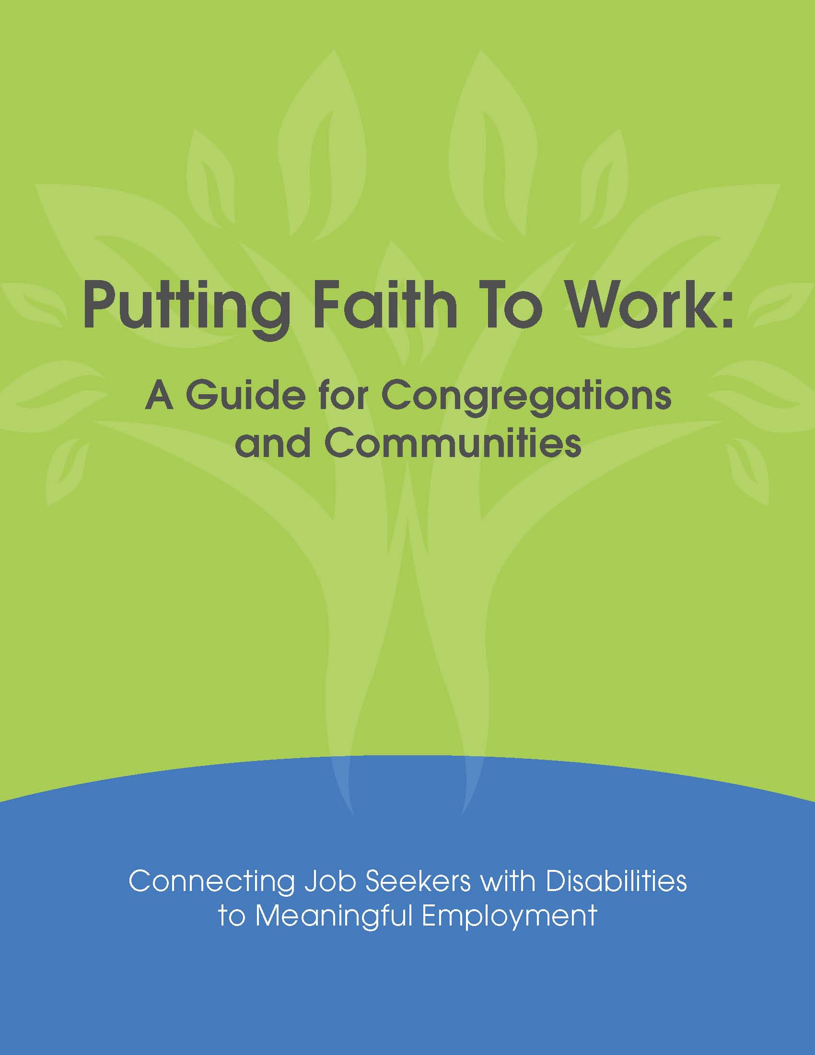
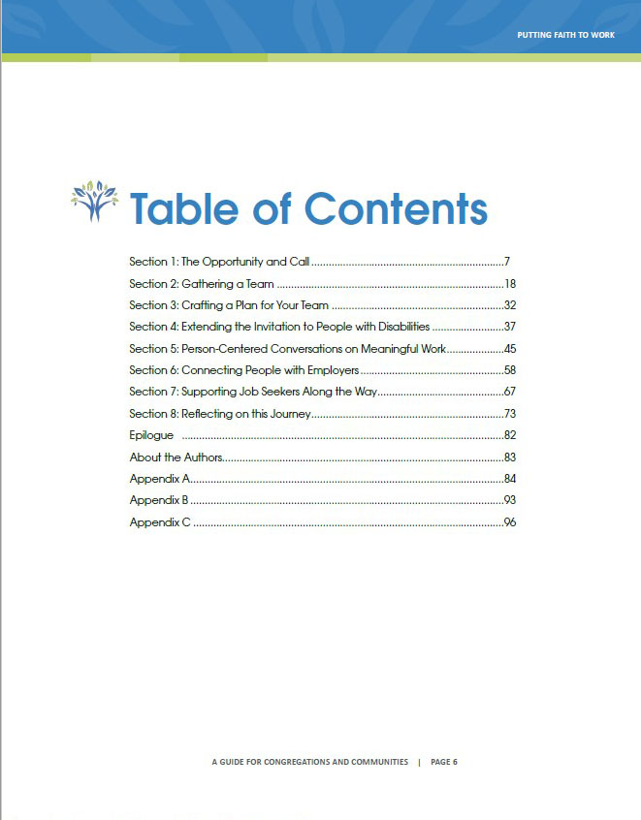
Congregational Manual

Slide 43

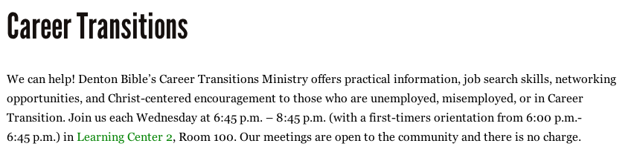
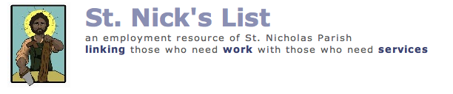
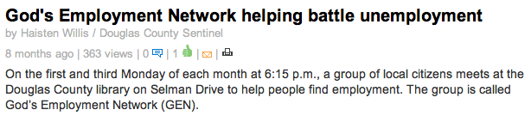
Efforts of Individual Congregations
Notes:
Just note that we have some. This slide needs to come by the 8 minute mark or earlier because of meat of proposal is coming up.
Stories related to Faith Communities and Employment of People with Disabilities
1. The church has hired a young woman with a developmental disability to do clerical work and she is featured on our Special Needs Ministry brochure. Also in networking through our congregation, my daughter Kelly was able to get a job for the summer through an agency that hires and serves individuals with developmental disabilities. My daughter, Kelly is 21, has CP and attends college in Ohio. She was home for the summer and despite sending out many applications for typical summer employment for college students, was unable to get a job. She would have an interview and as soon as she "rolled" in the door she was told the position was filled. This happened over and over again. Very discouraging! Kelly has a very strong commitment to her faith, participates in university based Jimtian organizations and is very interested in pursuing counseling from a faith based perspective after she graduates from college. She is currently looking at graduate schools which would prepare her for this. This past summer she contacted Joni Erikson's organization. They were very receptive to her and invited her to attend a seminar/event during the summer. Unfortunately due to conflicts and lack of transportation she could not make it. I don't know if any of this is relevant to what you were looking for, but wanted to share it
2. Some congregations in Boulder started support groups that resourced together and found places to volunteer to keep active and hopeful while searching. A few helped with food, clothing and gas cards. My experience in boulder was they gave caring support but it was up to the individual to self find a position. Unfortunately not so much for individuals with disabilities.
~In my current church when someone called looking for assistance it went out in our weekly pray list and if anyone had suggestions to pass that onto the pastor.
~A few connections I have suggested in the past. Some are national job lines and a few are state for individuals with disabilities and friendly companies. http://www.opm.gov/disability/, http://federaljobs.net/disabled.htm, http://coddc.org/, http://www.careerjet.com/developmental-disabilities-jobs/colorado-371.html, http://www.colorado.gov/cs/Satellite/CDHS-VetDis/CBON/1251579253372. Unfortunately I don't have any specific faith connection. Faith communities seem to respond on an individual base.
~I find that there is more support, training, systems in place to support individual with state agencies and specific organizations than churches. As I navigate my journey to better understand churches I am learning they don't understand difference unless someone in the congregation presents with one or a new comer comes in with difference and then the church will work to understand. But, until it is present in the church they do not address or discuss it. A space of reaction which I find potentially harming and unwelcoming.
3. My friend Jim worked for Ames, a small store chain, for many years. Jim experienced Down Syndrome and did not communicate well using words. Jim is a kind and gentle person, reliable, a good friend but let’s just say speedy is not an adjective one would use when describing him. His employers at Ames understood Jim, knew him to be dedicated and reliable, and so they overlooked that what took Jim most of a four hour shift to complete another employee may have done in an hour or so. Jim was happy there and they were happy with Jim.
Well disaster struck when Ames closed. As Jim’ job coach I was tasked with helping Jim to find another job. Oh dear…Jim did not interview well and it was difficult for potential employers to see the diamond in the rough. After a few months of dismal failure, I spoke to Jim and his family. Was there anyone they knew who could make an appeal for Jim? Just get us in the door, get us a chance to show them what Jim was capable of doing. The next weekend, Jim’ family made an appeal at their local parish where they had been members for generations. That very day, another parishioner approached them to let them know his brother was in HR at GIANT, a food store with a location in the area, and that they could be sure that Jim would be given an interview and be given due consideration for a position. Jim did indeed interview and did get the job. He spent a few more years there before deciding he’d like to retire (just like his dad had done a few years back).
4. One more story…
I have been working with my friend John since 2008. John is a wonderful young man on the Autism spectrum. He is a hard worker, aims to please, has boundless energy, a tremendous sense of humor and is an artist. What John doesn’t have is a filter…sometimes things just come out of his mouth that are nowhere near appropriate for a given situation. This ‘Achilles heal’ has plagued him for years. This, his last year of high school, we were bound and determined to get him independent in the community. At the beginning of the school year we found 2 volunteer opportunities for him doing outside maintenance and grounds keeping. One at a local bird sanctuary and another at a local Church of the Nazarene. I was a little hesitant when I approached the church about John. I didn’t want to set him up for failure. Without disclosing his disability I tried to prepare the pastor for what could happen with John around. He seemed unconcerned. When I also told him that John would really like to use some power tools ( a fact that usually sent other folks running for the hills) he came up with a short list of duties that would include the use of a hedge trimmer and leaf blower. Perfect!!
John worked successfully at both locations giving him a lot of experience and boosting his confidence and independence. Later in the year, John was offered a paid job at a local drive in restaurant. John was offered paid employment 5 days a week M-F. But because he loved his work at the church so much he opted to work T-F at the restaurant and stay on as a volunteer on Mondays at the church. John continues to be a beloved member of the grounds crew and loves his time there.
5. When Fred Hubach, Jr., was assigned a Service Learning Project during his senior year of high school, he chose a project that many adults wouldn’t have tackled. Interested in economics and mercy ministries, Fred ambitiously created a Jobs for Life site at his church, Reformed Presbyterian, in Ephrata PA. Jobs for Life (JfL) is a Christ-centered ministry, utilized by several PCA congregations, that equips churches and community-based organizations to help unemployed and underemployed adults find and keep jobs. Classes are held at sites formed at churches and community outreach centers. Each site is given all the tools and training materials necessary to teach and mentor students. Fred’s venture was a success. Of the five adults with developmental disabilities who started the class, four completed all of the requirements with flying colors and graduated—each possessing both increased soft job skills and an enhanced confidence level. Of the four graduates, one was able to move out of a sheltered workshop environment into a community-based work environment.
Fred was awarded the 2008 JfL Samaritan Award as Volunteer of the Year. “Our goals are to teach character and to connect people to their community,” says David Spickard, President of JfL. “Character is taught through the Word of God, and community comes through God’s people.” Steve Nash, Executive Director of Advance Memphis, says this philosophy is what makes JfLsuccessful. “Jobs for Life is a great tool for churches to use in justice and mercy ministry,” he says. Advance Memphis works to bring economic revitalization to inner city Memphis, one of the poorest zip codes in the nation. Its first JfL class, offered in 2005, was unsuccessful, fizzling out by the second week. Advance Memphis turned to JfL for advice. “We told them to start another class,” laughs David. Advance Memphis did, and by the end of 2007, over 275 people had applied. Currently, 82 people have graduated in 2008, with two more classes to be offered this year. In June 2008, Advance Memphis was awarded the JfL Site of the Year. Steve stresses that JfL requires long-term commitment and dedication: “If you see it as a good deed to do for the weekend, it’s not for you.” But Advance believes the results make the effort worthwhile.
JfL is more than a handout; it’s a way to empower historically marginalized communities, to bring justice and healing to the least of these. And maybe most importantly, in racially divided Memphis, it provides a forum for peer and mentor relationships between African American and white believers to flourish. As Steve often reminds donors and volunteers, “Rich and poor alike – we both have a lot to learn from each other.” The ability to customize the JfL program helps meet each site’s needs.
The lead teacher at Fred’s site modified the program to teach adults who are part of the church’s Special Needs Ministries. “Adapting JfL for the developmentally disabled is especially meaningful, as they are typically neglected and often experience chronic unemployment or underemployment,” says Fred. “JfL provides a wonderful way to teach soft job skills as well as a Biblical work ethic to people with disabilities,” adds Fred’s mother Stephanie, MNA Special Needs Ministries Director. After completing Fred’s class, one man was able—for the first time—to look an interviewer in the eye and shake his hand. Understanding his value in God’s Kingdom gave him the confidence he needed to begin transforming his life. To learn more about JfL, including how to launch a site at your church or ministry organization, call Paula Bryan at888-408-1565 x3 or visit www.jobsforlife.com.

Slide 44
Why This Work Matters
All hard work brings a profit, but mere talk leads only to poverty. (NIV) Proverbs 14:23
The Prophet Muhammad (peace be upon him) was asked what type of earning was best, and he replied: ” A man’s work with his hands and every (lawful) business transaction.”
Al-Tirmidhi, Hadith 846.
4 Now there are varieties of gifts, but the same Spirit; 5 and there are varieties of services, but the same Lord; 6 and there are varieties of activities, but it is the same God who activates all of them in everyone. 7 To each is given the manifestation of the Spirit for the common good.
I Corinthians 12:4-7
Notes:
Just the beginning of some of the spiritual and theological foundations. Stress, this is their mission, not the system’s.

Slide 45

Contact Info
Project Director: Erik Carter, Vanderbilt Kennedy Center
Website: www.faithanddisability.org
Minnesota Director: Joe Timmons
Consultant: Bill Gaventa

