Slide 1


Notes:
Source: Coalition for Public Safety

Slide 2
Why Criminal Justice Reform?
The U.S. is home to five percent of the world’s population, but 25 percent of the world’s prison population. 2.2 million people are currently in our nation’s prisons or jails – a 500 percent increase during the past 30 years.
The federal prison population increased from approximately 25,000 to 219,000 individuals over the last two decades:
  790 percent increase
  60 percent of those currently incarcerated in federal prisons are non-violent offenders
  Prisons cost taxpayers $80 billion a year
More than 60 percent of the people in prison are now racial and ethnic minorities.
Notes:
Source: Coalition for Public Safety

Slide 3
Why Criminal Justice Reform?(cont.)
At the local level, jails process nearly 12 million people per year, and have a disproportionate impact on communities of color. Nationally, African Americans are jailed at almost four times the rate of white Americans.
Between 70 million and 100 million — or 1-in-3 of all American adults — now have a criminal record, which carries lifelong barriers that can block successful re-entry and participation in society because of restrictions on employment, housing and voting. Over-incarceration contributes to a cycle of poverty that traps individuals, families and entire communities for generations.
Approximately 10 million children have experienced parental incarceration at some point in their lives.
Notes:
Source: Coalition for Public Safety, Rutgers NRCCFI Fact Sheet

Slide 4
Creating Success
Yet three-quarters of people who leave incarceration will be re-arrested within five years, and two-thirds will return to incarceration.
The current system is not working.
What facts do we need to know, and questions do we need to raise, to get criminal justice reform right?

Slide 5
Hiding in Plain Sight!
“It ain't what you don't know that gets you into trouble. It's what you know for sure that just ain't so.”
Mark Twain (as paraphrased in The Big Short)
Like in the housing crisis, there are some people who can see through the data, including our co-author Philip Pauli. See: http://unsolvedmysteries.wikia.com/wiki/Philip_Pauli.
Notes:
“It ain't what you don't know that gets you into trouble. It's what you know for sure that just ain't so” - Mark Twain

Slide 6


Necessary vs. Sufficient
A + B + C = D
Steam Engine
Water of any other temp. VS. Water at 212F

Slide 7


Why a Theory of Change?
Blueprint describing how an organization/policy changes some domain of the world for the better
Articulates a TESTABLE hypothesis of how change will occur
Sieve through which to make decisions and trade-offs
MUST HAVE DATA

Slide 8
A Good TOC Will Answer
Key Strategic Questions
Are we doing the right things to get the outcomes we want?
  Do we need to improve activities?
  Do we have the right mix of activities?
  Do we have extraneous activities?
How should we increase our impact?
  Do we deepen our current activities?
  Do we extend activities to new areas?
  Do we aim to influences new beneficiaries and/or audiences?
  Do we expand our geographic reach?
What do we need to learn and measure?
  How will we answer our open questions?
  What do we need to track internally and externally?
  Test question: If criminal justice system faced a sudden 25 percent budget cut or 25 percent budget growth, could your TOC help you decide what to do and articulate the rationale behind your decisions to your stakeholders?

Slide 9
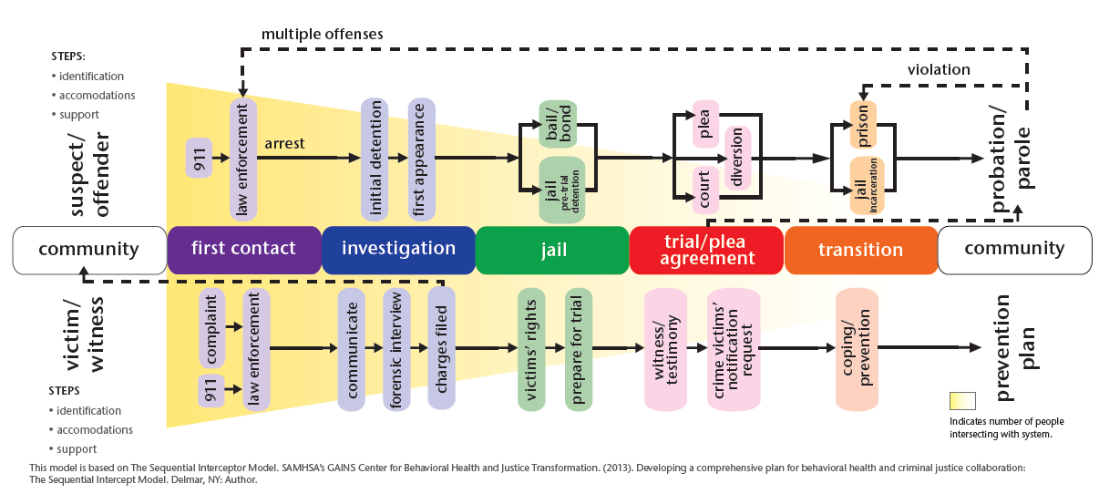
Cycle of Justice Involvement
(graphic by The Arc)
Pathways to Justice Model (by the Arc)
Notes:
The Pathways to Justice Model
Based on the Sequential Intercept Model used for suspects/offenders with mental illness.
Source: The Arc, National Center on Justice and Disability

Slide 10
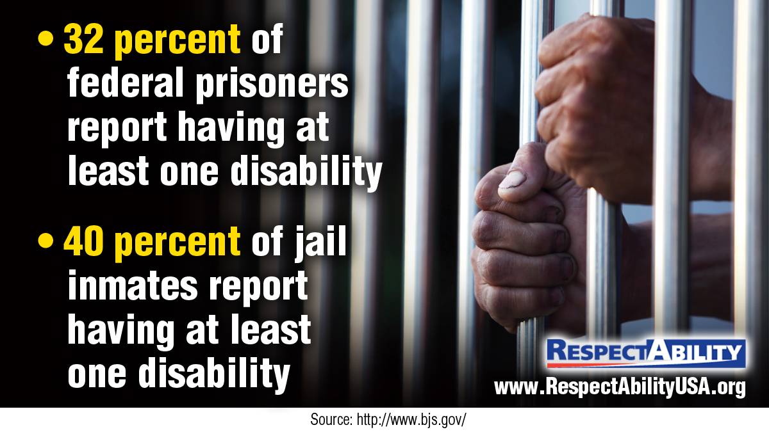
750,000+ Inmates with Disabilities
Notes:
"32 percent of federal prisoners report having at least one disability, and 40 percent of jail inmates report having at least one disability."
Source: Bureau of Justice Statistics

Slide 11
How Many are Incarcerated?
There are 2.3 million incarcerated in the U.S. in total; 1.35m in state prison, 646k in jail and 211k in federal prison.
Of those, how many have disabilities?
Disability | Jail % | Prison% | Estimated Total
Any Disability | 39.9% | 31.6% | 751,000
Vision | 7.3 | 6.2 | 146,000
Hearing | 6.5 | 7.1 | 152,000
Ambulatory | 9.5 | 10.1 | 219,000
Cognitive | 30.9 | 19.5 | 504,000
Self-care | 2.8 | 2.1 | 50,000
Independent living | 8.7 | 7.5 | 192,000
Source: Prison Policy Initiative
Respect Ability
Notes:
Source: Prison Policy Initiative

Slide 12
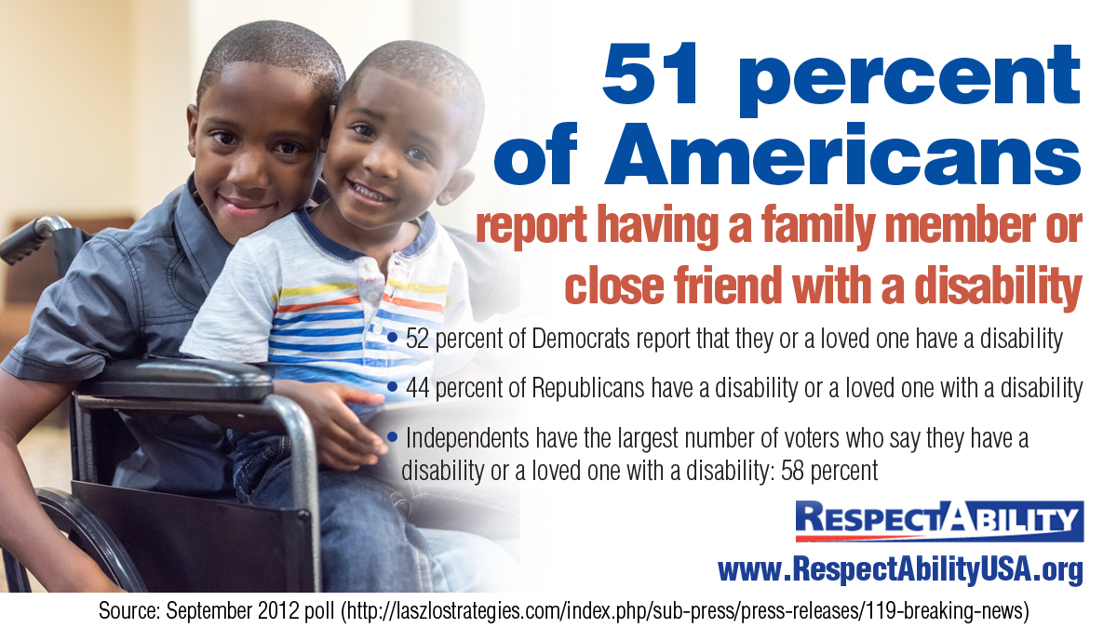
Forget 6 Degrees
Notes:
"51 percent of Americans report having a family member or close friend with a disability. 52 percent of Democrats report that they or a loved one have a disability. 44 percent of Republicans have a disability or a loved one with a disability. Independents have the largest number of voters who say they have a disability or a loved one with a disability: 58 percent."
Source: Laszlo Strategies September 2012 poll

Slide 13

Who Has a Disability?
Notes:
"1 in 5 Americans have a disability. 56.7 Americans have a disability, 8.1 million difficulty seeing, 7.6 million difficulty hearing."
Source: U.S. Census

Slide 14
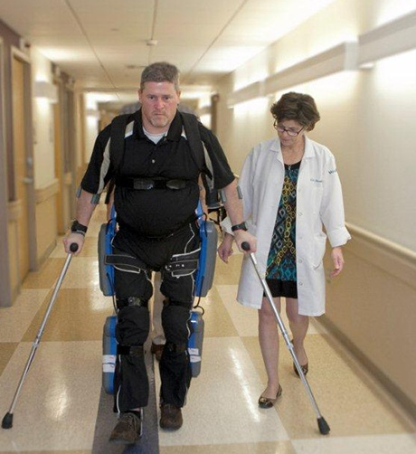

Not All Disabilities Can Be Seen
Disabilities present and affect people differently:
Temporary and Permanent
Invisible and Visible

Slide 15

Freddie Gray
“Before Freddie Gray was injured in police custody…his life was defined by failures in the classroom, run-ins with the law and an inability to focus on anything for very long.”
Can’t/Won’t and Executive Function Disorder (EFD)
Source: Washington Post
Notes:
Source: Washington Post

Slide 16
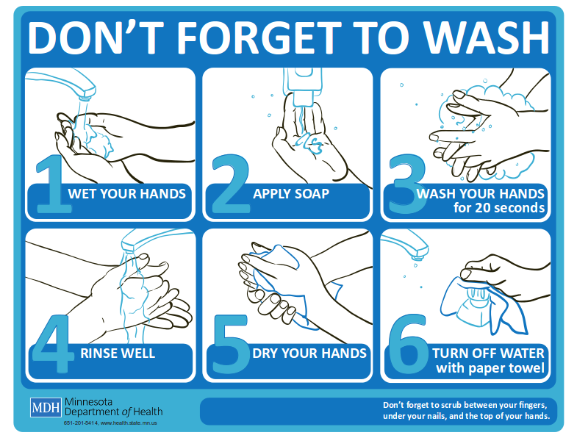
Enabling People with EFD to Succeed
Executive Function Disorders (EFD) involves a pattern of chronic difficulty executing daily tasks. Some with executive function issues may struggle with analyzing, planning, organizing and completing tasks on time, or at all.

Slide 17
Key Terms: Disability
Disability can be physical (i.e.
vision, hearing, mobility), cognitive, intellectual, mental, sensory, developmental or some combination of these that substantially limits one or more major life activity.
The Americans with Disabilities
Act of 1990 (ADA) prohibits discrimination and ensures equal opportunity for persons with disabilities in employment, state and local government services, public accommodations, commercial facilities and transportation.
Accommodation is any change in the work environment or in the way things are done that enables an individual with a disability to enjoy equal access and treatment.
Ableism is discrimination in favor of able-bodied people; the belief that that people who have disabilities are somehow less human, less valuable, and less capable than others.

Slide 18
Key Terms: Incarceration
Returning Citizen is a person who has been found guilty of a crime by a court, and has completed their sentence.
Recidivism is the rearrest, reconvictio, or reincarceration of an ex-offender within a given time frame.
Intersectionality refers to the interconnected nature of social categorizations such as race, class and gender as they apply to a given individual or group, regarded as creating overlapping and interdependent systems of discrimination or disadvantage.

Slide 19
Disability & Criminal Justice Reform:
Keys to Success
95 percent of people imprisoned in the states will eventually be released and return home.
32 percent of federal prisoners and 40 percent of people in jail self-report that they have at least one disability.
Within five years, three out of four
ex-offenders will be re-arrested and reenter the criminal justice system.

Slide 20
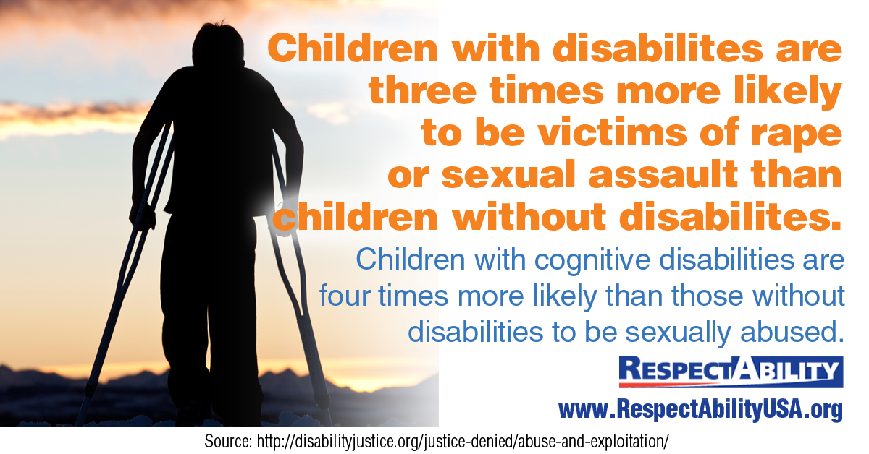
Key Fact: Sexual Abuse of Children
Notes:
“Children with cognitive disabilities are four times more likely than those without disabilities to be sexually abused.”
Sources: Disability Justice
From NCVS, all points are from a statistical average of the years 2009-2013, unless otherwise noted.
4x : Source: Sullivan, P.M. & Knutson, J.F. (1994). The Relationship Between Child Abuse and Neglect and Disabilities: Implications for Research and Practice. Omaha, NE: Boys Town National Research Hospital

Slide 21
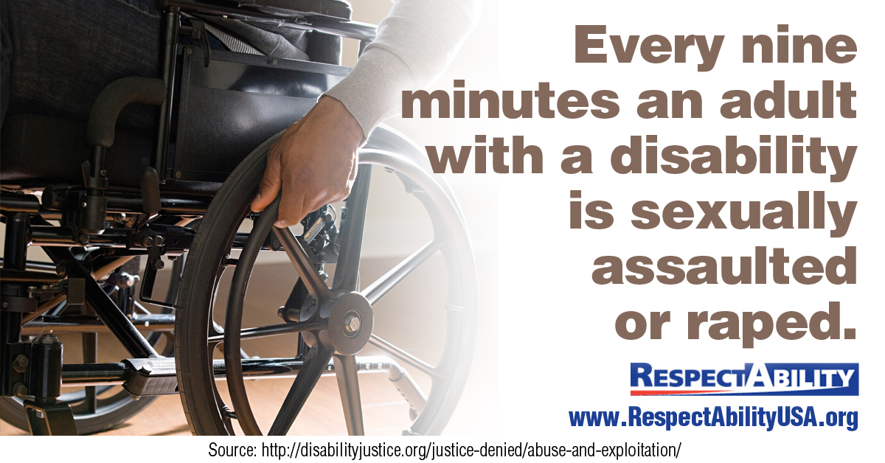
Key Fact: Abuse leads to crime &…
Notes:
“Every nine minutes an adult with a disability is sexually assaulted or raped.”
Source: Disability Justice

Slide 22
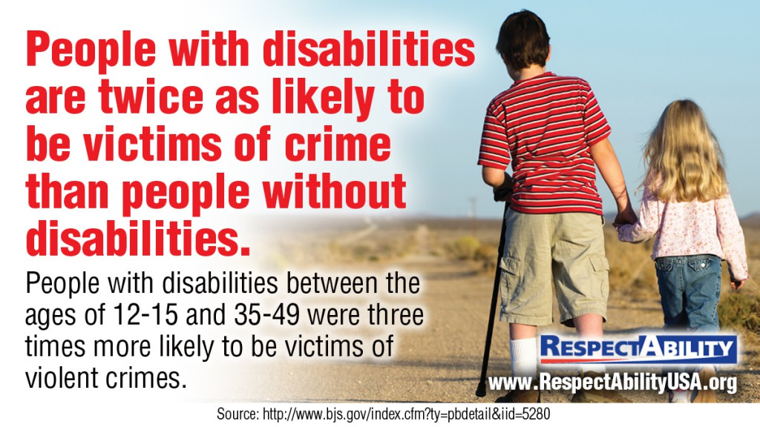
Victimization
Notes:
“People with disabilities are twice as likely to be victims of crime than people without disabilities. People with disabilities between the ages of 12-15 and 35-49 were three times more likely to be victims of violent crimes.”
Source: Bureau of Justice Statistics

Slide 23
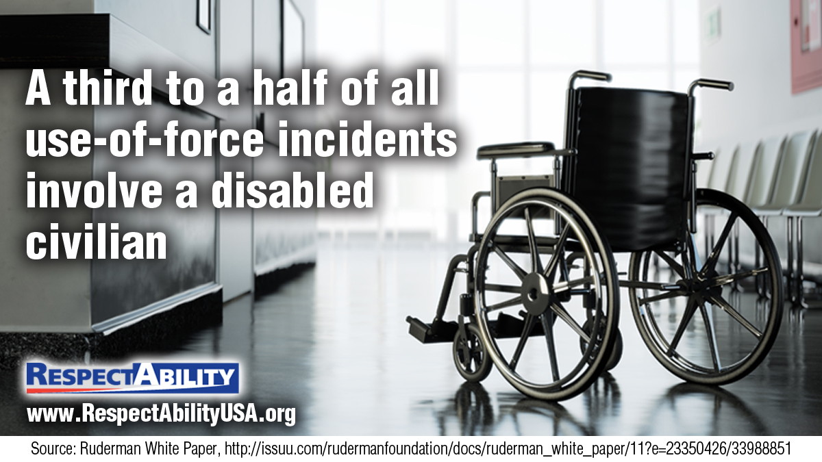
Disability and Police Shootings
Notes:
Graphic with an empty wheelchair to show loss, overlayed with the statistic: "A third to a half of all use-of-force incidents involve a disabled civilian."
Source: Ruderman White Paper

Slide 24
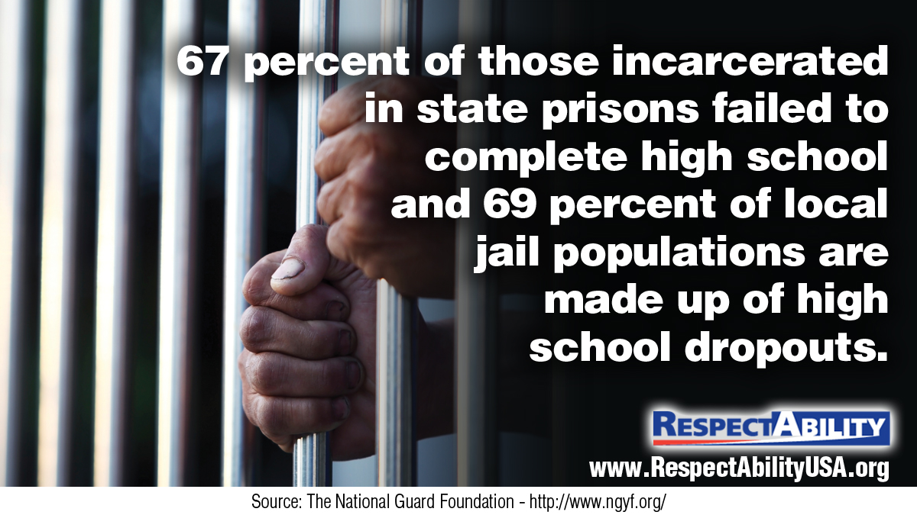
HS Attainment and Prison
Notes:
7% of those incarcerated in state prisons failed to complete high school and 69% of local jail populations are made up of high school dropouts.
Source: The National Guard Foundation - The National Guard Foundation

Slide 25
Who Hasn’t Completed HS in Prison?
68 percent of state prison inmates did not receive a high school diploma.
The groups of prison inmates who had not completed a high school diploma or GED included:
  59% with a speech disability
  66% with a learning disability
  37% without a reported disability
Notes:
Source: Bureau of Justice Statistics, Special Report

Slide 26
High School Graduation
Public high school four-year adjusted cohort graduation rate (ACGR), by race/ethnicity and selected demographics for the United States, the 50 states, the District of Columbia, and other jurisdictions, school year 2011–12
Source: National Center for Education Statistics
Notes:
Source: National Center for Education Statistics

Slide 27

Key Fact: Jobs Without Literacy??
Notes:
Only 61% of young people with disabilities achieve a high school diploma, compared to 81% of people without disabilities - a 20 point gap.
Source: Public High School Four-Year-On-Time Graduation Rates and Event Dropout Rates - National Center for Education Statistics

Slide 28
School Suspensions Lead to Dropping Out
Youth with Disabilities are suspended at much higher rates than the average.
Source: The Civil Rights Project
Notes:
Source: The Civil Rights Project

Slide 29
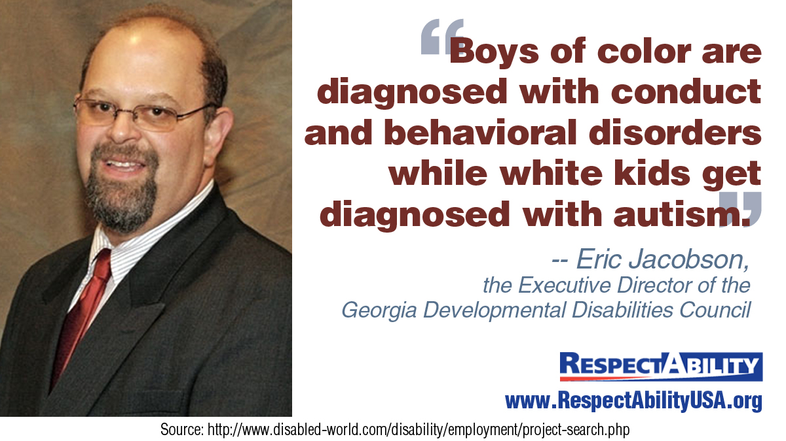
Race/Disability Intersection
Notes:
"Boys of color are diagnosed with conduct and behavioral disorders while white kids get diagnosed with autism" - Eric Jacobson, the Executive Director of the Georgia Developmental Disabilities Council.

Slide 30
Minority Disability Suspension
Minority youth with disabilities are suspended at the highest rates of all.
Source: The Civil Rights Project
Notes:
Source: The Civil Rights Project

Slide 31
Ages 6 to 21 IEPs by Category US
Disability Category | 2011 | 2012
All Disabilities | 5,670,680 | 5,693,441
Specific Learning Disability | 2,293,861 | 2,268,098
Speech or Language Impairment | 1,043,781 | 1,032,729
Intellectual Disability | 422,401 | 415,697
Emotional Disturbance | 370,049 | 359,389
Multiple Disability | 123,762 | 124,722
Hearing Impairment | 68,494 | 68,069
Orthopedic Impairment | 53,939 | 52,052
Other Health Impairment | 722,993 | 757,904
Visual Impairment | 24,811 | 24,987
Autism | 404,544 | 440,592
Deaf Blindness | 1,294 | 1,281
Traumatic Brain Injury | 24,224 | 25,020
Developmental Delay | 115,454 | 122,901
Source: Annual Disability Statistics Compendium
Notes:
SOURCES:
Data for 2011, Charts 11.3a to 11.3d: Annual Disability Statistics Compendium, 2013
Data for 2012, Charts 11.3a to 11.3d: Annual Disability Statistics Compendium, 2014
31

Slide 32
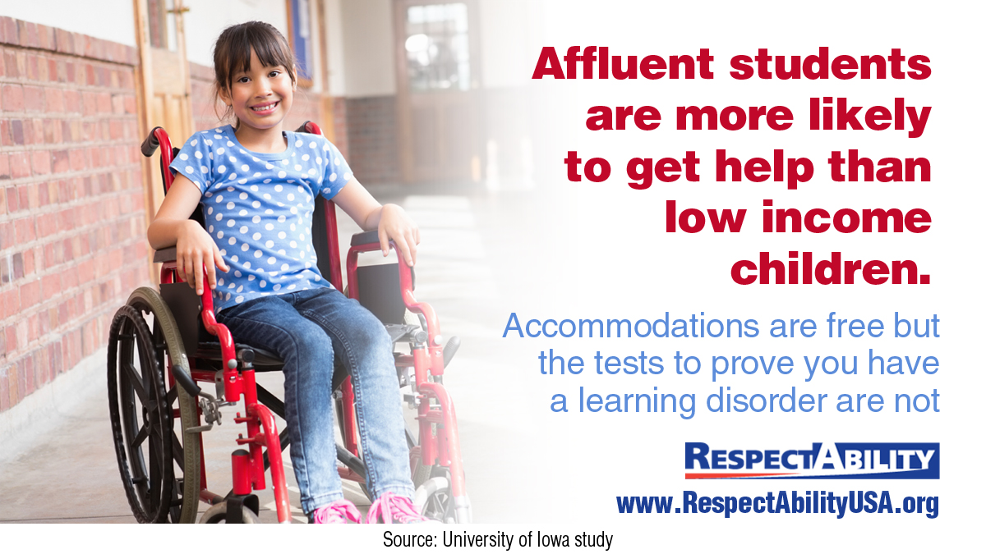
Affluence and IEPs
Notes:
"Affluent students are more likely to get help than low income children. Accommodations are free, but the tests to prove you have a learning disorder are not."
Source: University of Iowa

Slide 33
Prevalence of Disability Among Non-Institutionalized People Ages 16 to 20 in U.S. in 2013
*Total numbers reported
**Because of a physical, mental, or emotional condition, does this person have serious
difficulty concentrating, remembering, or making decisions?
Source: Cornell University
Notes:
Source: Cornell University
*Total numbers reported
Any Disability – 1,221,000
Visual – 212,500
Hearing – 140,000
Ambulatory – 171,300
Cognitive – 850,700
Self-Care – 152,900
Independent Living – 432,100

Slide 34
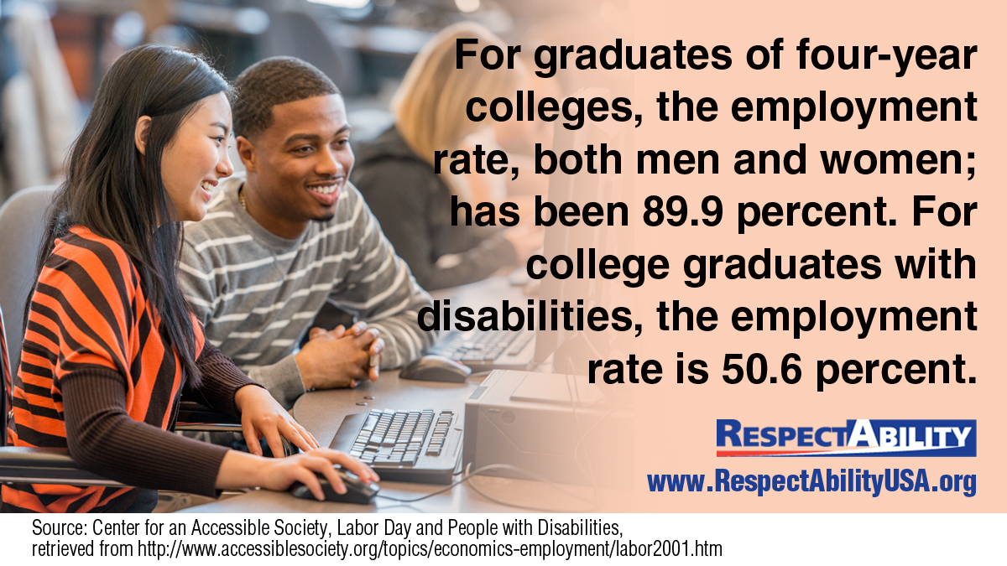
Stigma: Post-College Employment Gap
Notes:
A photo of a group of students including some with disabilities working together on a project overlaid with the statistic: "For graduates of 4-year colleges, the employment rate, both men and women; has been 89.9 percent. For college graduates with disabilities, the employment rate is 50.6 percent."
Source: Center for an Accessible Society

Slide 35
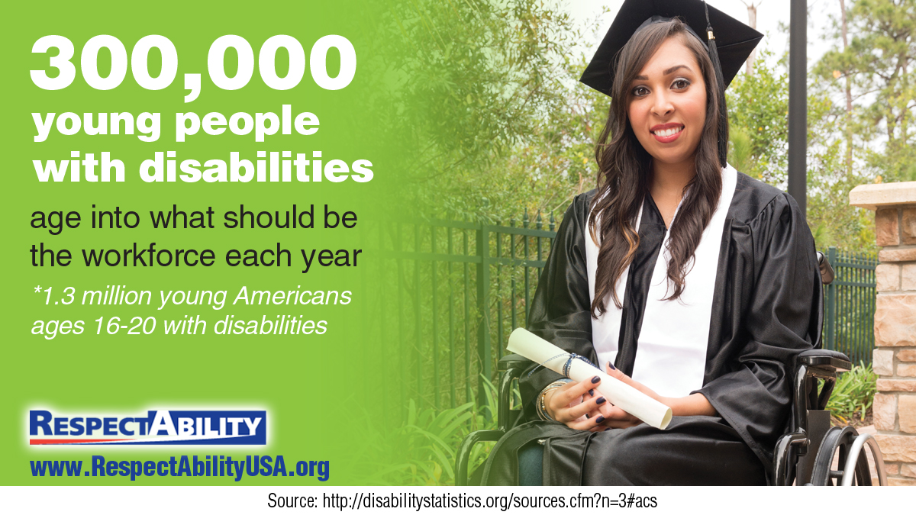
Successful Transition is Necessary
Notes:
"300,000 young people with disabilities age into what should be the workforce each year. 1.3 million young Americans ages 16-20 with disabilities."
Source: Disability Statistics, by Cornell University

Slide 36
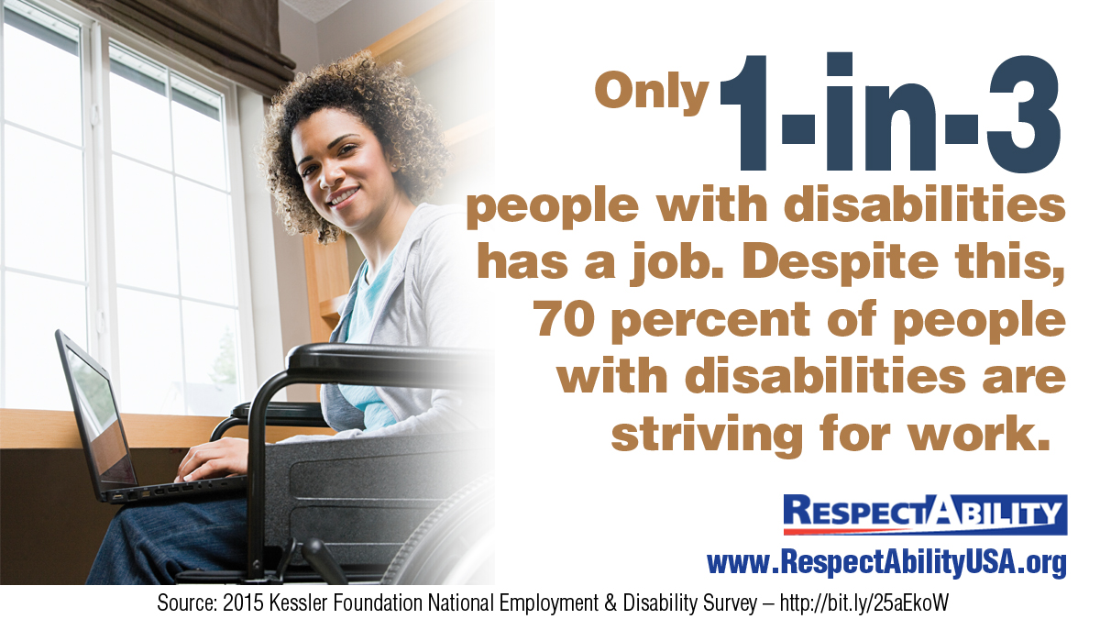
Existing Demands on Workforce
Notes:
"Only 1 in 3 people with disabilities has a job. Despite this, 70% of people with disabilities are striving for work.“
Source :2015 Kessler Foundation National Employment & Disability Survey

Slide 37
PwDs are the Poorest of the Poor
Notes:
Sources: EPI Chart, Annual Disability Statistics Compendium, Disability Statistics, by Cornell University, U.S. Census Data

Slide 38
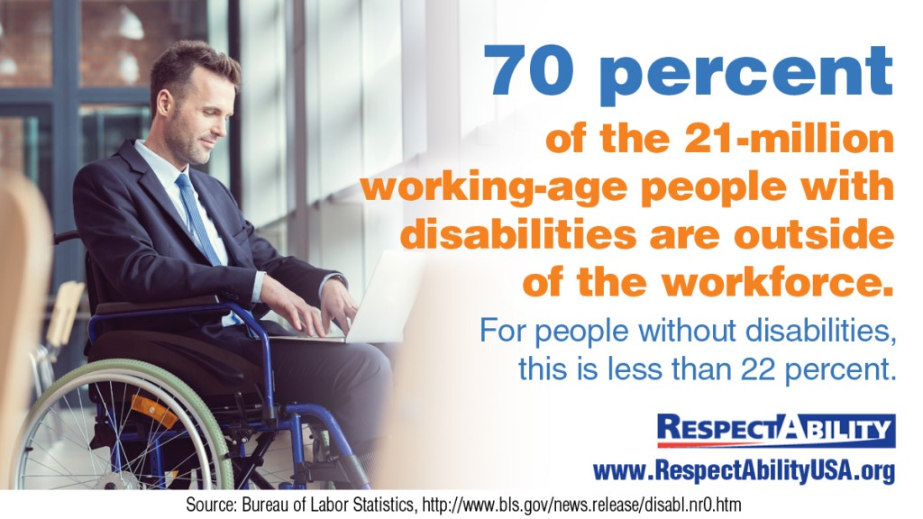
Vast Majority Outside the Workforce
Notes:
"70 percent of the 21 million working-age people with disabilities are outside of the workforce. For people withour disabilities, this is less than 22 percent."
Source: Bureau of Labor Statistics

Slide 39
Labor Force Participation Rate
In recent years, while things have improved for African Americans, Hispanics and women, sadly the labor force participation rate (LFPR) for people with disabilities has decreased significantly.
Notes:
Source: Annual Disability Statistics Compendium, Table 2.22, U.S. Department of Labor, Bureau of Labor Statistics, Bureau of Labor Statistics
Labor force participation data points graphed, with trendlines illustrating that while there is an upward trend for women, African americans and Hispanic americans, the labor force participation rate has gone down for americans with disabilities since the 1980s.

Slide 40
National Employment Rates by Disability
Notes:
Source: Annual Disability Statistics Compendium

Slide 41
State Disability and Employment Statistics
Alabama: Download the PDF here. Download the PPT here.
Alaska: Download the PDF here. Download the PPT here.
Arizona: Download the PDF here. Download the PPT here.
Arkansas: Download the PDF here. Download the PPT here.
California: Download the PDF here. Download the PPT here.
Colorado: Download the PDF here. Download the PPT here.
Connecticut: Download the PDF here. Download the PPT here.
DC: Download the PDF here. Download the PPT here.
Delaware: Download the PDF here. Download the PPT here.
Florida: Download the PDF here. Download the PPT here.
Georgia: Download the PDF here. Download the PPT here.
Hawaii: Download the PDF here. Download the PPT here.
Idaho: Download the PDF here. Download the PPT here.
Illinois: Download the PDF here. Download the PPT here.
Indiana: Download the PDF here. Download the PPT here.
Iowa: Download the PDF here. Download the PPT here.
Kansas: Download the PDF here. Download the PPT here.
Kentucky: Download the PDF here. Download the PPT here.
Louisiana: Download the PDF here. Download the PPT here.
Maine: Download the PDF here. Download the PPT here.
Maryland: Download the PDF here. Download the PPT here.
Massachusetts: Download the PDF here. Download the PPT here.
Michigan: Download the PDF here. Download the PPT here.
Minnesota: Download the PDF here. Download the PPT here.
Mississippi: Download the PDF here. Download the PPT here.
Missouri: Download the PDF here. Download the PPT here.
Montana: Download the PDF here. Download the PPT here.
Nebraska: Download the PDF here. Download the PPT here.
Nevada: Download the PDF here. Download the PPT here.
New Hampshire: Download the PDF here. Download the PPT here.
New Jersey: Download the PDF here. Download the PPT here.
New Mexico: Download the PDF here. Download the PPT here.
New York: Download the PDF here. Download the PPT here.
North Carolina: Download the PDF here. Download the PPT here.
North Dakota: Download the PDF here. Download the PPT here.
Ohio: Download the PDF here. Download the PPT here.
Oklahoma: Download the PDF here. Download the PPT here.
Oregon: Download the PDF here. Download the PPT here.
Pennsylvania: Download the PDF here. Download the PPT here.
Rhode Island: Download the PDF here. Download the PPT here.
South Carolina: Download the PDF here. Download the PPT here.
South Dakota: Download the PDF here. Download the PPT here.
Tennessee: Download the PDF here. Download the PPT here.
Texas: Download the PDF here. Download the PPT here.
Utah: Download the PDF here. Download the PPT here.
Vermont: Download the PDF here. Download the PPT here.
Virginia: Download the PDF here. Download the PPT here.
Washington: Download the PDF here. Download the PPT here.
West Virginia: Download the PDF here. Download the PPT here.
Wisconsin: Download the PDF here. Download the PPT here.
Wyoming: Download the PDF here. Download the PPT here.

Slide 42
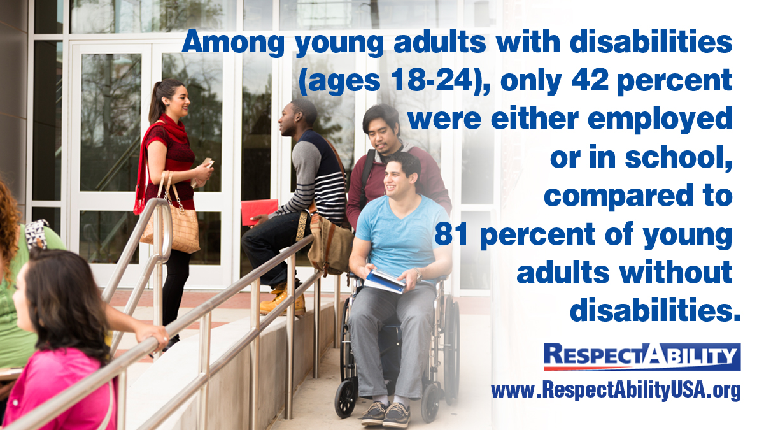
“Disconnected Youth”
Notes:
"Among young adults with disabilities (ages 18-24), only 42 percent were either employed or in school, compared to 81 percent of young adults without disabilities.“
Source: National Council on Disability

Slide 43
Best and Worst States on Jobs for People with Disabilities
Top 10 States with the Lowest Employment Rate Gaps for PWDs
10 States with the Highest Employment Rate Gap for PWDs
# | State | Gap
1 | N. Dakota | 32.1
2 | Nevada | 33.4
3 | Utah | 33.5
4 | S. Dakota | 33.6
5 | Hawaii | 34.2
6 | Alaska | 35.3
7 | Iowa | 35.7
8 | Wyoming | 35.9
9 | Idaho | 37
10 | Montana | 37.3
# | State | Gap
41 | Alabama | 44.1
42 | Vermont | 44.2
43 | Missouri | 44.4
44 | Tennessee | 44.5
45 | Arkansas | 44.6
46 | West Virginia | 44.9
47 | Michigan | 45
48 | South Carolina | 45
49 | Kentucky | 47.1
50 | Maine | 47.4
Read our full report here: The Best-and Worst-States for Workers with Disabilities
Employment rate percentage point gap given by (Non-Disability Employment Rate – Disability Employment rate)
Notes:
Source: Annual Disability Statistics Compendium

Slide 44
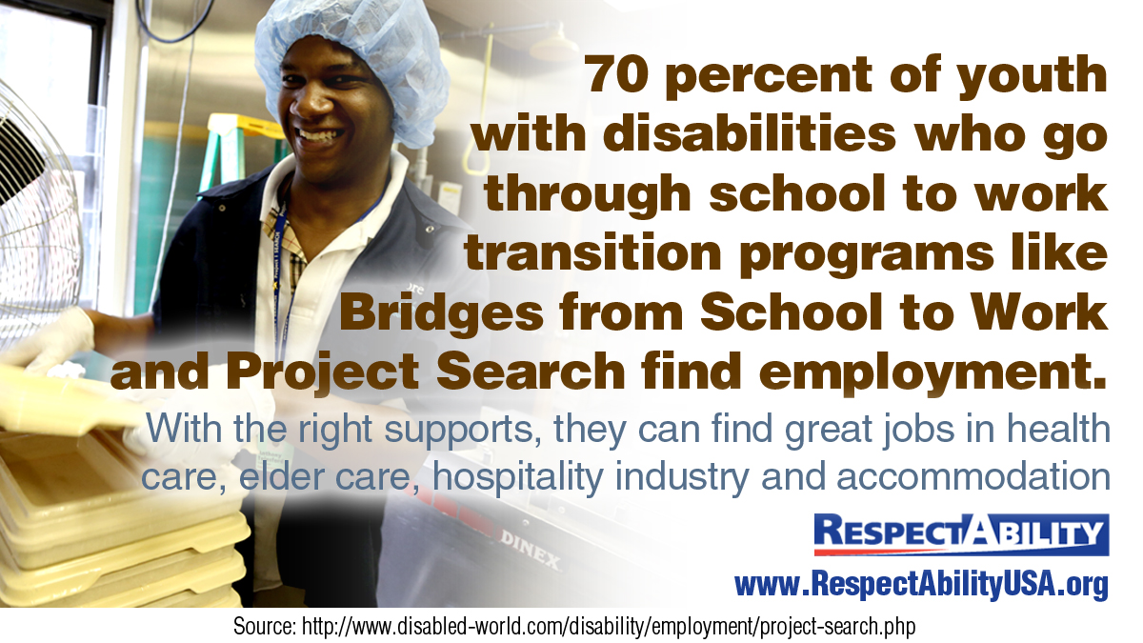
Transition Programs Work
Notes:
Source: Mathematica Project Search Report

Slide 45
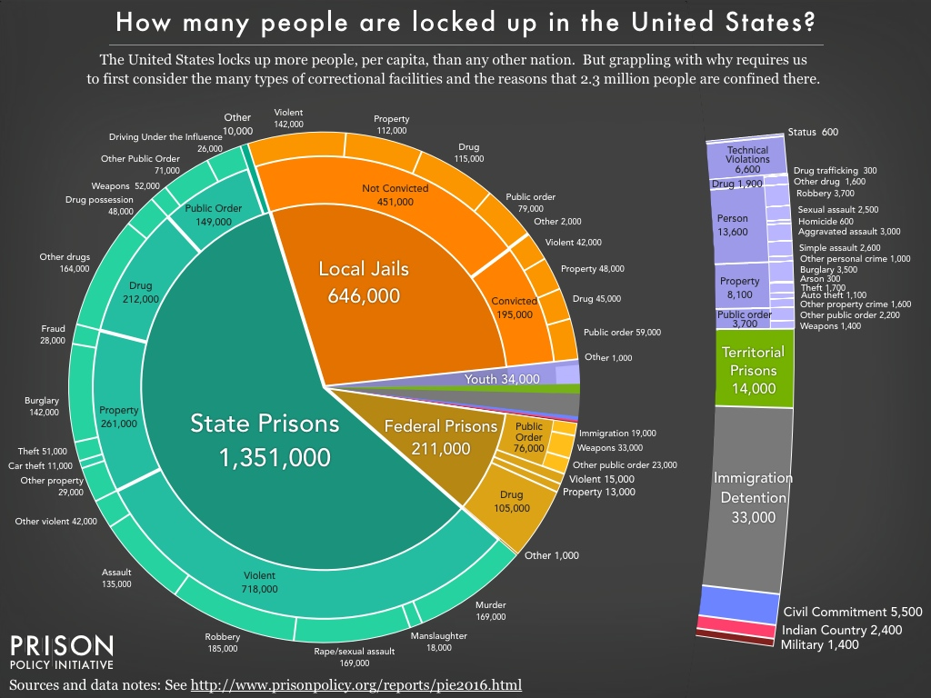
Prison Population Breakdown
Notes:
2.3 Million in corrections
Sources and data notes: Prison Policy Initiative
State Prisons – 1,351,000
Violent – 718,000
Property – 261,000
Drug – 212,000
Public Order – 149,000
Other – 10,000
Local Jails – 646,000
Convicted – 195,000
Not Convicted – 195,000
Federal Prisons – 211,000
Public Order – 76,000
Violent – 15,000
Property – 13,000
Drug – 105,000
Other – 1,000
Youth – 34,00
Territorial Prisons – 14,000
Immigration Detention – 33,000
Civil Commitment – 5,500
Indian Country – 2,400
Military – 1,400

Slide 46
Demographics of Incarcerated Population
Notes:
Figure 29: Demographics of Incarcerated Population, 2002-2004
Bar graph depicting the characteristics of the prison/jail population between 2002 and 2004, organized by the following demographic characteristics: “Grew up in Foster Care”; “Ever Received Public Assistance”; “Family Member Ever Incarcerated”; “Parental Substance Abuse”; “Regular Alcohol Use”; “Regular Drug Use”; “Past Physical or Sexual Abuse”; “Homelessness in the Past Year”; “Mental Health Problem.” The data was compiled using state and federal prisoners as well as jail inmates. The graph shows that the most prevalent characteristic among the incarcerated population between 2002 and 2004 was “regular drug use.” 69% of the incarcerated population regularly used drugs. The second most prevalent characteristic was “regular alcohol use.” 65% of the incarcerated population regularly used alcohol. The third most prevalent characteristic between 2002 and 2004 was “mental health problem.” 58% of the incarcerated population reported having a mental health problem. On the opposite end, the least prevalent characteristics were “homelessness in the past year” (11%) and “grew up in foster care” (13%).

Slide 47
Prevalence of Disability: Prisons
State and Federal Prisoners
Any Disability – 31.6%
Vision – 7.1
Hearing – 6.2
Ambulatory – 10.1
Cognitive – 19.5
Self-care – 2.1
Independent living – 7.5
General Population
Any disability – 10.9%
Vision – 2.1
Hearing – 2.6
Ambulatory – 5.1
Cognitive – 4.8
Self-care – 2.1
Independent living – 4.0
Source: Bureau of Justice Statistics
Notes:
Table 1: Prevalence of disabilities among state and federal prisoners and the general population, standardized, 2011–12
Source: Bureau of Justice Statistics
Data table depicting the prevalence of disabilities among state and federal prisoners and the general population, standardized, between 2011 and 2012. The table shows that 31.6% of state and federal prisoners have a disability, while only 10.9% of people in the general population have a disability. The table also shows that the most prevalent disability in the prison population is cognitive disability, which 19.5% of federal and state prisoners have. In contrast, the most prevalent disability in the general population is ambulatory disability, which 5.1% of the general population has.

Slide 48
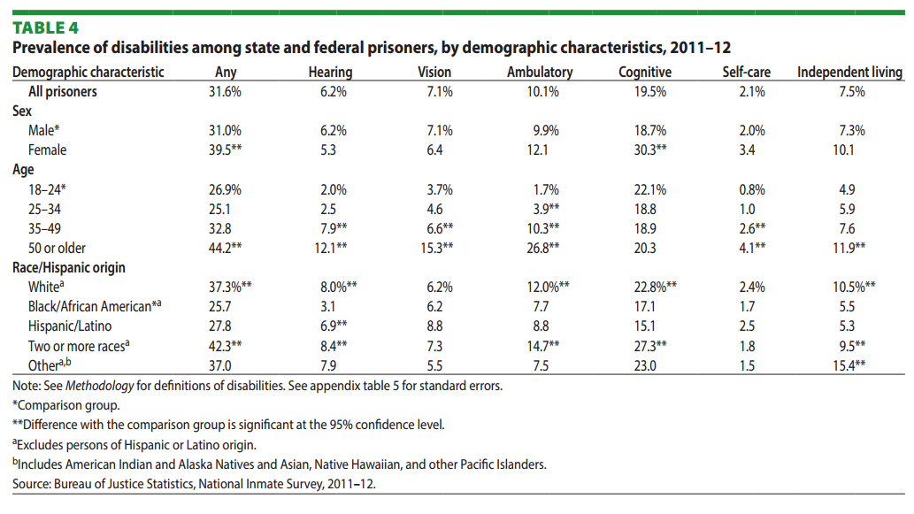
Specific Types of Disabilities: Prison
Notes:
Table 4: Prevalence of disabilities among state and federal prisoners, by demographic characteristics, 2011–12
Source: Bureau of Justice Statistics
Data table depicting the prevalence of disabilities among state and federal prisoners between 2011 and 2012, organized by demographic characteristics. 31.6% of all prisoners have a disability. In terms of sex, disabilities are most prevalent among female prisoners. 39.5% of female prisoners have a disability, while 31.0% of male prisoners have a disability. In terms of age, disabilities are most prevalent among prisoners who are 50 or older. 44.2% of prisoners age 50 or older have a disability. The next most prevalent is in the 35-49 age group, where 32.8% of prisoners have a disability. In terms of race, disabilities are most prevalent among prisoners who are of “two or more races.” 42.3% of the prisoners who identify as “two or more races” have a disability.

Slide 49
Prevalence of Disability: Jails
Jail Inmates
Any Disability – 39.9%
Vision – 7.3
Hearing – 6.5
Ambulatory – 9.5
Cognitive – 30.9
Self-care – 2.8
Independent Living – 8.7
General Population
Any Disability – 9.3%
Vision – 1.7
Hearing – 1.9
Ambulatory – 3.7
Cognitive – 4.7
Self-care – 1.7
Independent living – 3.4
Source: Bureau of Justice Statistics
Notes:
Table 2: Prevalence of disabilities among jail inmates and the general population, standardized, 2011–12
Source: Bureau of Justice Statistics
Data table depicting the prevalence of disabilities among jail inmates and the general population, standardized, between 2011 and 2012. The table shows that 39.9% of jail inmates have a disability, while only 9.3% of the general population has a disability. The majority of jail inmates that have a disability have a cognitive disability.

Slide 50
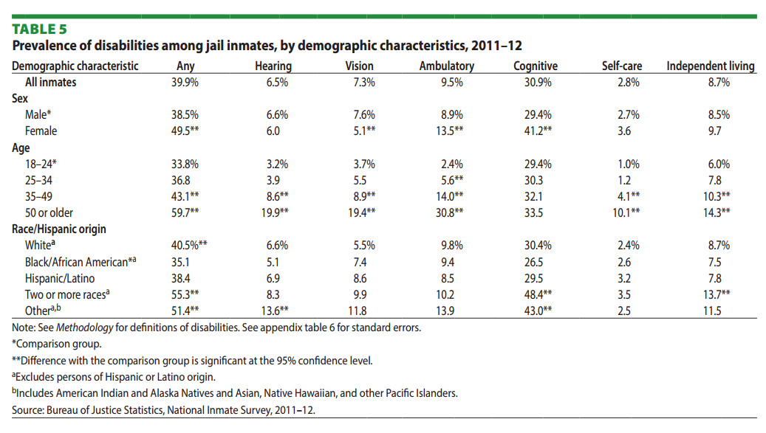
Specific Types of Disabilities: Jails
Notes:
Table 5: Prevalence of disabilities among jail inmates, by demographic characteristics, 2011–12
Source: Bureau of Justice Statistics
Data table depicting the prevalence of disabilities among jail inmates between 2011 and 2012, organized by demographic characteristics. 39.9% of all jail inmates have a disability. In terms of sex, disabilities are most prevalent among female jail inmates. 49.5% of female jail inmates have a disability, while 38.5% of male jail inmates have a disability. In terms of age, disabilities are most prevalent among jail inmates who are 50 or older. 59.7% of jail inmates age 50 or older have a disability. The next most prevalent is in the 35-49 age group, where 43.1% of jail inmates have a disability. In terms of race, disabilities are most prevalent among jail inmates who are of “two or more races.” 55.3% of the jail inmates who have a disability are of “two or more races.”

Slide 51
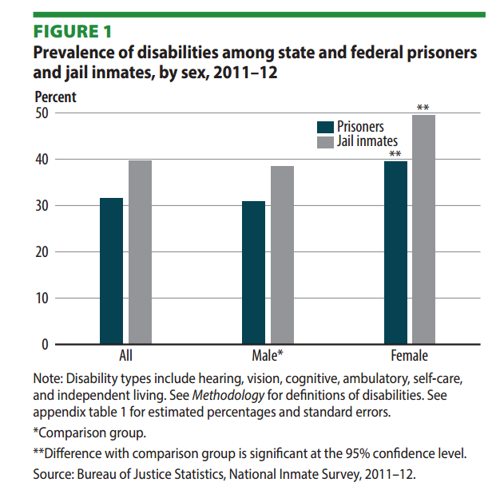
Disability Prevalence, by Sex
Notes:
Figure 1: Prevalence of disabilities among state and federal prisoners and jail inmates, by sex, 2011–12
Source: Bureau of Justice Statistics
Bar graph depicting the prevalence of disabilities among state and federal prisoners and jail inmates, by sex, between 2011 and 2012. For the purpose of this graph, the disability types represented are hearing, vision, cognitive, ambulatory, self-care, and independent living. Just over 30% of all prisoners report having a disability. Just under 40% of all jail inmates report having a disability.

Slide 52
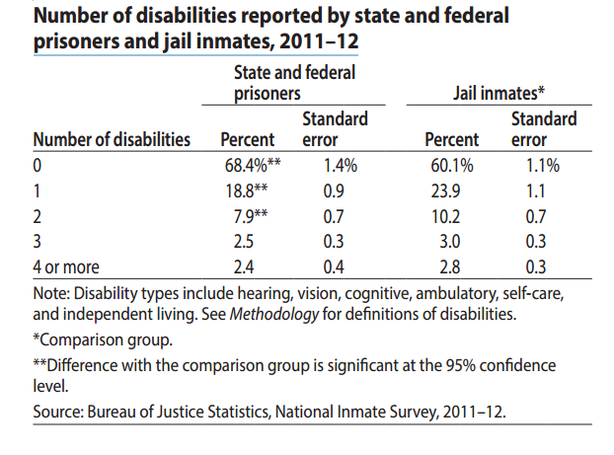
Number of Disabilities Reported
Notes:
Table 3: Number of disabilities reported by state and federal prisoners and jail inmates, 2011–12
Source: Bureau of Justice Statistics
Data table depicting the number of disabilities reported by state and federal prisoners and the number of disabilities reported by state and federal jail inmates, between 2011 and 2012. Disability types included in this data: hearing, vision, cognitive, ambulatory, self-care, and independent living. 68.4% of state and federal prisoners, and 60.1% of jail inmates, report having no disabilities. 18.8% of state and federal prisoners, and 23.9% of jail inmates, report having 1 disability. 7.9% of state and federal prisoners, and 10.2% of jail inmates, report having 2 disabilities. 2.5% of state and federal prisoners, and 3.0% of jail inmates, report having 3 disabilities. 2.4% of state and federal prisoners, and 2.8% of jail inmates, report having 4 or more disabilities.

Slide 53

Human Rights Violated in Prison
Notes:
"People with disabilities in the corrections system routinely have their rights violated," along with news headlines demonstrating such.
Report: Blind, Deaf, Disable Inmates abused in Prison, Source: Texas Tribune
The Invisible Punishment of Prisoners with Disabilities. Source: The Nation
Cruel Confinement: Abuse, Discrimination and Death within Alabama's Prisons. Source: Southern Poverty Law Center
Execution of Warren Hill "shakes the foundation of our legal system for people with intellectual disabilities." Source: The Arc Blog
U.S. Jury orders D.C. Corrections to pay $70,000 to deaf inmate in ADA claim. Source: Washington Post
Wrongfully Imprisoned D.C. Man Settles suit for 1.74 Million. Source: Prison Legal News

Slide 54

Joseph Heard
“He wrote notes to nurses and doctors in the jail’s mental health unit where he stayed in a solitary cell. He said they ignored him and would throw his letters away.”
Source: Herald-Journal – Sep. 1, 2001
Notes:
Source: Herald-Journal – Sep. 1, 2001
Photo Source:

Slide 55
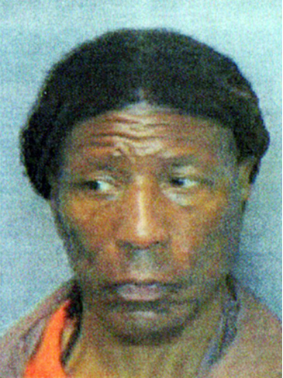


Lives of PwDs Lost in Prison
Arthur Johnson
Intellectual disabilities
At appeal, claimed to have been beaten into confessing.
Locked in solitary since 1979.
Paul Schlosser -Bipolar Disorder
Denied medical treatment and was pepper sprayed while restrained.
Christopher Lopez Schizoaffective disorder
Died in police custody in 2013
Notes:
Sources: Human Rights Watch, Philadelphia Inquirer, Quiet Mike

Slide 56
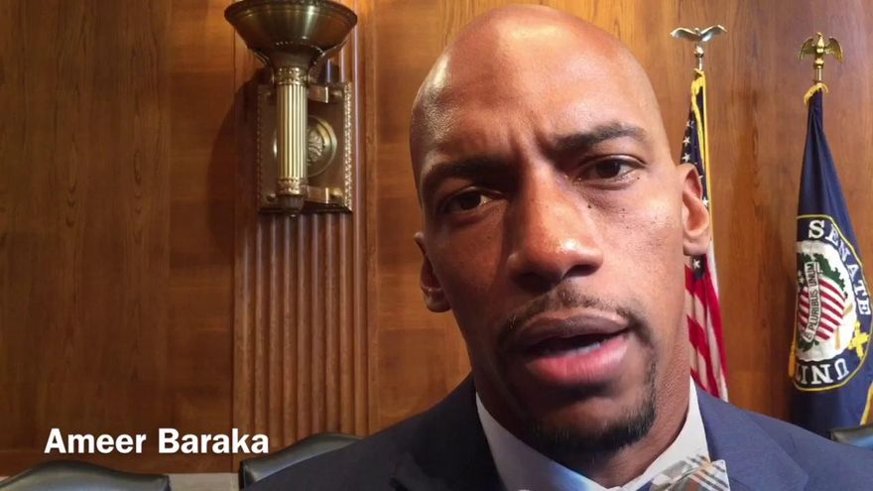
Ameer Baraka
“For many years, I allowed Dyslexia to control my life and rob me of my God given potential.”
“At age 23, I entered into a prison correctional facility reading at a 3rd grade level. I didn't feel so bad because many of the men there were just like me. We all read poorly.”
“A GED teacher noticed that I struggled with phonics and had me tested. After testing me, he said I had a reading disability and it could be corrected if I was willing to work hard.”
Ameer is now a successful actor and is a series regular on American Horror Story.
Read his Testimony to the Senate HELP Committee here: http://www.help.senate.gov/imo/media/doc/Baraka1.pdf

Slide 57
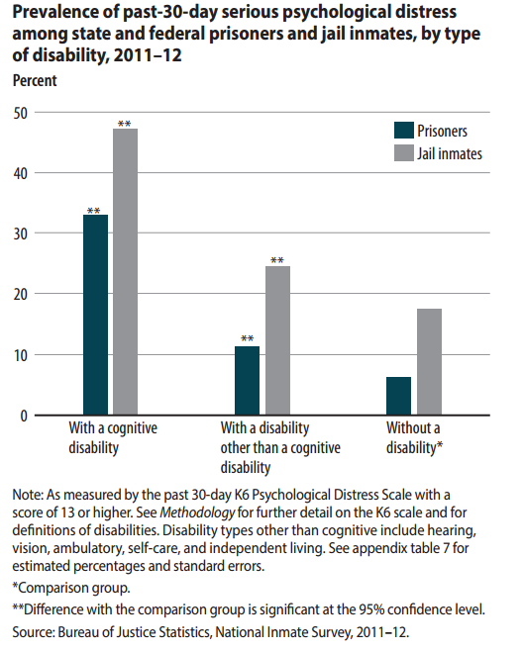
Psychological Distress and Disability
Notes:
Figure 2: Prevalence of past-30-day serious psychological distress among state and federal prisoners and jail inmates, by type of disability, 2011-12
Bar graph depicting the prevalence of past-30-day serious psychological distress among state and federal prisoners and jail inmates, by type of disability, between 2011 and 2012. The three categories in the graph are “with a cognitive disability”, “with a disability other than a cognitive disability”, and “without a disability.” Past-30-day serious psychological distress is significantly more prevalent among prisoners and jail inmates with a cognitive disability than those with a non-cognitive disability and those without a disability. About 32% and 47% of prisoners and jail inmates, respectively, with a cognitive disability report serious psychological distress in the past 30 days. In contrast, only about 6% and 15% of prisoners and jail inmates without a disability, respectively, report serious psychological distress in the past 30 days. The rate for prisoners and jail inmates with a disability other than a cognitive disability is slightly higher, but significantly less than the rate for those with a cognitive disability.

Slide 58
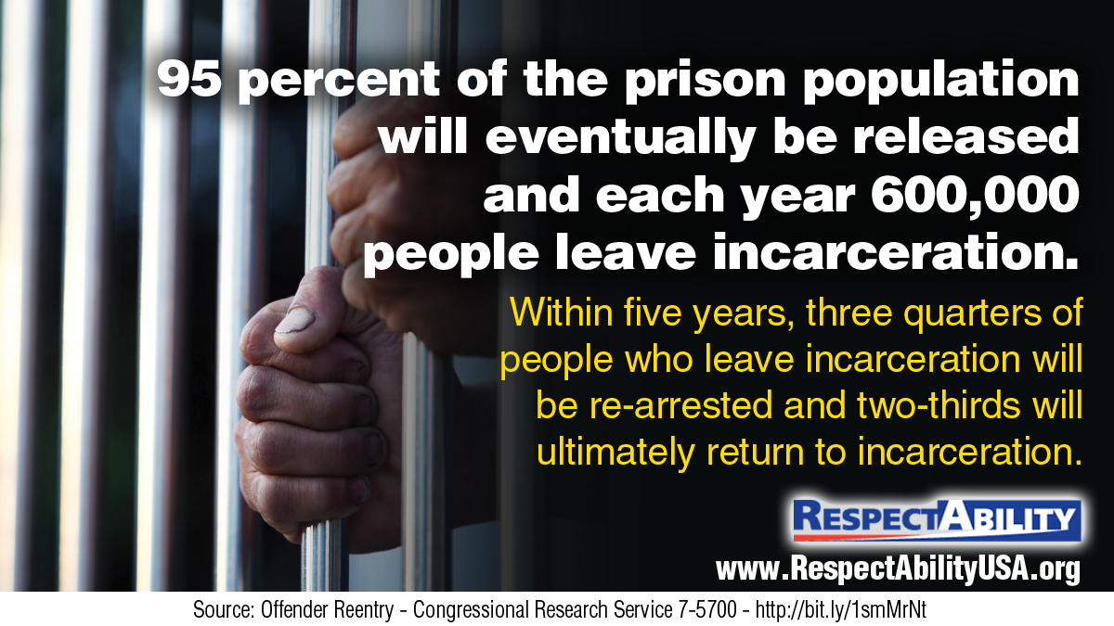
Key Fact: 95% Are Coming Home
Notes:
Source: Offender Reentry – Congressional research Service 7-5700

Slide 59
Bottom Line
Criminal Justice Reform will not succeed unless and until disability is addressed in all three stages:
  Early Intervention to keep people with disabilities from entering the school to prison pipeline in the first place.
  Adequate accommodations throughout the criminal justice system, which includes proper training and accountability for police, judicial officials, corrections officers and educators or others working to educate, train and appropriately serve people who are incarcerated.
  Re-entry process that understands the unique dimensions of what it means to be a person with varying kinds of disabilities.
Only when the system not only identifies but also addresses disability through proper diagnosis, accommodations and supports will criminal justice reform succeed.

Slide 60

Eddie Ellis
“I remember having my first seizure in Youngstown Ohio in 1997 after being jumped on by some correctional officers, and from that time until I was released, I was never given any medication or tested to see what was happening to me.”

Slide 61
Combat Stigma
Combat stigmas around disability through focused, culturally competent communications campaigns that will empower parents in vulnerable communities to enable their children with disabilities to succeed:
  National Disability Employment Awareness Month raises awareness about disability employment issues and celebrates the contributions of America's workers with disabilities, past and present.
  The Campaign for Disability Employment promotes positive employment outcomes for people with disabilities by encouraging employers and others to recognize the value and talent they bring to the workplace.
  The National Mental Health Consumers’ Self-Help Clearinghouse’s report “How to Use the Media to Fight Stigma and Discrimination.”

Slide 62
Empower Parents
Empower parents, families and other social supports with resources which will combat stigma and safeguard youth with disabilities from falling through the cracks. Parenting a child with a disability can be deeply rewarding. It also can be challenging regardless of economic means but the obstacles only grow more complex for low-income families or single-parent households:
  Free resources on learning disabilities from understood.org
  Free parenting toolkit from the Autism Society
  The Office of Disability Employment Policy (ODEP) has free and practical information that can help any parent of a child with a disability.
  The Georgia Appleseed Center for Law and Justice has a toolkit aimed at building a “school to opportunity” pipeline.
  Parents of children with disabilities need culturally competent training that will empower them to support their children.

Slide 63
Reduce Sexual Assault and Abuse
Take steps to address sexual assaults and sexual abuse of people with disabilities by ensuring that youth with disabilities, their parents, and special educators understand the risks, their rights, and have access to the right resources.
  Estimates show that around 59,000 adults with disabilities will be raped or sexually assaulted each year.
  Partnerships should be developed with organizations that have specialized expertise and resources such as RAINN (Rape, Abuse & Incest National Network).
  Their website, which is screen reader accessible, provides background information on state law, information on ways to access help including if a victim is deaf, referrals to local sources of support and anonymous online avenues for connecting victims to specialists.

Slide 64
Reform Broken Educational Policy
Reform educational policies, such as physical restraint and school suspensions, which have disparate, negative impacts on students of color and students with disabilities. This can be accomplished by ending zero-tolerance policies, ensuring school staff understand the difference between visible/invisible disabilities, helping students overcome bullying and decreasing calls to School Resource Officers (SROs):
  SRO programs should be scaled back, and federal funds re-directed to programs such as Restorative Justice and Communities in Schools.
  The Responsive Classroom approach
  South Carolina’s school policy forbidding the use of SROs to discipline students for behavioral issues, limiting their involvement to suspected criminal activity.

Slide 65
Improve Effective Youth Programs
Improve mentorship programs and expand early work experiences to empower youth with disabilities. Increasing the number of youth who successfully transition from school to work will require solutions beyond government such as mentorship and internship programs, as well as summer jobs and apprenticeships that can help students gain skills, develop contacts and have high expectations for success:
  The National Mentoring Partnership’s Detailed Report: Referring Youth in Juvenile Justice Settings to Mentoring Programs”
  The Division of Youth Services in Indiana, which has a multi-tiered approach to serving youth
  The National Youth Leadership Network and theNational Consortium on Leadership and Disability for Youth

Slide 66
End Criminalization of Homelessness
Instead of criminalizing homelessness, community resources and supportive settings are better alternatives to incarceration. Too many people with mental health disabilities and addiction issues end up on the street or are arrested by police instead of having access to community supports and other resources:
  Stepping Up initiative launched by the National Association of Counties, the Council of State Governments and the American Psychiatric Association Foundation
  In San Antonio, a series of linked programs is saving around 10 million dollars a year by offering comprehensive services to the homeless, free mental health care, training to local law enforcement and more.

Slide 67
Reform Policing
Reform policing practices and use-of-force policies that have disparate impacts on people with disabilities. In 2015, more than a third of the people killed by police were people with disabilities. This means that there is a clear need for police to be trained in non-lethal interventions and to understand how to interact with people who have non-apparent disabilities:
  Programs such as the Crisis Intervention Team (CIT) model
  Maryland’s Commission for Effective Community Inclusion of Individuals with Intellectual and Developmental Disabilities

Slide 68
Let Juvenile Justice Lead Somewhere
Provide better resources to the juvenile justice system so that justice-involved youth are not trapped in the school-to-prison pipeline. Youth with disabilities who are on probation, particularly those with cognitive disorders, might not understand all of the requirements, and therefore be at a higher risk of violating them:
  The Tools for Success Curriculum developed by the Substance Abuse and Mental Health Services Administration (SAMSHA), focused exclusively on helping juvenile justice professionals address fetal-alcohol syndrome issues.

Slide 69
Expand Alternative Sentencing
Expanding alternative sentencing programs are critical to decreasing juvenile incarceration and ensuring youth with disabilities are no longer trapped by a pipeline into the justice system. Innovative models that prioritize getting youth with disabilities supports rather than jail time need to be closely studied and widely expanded:
  Project SEARCH provides skill training and work experiences for youth with disabilities before the end of high school.
  Annie E. Casey Foundation’s Juvenile Detention Alternatives Initiative
  Court Employment Project (CEP) from the Vera Institute of Justice
  “Civil Citation” program being instituted by the Miami-Dade Juvenile Services Department

Slide 70
Reform the Courts
Reforming the court system requires looking at the ways that wrongful convictions, false confessions and the death penalty disproportionately impact people with a range of disabilities. People with disabilities interact with the entire justice system from being victims, witnesses and as alleged perpetrators. Accommodations are needed at each step of the way:
  Washington State Access to Justice Board’s guide Ensuring Equal Access for People with Disabilities
  The Center for Legal and Court Technology’s and the American Foundation for the Blind’s Accessible Courts Initiative launched in 2007
  California Department of Corrections and Rehabilitation’s Developmental Disabilities Program regarding access to informed and supportive counsel

Slide 71
Reduce Solitary and Chemical Restraint
The use of solitary confinement and chemical restraint needs to be dramatically reduced so that people are not traumatized unnecessarily and new disabilities are not created. Solitary can be particularly traumatic for prisoners with disabilities and can exacerbate physiological disorders:
  Solitary confinement can cause mental health deterioration for those with a previous condition, or can cause an onset of new disorders (such as psychosis and depression).
  Organizations such as the VERA Institute of Justice through their Safe Alternatives to Segregation Resource Center (SASRC) are working to identify practical alternatives to solitary confinement in the prison system.

Slide 72
Need for Accommodations
The corrections system needs structures in place that will diagnose and accommodate people with a range of disabilities upon entering incarceration. Up to one-third of all inmates have some level of deafness; they must be able to communicate and corrections officers need disability training:
  National Center on Criminal Justice and Disability has compiled training resources for law enforcement and corrections officers.
  The protection and advocacy system has a profound role in helping the system fully respect the rights and meet the needs of inmates with disabilities.
  Prisoners themselves need to understand their rights under Title II of the ADA and be able to self-advocate as needed.

Slide 73
Release Begins on Day One
People who are incarcerated need to receive assessments, begin appropriate education in correctional facilities and start job training on day one in the system. The first step in building a justice system that respects the rights of prisoners with disabilities is having a better data system, replicating best practices and combating stigma:
  Every Student Succeeds Act (ESSA): Among the most important elements are new requirements related to transition services for youth in correctional facilities. State agencies must now collaborate with correctional facilities to assess justice-involved youth both for educational needs and disability status. However, there are no such requirements around collaboration and transition on the adult side of the justice system.

Slide 74
Utilize Existing Educational Supports
Corrections education programs funded under Title II of the Workforce Innovation and Opportunity Act (WIOA) need to better serve prisoners with disabilities. From the beginning of incarceration, people behind bars need training in skills to successful reintegrate into society. Time served should become time for preparation:
  Khan Academy, Massive Open Online Courses (MOOCs), TEDtalks and other learning options are particularly well suited to diverse learning needs, but are kept off-limits.
  Hawaii coordinates efforts between its corrections department and the Department of Education to provide highly qualified teachers and counselors so that returning citizens can be prepared to succeed.
  The North Dakota Department of Corrections and Rehabilitation includes teachers with professional development and/or special education experience in their adult and juvenile corrections personnel.

Slide 75
Capacity Building: Our Part to Play
Extend and expand capacity through non-governmental supports focused on providing reentry solutions for returning citizens. Volunteers, nonprofits, philanthropists and faith-based organizations must play a meaningful role in helping returning citizens with disabilities find and keep jobs or start a business:
  The Philanthropy Roundtable’s Clearing Obstacles to Work compiles proven programs for successful reentry for returning citizens.
  The Center for Employment Opportunities works with parole and probation officers to support reentry for people who have been released and are seeking employment.
  The Ridge Project offers training classes to inmates before and after release, working on social and employment skills at the same time. These efforts build greater capacity to successfully reintegrate inmates into society.

Slide 76
Collect and Use Better Data
Use better performance metrics to ensure the success of people with disabilities and returning citizens. Use Labor Force Participation Rates instead of unemployment data to understand the challenges facing people with barriers to work:
  South Dakota has high employment outcomes for people with disabilities partly due to heavy investment in training, mentorship, and support services and an emphasis on performance metrics.
  Michigan, California, Oregon, Wyoming, and other states are using their Labor Force Participation Rate as a performance metric for people with disabilities.

Slide 77
Engage Employers
Recruit employers that will hire returning citizens with disabilities for business reasons, not charity. Employment opportunities with willing employers are critical to successful reintegration for returning citizens as are Section 503 requirements for federal contractors to hire people with disabilities. Banning the Box is necessary but only part of the re-entry process:
  Criminal records should be disclosed to employers later in the hiring process so that returning citizens will be considered for employment and can take advantage of policies like the Federal Bonding Program.
  An example of the type of innovative reentry program we would like to see widely replicated is the Prisoner Entrepreneurship Program (PEP).
  Another example is the Renaissance Center in California’s Bay Area.

Slide 78
Fund Innovative Recidivism Reduction
Expand the use of innovative funding sources such as Pay-For-Performance Contracting or Social Impact Bonds to reduce recidivism rates. Leverage WIOA funding to address recidivism, channel the power of social entrepreneurship programs and build on the promising practice of social impact bonds:
  Utilize innovative “Pay for Performance” (PfP) contracting, as documented by Social Finance
  The Center for Employment Opportunities’ Pay-For-Success project in New York State is achieving incredible results.
  Growing power of social enterprise to combat recidivism through public-private partnerships such as the Second Chance Act Comprehensive Statewide Recidivism Reduction (SRR) Program.
  Adolescent Behavioral Learning Experience (ABLE) program in NY and the Juvenile Justice Pay for Success Initiative in Massachusetts.

Slide 79
“Second Chances,” not “Three Strikes”
Change the narrative from “three strikes” to “second chances” by focusing outreach on business leaders, HR professionals and returning citizens themselves. Attitudinal barriers and stigmas facing returning citizens and people with disabilities need to be overcome through target messaging and communications efforts.
  The best way to fight stigma is to let employers see the facts from other employers who already are succeeding by hiring people with disabilities, whether they were in the corrections system or not.

Slide 80
Contact Us!
We have many resources for policy makers and
leaders on our website and are ready to help!
RespectAbilityUSA
11333 Woodglen Drive, #102
Rockville, MD 20852
http://www.RespectAbilityUSA.org
Cell: (202) 365 0787
Jennifer Laszlo Mizrahi
President
JenniferM@RespectAbilityUSA.org

Slide 81

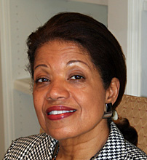
Meet the Report’s Authors
Jennifer Laszlo Mizrahi is President and CEO of RespectAbilty, a nonprofit organization working to empower people with disabilities to achieve the American dream. She works regularly with national, state and local policy leaders, workforce development professionals, media and employers, as well as with disability and faith-based organizations in order to expand opportunities for people with disabilities. She already has met with teams from all 50 states, including 40 governors, on WIOA implementation. She has published dozens of op-eds on disability issues, including in USA Today, Huffington Post, The Hill and other publications. Dyslexic herself, she also knows what it means to parent a child with multiple disabilities.
Janie L. Jeffers is founder and president of Jeffers and Associates, LLC. President Bill Clinton appointed her a Commissioner on the United States Parole Commission in 1999. She has had a distinguished career in public policy, education, management, health care, and criminal justice at the federal and local levels. Ms. Jeffers served as Executive Deputy Director for the Federal DC Interagency Task Force at the White House Office of Management and Budget, where she coordinated technical assistance to the District of Columbia government on economic development, education, childcare and public/private partnerships. She also served as Policy Advisor for the President’s Crime Prevention Council, chaired by Vice President Gore. From 1992-1996, she was Chief of the National Office of Citizen Participation for the Federal Bureau of Prisons at the Department of Justice and, from 1985-1991, she was Deputy Commissioner for the New York City Department of Correction, rising through the ranks to become the first civilian to achieve that position.

Slide 82


Meet the Report’s Authors
Eddie B. Ellis Jr., Criminal Justice Associate. Ellis created Oneby1, an organization that works with communities and partners to provide youth development workshops and mentoring services to keep youth out of the corrections system and help those exiting the system stay out. A champion for change, Eddie’s own experience as a former convict provides an insight and depth into his work that allows him to connect with and engage audiences. Mr. Ellis professional experience, certifications and training allow him to serve as a resource to the community. He also has written and published several resource guides offering service referrals, practical tips and inspiration to former offenders and parolees returning into the Washington, D.C., metropolitan area.
Philip Pauli is the Policy and Practices Director of RespectAbility. His role with RespectAbility includes communicating with state leaders and workforce agencies on best practices for employing people with disabilities under WIOA and addressing issues related to competitive integrated employment. Raised by a single mother with serious chronic health issues, he is deeply committed to helping build a better future for people with disabilities. You can reach him at PhilipP@RespectAbilityUSA.org.

Slide 83


Meet the Report’s Editors
David M. Perry, a disability rights journalist and Associate Professor of History at Dominican University, in River Forest, IL. His work has appeared at CNN.com, The Chronicle of Higher Education, The New York Times, The Atlantic, Al Jazeera America, The Guardian, The Washington Post, Pacific Standard Magazine and many other publications. He is writing a book called Disability Is Not a Crime for Beacon Press (expected Fall, 2017). Perry is the father of a nine-year-old boy with Down syndrome. He can be reached at lollardfish@gmail.com.
Lauren Appelbaum, Communications Director of RespectAbility. Her role includes managing the presidential outreach and #RespectTheAbility stigma and social media campaigns. Coordinating outreach, she and her team have talked with all of the presidential candidates about the importance of engaging the disability community, reporting all interviews in The RespectAbility Report. She has a lifelong commitment to equality for people with disabilities. You can reach her at LaurenA@RespectAbilityUSA.org.

