Slide 1
Technology in the classroom & on the Job
Lisa M. Enright, M.Ed.
Instructor
Project SEARCH at Bayhealth
Capital School District
Kent County Community School

Slide 2
Interviewing & Preparing a Career Portfolio
This LiveBinder of resources includes: http://bit.ly/DesignDeliver
Interviewing Videos with Answers to the Top Four Questions:
Tell me a little about yourself
What is one of your strengths?
What is one of your weaknesses?
Why should we hire you?
Sample scoring rubric to evaluate interview responses
Career Portfolio Templates on Google Drive

Slide 3
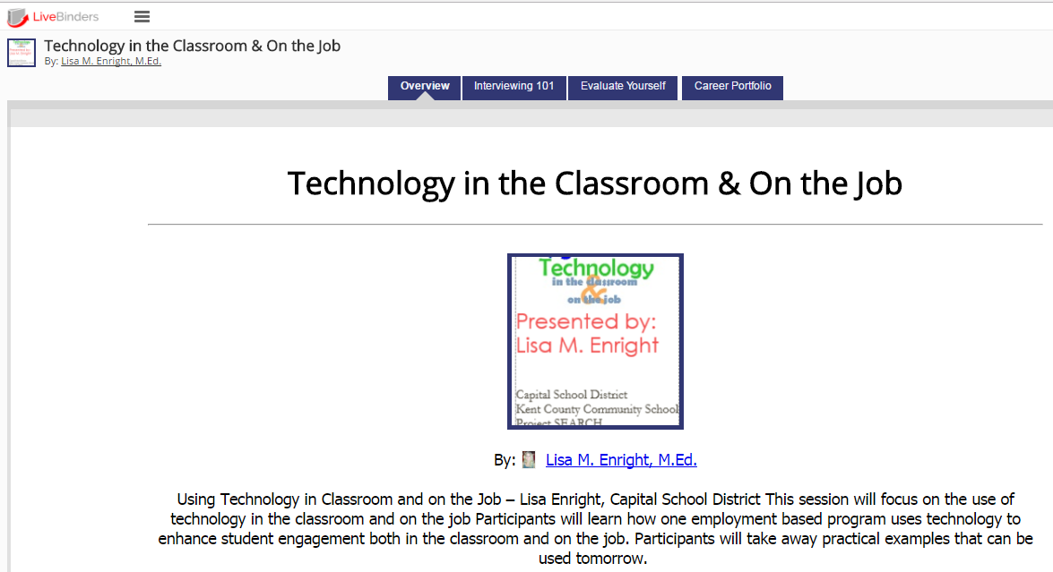
Livebinder resource: http://bit.ly/DesignDeliver

Slide 4
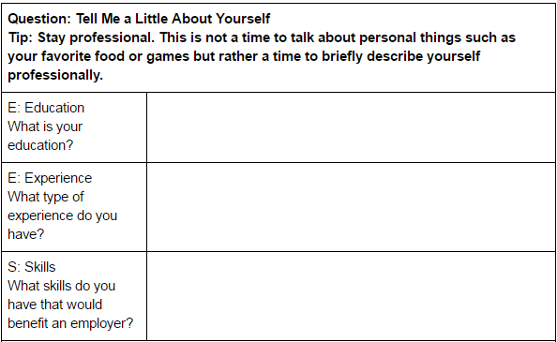
Interviewing 101: Tell me a little about yourself Video: https://www.youtube.com/watch?v=OW-yxxPMtro&t=91s

Slide 5
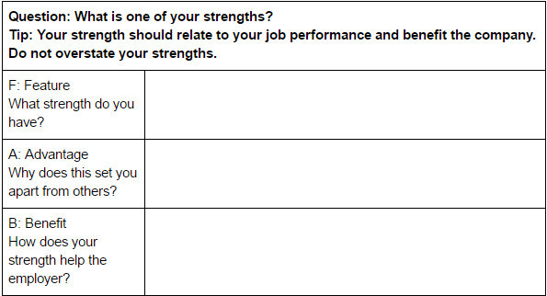
Interviewing 101: what is one of your strengths? Video: https://www.youtube.com/watch?v=UXwW6I3-bUA

Slide 6
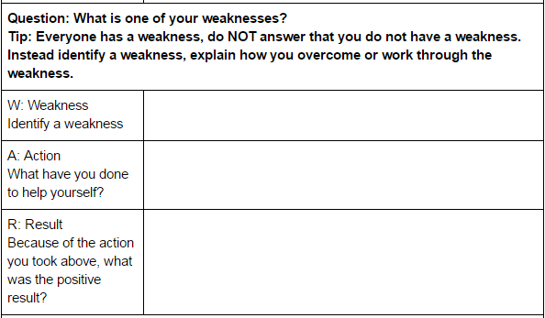
Interviewing 101: what is one of your weaknesses? Video: https://www.youtube.com/watch?v=u_VdMHGQnZU

Slide 7
Video modeling demonstration: What is one of your weaknesses
Watch Kaitlyn’s October Response
Continued practice, instruction, video modeling, and self-evaluation occurred over the next several months
Watch Kaitlyn’s February Response

Slide 8
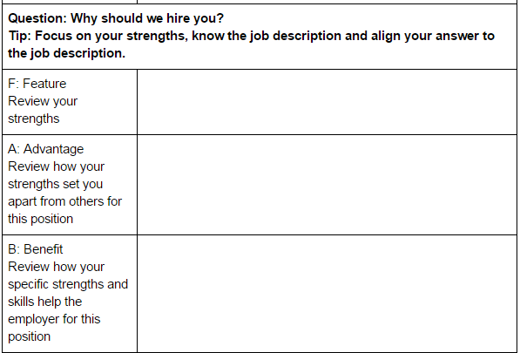
Interviewing 101: why should we hire you? Video: https://www.youtube.com/watch?v=KLdboEjNSdM&t=77s

Slide 9
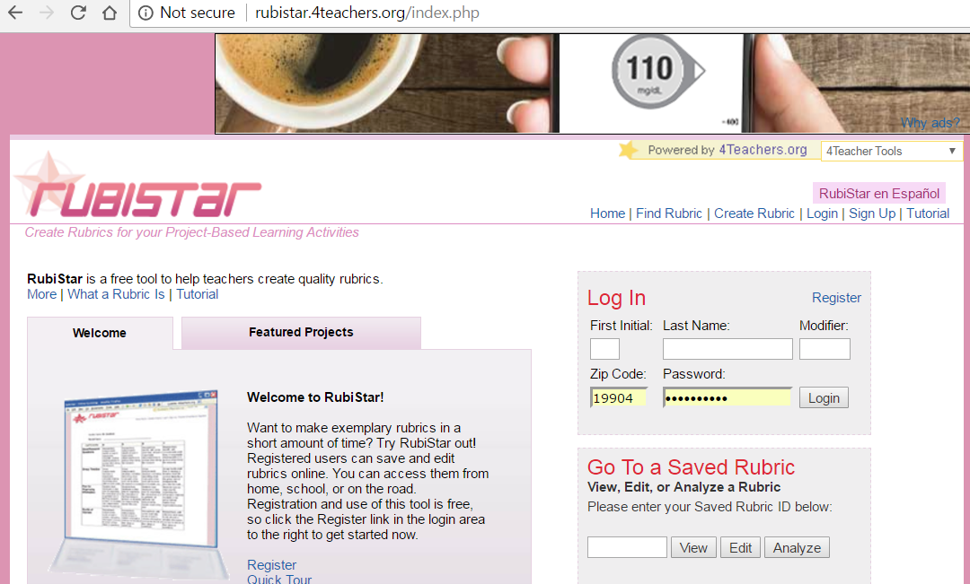
Rubistar: http://rubistar.4teachers.org/index.php

Slide 10
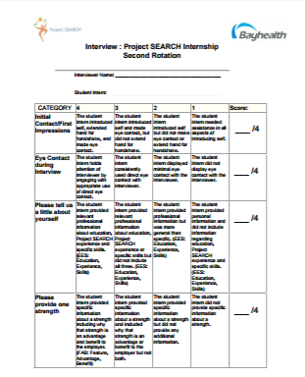
Evaluate yourself

Slide 11
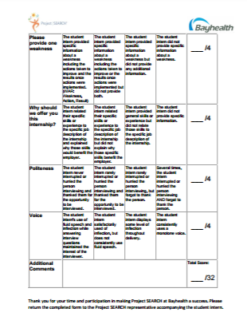
Evaluate yourself

Slide 12
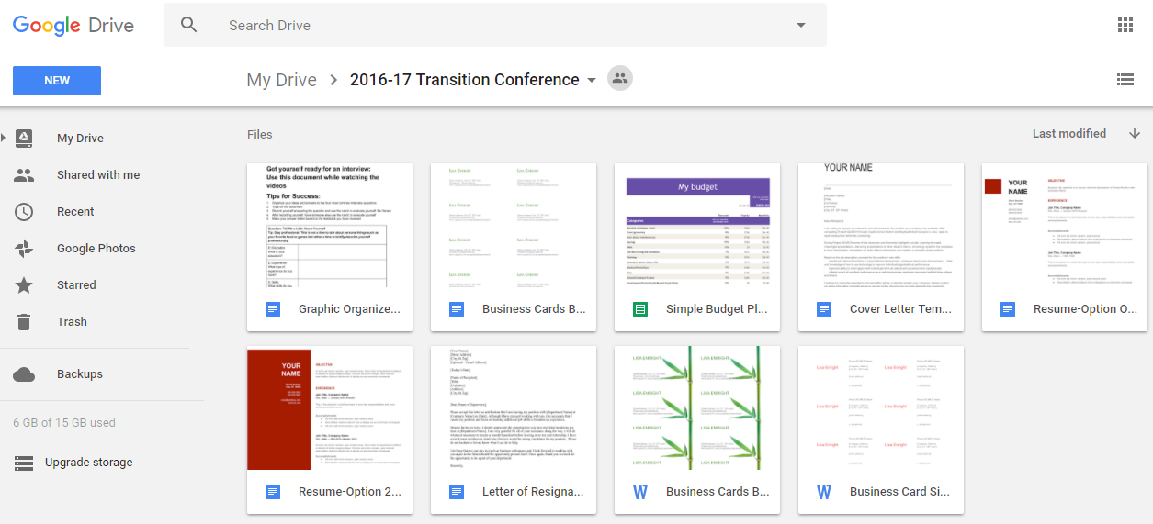
Career portfolio templates

Slide 13
Summary of tech tools used & why. there is no cost for these sites
LiveBinders: Organize online content or upload your own to bring the traditional static binder of information to life!
Create an account and get started: http://www.livebinders.com/
YouTube: Find videos that provide helpful information or upload your own!
Use your Google account for best results: https://www.youtube.com/
RubiStar: Create rubrics quickly and easily! You can also evaluate individual or class data on the site.
Create an account and get started: http://rubistar.4teachers.org/index.php
Google Docs: Create, edit, collaborate and share documents with ease.
Create or use your Google account: http://www.google.com
Google Drive: Store files, videos, pictures, and documents for easy access and sharing with your team! (Think sharing career portfolios of clients with VR, job developers and job coaches.)
Create or use your Google account: http://www.google.com
Bitly: Shorten and customize lengthy website URLs.
Use your Twitter or Facebook account or create an account with your email: https://app.bitly.com/bitlinks

Slide 14
Other helpful resources
Effective Job Development: http://www.livebinders.com/play/play?id=2030964
iPad Resource for Apps: http://www.livebinders.com/play/play?id=1275106
Want to try Twitter but not sure what to do? Try this Welcome to the Twitterverse LiveBinder: http://bit.ly/TweetPS

Slide 15
Questions?
Email: Lisa.Enright@capital.k12.de.us
Twitter: @thelisaenright
Project SEARCH at Bayhealth Twitter: @ProjectSEARCHKC
Project SEARCH at Bayhealth Facebook: http://www.facebook.com/projectsearchde/
Website: www.capital.k12.de.us/capitalsd/projectsearch

