Slide 1
EY’s r u ok? initiative
Lori Golden, Abilities Strategy Leader
November 22, 2016

Slide 2
Mental illness* is a critical issue
1 in 4 adults experience mental illness in a given year.
Mood disorders are the third major cause of hospitalizations for 18-44 year olds.
Serious mental illness costs $193.2 billion in lost earnings per year.
Less than one third of adults with mental illness receive treatment.
Unintentional overdose deaths from prescription pain relievers has quadrupled since 1999.
  * Including addiction

Slide 3
It has detrimental impacts in the workplace
It costs employers an estimated $80- to $100 billion/year.
At any given time, 1 in 10 employees experience depression.
Depression alone causes $400 million lost work days/year, costing companies $52 billion in absenteeism and reduced productivity.
Mental illness can impair cognitive functioning in ways that impact work quality, professional behavior, and relationships. These can negatively impact team effectiveness, productivity and overall profitability.

Slide 4
EY is among leading employers focusing on this
In 2015, EY piloted Mental Illness Readers Theatre office events.
Americas Chairman Steve Howe participated in first CEO Roundtable on Mental Illness in the Workplace at New York Stock Exchange.
In 2016 became a National Alliance on Mental Illness Stigma-Free Company
Sponsored Cities Thrive conference with Mayor’s Fund in NYC
Launched r u ok? national initiative in fall 2016

Slide 5
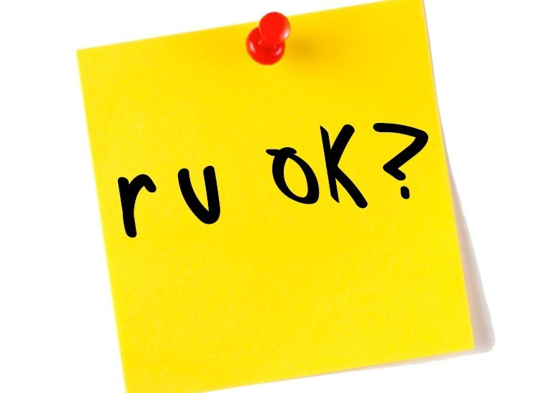
r u ok?
(post it note that reads “r u ok?”)

Slide 6
r u ok?
Awareness and education campaign around mental illness and addiction
Designed to equip EY people to support colleagues who might be struggling
3 pronged approach
  Education – training, tools
  Awareness – articles, posters, leader messages
  Engagement – advocates, in person learning events, etc.
Notes:
Under education, there are two trainings: the online, 30 minute training and the “how to” quick videos. The tools include the stories videos and the r u ok? quick guides

Slide 7
Education
Quick colleague to colleague videos on how to have an r u ok? conversation
Online 30 minute training available on demand
Focused on what people should know about mental illness and addiction, its impacts, and how to be supportive
Targeted to:
  HR
  Executives
  Colleagues
Notes:
The quick video training was created by AccessAbilities and features members of the Network; we posted on ey.com/abilities so you can access it yourself

Slide 8
Awareness
Communications to position why this is important, encourage people to take the trainings, promote openness and reduce stigma
  Leader messages
  Talent team messages
  Articles including self quizzes
  Banners, posters. electronic signage in EY offices
  E-mail signature messages

Slide 9
Engagement
90 minute in person learning events hosted by top leader in the office
Video stories told by EY people
Brief how to videos focused on:
  How to spot colleagues who may be struggling
  How to have an r u ok? conversation
  Where to refer to in and outside the firm
Facilitated dialogue
Deeper discussion on resources
  AccessAbilities
  EY Assist
  National Alliance on Mental Illness
Notes:
In person learning events to get people engaged around the topic and AccessAbilities network is leading those and encouraging other networks to co-sponsor
3 parts
Hosted by highest leader in the office
Bring in EY Assist
Local NAMI
AccessAbilities champion
Using videos with stories told by EY people on how they have been impacted by MI or addiction
Series of brief how to videos where member of the network walk colleagues through how to spot those struggling, how to prep and how to have the conversations as well as where to refer to in and out of the firm

Slide 10
What’s next?
Mini learning events in small group settings - teams, counseling families, service lines
Measuring outcomes, gathering stories
Sharing practices with other organizations
Promoting NAMI’s stigma-free company externally

Slide 11
Questions???

