Slide 1
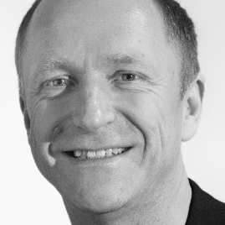
Specialisterne USA
Hope, Action, Impact
- Cutting Edge Jobs for People on the Autism Spectrum
Thorkil Sonne
Founder, CEO
thso@specialisterne.com
302 290 1021
Specialisterne USA is a 501c3 charity (EIN 45-3612906) www.usa.specialisterne.com

Slide 2



The Divide To Be Removed
People
(Supply)
Jobs
(Demand)
1% autism prevalence
80% un/under-employment
Low degree of self-disclosure
Lack of opportunities for talent development
Mismatch between talent and job
Aging work force
Lack of innovation capacity
Thousands of vacant jobs
Business growth constrain
Limited talent pipeline
Autistic talent overseen

Slide 3

Weed or herb?
Negative or positive?
You decide!
Notes:
3

Slide 4
About Specialisterne
Vision
A world where people are given equal opportunities in the labor market
Mission
To educate stakeholders in talent and career development for autistic people through innovation, collaboration and knowledge sharing
Track record
12 years operational experiences from 15 countries
Formal global collaboration with HPE and SAP.
Associated with USBLN, UN DPI and World Economic Forum
Operational in USA since June 2013, 200 jobs, major corporate clients, community agency partners and education partners

Slide 5

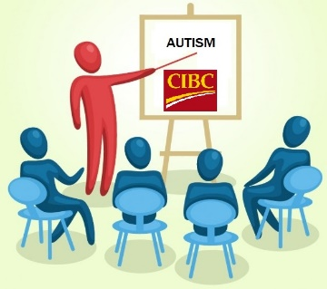






On-boarding Program
Phase 1:
Identify Roles
Phase 2:
Recruitment
Phase 3:
Assessment
Phase 4:
Transition
Phase 5:
Employment
Jobs!
/Corporate partner

Slide 6

The Assessment Program
Cultivates the Dandelion
We offer the opportunity to
In an effort to bring out the Herb Qualities
Get into a
  Comfort Zone
Work in
  Team Zone
Opportunities to show a
  Passion for Details
Prepare for the
  Work Zone
We Observe & Assess
Provide opportunities to see an individual’s
  Motivation
  Workability
  Skills
    professional
    shared
    specialist

Slide 7











Specialisterne USA
Collaboration partners
Corporate clients
Corporate partner
Community agencies

Slide 8
Specialisterne evolution
Phase | Philosophy | Product | Perception | Proof
Past Decade | Dandelion | Individual Placement | Awareness | 1,000 jobs/ 15 countries
Present | Greenhouse | Company on-boarding | Acceptance | 10 global companies/ partners
Next Decade | Fields | Innovation Education | Appreciation | 100K jobs USA/1M globally

Slide 9

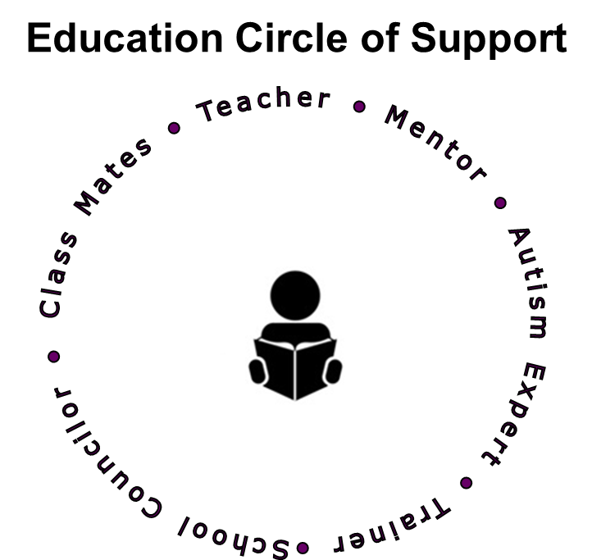
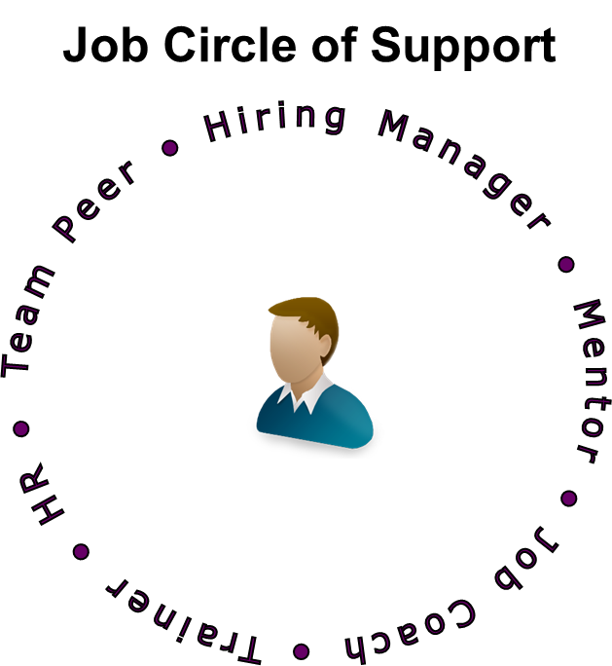
Removing The Divide
Educating same models on both sides of divide:
    Dandelion philosophy
    Shared values
    Shared training programs
    Recruitment via internship
    Shared support structure
    Education and certification
People
(Supply)
Jobs
(Demand)

Slide 10
To Whom it May Concern
(video)

Slide 11
Specialisterne Objectives
Increase job opportunities nationally at small, medium sized and large public and private employers for autistic people
Increase opportunities for autistic students to identify and develop their talent
Increase transition opportunities by applying the same knowledge among stakeholders on the demand and supply side
Promote appreciation of autistic people and neurodiversity

Slide 12
Specialisterne Strategy
Identify and validate barriers to talent and career development through research and metrics
Remove barriers through development of scale-able solutions
Document, manage and share knowledge
Provide education, accreditation and support services
Form collaborations and partnerships on supply and demand side
Train, accredit and support partners as engagement and delivery channel of operational services

Slide 13
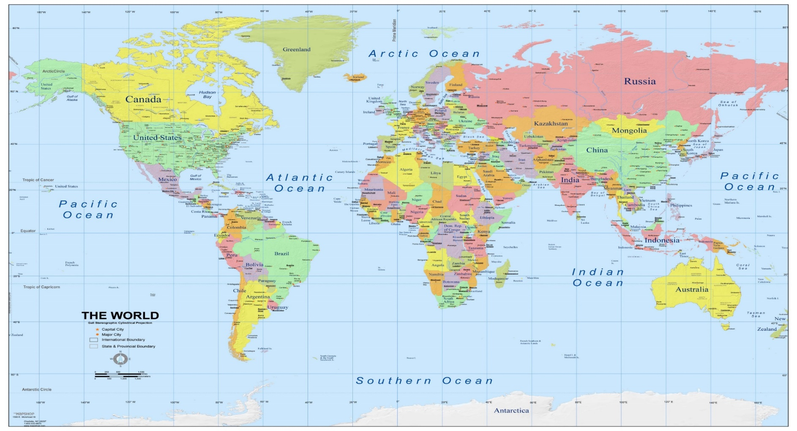

Specialisterne International
Specialisterne Europe
Austria
Czech Republic, APLA
Denmark
Iceland
Ireland
Norway, Unicus
Northern Ireland
Spain (Barcelona, Madrid)
Switzerland
Specialisterne Canada
Montreal
Toronto
Vancouver
Specialisterne US
California, ExpandAbility
Delaware, CAI
New York, AHRC
Pennsylvania, SPArc
Utah, Columbus Community Center
Virginia, Arc DC
Washington, PROVAIL
Specialisterne Asia:
India, Enable India
Specialisterne LatAm
Brazil, São Paolo
Brazil, São Leopoldo, Pandorga
Specialisterne Australia
Adelaide,
Brisbane,
Canberra

Slide 14
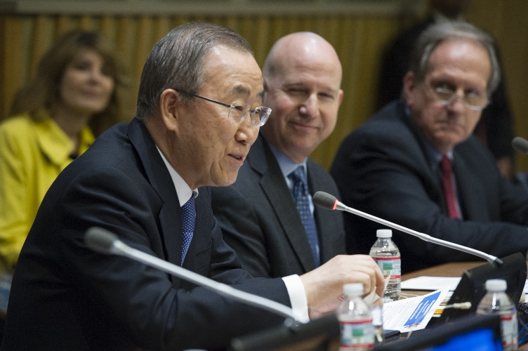
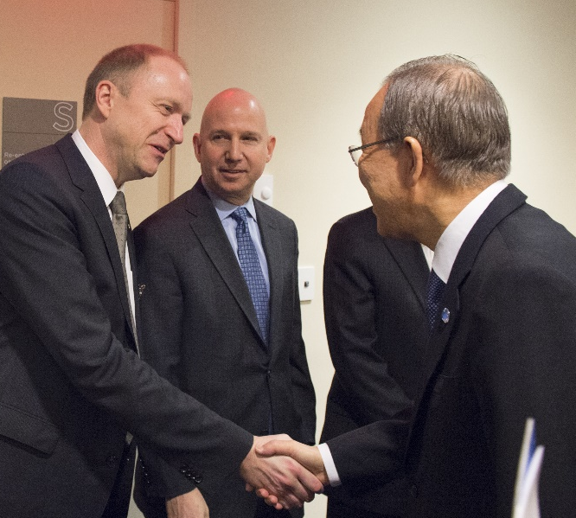

Removing the Divide as UN DPI Associated
“This year, I am pleased to launch an employment “Call to Action”, inviting businesses to make concrete commitments to employ people on the autism spectrum”
UN General Secretary, Ban Ki-moon
UN World Autism Awareness Day 2015

Slide 15
Collaboration Demand Side
Partners: SAP, HPE, Specialisterne
The goal of this collaboration is to work on removing some of the barriers to employment and create greater inclusion and acceptance for autistic people
Creation of information assets that will help raise awareness of the value of Neurodiversity in the workplace
Collaborate in the creation of cross-company common training curriculums to hire and retain autistic people
Exchange experiences in the areas of sourcing, training, hiring, work experience programs and retaining individuals in the autism spectrum
Investigate other barriers to employment for autistic people such as industry accreditation courses
Participate in information sharing sessions at the World Economic Forum, Davos, UN events and at annual summits for employers, governments and community groups.
Announced at the UN World Autism Awareness Day Event 2016

Slide 16
Dandelion Program
Callan Hanley
Autism at Work Summit
23–24 March 2016

Slide 17
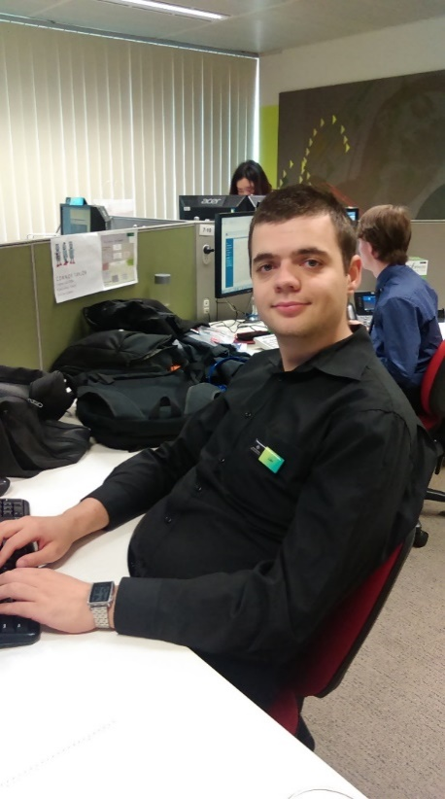
Dandelion Program: What is it?
Partnership between DHS, HPE, and Specialisterne; true public, private, and non-profit partnership to include people with autism into the workforce.
  Focuses on employing people based on their special abilities and not their ‘disability’, unlocking a new talent pool.
Initiative has been recognised
  Dandelion Program was invited to present at the United Nations World Autism Awareness Day
  Asia Pacific Autism Conference Award 2015 for outstanding service to the community

Slide 18
What makes the Dandelion Program unique?
  “This program is unique because it attacks the problem of employment for people with an ASD, not simply by pushing harder the peg into the square hole, but instead by addressing the supports needed on both ends…”
  Professor Cheryl Dissanayake - Director, Olga Tennison Autism Research Centre

Slide 19
Benefits and impact through social inclusion: economic
Economic
Social
  Realising Potential – PwC Report May 2015 (page 17)
Organisational
Individual
  Realising Potential – PwC Report May 2015 (page 19)
20 years - $167 million government, and $425 million to GDP
Win, win, win, win value proposition

Slide 20
Benefits and impact through social inclusion: social
Economic
  Families of the ASD trainees are profoundly impacted.
  Employees are impacted on a social level.
  The Autism community is inspired and provides hope.
  "So when I rapidly walked out of the briefing yesterday, turned the corner, and burst in tears, it was because I was monumentally relieved and confident that ‘my boy’ was entering an environment where he’ll be understood, treated like the valued candidate he is, and enabled to undertake personal and professional growth within a protected environment.”
  Parent of Dandelion Program employee
Social
Organisational
Individual

Slide 21
Benefits and impact through social inclusion: organisational
Economic
  Improvements in quality and efficiency
  There is excitement and pride in the organisations for the program, and improved staff morale.
  “I’d like to say how impressed at the progress that the Dandelion team have made so far and the effort they all put in for this release … The defects discovered during the ad hoc testing phase were amazing and that they discovered so much was highly impressive.”
  DHS Test Manager
  “As the mother of an Autistic boy I can’t tell you how proud I am to be associated with a department and a country, for that matter, that would run such a fabulous and ground-breaking program.”
Social
Organisational
Individual

Slide 22
Benefits and impact through social inclusion: individual
Economic
  The program enables people with ASD to improve self-confidence, gain their independence, reduce their reliance on carers and family, and dependency on government payments.
  As an adult, being treated like a child by your parents is humiliating.
  A lack of success in finding a job can often lead to other issues, such as depression.
  The team is making new friends within the team and the organisations.
Social
Organisational
Individual

Slide 23
Learnings
Commitment and investment – financial and non-financial at Executive levels
Organisational commitment to the program
Early stakeholder engagement including autism community groups
SpecialistPeople Foundation of identification and assessment model
Family, HPE staff, and client information and awareness sessions
Trainee support structures

Slide 24
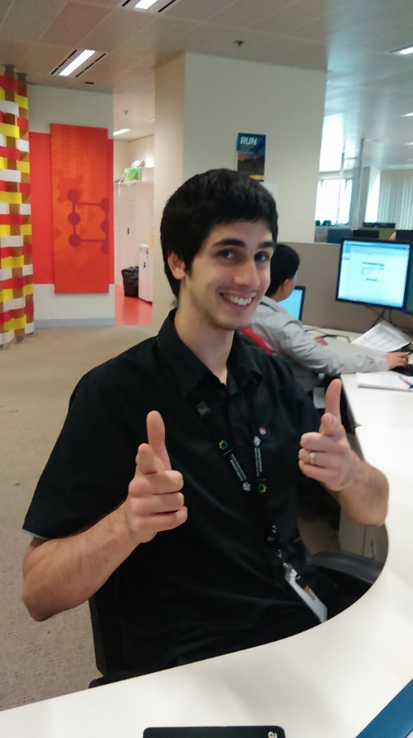
Success stories, personal growth & transformation
Improved self confidence and sense of self worth
Increased social networks
Breaking down the stigma and negative stereotypes surrounding autism and neurodiversity
Two team members have purchased their first home; three have new partners
Significant increase in skill levels and knowledge base
Trainees have provided training and knowledge sharing with the client’s employees
All project deadlines have been achieved
Support team have learned so much whilst supporting the trainees

Slide 25





Autism at work

Slide 26
SAP Vision
Autism at Work
In May of 2013, SAP Announced its objective to have 1% its global workforce represented by employees in the autism spectrum. About 650 Jobs
SAP Vision
Make the World Run Better and Improve People’s Lives

Slide 27
Why Hire People With Autism ?
Attract the Best Talent in Our Industry
Bring a Different Perspective to Our Creative Process
Tap into Underutilized Source of Talent
Capture Special Skills of People with ASD
Retention: Loyalty Works Both Ways

Slide 28
Roadmap
2013 2015
2016 2017
2019
2020
…
LEARN VIA PILOTS AT LOCATIONS WORLDWIDE
Create “Good /Basic Practices”.
Create “Glocal” Globally defined practices with country-optimized processes
PROCESS MAINSTREAMING & SUSTAINIBILITY
From Good to Better Practices
Consolidate SAP Autism at Work Practices and transfer these to Mainstream SAP Processes
PROCESS MATURITY ONBOARDING EQUIVALENCY
From Better to Best Practices.
The organization has organic practices to source, train, onboard and retain employees with autism
Change Management
Mainstreaming Best Practices, Sharing Learnings

Slide 29
18 Roles
Software Developer
Information Developer/KM
Software Tester
Business Analyst
IT Technical Support
System Administrator
Marketing Operations Associate
Networking Specialist
Procure-to-Pay Service Associate
IT Project Management Associate
Customer Support Associate
Graphic Designer
Multimedia Specialist
Employee Communications Associate
Data Analyst
Associate Consultant
Product Manager
HR Service Associate

Slide 30
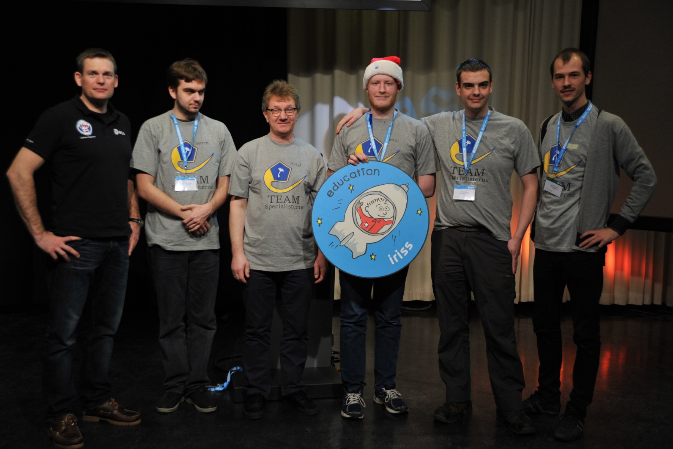
Specialisterne Student Robotic Team
Winners European Space Agency Robotics Competition 2015

Slide 31
Thanks
Questions
Answers
Thorkil Sonne
Founder, CEO
thso@specialisterne.com
302 290 1021
Specialisterne USA is a 501c3 charity (EIN 45-3612906) www.usa.specialisterne.com

Slide 32
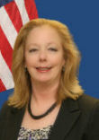

Don’t Miss Our Next Webinar!
Wednesday, August 10, 2016 at 1:30p ET
Best Practices in Action: Nevada VR - Employer Engagement, Collaboration and Sector Strategies
Featuring Shelley Hendren, Rehabilitation Division Administrator and Janice John, Deputy Administrator, Nevada State Rehabilitation Division
RSVP at respectabilityusa.com/events/

Slide 33
RespectAbility Contact Information
We have many resources for policy makers and employers on our website and are ready to help!
RespectAbilityUSA
11333 Woodglen Drive, #102
Rockville, MD 20852
www.RespectAbilityUSA.org
Cell: (202) 365 – 0787
Jennifer Laszlo Mizrahi
President
JenniferM@RespectAbilityUSA.org

