Slide 1
Best Practices in Action: Iowa
IVRS and Employer Engagement
July 11, 2016
David Mitchell, IVRS Administrator
Michelle Krefft, IVRS Business Consultant
Emily Brown, HR Retention Specialist, UnityPoint Health – Des Moines

Slide 2
A Quick Thank You to Our Sponsor

Slide 3
IVRS and Employer Engagement
David Mitchell, IVRS Administrator
Michelle Krefft, IVRS Business Consultant
Emily Brown, HR Retention Specialist, UnityPoint Health – Des Moines
A relationship can be the catalyst for having real impact in someone’s life. This is why we’ve focused on building relationships in order to effectively support individuals with disabilities.

Slide 4
Our Partners

Slide 5
Brief Overview
New staff training
Business Services Manual
Reverse Job Fair
Kwik Star
Access to Ability
Business Engagement
UnityPoint Contract
Steven’s Success

Slide 6
Business Services Manual/Staff training
New Staff training
Area office training
1:1 staff training
Business services training
Business Intake
Job Analysis
Tools for partnership versus job placement
Section 503 Federal Contracting

Slide 7
The Value of Training
Comments from our staff.
Different job duties at 2 businesses- how to get more comfortable with businesses and strategies for the first meeting
I also learned that there are many employers that NEED our clients just as much as our clients want to work.
To be open and direct with employers so that they can best serve individuals
It was nice to learn about UnityPoint and have a tour of the facility
IVRS Business Questions hand out will be very helpful to take back home and utilize with local employers
Building business relationships- employers perspective: how to arrange meetings, what to say and what not to say

Slide 8
The Value of training continued
I learned a better approach to contacting businesses, adjusting approach based on audience. Importance of finding the need of the business, where their turnover is and how to make the best match of the JC to fill their need.
I enjoyed meeting with employers and not only role playing, but also “picking their brain” as to things they need from VR
I enjoyed talking/speaking with the different employers and learning what they look for in JCS. As well as how to properly approach them.
I was dreading the employer role play, but it ended up being my favorite part and most helpful ☺

Slide 9
The Reverse Job Fair
Job candidates set up a booth that displayed their work experience, skills and abilities and the employers traveled to their booth, rather than the candidate going to various employer booths. Job seekers were assisted with preparation through boot camps that were offered as a dry run prior to the day of the Reverse Job Fair.
50 employer representatives present
24 job candidates
10 jobs offered
5 successful placements in their desired career field

Slide 10
Business Partnership Video #1
Kwik Star Video Clip

Slide 11
Staffing Agencies – Access2Ability
Vision- A partnership that relies on collaboration with Vocational Rehabilitation to provide a workforce solution and talent to job seekers that have a disability.
Stats from April 2015
Referrals 99
Manpower Placements 28
Status 26 closures 1

Slide 12
Business Partnership Video #2
Owners Revolution, Plastic Professionals

Slide 13
UnityPoint Health – Des Moines
An innovative partnership between UPH-DM and IVRS that focuses on matching the needs of the business with the abilities and interests of the job candidate.
Career Coaching for VR Job Seekers
Applicants get support with their resume, application, interviews and how to follow up.
Alternative supports like applicant tours, staff tours, speaking at conferences and support with staff training.
Coached 94 job seekers / 22 successful hires since February 2014
An average of 149 days to be hired, ranges from 8 up to 715

Slide 14
UnityPoint Health – Des Moines
Rehoming Process for current employees
When an employee has permanent restrictions that limit their ability to do their job, we rehome. This includes evaluating current openings, identifying positions that match the employees skills, interests and restrictions, having employees complete job shadows and ultimately placing our staff into new positions.
8 staff have gone through official “rehoming” since December of 2015 and 6 have been successfully rehomed

Slide 15
UnityPoint Health - Des Moines
Project SEARCH
-An onsite training program for young adults with disabilities. Internships are the hallmark of the Project SEARCH program and focus on work based learning but also has a classroom component to focus on the soft skills that it takes to keep a job.
-60 students have completed the program and the 6th class will start this fall
-UPH-DM has hired 15 of them in a variety of roles including Food and Nutrition, Housekeeping, Lab Support Techs, Supply Techs, Patient Transporters, Data Entry and Laundry Workers
-There is no number that can begin to express the culture shift that’s taken place within our hospital

Slide 16
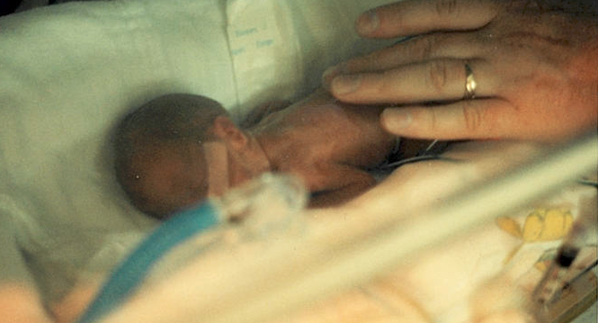
Steven’s Story
Steven weighed less than a pound at birth and wasn’t expected to live.
After graduating high school Project SEARCH allowed him an opportunity to prove to the world how capable he was.
Today Steven is a Lab Support Tech and works behind the scenes in our lab. His duties include entering and verifying information in patient medical records, some sample management, putting supply orders together as well as assisting our clinics throughout campus when needed.

Slide 17
Steven’s Story
If it wasn’t for Project SEARCH, Steven would’ve been screened out in the typical hiring process because he had no work experience.
The internship allowed Steven to prove that not only could he do the work but that he fit in perfectly with the team. It also takes the emphasis off the typical application , resume and interview.
Steven recently celebrated his 4 year anniversary and continues to have some of the highest accuracy ratings for his data entry and his productivity does not suffer.

Slide 18
Questions??

Slide 19
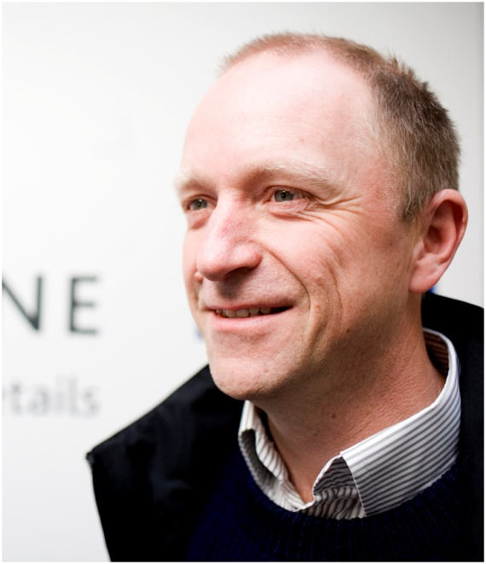
Don’t Miss Our Next Webinar!
Wednesday, July 27, 2016 at 1:30pm ET
Specialisterne USA, Hope, Action, Impact- Cutting Edge Jobs for People on the Autism Spectrum
Featuring Thorkill Sonne, CEO and Founder, SpecialsiterneUSA
RSVP at respectabilityusa.com/events/

Slide 20
RespectAbility Contact Information
We have many resources for policy makers and employers on our website and are ready to help!
RespectAbilityUSA
11333 Woodglen Drive, #102
Rockville, MD 20852
www.RespectAbilityUSA.org
Cell: (202) 365 – 0787
Jennifer Laszlo Mizrahi
President
JenniferM@RespectAbilityUSA.org

