Slide 1
Best Practices in Action: Youth Transitions and Employment Outcomes in Iowa
June 29th, 2016
David Mitchell, Administrator, IVRS
With April Stotz and Mary Jackson

Slide 2
A Quick Thank You to Our Sponsor

Slide 3
Iowa Vocational Rehabilitation

Slide 4
IVRS: Who We Are
David Mitchell, IVRS Administrator
April Stotz, Rehabilitation Counselor
Mary Jackson, Resource Manager

Slide 5
Transition Approaches in Northwest Iowa
April Stotz, Rehabilitation Counselor, serves three primary counties:
Lyon County: population 11,745
Osceola County: population 6,154
O’Brien County: population 13,984

Slide 6
Transition Approaches in Northwest Iowa (cont.)
In these three counties, there are seven Community School Districts.
A graduating class can be around 25 students from each of these schools.
April lives in a town with a population size of 336 (that number may include pets!).
The largest town in the three-county area is population 5,188.

Slide 7
Building Connections ─ The Importance of Partnering
Building visibility in the community
Strategies for connecting
Business presentations

Slide 8
Progressive Employment
There is something for everyone with the right supports – assisting with their employment journey.
Job Shadows
Tours
Informational Interviews
Volunteer Work
Part-time Work
OJT
Internships

Slide 9
Pre-Employment Transition Services
Job Exploration
Counseling
Work-Based Learning Experiences
Workplace Readiness Training
Self-Advocacy

Slide 10
WIOA Workforce Innovation and Opportunity Act
Partnerships
Opportunities to change the conversation with our partners
IVRS strategies for approaching Section 511: Competitive, Community-Integrated Employment

Slide 11
Summer Work Readiness Schedules
Science | Technology | Engineering | Math
Monday, July 11 | Tuesday, July 12 | Wednesday, July 13 | Thursday, July 14
Pizza Ranch | Wal-Mart | Hy-Vee | Stoney Creek
Dishwashing | Janitorial | Bag groceries | Housekeeping
Bussing tables | Security | Stock shelves | Laundry
Buffet line |  |  | Cleaning
Science | Technology | Engineering | Math
Monday, August 1 | Tuesday, August 2 | Wednesday, August 3 | Thursday, August 4
Unity Point | KCAU - TV | Palmer Candy | Bank
C.N.A. | Anchor | Machinist | Teller
Nurse | Technician | Maintenance | Data entry
Lab Technician | Camera | Safety Manager | Loan officer
Ultrasound / x-ray tech |  |  | Financial planner
Pharmacy tech
Bio Medical

Slide 12
Summer Work Readiness
Tour business
Job shadow
Informational interviews, etc.
Discuss and compare what you thought the job looked like, compared to what it really was
Document what you learned and store in notebook

Slide 13
Making the Grade
Studies have shown that students who have paid employment experience in high school have a greater likelihood of future employment success!

Slide 14
Transition Alliance Program
A VR and secondary school partnership resulting in a 50-50% shared financial cost. IVRS is using this as a third-party contract and is able to utilize federal match.
Expands school-to-work capacity.
Provides follow-along services once employed.
Provides follow-up services to age 25 for the student

Slide 15
Providing Solutions. Generating Success.

Slide 16
Iowa Business Spotlight
Em’s Coffee Company
Johnston Creek Farms
In The Country Garden and Gifts
Kwik Trip
Winnebago Industries

Slide 17
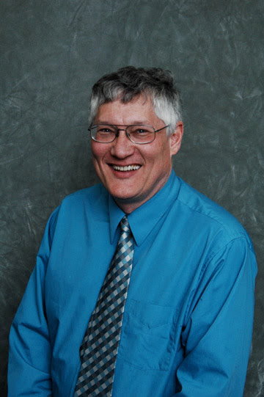
Don’t Miss Our Next Webinar!
Monday, July 11, 2016 at 1:30 p.m. ET
Best Practices in Action: VR and Business Partnerships and in Iowa
Featuring David Mitchell, Administrator of Iowa Vocational Rehabilitation Services (IVRS)
RSVP at respectabilityusa.com/events/

Slide 18
RespectAbility Contact Information
We have many resources for policy makers and employers on our website and are ready to help!
RespectAbilityUSA
11333 Woodglen Drive, #102
Rockville, MD 20852
www.RespectAbilityUSA.org
Cell: (202) 365 – 0787
Jennifer Laszlo Mizrahi
President
JenniferM@RespectAbilityUSA.org

