Slide 1
Introduction to Web Accessibility: Tips and Tricks
Notes:
Jennifer introduces webinar

Slide 2
Meet Today’s Presenters
Dana Marlowe is an architect of inclusion and accessibility. Her voracious passion for equal access for all has made her a staunch, lifelong advocate for people with disabilities. Dana’s primary goal in life is to fight for a society that fully accepts the contributions of those with disabilities. Marlowe is the principal partner and co-founder of the company, Accessibility Partners LLC, a disability and accessibility advocacy IT consulting firm. Dana partners with Federal Agencies and Fortune 500 businesses to help them test, consult, and train on accessible IT products for people with disabilities.
Sharon Rosenblatt is an accessibility professional working to improve the overall experience by a user with disabilities. With her tendency to be ‘hands on’, Sharon prefers manual testing over automated solutions. Sharon feels that accessibility is a right, and not a ‘nice to have’. She has been a part of the Accessibility Partners team for the past five years, and specializes in document remediation and compliance testing. Sharon enjoys trying new types of assistive technologies, and pushes for greater integration of said AT with the newest products on the market today. With her enthusiasm highlighted in several publications, she enjoys participating in the constant dialogue between accessibility and innovation.
Accessibility Partners' mission is to help organizations improve their accessibility posture by providing distinctive and powerful solutions for their stakeholders. Accessibility Partners prides itself on not only its accessibility testing capabilities but its commitment to training as well. With a full-time staff comprised of engineers with disabilities, Accessibility Partners has a vested interest in the future of usable technology be ensuring that their unique workforce works with developer to create products that enable all of us better access to information technology.

Slide 3
Agenda
Disability and Accessibility
Introduction to Web Accessibility
Creating a Welcoming and Inclusive Site
Making Web Content Accessible
Accessibility Tips for Social Media
Conclusion: Moving Forward
Contact Information and Resources
Questions and Answers

Slide 4
Disability and Accessibility
Americans with Disabilities Act (ADA):
a physical or mental impairment that substantially limits one or more major life activities
Blindness and Low Vision
Deafness and Hearing Loss
Limited Movement
Speech Disabilities
Cognitive Limitations
Combinations of the above

Slide 5
Disability Demographics
60 million Americans or 1 out of 5
76 million baby boomers
52% of Americans either have a disability or a close friend or loved one with a disability
$220 billion discretionary income

Slide 6
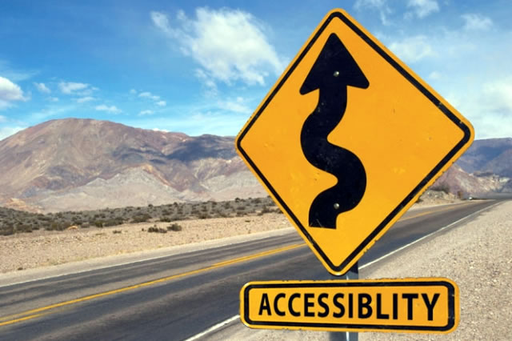
Accessibility
Accessibility means equal access
Technology must be designed and developed to provide equal access and usability to every member of your target audience

Slide 7
Assistive Technology
Technology used by people with disabilities to perform functions that might otherwise be difficult or impossible
Can include:
Conventional items--walkers and wheelchairs
Hardware (refreshable Braille display)
Software (screen reader, speech recognition)
Peripherals

Slide 8
Screen Reader in Action
Art Beyond Sight: JAWS Screen Reader - Hear an Example
https://www.youtube.com/watch?v=IK97XMibEws

Slide 9
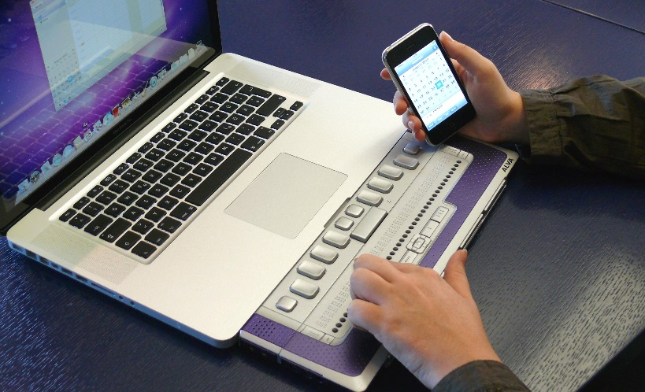
Assistive Technology: Examples
Augmented input/output devices
Visual representation of auditory information for hearing impaired
Network-based TTY systems
Videophones

Slide 10
Web Accessibility
Essentially, people with disabilities can use the Internet
Perceive, understand, navigate, and interact
Encompasses all disabilities that affect Web access

Slide 11
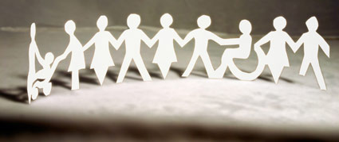
Creating an Inclusive Site
Two purposes: branding and a tool for users
Essential to make website welcoming and accessible
Welcoming words
Inclusive photos and images
Advertise available accommodations

Slide 12
What is Alternative Text?
Alternative Text (alt text): First principle in web accessibility
Textual alternative to non-text content on web pages
Add into HTML code:
<img src=“image.gif" alt=“Alternative text goes here">
Accurate, equivalent, and succinct
Not redundant text
No ‘image of’, ‘graphic of’ etc.

Slide 13
Creating Effective Alt Text
Finding a balance between too much and too little
How is image used?
to convey important content
to provide visual enhancements which offer no real content
to link to other areas
Alternative text communicates the purpose of the graphic, not its appearance

Slide 14
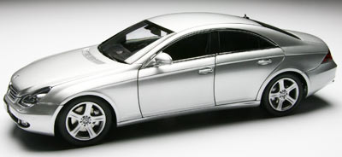
Alternative Text Example
Bad alt text: A car
Good alt text: A silver Mercedes sports car
Better alt text: A silver Mercedes CLS 350 sports car

Slide 15
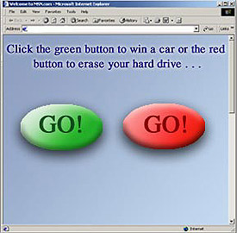
Color Usage
Color should never be used to convey information
Some users with disabilities cannot distinguish colors
May lose meaning if viewed in high contrast

Slide 16
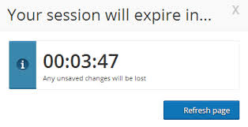
Timeouts
Timeouts are employed to track a user’s inactivity
Issues include:
Not identified on screen
Not long enough to complete an activity

Slide 17
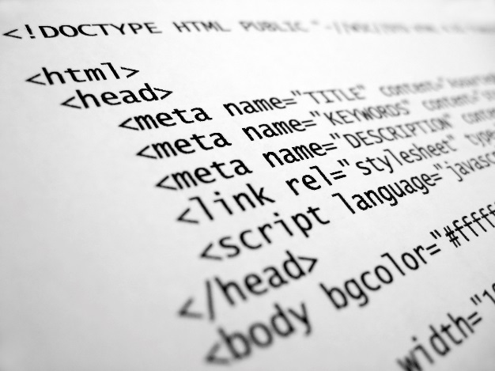
Provide Descriptive Links
Links are most basic element of HTML
Links work with all assistive technologies, but can be inaccessible
Must be accessible from the keyboard
Must be descriptive

Slide 18
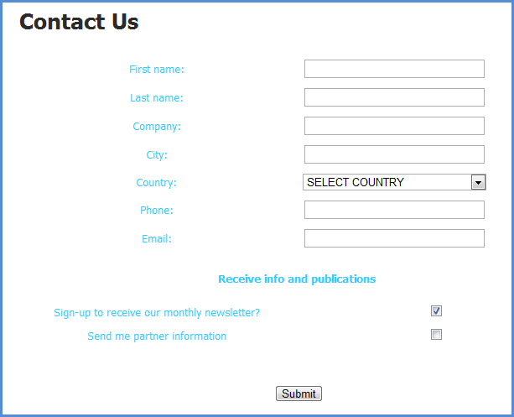
Labeled Form Fields
Matching “for” and “id” labels
ID must be unique, can’t have one label for multiple
Text labels describe the function of each form control
<label> element used to associate text label

Slide 19
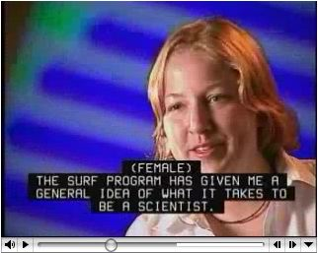
Subtitles and Transcripts
Equivalent alternatives that are synchronized
Add subtitles/captions for audio and movie files

Slide 20
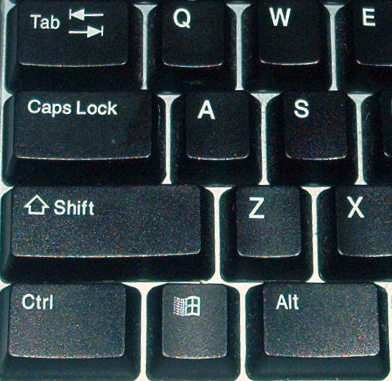
Keyboard Usage
Access to the user interface
Don’t have difficult to reach areas
Consider testing with assistive technology
Solution: keyboard accessibility
Test with tab key: ensure visual focus

Slide 21
Skip Navigation
Main content is not typically located ‘first’
Long navigation lists are first, among others
Skip navigation bypasses the top
Create a visible or invisible link that ‘jumps’ or ‘skips’

Slide 22
ARIA: An Introduction
WAI-ARIA: Accessible Rich Internet Applications Suite
Helps with dynamic content and UI controls
Some functionality is limited to users of IT
ARIA defines new ways to provide access to AT
Makes advance web applications usable

Slide 23
Social Media and Accessibility
Social media isn’t always most accessible
Very image heavy, updating dynamically
WebAIM conducted a screen reader survey in 2012:
Roughly half found social media sites accessible
1/3 found them inaccessible
http://webaim.org/projects/screenreadersurvey4/
Many issues, but hopefully increased awareness on web accessibility can fix this

Slide 24
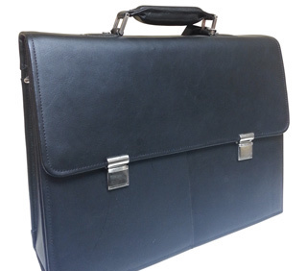
Conclusion: Accessibility Benefits
Maximize reach, revenues and ultimately profits
Create accessibility statements and roadmaps
Retain your current investment in resources
Tap into new pool of knowledge workers – those with disabilities
Increase productivity for all

Slide 25
Conclusion: Accessibility Benefits
Generate a positive media response
Use as a competitive differentiator
Increase customer loyalty
Support corporate social responsibility
Attract not only those people with disabilities, but:
Families, friends, co-workers, health care professionals

Slide 26
Contact Information
Dana Marlowe: DMarlowe@AccessibilityPartners.com
Sharon Rosenblatt: SRosenblatt@AccessibilityPartners.com
www.AccessibilityPartners.com 301-717-7177
www.facebook.com/AccessibilityPartners
@Access_Partners

Slide 27
Let Us Know If We Can Help!
We have many resources for policy makers and employers on our website and are ready to help!
RespectAbilityUSA
4340 East-West Hwy, Suite 1100
Bethesda, MD 20814
www.RespectAbilityUSA.org
Cell: (202) 365 – 0787
Jennifer Laszlo Mizrahi
President
JenniferM@RespectAbilityUSA.org

Slide 28
Creating Accessible Documents: Word, PDF, PowerPoint
Free webinar on making documents and presentations accessible
Download presentation here: http://respectabilityusa.com/Resources/Creating%20accessible%20documents-%20Cristopher%20Broyles.pdf
Watch recording of webinar here: https://www.youtube.com/watch?v=XSkT5xJGVao&feature=youtu.be

Slide 29
Free Webinar: “Best Practices in Youth Employment for People With Disabilities
Join us for a free webinar to learn about Project SEARCH, and immersive school-to-work program for people with disabilities with a 70% employment outcome!
Live captioning provided. Free of charge. Date to be announced soon.
Speaker: J. Erin Riehle, MSN, RN
Erin is a national Leader in promoting employment opportunities for people with disabilities and other barriers to employment, She is a founder and Director of Project SEARCH, an employment and transition program that has received national recognition for innovative practices.

Slide 30
Resources
http://webaim.org/
http://www.w3.org/WAI/
http://www.afb.org/info/programs-and-services/technology-evaluation/creating-accessible-websites/123
http://www.ssa.gov/accessibility/
http://webaccess.msu.edu/

