Slide 1
“Best Practices & Success in Inclusive Employment
in the Hospitality Sector”
Valentini Kalargyrou, Ph.D., David Scott and LeAndra Collins

Slide 2
Planning Tool
Click here to download the Disability Employment First Planning Tool
Direct link:
http://respectabilityusa.com/Resources/Disability%20Employment%20First%20Planning.pdf

Slide 3
State Specific Data
Alabama: Download the PDF here. Download the PPT here.
Alaska: Download the PDF here. Download the PPT here.
Arizona: Download the PDF here. Download the PPT here.
Arkansas: Download the PDF here. Download the PPT here.
California: Download the PDF here. Download the PPT here.
Colorado: Download the PDF here. Download the PPT here.
Connecticut: Download the PDF here. Download the PPT here.
DC: Download the PDF here. Download the PPT here.
Delaware: Download the PDF here. Download the PPT here.
Florida: Download the PDF here. Download the PPT here.
Georgia: Download the PDF here. Download the PPT here.
Hawaii: Download the PDF here. Download the PPT here.
Idaho: Download the PDF here. Download the PPT here.
Illinois: Download the PDF here. Download the PPT here.
Indiana: Download the PDF here. Download the PPT here.
Iowa: Download the PDF here. Download the PPT here.
Kansas: Download the PDF here. Download the PPT here.
Kentucky: Download the PDF here. Download the PPT here.
Louisiana: Download the PDF here. Download the PPT here.
Maine: Download the PDF here. Download the PPT here.
Maryland: Download the PDF here. Download the PPT here.
Massachusetts: Download the PDF here. Download the PPT here.
Michigan: Download the PDF here. Download the PPT here.
Minnesota: Download the PDF here. Download the PPT here.
Mississippi: Download the PDF here. Download the PPT here.
Missouri: Download the PDF here. Download the PPT here.
Montana: Download the PDF here. Download the PPT here.
Nebraska: Download the PDF here. Download the PPT here.
Nevada: Download the PDF here. Download the PPT here.
New Hampshire: Download the PDF here. Download the PPT here.
New Jersey: Download the PDF here. Download the PPT here.
New Mexico: Download the PDF here. Download the PPT here.
New York: Download the PDF here. Download the PPT here.
North Carolina: Download the PDF here. Download the PPT here.
North Dakota: Download the PDF here. Download the PPT here.
Ohio: Download the PDF here. Download the PPT here.
Oklahoma: Download the PDF here. Download the PPT here.
Oregon: Download the PDF here. Download the PPT here.
Pennsylvania: Download the PDF here. Download the PPT here.
Rhode Island: Download the PDF here. Download the PPT here.
South Carolina: Download the PDF here. Download the PPT here.
South Dakota: Download the PDF here. Download the PPT here.
Tennessee: Download the PDF here. Download the PPT here.
Texas: Download the PDF here. Download the PPT here.
Utah: Download the PDF here. Download the PPT here.
Vermont: Download the PDF here. Download the PPT here.
Virginia: Download the PDF here. Download the PPT here.
Washington: Download the PDF here. Download the PPT here.
West Virginia: Download the PDF here. Download the PPT here.
Wisconsin: Download the PDF here. Download the PPT here.
Wyoming: Download the PDF here. Download the PPT here.
RespectAbility, NACDD, Best Buddies, NCIL, PVA and NOD’s Disability Employment First Planning Tool:
- Download the PDF.
- Download the Word document.

Slide 4
Your Compressive Resource for Lodging and Restaurants for Information on Including Guests with Disabilities
www.ADAhospitality.org
The regional ADA Centers can answer all your questions on the
Americans with Disabilities Act (ADA)
1-800-949-4232 v/tty

Slide 5
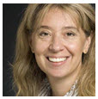
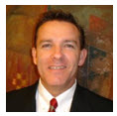
Thank You for Joining Us!
“Best Practices & Success in Inclusive Employment
in the Hospitality Sector”
Valentini Kalargyrou, Ph.D. is an Assistant Professor of Hospitality Management in the Peter T. Paul College of Business and Economics at the University of New Hampshire. She has extensive experience in international entrepreneurship and she was on several opening teams of integrated resorts in Las Vegas, NV. Her outstanding and scientifically done work on best practices in the hospitality industry has been widely published in top-tier reviewed journals. Her research focuses on leadership, training, sex trafficking and disability issues in the workplace and service operations with an emphasis on the business case of employing people with disabilities and customers attitudes and perceptions when served by employees with disabilities.
David Scott is Director of Sales at the award winning Embassy Suites and the Courtyard by Marriott Hotels in Omaha-La Vista, Nebraska. The hotels are model inclusive employers which have garnered recognition by the White House, the Nebraska Governor and in numerous media outlets. Moreover, inclusion was not done for charity – it was done for, and remains, great for business. Originally from Sydney, Australia, David has worked in tourism and hospitality for over 30 years.
LeAndra Collins has been a Director of Human Resources in the hospitality industry for over eight years. She has overseen three Project SEARCH host sites based at hotels averaging 85% employment in the first year following their graduation. LeAndra is a member of the Human Resources Association of the Midlands and holds her PHR Certification. In addition to her work, she is also kept busy by her two daughters who are six and three years old.

Slide 6
Part I
“The Business Case of Employing People with Disabilities”
Valentini Kalargyrou, Ph.D.
Assistant Professor
University of New Hampshire
Peter T. Paul College of Business and Economics
Hospitality Management
Notes:
Introductions…
Today, we’re going to discuss why Hospitality may be just be a natural fit for your ProjectSEARCH students and how YOU can convince Hospitality Managers that they are the best, most qualified applicant they would ever hire!
First, let us understand our audience and your background. Who is a teacher, business liaison, VR rep? What are your experiences with the Hospitality Industry?
5 MINUTES TOPS

Slide 7
Agenda
Employers’ perspectives in hospitality and leisure
Comparison with other industries
Business Case-Gaining a competitive advantage
Consumers’ perspectives

Slide 8
Employer’s Perspectives in Hospitality
Houtenville and Kalargyrou, 2012
Study of 320 US hospitality and leisure companies
23% of companies employ and 16% actively recruit people with disabilities
Top concerns include cost, lack of skills and experience, supervisors unsure how to discipline/evaluate/manage, low productivity and safety compared to typically abled
Policies encouraging hiring include employer tax credits, data on benefits in other related companies related to job performance, attendance, retention and productivity and disability awareness training

Slide 9
Comparing Hospitality to Other Sectors
Houtenville and Kalargyrou, 2015
Compared 263 leisure and hospitality companies to 3,126 firms from other industries
Service-producing industries are more likely to actively recruit people with disabilities compared to goods-producing
(see appendix 1 for employment by sector and industry)
Customer attitudes biggest concern in hospitality compared to other service-producing industries

Slide 10
Gaining a Competitive Advantage
Kalargyrou, 2014; Kalargyrou and Volis, 2014
Two studies; selected companies with disability inclusion initiatives
Based on Grant’s model of resource-based approach (see exhibit 1)
Benefits (competitive advantage)
Lower turnover, increased psychological safety and productivity
Improved innovation, problem solving abilities, ability to compete in all markets, react to expectations of diverse consumers.
Establishing positive company image and increasing customer satisfaction
Positive effects on workforce
Challenges
Stereotyping/skepticism
New studies show mixed results (Kuo and Kalargyrou 2014)
Productivity issues when there is a mismatch between position and abilities

Slide 11
Gaining a Competitive Advantage (cont.)
Kalargyrou, 2014; Kalargyrou and Volis, 2014
Best practices
Leadership commitment and appropriate management style
Matching abilities with position
Training
Holding all employees accountable to the same standards
Dedicated department/person
Partnering with school systems, local agencies and disability groups
Establishing disability champions and ambassadors

Slide 12
Gaining a Competitive Advantage Exhibit 1
5. Profitability
Lower Turnover, higher attendance, improved corporate reputation and consequently decreased costs and higher profits
4. Strategy
Proactively recruit people with disabilities. Develop disability inclusion programs.
3. Sustained Competitive Advantage
Bigger and better pool of applicants, benefits from Corporate Social Responsibility
2. Capabilities
Company can create a culture of inclusion
1. Resources (HR Resources)
Opportunities to recruit an untapped skilled and loyal minority; People with disabilities
Source: Adapted from Grant (1991)

Slide 13
Summary
Hospitality industry has high levels of employee turnover resulting in high recruiting and training costs
Employees with disabilities are very loyal and dedicated
Create a disability-friendly culture where people with disabilities are viewed as assets not costs

Slide 14
PART II
Making Hospitality Employment an Option in your City
David Scott, Director of Sales
Embassy Suites Omaha – La Vista, Nebraska
Hotel and Conference Center
LeAndra Collins, Director of Human Resources
Embassy Suites Omaha – La Vista, Nebraska
Hotel and Conference Center
Notes:
Introductions…
Today, we’re going to discuss why Hospitality may be just be a natural fit for your ProjectSEARCH students and how YOU can convince Hospitality Managers that they are the best, most qualified applicant they would ever hire!
First, let us understand our audience and your background. Who is a teacher, business liaison, VR rep? What are your experiences with the Hospitality Industry?
5 MINUTES TOPS

Slide 15
Overview of Today’s Session
Impact of Project SEARCH for business
How to relate to the Hospitality Industry
Understand the Hospitality Industry’s jobs and hiring requirements
How to tailor job applications to meet the Hospitality Industry’s needs
See our Success Stories!
Notes:
Here is an overview of what our session will cover, today we’re going to talk about….
How to relate and EMPATHIZE with the Hospitality Industry and their Hiring Managers
Understanding what their needs are, jobs they are hiring for and what their qualifications are
How to tailor resumes and most importantly, JOB ROTATIONS to highlight the skill requirements of Hospitality jobs
And lastly, we’re going to brag a little - see the success stories of our Hospitality ProjectSEARCH hires

Slide 16
Impact of Project SEARCH
Partnership with Nebraska VR and local School District
Began program in 2012 with third class graduating May 2015
17 graduates last 2 classes, 16 hired, 9 on property although not obligated to hire
Awarded Community Service Hotel of Year TWICE for both hotels
Associate Opinion Scores AND Guest Survey scores have all improved

Slide 17
Relating to the Hospitality Industry
Includes lodging, restaurants, theme parks
#1 industry for turnover
Retention & longevity important!
Fun environments and great travel benefits!
Notes:
First of all, let’s define the Hospitality Industry = includes lodging, restaurants, theme parks, basically anyone who provides a service to tourists or leisure travelers using disposable income.
Disposable income = can be very volatile, which is why Hospitality is often their first industry impacted and the last to recover during hard economic times. To maintain profit margins, wages may be lower than other industry averages which then lead to higher turnover.
United States Bureau of Labor Statistics rate leisure & hospitality as the #1 industry for turnover, beating out retail, health care and construction who also top high on the turnover lists.
Losing employees costs money. You incur expenses for advertising job openings, interviewing, training, not to mention lost productivity and possible loss of customers because of poor performance, so retention and longevity are key!
Hospitality industries have to off-set low wages and turn-over by offering good training programs, room for advancement and fun environments. Travel discounts don’t hurt either.

Slide 18
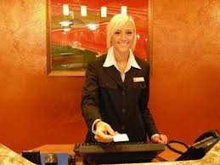
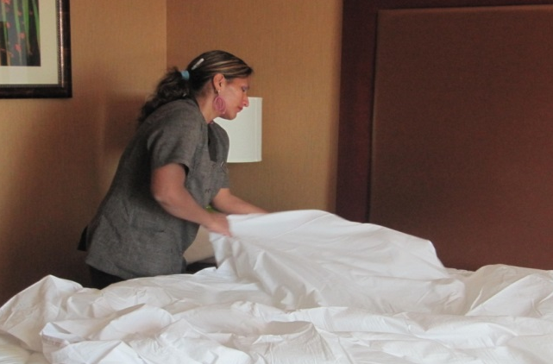
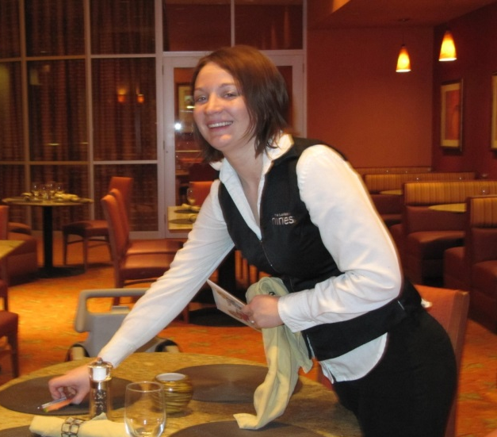
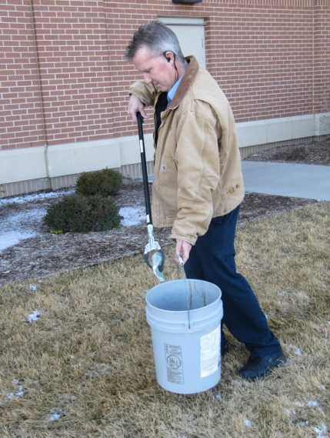
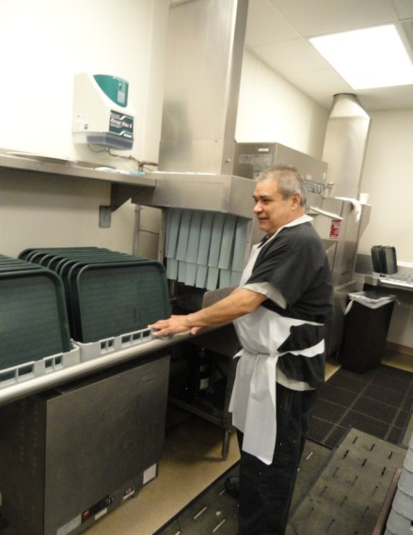
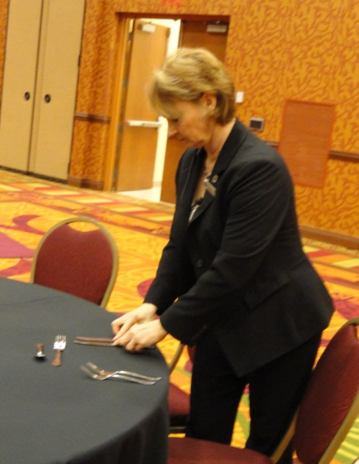
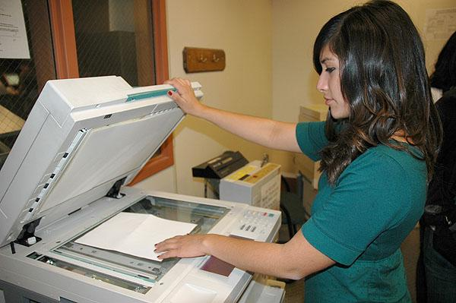
Understand Jobs and Requirements
Guest Services
Housekeeping
Food Services
Engineering
Culinary
Banquets
Admin/Sales
Notes:
Hospitality offers a variety of jobs throughout the hotel, most typical departments include: Guest Services, Housekeeping, Food Services and Engineering. Many full-service properties may also offer job opportunities in Culinary, Banquets, Administrative and Sales Areas as well.

Slide 19
Understand Jobs and Requirements
Guest Services
Front Desk Agents
Strong technical and computer skills, ability to stand long periods, read/write, strong communication skills, friendly proactive demeanor, accuracy, problem solving skills, confidence
Phone Operators
Strong technical and computer skills, ability to multitask, friendly proactive demeanor, problem solving skills, only sedentary position
Bell Person
Ability to stand long periods, lift/pull/push up to 50lb, friendly proactive demeanor, problem solving skills, confidence
Notes:
Guest Services positions often include three areas, Front Desk Agents, Phone Operators and Bell Persons.
Mostly about communication, confidence, decision making
Customer Services, Friendly proactive demeanor, problems solving, confidence

Slide 20
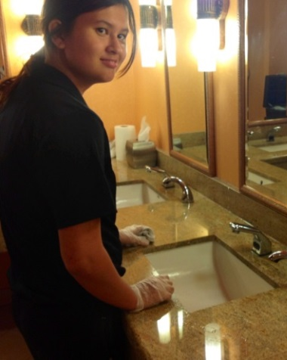
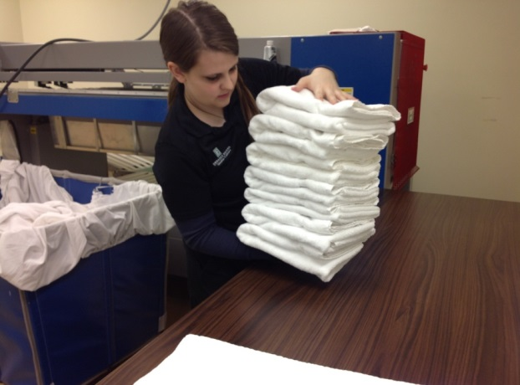
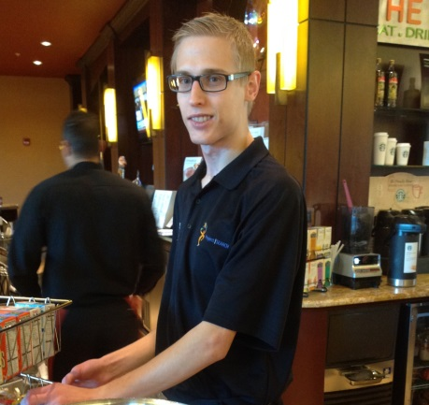
Understand Jobs and Requirements
Housekeeping
Room Attendants/Public Area Attendants
Ability to stand/walk long periods, lift/pull/push up to 25lb, friendly proactive demeanor, attention to detail, move quickly
Laundry Attendants
Ability to stand long periods, lift/pull/push up to 50lb, move quickly
Lori – Public Area Attendant
Connor – Laundry
Amy – Laundry
Notes:
Housekeeping positions often include four different areas, Room Attendants, Public Area Attendants, Laundry Attendants, and Housekeeping Utility.
Entry level, mostly physical requirements, fast-paced, very repetitive
Cleaning - Attention to detail, following precise directions, fast-paced experience

Slide 21
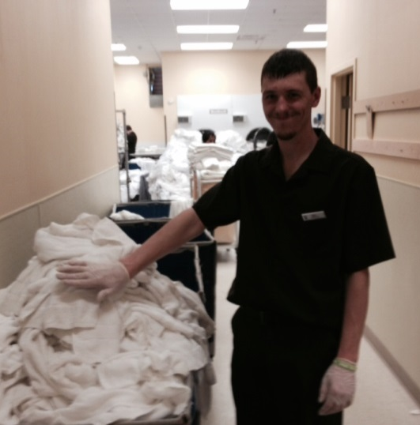
Understand Jobs and Requirements
Housekeeping
Housekeeping Utility (House Person)
Ability to stand/walk long periods, lift/pull/push up to 25lb, friendly proactive demeanor
Sean – House Person
Daniel – House Person
Notes:
Housekeeping positions often include four different areas, Room Attendants, Public Area Attendants, Laundry Attendants, and Housekeeping Utility.
Entry level, mostly physical requirements, fast-paced, very repetitive
Cleaning - Attention to detail, following precise directions, fast-paced experience

Slide 22
Understand Jobs and Requirements
Food Services
Breakfast Attendants
Ability to stand/walk long periods, lift/pull/push up to 25lb, friendly proactive demeanor, attention to detail, move quickly
Servers/Banquet Servers
Ability to use computer system, ability to stand/walk long periods, friendly proactive demeanor, accuracy, problem solving skills, confidence
Hosts/Bussers
Ability to stand/walk long periods, lift/pull/push up to 25lb, friendly proactive demeanor, attention to detail
Notes:
Food Services positions may include the following areas, Breakfast Attendants, Servers, and Hosts/Bussers.
Combination of communication – front of house, physical requirements – back of the house
Attention to detail, following precise directions, fast-paced experience

Slide 23
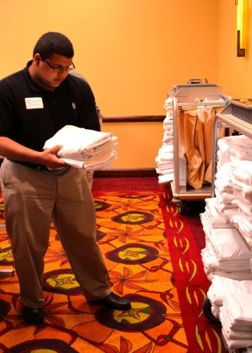
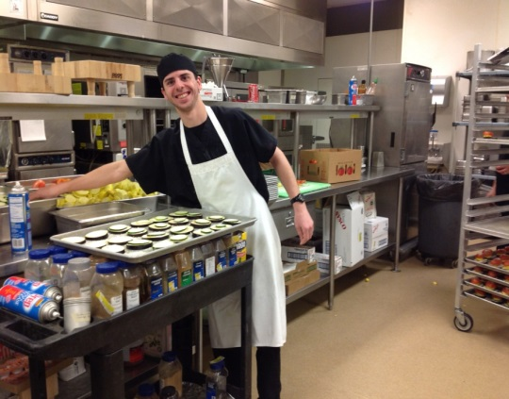
Understand Jobs and Requirements
Food Services
Prep Cooks
Ability to stand/walk long periods, lift/carry up to 50lb, ability to read/write, precisely follow instruction, accuracy, attention to detail
Stewards/Banquet Set-up
Ability to stand/walk long periods, lift/carry up to 50lb, move quickly, attention to detail
Bruce – Banquet Set-up
Joey – Steward/Prep
Darien – Steward/Prep
Notes:
Food Services positions may include the following areas, Breakfast Attendants, Servers, and Hosts/Bussers.
Combination of communication – front of house, physical requirements – back of the house
Attention to detail, following precise directions, fast-paced experience

Slide 24
Understand Jobs and Requirements
Engineering
Maintenance Utility
Ability to stand long periods, lift/pull/push up to 50lb, strong technical skills and ability to use heavy machinery, friendly proactive demeanor, attention to detail, problem solving skills
Admin/Sales
Administrative Assistant
Strong technical and computer skills, ability to read/write, strong communication skills, friendly proactive demeanor, accuracy, problem solving skills
Notes:
More technical positions include Maintenance Utility and Administrative positions.
Non-repetitive, independent, Strong technical/computer skills, strong communication skills, reading/writing, accuracy, ability to multi-task

Slide 25
How to Tailor Job Applications
Job Applications:
Resumes not necessary, complete applications are
Internships/volunteer work a huge help
Stable work history or reasons for gaps in employment
Experience will provide the edge
Notes:
Resumes are helpful to have on hand as a guide but aren’t always required for entry-level positions. Most companies use an on-line application system, which can take upwards of 1 hour to complete. It is essential that the application be filled out completely and accurately or may get disqualified prior to even being reviewed.
Many high school graduates have little experience, but a blank application is not helpful. Even more annoying to a recruiter is a list of classes taken in lue of work history. Encourage volunteer work and include that on the application. Be sure to also include any internship and detailed list of responsibilities and tasks assigned.

Slide 26
Questions?
Valentini Kalargyrou, Ph.D., Assistant Professor
Valentini.kalargyrou@unh.edu
Tel. 603-862 3863
University of New Hampshire – Durham, New Hampshire
Peter T. Paul College of Business and Economics
Hospitality Management
David Scott, Director of Sales
David.Scott@JQH.com
Embassy Suites Omaha – La Vista, Nebraska
Hotel and Conference Center
Leandra Collins, Director of Human Resources
Leandra.Collins@JQH.com
Embassy Suites Omaha – La Vista, Nebraska
Hotel and Conference Center

Slide 27
Watch our Past Webinars!
Mathematica Research Webinar
http://respectabilityusa.com/implementation-of-wioa-lessons-from-research-on-employment/
Project Search
Part 1: https://www.youtube.com/watch?v=KHI5JAlZpZg&spfreload=10 Part 2: https://www.youtube.com/watch?v=__Ko-gveghM&spfreload=10
Conference Call with Governor Scott Walker of Wisconsin
http://respectabilityusa.com/conference-call-with-scott-walker/
Webinar with Rita Landgraf, Secretary of the Delaware Department of Health and Social Services
http://respectabilityusa.com/implementing-the-workforce-investment-and-opportunity-act-wioa-and-the-national-governors-associations-better-bottom-line-employing-people-with-disabilities-lessons-from-the-front-line/
Conference call with Scott Walker
http://respectabilityusa.com/conference-call-with-scott-walker/

Slide 28
Bibliography
Disability Statistics Compendium (2013), Tables 1.3-1.13 and 6.1; using 2012 American Community Survey. Download
Grant, R. 1991. The sources-based theory of competitive advantage: Implications for strategy formation. California Management Review 33 (3):114-35. Download
Groschl, S. 2005. A source of nontraditional labor for Canada’s hotel industry: Persons with disabilities. Cornell Hotel & Restaurant Administration Quarterly 46 (2): 258-74. Download
Groschl, S. 2007. An exploration of HR policies and practices affecting the integration of persons with disabilities in the hotel industry in major Canadian tourism destinations. International Journal of Hospitality Management 26 (3): 666-86. Download
Groschl, S. 2012. Presumed incapable: Exploring the validity of negative judgments about persons with disabilities and their employability in hotel operations. Cornell Hospitality Quarterly 54 (2): 114-23. Download
Houtenville, A. & Kalargyrou, V. (2012). People with disabilities: Employers’ perspectives on recruitment practices, strategies and challenges in leisure and hospitality. Cornell Hospitality Quarterly, 53(1), 40-52. (Cabell’s acceptance rate = 11-20%; ISI Web Science IF = 1.165). Download

Slide 29
Bibliography (cont.)
Houtenville, A. & Kalargyrou, V. (2014). Employers’ perspectives about employing people with disabilities: A comparative study across industries. Cornell Hospitality Quarterly, 56(2). DOI: 10.1177/1938965514551633. (Cabell’s acceptance rate= 11-20%; ISI Web science IF = 1.165). Download
Kalargyrou V. (2014). Gaining a competitive advantage with disability inclusion initiatives. Journal of Human Resources in Hospitality and Tourism, 13(2), 120-145. (Cabell’s acceptance rate = 21%) Download
Kalargyrou V. & Volis, A. (2014). Disability inclusion initiative in the hospitality industry: An exploratory study of industry leaders. Journal of Human Resources in Hospitality and Tourism, 13(4), 430-454. (Cabell’s acceptance rate = 21%)
Download
Kuo, P. & Kalargyrou, V. (2014). Consumers’ perspectives on service staff with disabilities in the hospitality industry. International Journal of Contemporary Hospitality Management, 26(2), 164-182. (Cabell’s acceptance rate = 15- 20%; Current acceptance rate: 10%; ISI Web science IF = 1.623) Download
Siperstein, G. N., N. Romano, A. Mohler, and R. Parker. 2006. A national survey of consumer attitudes towards companies that hire people with disabilities. Journal of Vocational Rehabilitation 24 (1): 3-9. Download
Tews, M., K. Stafford, and J. Zhu. 2009. Beauty revisited: The impact of attractiveness, ability and personality in the assessment of employment suitability. International Journal of Selection and Assessment 17 (1): 92-100.
Download

Slide 30
Employed Persons Ages 21 to 64, by Industry, 2010 Appendix 1
Industry | % with Disability
All industries | 9.1
Goods-producing industries | 8.2
Construction (lowest rate) | 7.4
Manufacturing | 8.6
Public Sector | 10.0
Source: Houtenville, A. & Kalargyrou, V. (2014).

Slide 31
Employed Persons Ages 21 to 64, by Industry, 2010 Appendix 1 (cont.)
Industry | % with Disability
Service Producing Industries | 9.2
Transportation and warehousing (highest rate) | 10.6
Wholesale | 7.8
Retail trade | 10.5
Leisure and hospitality | 9.2
Information | 7.6
Financial activities | 7.8
Professional and business services | 9.3
Education and health services | 9.2
Other services | 10.0
Source: Houtenville, A. & Kalargyrou, V. (2014).

Slide 32
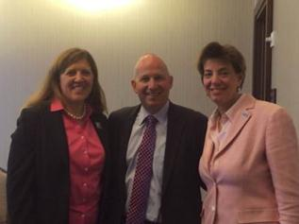
Let Us Know If We Can Help!
We have many resources for policy makers and employers on our website and are ready to help!
RespectAbilityUSA
4340 East-West Hwy, Suite 1100
Bethesda, MD 20814
www.RespectAbilityUSA.org
Cell: (202) 365 – 0787
Jennifer Laszlo Mizrahi
President
JenniferM@RespectAbilityUSA.org
Picture of Gov. Markell with Lisa Derx (VP, Best Buddies) and Jennifer Laszlo Mizrahi (President, RespectAbility).

